Slide 1
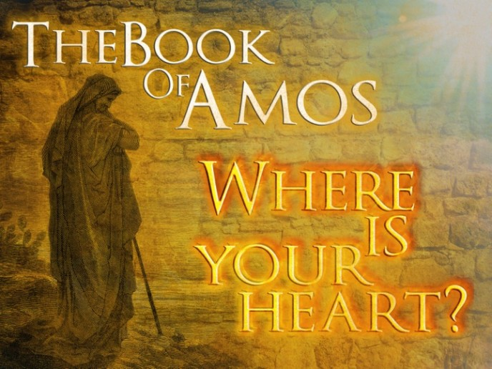
Hosea and Amos God’s Warning to His People Lesson 11,12, &13

Slide 2
Review the Book of Hosea
Hosea was a living example of the lesson intended for Israel.
The tender loving God was offering one last chance for restoration to Israel which had committed spiritual adultery
The righteousness of God is portrayed in Hosea. Although doom of wicked nation of Israel is announced, Hosea often speaks of the loving-kindness of the Lord.
God loved His people, but Israel had sown to the wind and deserved to reap the whirlwind.

Slide 3
Amos- Means Burden-Bearer
Date: 765-755 B.C.
Prophesied To: Israel (Northern Kingdom)
Purpose:
God’s Judgement on Israel
The sin of Israel are great
Contemporaries:
After: Obadiah, Joel, and Jonah
Before: Hosea, Micah, and Isaiah

Slide 4
Review: Amos 1-2
Judgement is coming against both heathen and covenant Nations
Damascus
Gaza
Tyre
Edom
Ammon
Moab
Judah
Israel

Slide 5
Review: Amos 3-4
Chapter 3
Their main concern was a selfish desire to be pampered.
Luxury may characterize them now, but the day is coming when they will be torn away as helpless fish taken by hooks.
Chapter 4
Since the people liked the idolatrous form of worship offered in Bethel and Gilgal, they must have thought God was pleased too.
God gave them several signs they were not going in the right direction- Famine, Drought, Blasting, Mildew, Locusts, Pestilence, and overthrown cities.

Slide 6
Review: Chapter 5-6
Chapter 5
Israel is fallen. Past tense is used because it is so certain. Only a small remnant will be left in each city.
The ruling class had perverted justice and turned righteousness into unrighteousness, but they should seek the omnipotent Lord.
Chapter 6
Israel’s values were all confused. They felt not guilt though they had false standards of justice and false standards of worship.

Slide 7
Review: Chapter 7
Chapter 7
Amos saw a swarm of locust eating up the latter growth of the crops. The king had taken the first harvest as taxes, and now if this second growth destroyed by locust the people would perish.
Amos’ message was not popular in the idolatrous headquarters of Bethel.

Slide 8
Chapter 8:1-4
Question 6: How would the basket of fruit signify the end of Israel?
Question 7: Why were the people anxious for the new moon and Sabbath to be over? Is there a lesson here for us?
Question 8: Using vs. 7 and other passages you may know, be prepared to discuss God’s knowledge of our actions.
Question 9: Isaiah 3:1, 10 and Mark 13:24. What does the darkening of the sun and moon in vs. 9 mean?

Slide 9
Chapter 8:1-4
Question 10: Describe the eventual mourning of Israel.
Question 11: What would be the fate of Israel according to vs. 12-14?

Slide 10
Chapter 9:1-10
Question 1: What did Amos see?
Question 2: Read Jonah 1:17-2:9. How does the story of Jonah illustrate the principle being taught in vs. 2-4?
Question 3: Based on your knowledge of the coming days of Israel, what does it mean that they will be sifted as grain?
Question 4: What would the sinners say?

Slide 11
Chapter 9:11-15
Question 5: Be prepared to discuss how vs. 11-15 are fulfilled in the Christian age.
Vs. 11 I will restore David’s fallen tent.
Vs. 12: all the nations that bear my name
Vs. 13-15
The fullness of spiritual blessings will be given to God’s people during the reign of the Messiah.

Slide 12
The Assyrian Invasion II Kings 15, 17
Question 6: Summarize what happened during the reign of:
Menahem:
Pekahiah:
Pekah
Question 7: Why was the Assyrians king angry at Hoshea?
Question 8: List the reasons given in II Kings 17 for the destruction of Israel?
Question 9: How well do these reasons match the warning of Hosea and Amos?

Slide 13
Lessons Learned
When one rejects the love of the truth the time may come when he will seek it but cannot find truth:
2 Thessalonians 2:10-12
James 1:22-25

Slide 14
Hosea and Amos God’s Warning to His People Lesson 11,12, &13

Slide 15
Hosea 1:1
Date: 760-720 B.C.
Prophesied To: Israel (Northern Kingdom)
Purpose:
To Demonstrate God's Loving Relationship With His People
To Call Israel To Repentance
Contemporaries: Amos, Isaiah, Micah Historical Parallel: 2 Kings 13-17

Slide 16
Amos 1:1
Date: 765-755 B.C.
Prophesied To: Israel (Northern Kingdom)
Purpose:
God’s Judgement on Israel
The sin of Israel are great
Contemporaries:
After: Obadiah, Joel, and Jonah
Before: Hosea, Micah, and Isaiah

Slide 17
What Happened?
II Kings 14:23-24 & I Kings 13:33
King Amaziah did evil in the eyes of the Lord
Appointed Priest from all sorts of people
II Chronicles 27:1-2
Jotham did what was right, but the people continued in their corrupt practices

Slide 18
The Book of Hosea
Question 2: Describe the marriage of Hosea and Gomer, including their reunion.
Question 3: According to Hosea 4, why were the people destroyed whose fault was it?
Question 4: What type of spirit did Israel develop (Hosea 5:4)?
Question 5: In Hosea 7:8-16 Israel is described as a cake, hair, a dove, and a bow. Find each image and be prepared to explain its meaning.

Slide 19
The Book of Hosea
Question 6: List all that God had done for Israel from 11:1-4. Read also 11:8-9
Question 7: When did Israel die (13:1)? Use Isaiah 44:9-20 to explain the foolishness of idolatry.

Slide 20
The Book of Amos
Question 8: How were the sins of Judah different from the sins of the other nations? (2:4)
Question 9: Read Amos 3:3-6 carefully. These are points of common sense, but what is the lesson Amos is teaching?
Question 10: List the characteristics of those in ease at Zion.
Question 11: Why were the people anxious for the New Moon and Sabbath to be over? (Amos 8:5,6)
What is the lesson for us today?
Question 12: Describe how Amos 9:11-15 is fulfilled today.

Slide 21
How do we overcome us depending on us
Don’t Depend on You Proverbs 3:5
Cry out to God Proverbs 3:6
Run from Evil 2 Timothy 2:22
Put God First in Your Life Proverbs 3:9-10
Check Yourself by God’s Word Jeremiah 17:9
Rest in God’s Love Proverbs 3:12

