Slide 1
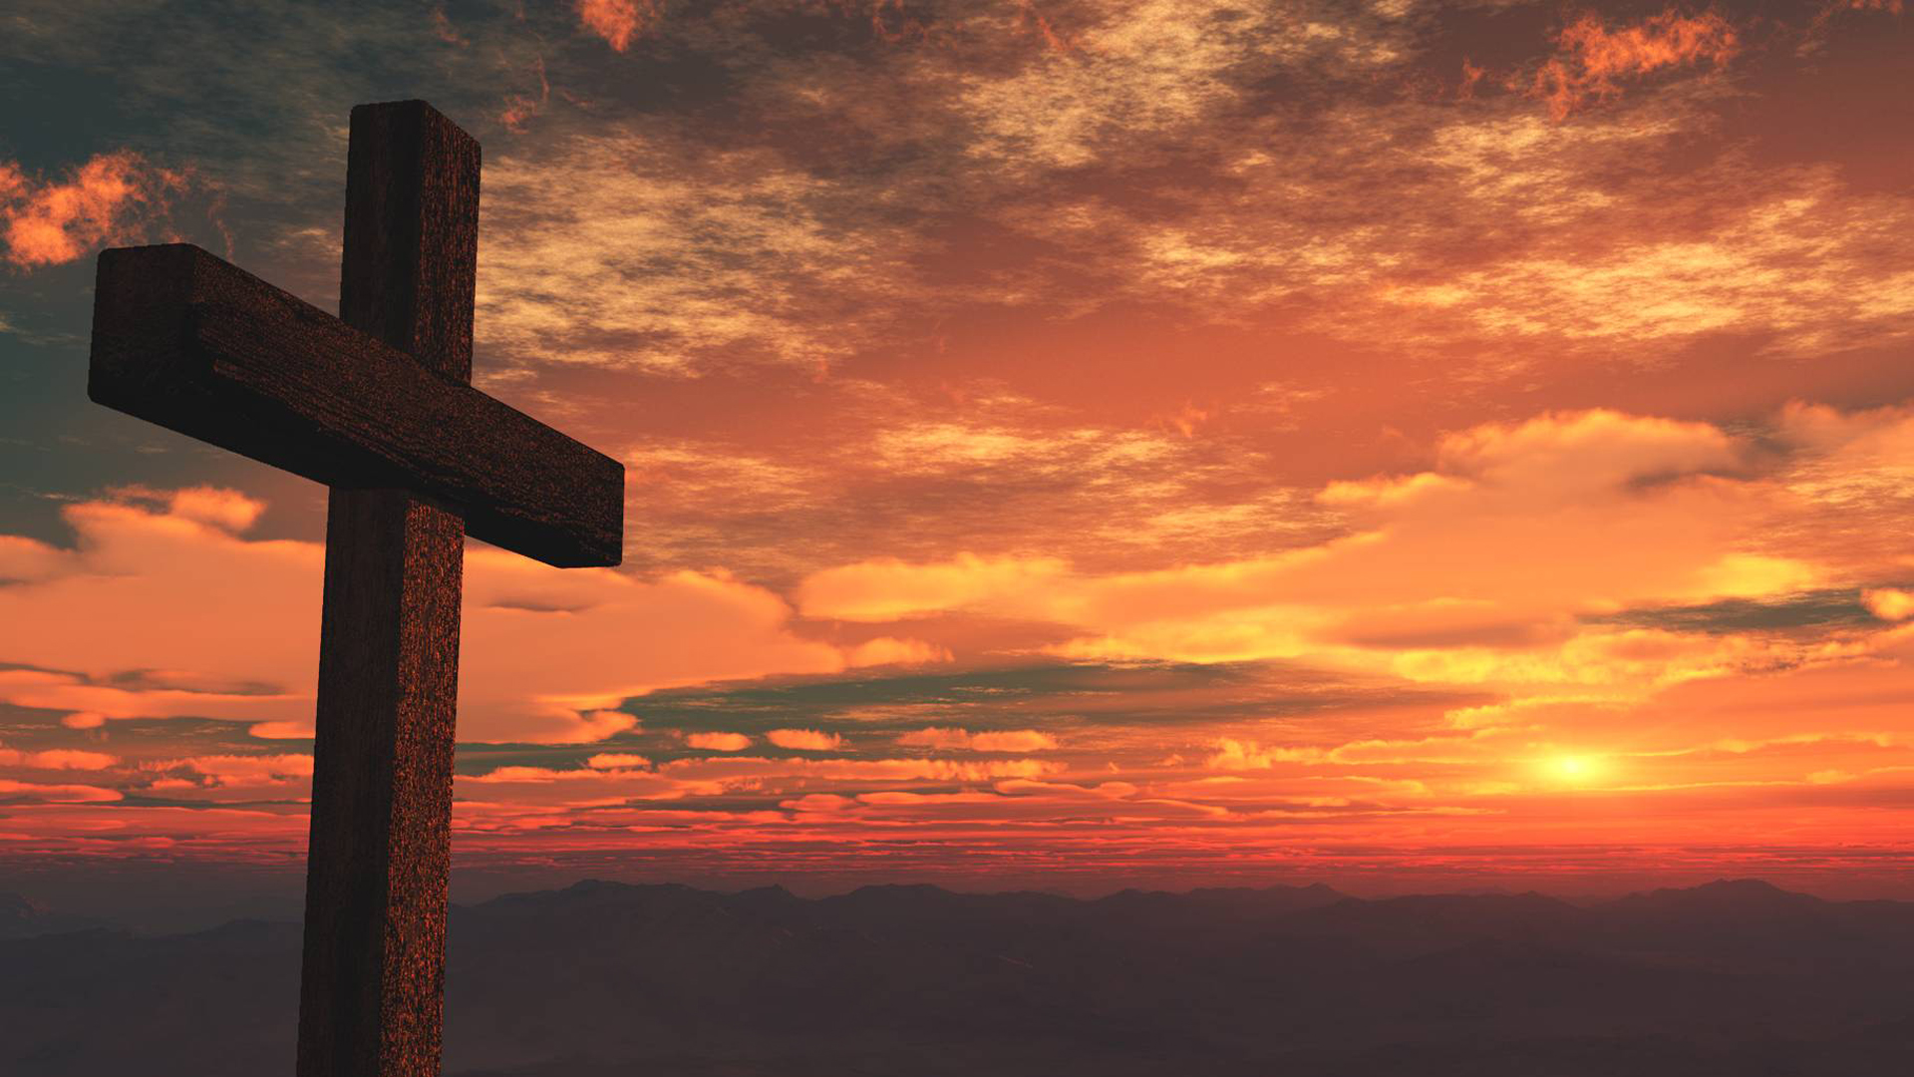
Who Do You See When Looking at Jesus on the Cross?
 | Description | Speaker | Verse
1 | My Son | Mary | Luke 1:30-33,38
2 | My Lord | John | John 19:26-27;21:24-25
3 | Blasphemer | Jewish Leaders | Luke 22:66-71
4 | Innocent | Pilate | Luke 23:13-16
5 | Criminal | Thief #1 | Luke 23:39
6 | Way to Heaven | Thief #2 | Luke 23:40-43
7 | Friend | Martha and Lazarus | John 11:32-36
8 | Savior | Sinners | Luke 19:1-10
9 | Son of God | Disciples, Us | John 1:29-49
Notes:
Luke 1:30-33, 38 And the angel said to her, “Do not be afraid, Mary, for you have found favor with God. ³¹ And behold, you will conceive in your womb and bear a son, and you shall call his name Jesus. ³² He will be great and will be called the Son of the Most High. And the Lord God will give to him the throne of his father David, ³³ and he will reign over the house of Jacob forever, and of his kingdom there will be no end. ³⁸ And Mary said, “Behold, I am the servant^{[f]} of the Lord; let it be to me according to your word.” And the angel departed from her.
John 19:26-27; 21:24-25
²⁶ When Jesus saw his mother and the disciple whom he loved standing nearby, he said to his mother, “Woman, behold, your son!” ²⁷ Then he said to the disciple, “Behold, your mother!” And from that hour the disciple took her to his own home.
²⁴ This is the disciple who is bearing witness about these things, and who has written these things, and we know that his testimony is true. ²⁵ Now there are also many other things that Jesus did. Were every one of them to be written, I suppose that the world itself could not contain the books that would be written.
Luke 22:66-71
⁶⁶ When day came, the assembly of the elders of the people gathered together, both chief priests and scribes. And they led him away to their council, and they said, ⁶⁷ “If you are the Christ, tell us.” But he said to them, “If I tell you, you will not believe, ⁶⁸ and if I ask you, you will not answer. ⁶⁹ But from now on the Son of Man shall be seated at the right hand of the power of God.” ⁷⁰ So they all said, “Are you the Son of God, then?” And he said to them, “You say that I am.” ⁷¹ Then they said, “What further testimony do we need? We have heard it ourselves from his own lips.”
Luke 23: 13-16
¹³ Pilate then called together the chief priests and the rulers and the people, ¹⁴ and said to them, “You brought me this man as one who was misleading the people. And after examining him before you, behold, I did not find this man guilty of any of your charges against him.¹⁵ Neither did Herod, for he sent him back to us. Look, nothing deserving death has been done by him. ¹⁶ I will therefore punish and release him.”^{[a]}
Luke 23:39
³⁹ One of the criminals who were hanged railed at him,^{[d]} saying, “Are you not the Christ? Save yourself and us!”
Luke 23:40-43
⁴⁰ But the other rebuked him, saying, “Do you not fear God, since you are under the same sentence of condemnation? ⁴¹ And we indeed justly, for we are receiving the due reward of our deeds; but this man has done nothing wrong.” ⁴² And he said, “Jesus, remember me when you come into your kingdom.” ⁴³ And he said to him, “Truly, I say to you, today you will be with me in paradise.”
John 11:32-36
³² Now when Mary came to where Jesus was and saw him, she fell at his feet, saying to him, “Lord, if you had been here, my brother would not have died.” ³³ When Jesus saw her weeping, and the Jews who had come with her also weeping, he was deeply moved^{[e]} in his spirit and greatly troubled. ³⁴ And he said, “Where have you laid him?” They said to him, “Lord, come and see.” ³⁵ Jesus wept. ³⁶ So the Jews said, “See how he loved him!”
Luke 19:1-10
19 He entered Jericho and was passing through. ² And behold, there was a man named Zacchaeus. He was a chief tax collector and was rich.³ And he was seeking to see who Jesus was, but on account of the crowd he could not, because he was small in stature. ⁴ So he ran on ahead and climbed up into a sycamore tree to see him, for he was about to pass that way. ⁵ And when Jesus came to the place, he looked up and said to him, “Zacchaeus, hurry and come down, for I must stay at your house today.” ⁶ So he hurried and came down and received him joyfully. ⁷ And when they saw it, they all grumbled, “He has gone in to be the guest of a man who is a sinner.” ⁸ And Zacchaeus stood and said to the Lord, “Behold, Lord, the half of my goods I give to the poor. And if I have defrauded anyone of anything, I restore it fourfold.” ⁹ And Jesus said to him, “Today salvation has come to this house, since he also is a son of Abraham. ¹⁰ For the Son of Man came to seek and to save the lost.”
John 1:29-49 – turn with me while we read together.

Slide 2
Who Do We View Him as Our Saviour?
We have three basic choices:
Liar – Jews were zealous for God, without the truth. Other Jews wanted to protect their power.
Lunatic – Some thought He was crazy to say God was His father. Some knew Him all His life – Nazareth
Lord – We examine the evidence; evaluate the claims; see the eyewitness accounts of miracles; taught as one having authority → We make a decision – He is LORD!
Heb 11:1-3; Heb 12:1-2 – We see Jesus on the cross, our Savior and King!
Notes:
11 Now faith is the assurance of things hoped for, the conviction of things not seen. ² For by it the people of old received their commendation. ³ By faith we understand that the universe was created by the word of God, so that what is seen was not made out of things that are visible.
12 Therefore, since we are surrounded by so great a cloud of witnesses, let us also lay aside every weight, and sin which clings so closely, and let us run with endurance the race that is set before us, ² looking to Jesus, the founder and perfecter of our faith, who for the joy that was set before him endured the cross, despising the shame, and is seated at the right hand of the throne of God.
As we partake of the Lord’s Supper, let us think back to this Jesus which died on the cross for us. Which one do you see?
He instituted this memorial supper for us to remember His death on the cross, for the remission of our sins. Let’s rejoice that he loved us so much to give His life. Let us all see the Savior of the world, our savior on the cross.

