Slide 1
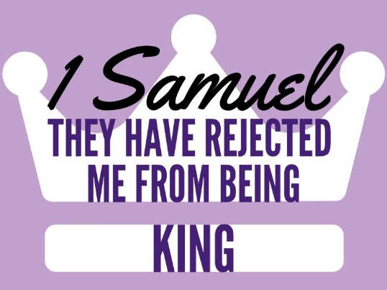
Discussion: Can one exhaust the patience of God? Why aren’t David & Solomon similarly rebuked at their sacrifices? 2 Sam 24:25; 1 Ki 3:15
Lesson 5
Chapters 13-14

Slide 2
Ch 12-13 Saul & Philistines
1) Describe Samuel’s speech before the coronation of Saul. What stands out to you?
A reminder that they had not been wronged by Samuel or God.
A warning not to allow or follow their chosen King to do evil.
v11 The LORD went Jerubbal & Bedan & Jephthah…
v18 That God would graciously work with the nation that rejected Him. cf. v22
2) What would cause “the hand of the Lord” to be against Israel? How is it proven?
v15 If they rebel. v18 proven by the rain for the grain harvest.

Slide 3
Ch 12-13 Saul & Philistines
3) What shows God’s grace in the conversation with Samuel?
v20-22 They had repeatedly committed evil YET Jehovah is pleased to make them His people!
4) Who did Saul go to war with? Why? What do some of the Israelites do?
Philistines.
I don’t see a ‘why’ in the text.
Most likely trying to simply get rid of an enemy.
There may be something noble in this, God had told them long ago to do this.
However, it may be the king trying to show is strength early in his reign. Not sure.
Some of the Israelites go into hiding v6, those with Saul are “trembling.” v7

Slide 4
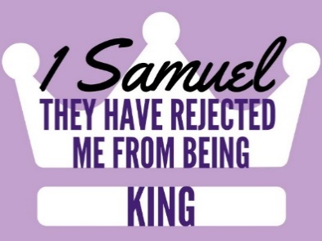
Ch 12-13 Saul & Philistines
5) What reasons did Saul give for offering a sacrifice?
How did Samuel respond?
The people were scattering from me. You weren’t here when you said you would be.
v12 He wanted to ask “the favor of the Lord” … “So, I forced myself & offered…”
v13 “You’ve acted foolishly, you didn’t keep the commandment of the Lord.”
6) Why did the Israelites need the Philistines at this time? v19 No blacksmiths in Israel so they paid a Philistine to sharpen their metal tools.

Slide 5
Ch 12-13 Saul & Philistines
Anatomy of sin:
(1) Tyranny of the urgent. It can’t wait!
(2) Insecurity & self-doubt. Or else…
(3) Rebellion, taking matters into our own hands, ignoring the authority of God.

Slide 6
Ch 12-13 Saul & Philistines
Possible Discussion Question?
Can one exhaust the patience of God?
Why aren’t David & Solomon similarly rebuked at their sacrifices? 2 Sam 24:25; 1 Ki 3:15

