Slide 1
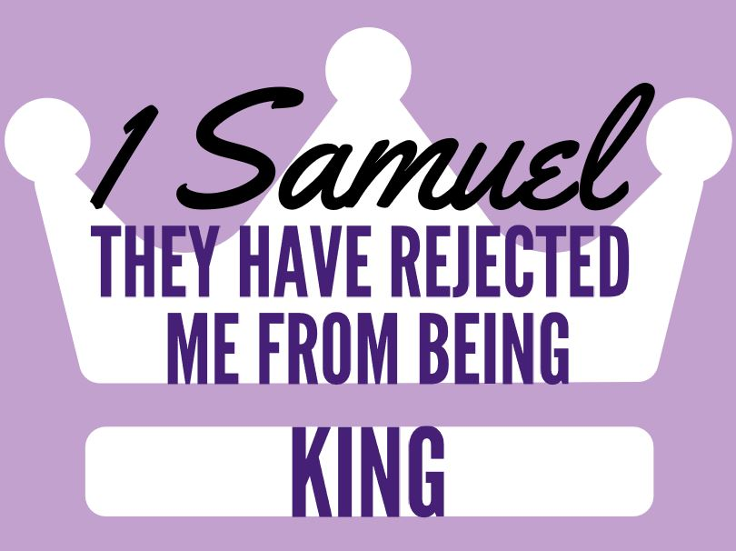
Discussion: Who is your ‘Samuel’? Is this quote biblical: “Easier to ask forgiveness than to get permission.”?
-Cleanliness is next to godliness.
-Neither a borrower or a lender be.
-To thine own self be true.
Lesson 6
Chapters 14-15
Added: What about 15:22 & 23 & 15:29?

Slide 2
Ch 14-15 Saul Disobeys
1) Describe Jonathan & his plans? Who is Ahijah?
They bravely cross into enemy territory & success starts.
Saul is wrongly using Ahijah as a priest & leaves early.
Ahijah of Ichabod, didn’t have the authority Samuel did.
1c) Do the plans work?
YHWH delivered Israel that day. Do we trust like Jonathan?
2) What was Saul’s oath?
“Cursed be the man who eats before evening or victory.”
3) Jonathan’s response to this news?
My Father has troubled Israel. We could have won more.
Admirable that he speaks truthfully about his family.

Slide 3
Ch 14-15 Saul Disobeys
4) Saul’s solution to Israel’s sin? Who was guilty?
Sacrifices at 1st altar. God is silent about next war step.
5) How was Jonathan saved? Who did Saul add?
People intercede due to military victories. Great warriors.
NOTE: The summary of Saul’s reign in 14:47-52.
6) Why attack Amalek? Did Saul obey?
Fulfills Exodus 17:14. He did NOT utterly destroy.
6c) God’s response? 15:11
I regret I made Saul king. v22 wants obedient worshippers.
15:23… Is Saul seeking a witch/divination?
Not yet. Rebellion believes a messenger’s lie about God.

Slide 4
Ch 14-15 Saul Disobeys
7) Describe Saul & Samuel’s conversation?
Saul deflects blame, justifies sin, says its temporary, & minimizes it’s importance. He fails to take responsibility.
He only confesses privately to avoid embarrassment.
15:29 God’s standards for His kings won’t change.
8) In the end, what has Saul lost?
A relationship w/ Samuel & God. Lost kingship & honor.
He freely chose rebellion internally & it now shows.

