Slide 1
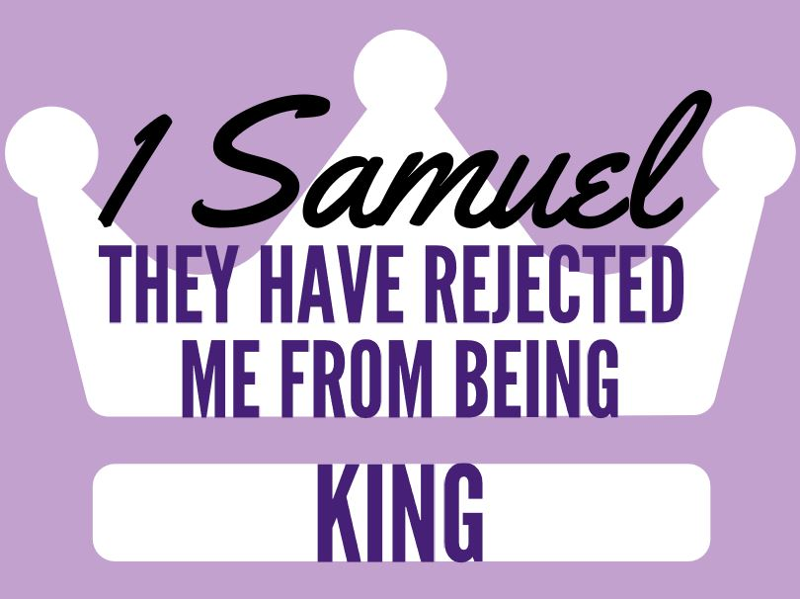
Discussion: A game of “What Would You Do with John Quinones?” Would you agree & console them? Can we ‘judge hearts’?
Lesson 7
Chapters 16-17
Added: Is there a contradiction between Ch 16 & 17

Slide 2
Ch 16-17 David’s Rise
1) Why did Samuel hesitate? God’s response?
Samuel’s scared of Saul, God doesn’t respond to that.
He simply tells him, “I’ve made a choice, take a sacrifice.”
1b) Why do the elders tremble?
After hacking Agag, I would be worried as well.
2a) David’s selection? How does God judge?
Young & handsome, David didn’t even bring him out.
Don’t look at things like humans but look at the heart.
2b) How should this affect our judging?
Do their words & actions reflect God oriented view of life?
God delights in ‘weakness.’ [2Cor 12:9-10; Isa 53:2-3]

Slide 3
Ch 16-17 David’s Rise
3) Why did God distress Saul? Who soothes him?
Saul’s sin brought the punishment of an evil spirit.
God uses this to bring David into the royal court. [16:18]
Are there contradictions between Ch 16 & 17?
1st both Saul & David had similar beginning stories.
God chose David (16) & David also took initiative. (17)
Ch 17 illustrates how David fits Ch 16. (Spiritual & Military)
4a) Goliath? ‘taller than others’ cf. 1 Sa 9:2
4b) Israel’s reason for a king? What is Saul doing?
To fight the Philistines. Saul is finally NOT rushing to battle.
Saul is dismayed & afraid of this mocking scoffer.

Slide 4
Ch 16-17 David’s Rise
5) Why does David appear? His response?
Bringing food to family. Brother judges wrongly. [v28]
He has fought beasts w/ bare hands. Bothered by taunts.
6) David’s emphasis in his speech? [v46]
YHWH of hosts, God of Israel, all the earth should know!
7) How did David win? Who is inspired? Result?
Runs into battle, God guides the stone. Israel is inspired.
David takes Goliath’s Philistine weapons into Tabernacle.
Consider the big picture from Ch 4-6.

