Slide 1
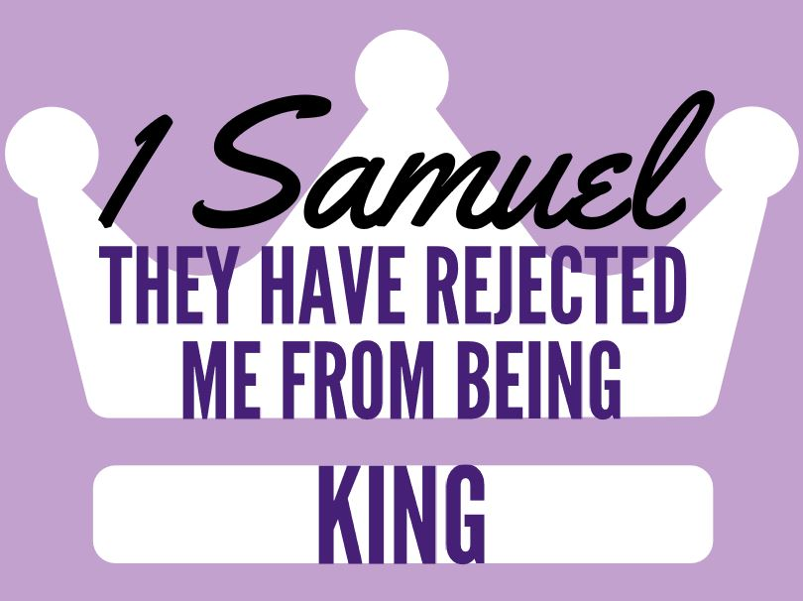
Discussion: How can people treat God like a magic token?
They trusted the system of their relationship rather than the God of that relationship.
Lesson 2
Chapters 4-6
Added: How do we enter war?
Where is Jesus in this story?

Slide 2
Ch 4-6 The Ark Travels
1) Israel’s reaction to defeat? Why?
Eli’s two sinful sons carry the ark to battle. It doesn’t work.
Israel did not repent, seek out God’s revealed will.
2) How did Israel view the ark?
Thought of it as a magic token, guaranteeing salvation.
The Philistines seem more theologically aware [4:7-9]
Israel assumed past success would work w/o heart.
3) Eli’s death? Ichabod’s name?
The family appears more upset at losing the ark. [4:18]
Notice again, sin of one/two causes others to suffer.
4) What happened at The Temple of Dagon?

Slide 3
Ch 4-6 The Ark Travels
“In the long run the answer to all those who object to the doctrine of hell is itself a question: “What are you asking God to do?” To wipe out their past sins and, at all costs, to give them a fresh start, smoothing every difficulty and offering every miraculous help? But he has done so, on Calvary. To forgive them? They will not be forgiven. To leave them alone? Alas, I am afraid that is what he does.”
4) What happened at The Temple of Dagon?
Dagon is humiliated & his hands are cut off.
5) What happened in The Philistine cities?
You can’t make God go where His will is not.
6) How long did they have The Ark? Return it?
7 months. With a “guilt offering.” “Virgin” cows. God’s wrath is more absence than vengeance.
7) Why did God strike Beth Shemesh?
Because they didn’t reverence YHWH’s commands.
How do we decide to enter war?
Where do you see Jesus in this story?

Slide 4
Ch 4-6 The Ark Travels
How do we decide to enter war?
Stay Humble: Germans thought God was with them!
1) Horrific wrong has been or is about to be committed.
2) Every peaceful alternative is attempted/explored.
3) Authority is granted & process carefully followed.
4) Achievable goals, reasonable chance of success exists.
5) Do goals outweigh the suffering that will be caused.
Where do you see Jesus in this story?
God is willing to be vulnerable & captured as a trophy, yet He still wins the victory for sinners!

