Slide 1
Discussion: Is Michal justified in lying? #5b Can this happen today?
Lesson 8
Chapters 18-20
Added: Where is Jesus in these chapters? Does Saul ever have 18:28 said about him?

Slide 2
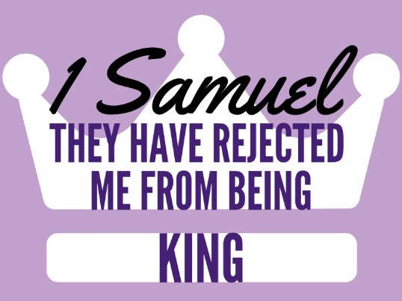
Ch 18-20 Saul’s Hatred
1) Why did Jonathan like David? Why did Saul hate? David’s response?
It appears connected with David’s defeat of Goliath.
The text simply repeatedly says “he loved him.”
This word for “love” is used politically.
Like our politics, “I love Reagan.”
Meanwhile, Saul is jealous.
Women are singing & dancing joyous songs of victory.
Specifically, they credit David w/ 10k victories & Saul w/1k.
He is “suspicious” of David.

Slide 3
Ch 18-20 Saul’s Hatred
2) What was Saul’s plan for David?
She should already be his… (17:25) it’s not chronological.
What did David think of being Saul’s son-in-law?
At some point, David refused to take Saul’s daughter as a wife, considered himself unworthy.
Apparently, Saul offers a daughter a 2nd time, asking not for money (dowry) but Philistine heads.
3) What did David offer Saul for marrying Michal? What was Saul’s response?
David kills not 100 as asked but 200 & so Saul gives him Michal & is more afraid of David.

Slide 4
Ch 18-20 Saul’s Hatred
3) What did David offer Saul for marrying Michal? What was Saul’s response?
David kills not 100 as asked but 200 & so Saul gives him Michal & is more afraid of David.
5) Evil spirit on Saul? Discussion on Michal.
She lied, unnecessarily. (Jonathan as well? Ch 20)

Slide 5
Ch 18-20 Saul’s Hatred
6) Where did David flee to? What happened?
David went to Samuel in Ramah.
Each group of them was overtaken by the spirit of prophecy.
Saul then went & the same happened to him, causing him to lay down unclothed all day & night.
7) David & Jonathan’s covenant? Saul’s response?
New Moon=Num 28:11-15
A vow before The LORD to protect one another & their descendants. [20:42]
He curses at Jonathan (v30) & even loses control & throws a spear at him!

Slide 6
Ch 18-20 Saul’s Hatred
8) Relationship lessons from David/Jonathan?
A son of Saul approved David’s kingship.
When “love” between the two is assumed as homosexual & it’s asserted it can’t be heterosexual…
That is unfair to heterosexual men.
It assumes that they can’t have deep, emotional friendships.
It ignores their culture that often-had women NOT in the role of best friend, but a “house aide.”

Slide 7
Ch 18-20 Saul’s Hatred
“There are times when believers should choose to accept the guilt of lying in order to accomplish a higher good… Thus, we recognize deception as always bad but sometimes desirable in extenuating circumstance.” –Bill Arnold, 1-2 Samuel, p 286

