Slide 1
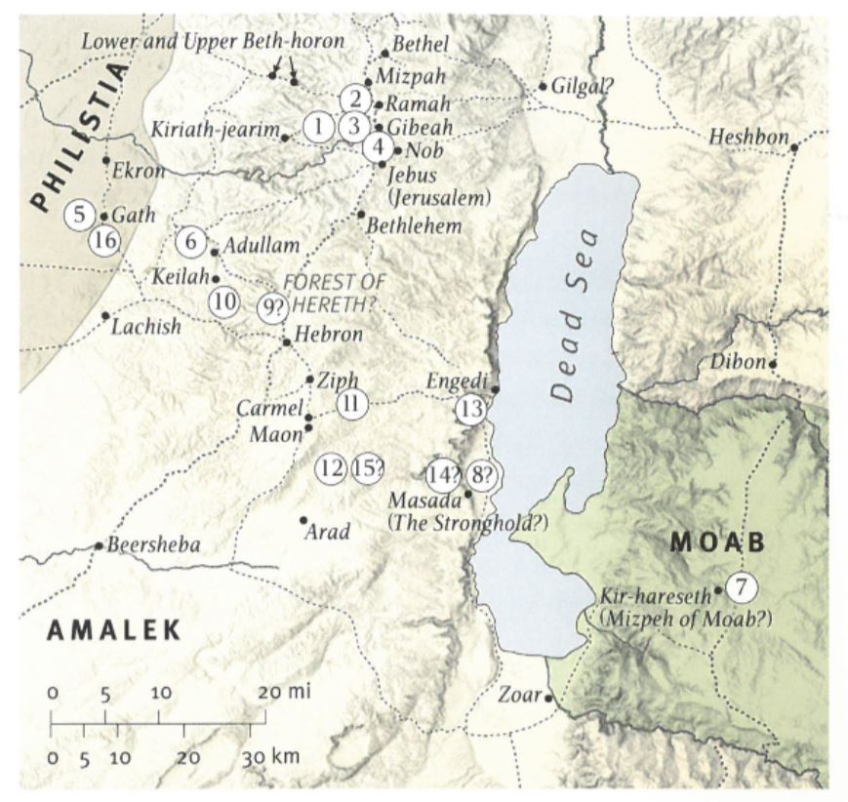
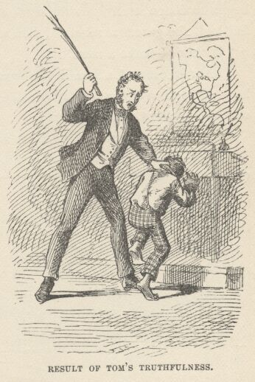
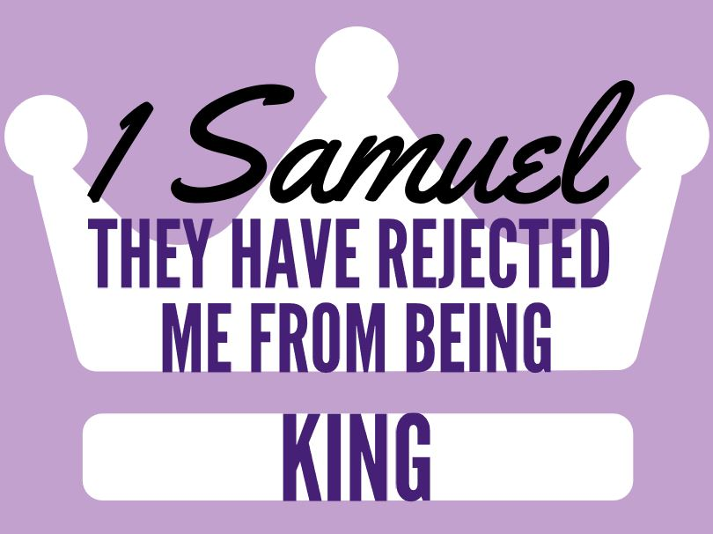
Discussion: Have you ever taken the blame when you weren’t at fault? Why?
Lesson 9
Chapters 21-23

Slide 2
Ch 21-23 David Flees
NOT Chronological BUT Theological…
21: Introducing 3 New Characters;
22: Illustrating The Risks Involved.
23: David’s Defense of Keilah & The Rock of Escape!
Ahimelech’s worry? David’s result?
David is alone, needs food, defenses, & more. Ch22
Notice who he goes to for help, prophets & priests.
2) Why did David flee? What happens? Why?
Hiding from Saul among the enemy, as a madman.
Doesn’t work. But they’ll be allies later. Ch 27-29

Slide 3
Ch 21-23 David Flees
3) At the cave of Adullam? David’s response?
Family & 400 joins him, he takes them to Moab.
How do we think about extended families?
4) Saul’s murder of priests? David’s reaction?
Doeg told Saul they helped David. Murders for Saul.
One escapes & David takes the blame! [22:20-23]
Saul cuts off access to inquiring of God. Needs rumors.
Don’t turn into Saul. Be the face of Christ! 2 Cor 4
5) David’s defense of Keilah? Who protects him?
[23:1-2, 13-14] He helps even non-supporters.
Don’t be distracted by a non-enemy. Cf. 23:10

Slide 4
Ch 21-23 David Flees
6) Ziphites & Saul? What distracts Saul?
Ziphites say they’ll help him. Philistines attack.
7) Who caused The Philistines to attack?
God. That is how Jonathan encouraged him. 23:15
8) Lesson Learned?
We can relate to the ‘escape’ Psalms of David.
God’s gracious hand provides justice.

