Slide 1
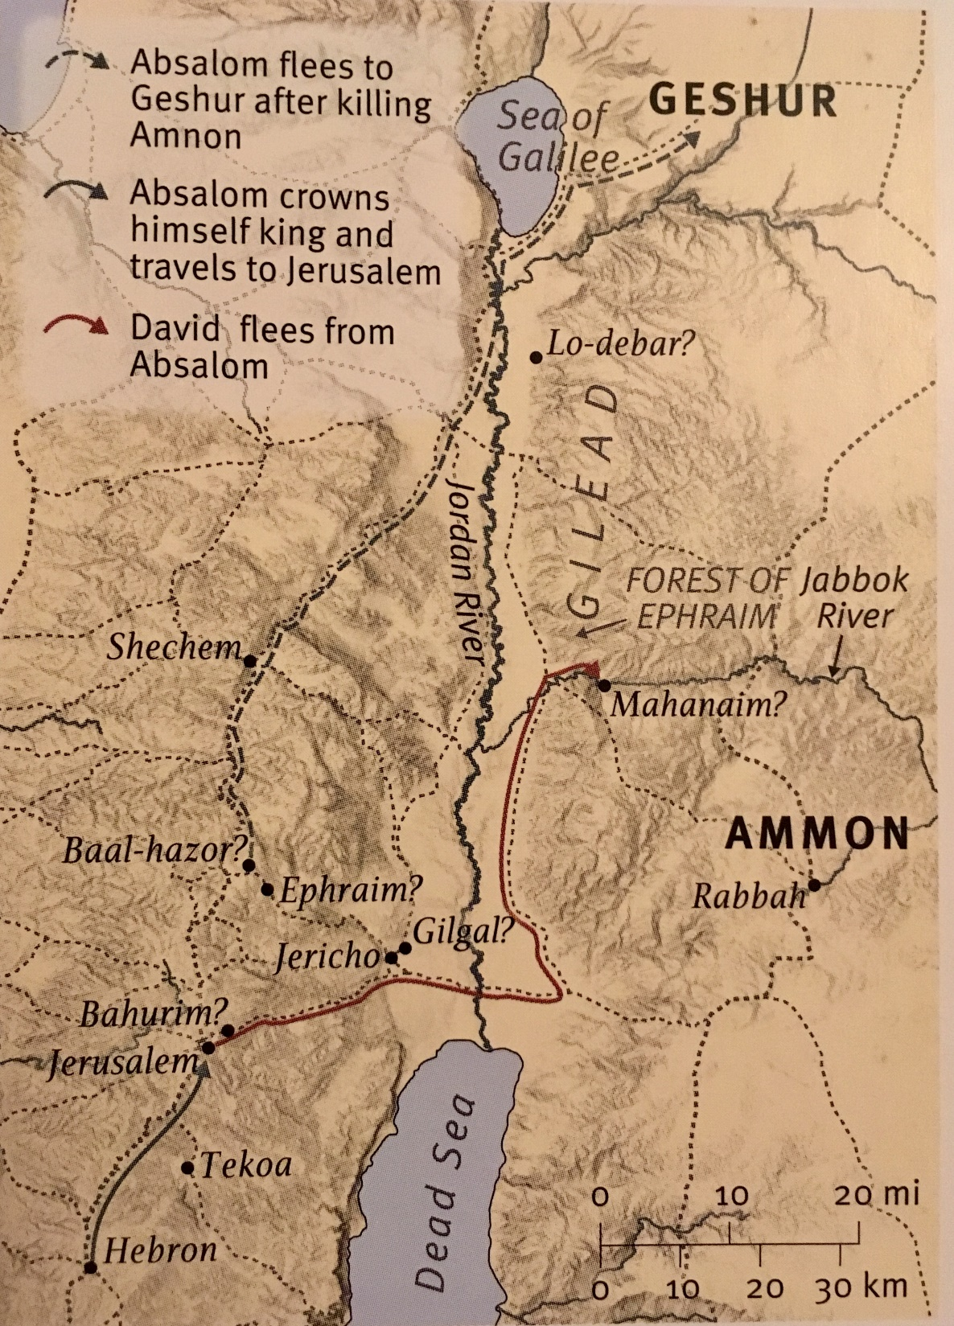
Ch 18-20 David Regains His House
OUTLINE: 2 Samuel 15-20
A. Rebellion Starts 15:1-12 B. David’s Flight: Meeting Scenes 15:13-16:14 C. Clash of Counselors 16:15-17:23 C’. Clash of Armies 17:24-19:8 B’. David’s Return: Meeting Scenes 19:8-43
A’. Rebellion Crushed 20:1-22
Discussion:
(#4) Is it ever right to encourage one in mourning to “move on”?

Slide 2
2 Sam 18-20 David Regains His House
1) David’s desire? The people’s response?
To fight with them. “Too valuable, guard the city.”
2) David’s decree? Who caused the most death?
Deal gently w/ my young son. Forests of Ephraim.
3) Absalom’s death? Monument? David’s reaction?
Long thick hair caught up in the oak trees! Pillar to preserve his name since he had no sons. He is deeply moved with great sadness.
4a) Joab’s Rebuke? Why?
Don’t hate your men who live, speak kindly to them. David needed to rally Israel to recover from crisis.

Slide 3
2 Sam 18-20 David Regains His House
4b) What tribe does David ask to ‘return him’?
Israel is debating David. He asks Judah to call for him. Appears to also make a political concession, Amasa.
5) Shimei’s desire? Objector? David’s response?
Forgiveness for cursing. Abishai wants to execute. 16:5ff David, “No one should die this day.” RECONCILLIATION
6) Dispute between Ziba & Mephibosheth?
Mephisbosheth is mourning, accuses Ziba of lying. He is grateful for David’s kindness, lets Ziba “have it all.”
7) New revolt? Who does Joab kill? Why?
A Benjamite. Amasa, cousin & former rebel. Selfish?

Slide 4
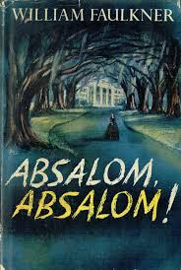
2 Sam 18-20 David Regains His House
8) Who delivers Sheba to Joab?
A wise woman of Sheba’s sanctuary city. The rebellion is framed by the power of virtuous women.
And has inspired great writers… to use God’s story as their title!

