Slide 1
20/20 Vision
Developing a Biblical Worldview

Slide 2
A Biblical Worldview
“The term literally means a view of the world, a biblically informed perspective on all of reality. A worldview is like a mental map that tells us how to navigate the world effectively.”
Nancy Pearcey, Total Truth (2004)

Slide 3
“The eye is the lamp of the body. So, if your eye is healthy, your whole body will be full of light, but if your eye is bad, your whole body will be full of darkness. If then the light in you is darkness, how great is the darkness!”
Matthew 6:22-23

Slide 4
What’s in a Worldview?
Where did everything come from?
How did everything go sideways?
What is the solution?
There are true answers to these and false ones.
The answers determine how I live in the world.

Slide 5
A Biblical View of…
God and Man
Nature and the World
Knowledge, Truth, Morality
Science and Education
Sex and Sexuality
Marriage and Family
Work and Recreation
Government and Politics
Religion and Philosophy
Why are we doing this?
Examine my beliefs against what the Bible teaches.
Unify all my thoughts, words, actions within Biblical truth.
Navigate the world wisely, protecting myself and my family, and reaching the lost.

Slide 6
20/20 Vision
Biblical View of God and Man

Slide 7
The Biblical View (Genesis 1-2)
God
There is an infinite, personal God.

Slide 8
In the beginning, God created the heavens and the earth. The earth was without form and void, and darkness was over the face of the deep.
And the Spirit of God was hovering over the face of the waters.
And God said, “Let there be light,” and there was light.
Genesis 1:1-3

Slide 9
And God saw everything that he had made, and behold, it was very good. And there was evening and there was morning, the sixth day.
Thus the heavens and the earth were finished, and all the host of them. And on the seventh day God finished his work that he had done, and he rested on the seventh day from all his work that he had done.
Genesis 1:31 – 2:2

Slide 10
The Biblical View (Genesis 1-2)
God
There is an infinite, personal God.
Man
Man is made in God’s image.

Slide 11
Then God said, “Let us make man in our image, after our likeness. And let them have dominion over the fish of the sea and over the birds of the heavens and over the livestock and over all the earth and over every creeping thing that creeps on the earth.”
So God created man in his own image, in the image of God he created him; male and female he created them.
And God blessed them.
Genesis 1:26-28

Slide 12
The Lord God took the man and put him in the garden of Eden to work it and keep it. And the Lord God commanded the man, saying, “You may surely eat of every tree of the garden, but of the tree of the knowledge of good and evil you shall not eat, for in the day that you eat of it you shall surely die.”
Genesis 2:15-17

Slide 13
The Biblical View (Genesis 1-2)
God
There is an infinite, personal God.
Man
Man is made in God’s image.
Spiritual
Rational
Free Will
Accountable

Slide 14
Alternate Views
God
There is no God—nature is all there is.

Slide 15
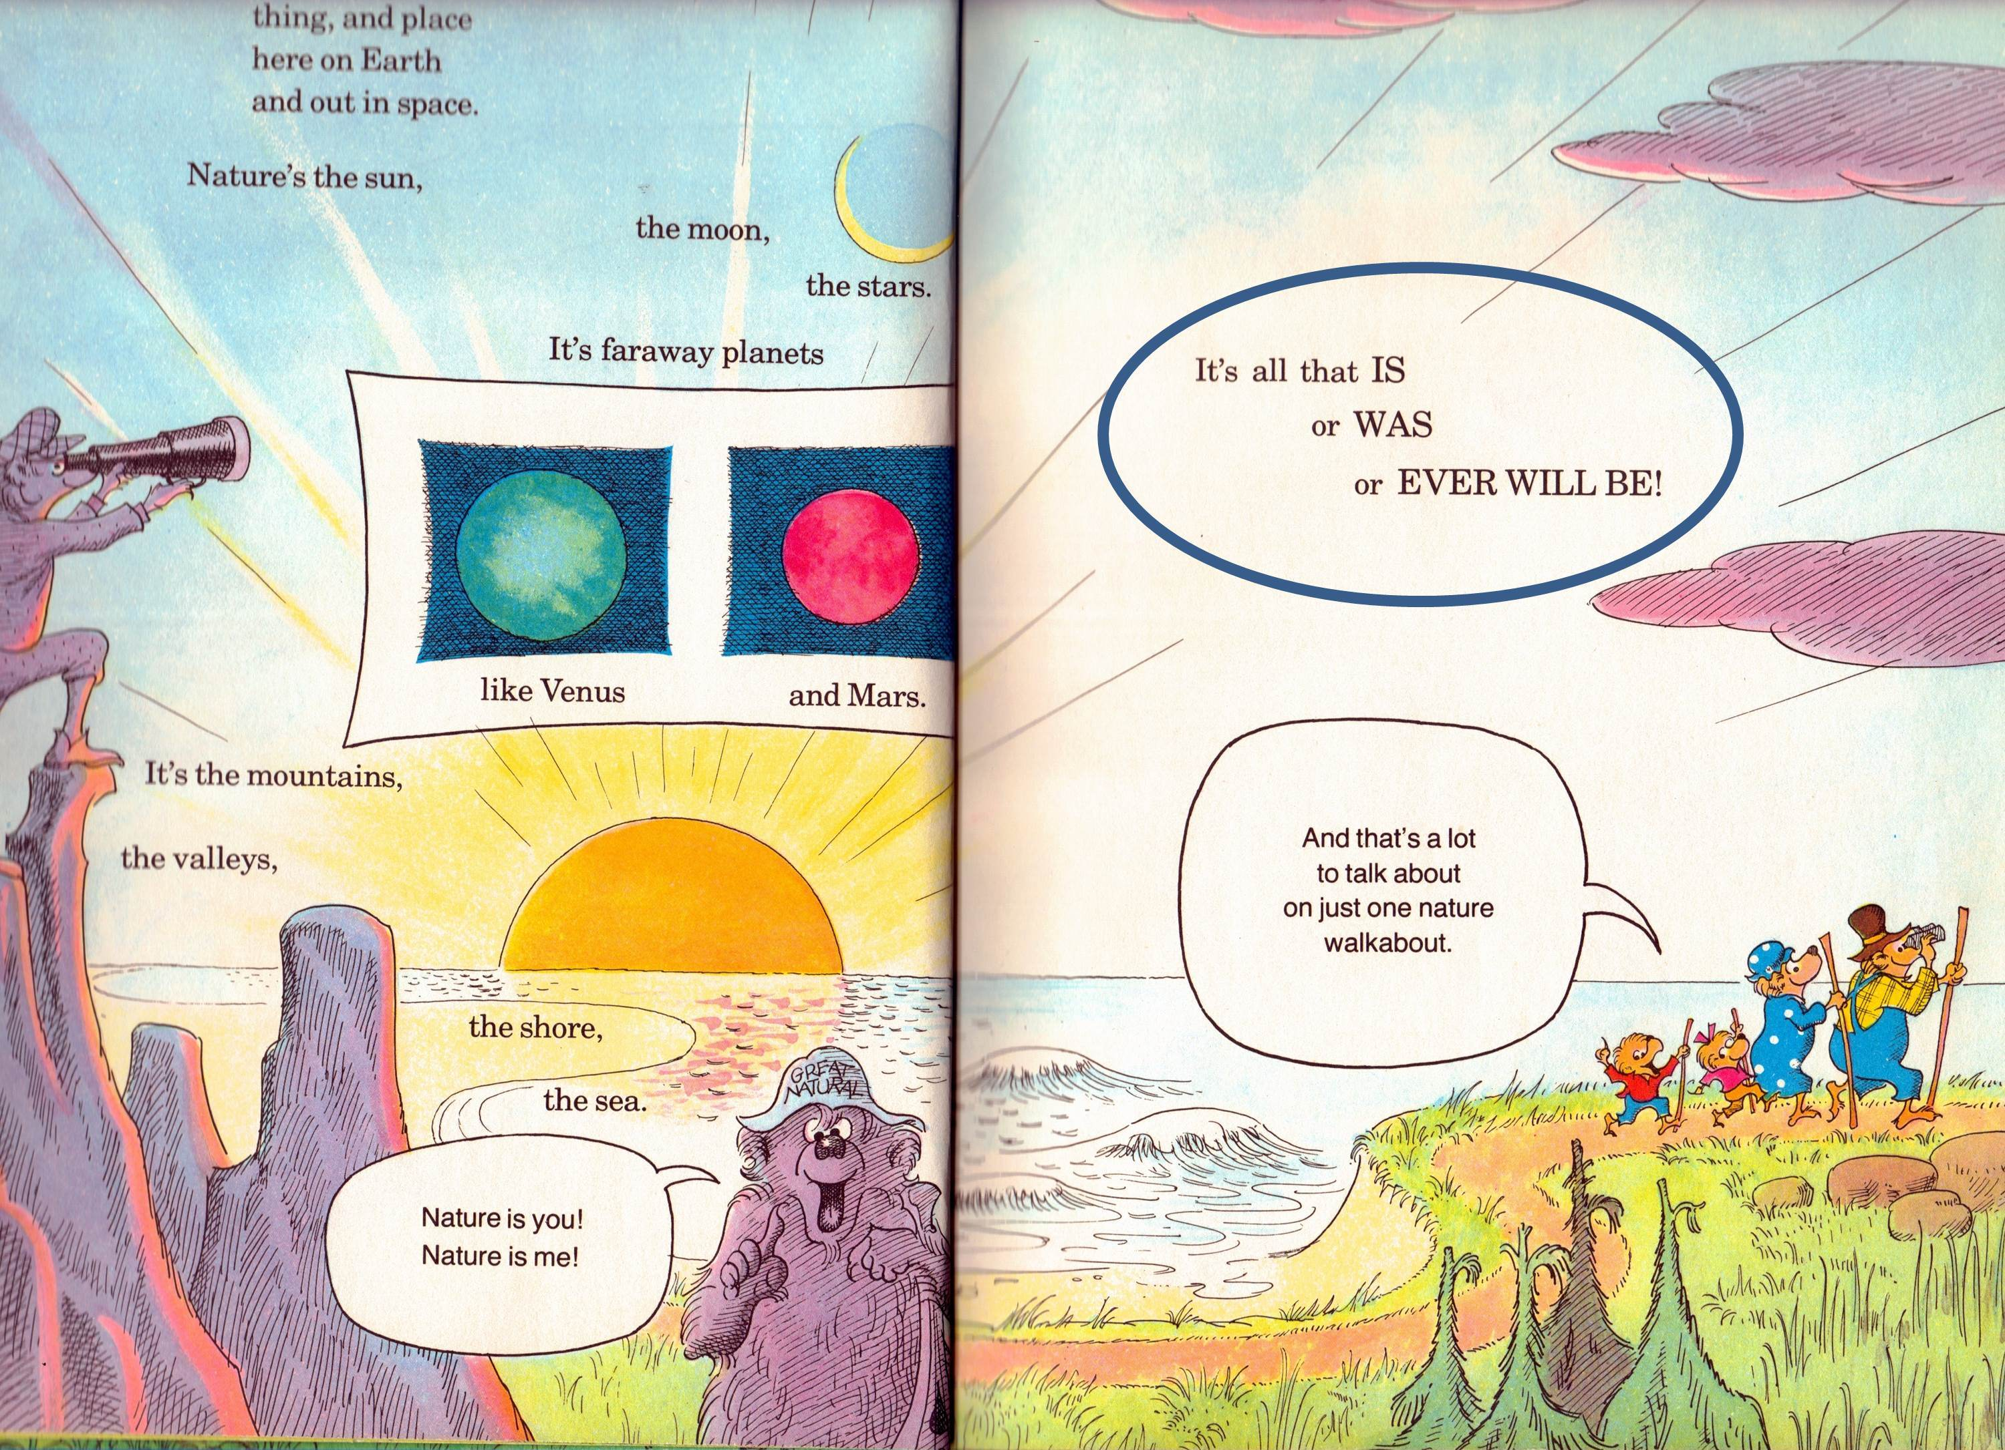

Slide 16
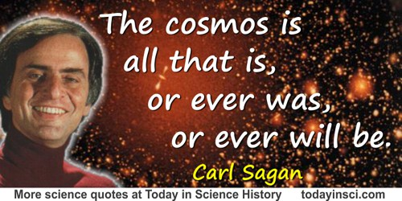

Slide 17
Alternate Views
God
There is no God—nature is all there is.
Man
Humans are merely biological machines.

Slide 18
We are survival machines, robot vehicles blindly programmed to preserve the selfish molecules known as genes. This is a truth which still fills me with astonishment.
Richard Dawkins
The Selfish Gene (1976)

Slide 19
It is hard to imagine how free will can operate if our behavior is determined by physical law, so it seems that we are no more than biological machines and that free will is just an illusion.
Stephen Hawking
The Grand Design (2010)

Slide 20
Alternate Views
God
There is no God—nature is all there is.
Man
Humans are merely biological machines.
Only physical
No Free Will

Slide 21
Anything that is living is a machine. I’m a machine; my children are machines. I can step back and see them as being a bag full of skin full of biomolecules that are interacting according to some laws.
That is not how I treat them…They have my unconditional love, the furthest one might be able to get from rational analysis.
I maintain two sets of inconsistent beliefs.
Rodney Brooks
Flesh and Machines (2002)

Slide 22
Alternate Views
God
There is no God—nature is all there is.
or “God” is limited and/or impersonal.
Man
Humans are merely biological machines.
Only physical
No Free Will
or Man is created but “on their own.”

Slide 23
The majority of teenagers are incredibly inarticulate about their faith, religious beliefs and practices, and its place in their lives. The de facto dominant religion among contemporary U.S. teenagers is what they call ‘Moralistic Therapeutic Deism’: A God exists who created and orders the world and watches over human life on earth; God wants people to be good, nice, and fair to each other, as taught in the Bible and by most world religions; the central goal of life is to be happy and to feel good about oneself; God does not need to be particularly involved in one’s life except when God is needed to resolve a problem; and good people go to heaven when they die.
Of Soul Searching: The Religious and
Spiritual Lives of American Teenagers

Slide 24
Alternate Views
God
There is no God—nature is all there is.
or “God” is limited and/or impersonal.
Man
Humans are merely biological machines.
Only physical
No Free Will
or Man is created but “on their own.”

Slide 25
What does it matter?
Biblical Worldview
Alternate Worldview
There is an infinite, personal God.
God created all things (and cares).
Man is made in God’s image.
What purpose is there in my life?
Am I responsible for my actions?
How do I view others, especially the weak and vulnerable?
There is no God—nature is all there is.
Or God is limited and/or impersonal.
Humans are merely biological machines.
Or Man is created, but “on their own.”

Slide 26
“For though we walk in the flesh, we are not waging war according to the flesh. For the weapons of our warfare are not of the flesh but have divine power to destroy strongholds. We destroy arguments and every lofty opinion raised against the knowledge of God, and take every thought captive to obey Christ…”
2 Corinthians 10:3-5

Slide 27
20/20 Vision
“If your eye is healthy, your whole body will be full of light.”

