Slide 1
Jeremiah
#26 – I Will Restore You
Jeremiah 30

Slide 2
Structure of the Book
Oracles Against Judah (ch. 1-25)
Historical Interlude (ch. 26-29)
Book of Comfort (ch. 30-33)
Historical Interlude (ch. 34-45)
Oracles Against Nations (ch.46-51)
Jeremiah has more historical content than other prophets.
Condemnation & Disaster (ch. 1-12)
God’s Plans, Jeremiah’s Complaints (ch. 13-20)
To Kings, Prophets (& others) (ch. 21-29)
Words of Hope (ch. 30-33)
To Kings (& others) (ch.34-35)
Jeremiah’s Suffering (ch.36-45)
Oracles Against the Nations (ch.46-51)
Jeremiah has more about himself than other books.

Slide 3
I Will Save You (30:1-11)
Write these things down in a book: they are messages for the future. (2)

Slide 4
Prophetic Pictures of the Future
When are they referring to?
The return from captivity?
Salvation in Jesus the Messiah?
Our future salvation?

Slide 5
2 Corinthians 3:14-16
¹⁴ But their minds were hardened; for until this very day at the reading of the old covenant the same veil remains unlifted, because it is removed in Christ. ¹⁵ But to this day whenever Moses is read, a veil lies over their heart; ¹⁶ but whenever a person turns to the Lord, the veil is taken away.

Slide 6
1 Peter 1:10-12
¹⁰ As to this salvation, the prophets who prophesied of the grace that would come to you made careful searches and inquiries, ¹¹ seeking to know what person or time the Spirit of Christ within them was indicating as He predicted the sufferings of Christ and the glories to follow. ¹² It was revealed to them that they were not serving themselves, but you, in these things which now have been announced to you through those who preached the gospel to you by the Holy Spirit sent from heaven—things into which angels long to look.

Slide 7
Prophetic Pictures of the Future
When are they referring to?
The return from captivity?
Salvation in Jesus the Messiah?
Our future salvation?
Messages have their most complete fulfillment in the work of Christ.
Typically there is also an immediate fulfillment, often a partial one.

Slide 8
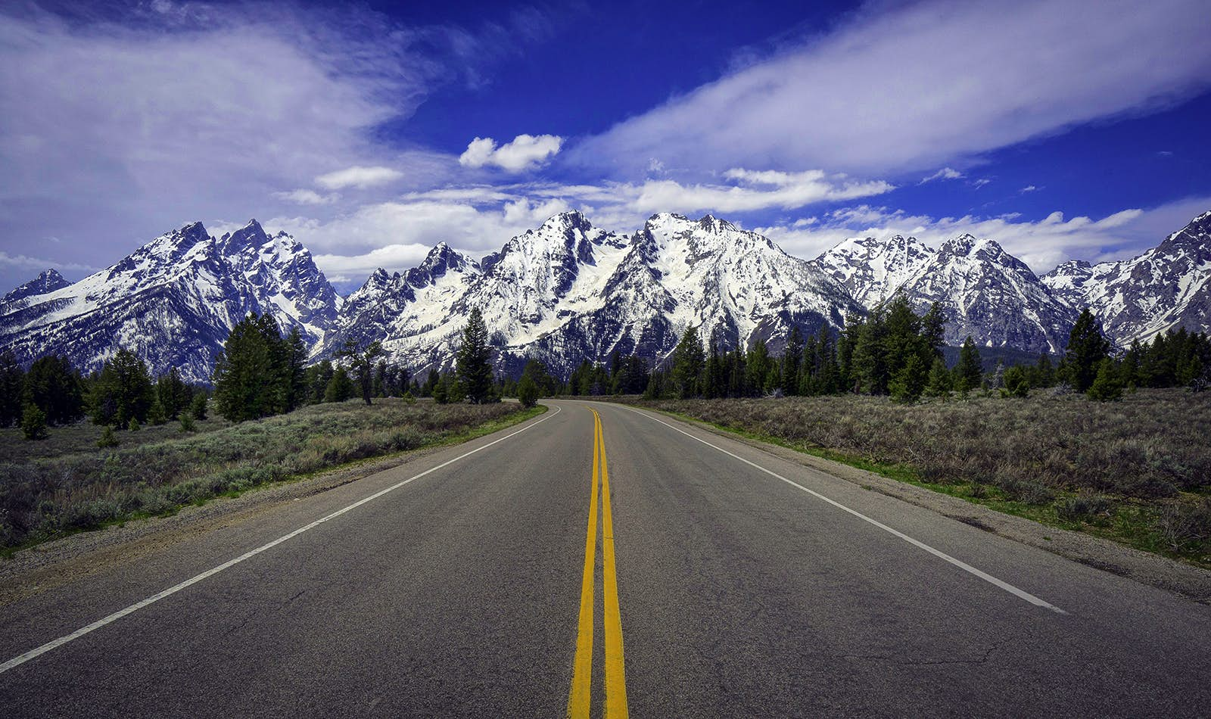
From a distance, prophecies are indistinct and lumped together as “the future.”
“In the latter days you will understand this.”
Jeremiah 30:24
As history unfolds, you can see that they are fulfilled at different times in degrees of completeness.

Slide 9
I Will Save You (30:1-11)
Write these things down in a book: they are messages for the future. (2)
He will restore their fortunes, bring them back to the promised land. (3)
Right now, there is terror, anguish, pain, and distress—but God will save. (4-7)
God will break their yoke so that they can serve God and David their king. (8-9)
Enemies will be punished completely—they will be chastened. (10-11)

Slide 10
I Will Heal You (30:12-17)
Current situation of the people:
Therefore, God will punish their enemies, restore them, and heal their wounds. (16-17)
Incurable wound. (12)
Serious injury. (12)
None to advocate. (13)
No healing, no recovery. (13)
Lovers have forgotten, no one helps. (14)
Wounded by an enemy. (14)
Great iniquity, numerous sins. (14,15)
Incurable pain. (15)
God has done this. (15)

Slide 11
I Will Be Your God (30:18-24)
Future situation of the people:
God will raise up a ruler (& priest) from the people who will reconcile God & people. (21-22)
But first, God’s wrath must fulfill His intended purpose. (23-24)
Restored fortunes. (18)
Compassion on the city. (18)
Rebuilt from ruins. (18)
Palace in its place. (18)
Voice of celebration and thanks. (19)
People multiplied. (19)
People honored and significant. (19)
Children in the city again. (20)
Congregation assembled again. (20)
Oppressors punished. (20)

Slide 12
Jeremiah
#26 – I Will Restore You
Next up: Jeremiah 31

Slide 13
What does the prophet talk about?
Eight things:
Lord of History
Divine Compassion
Election of Israel
Call to Repentance
Rebellion of Israel
Redemption/Restoration
Judgment to Come
Kingdom of God

Slide 14
Themes in the Prophets
Rebellion
Restoration
Repentance
Retribution
= Jeremiah

Slide 15
Fountain
“forsaken me, the _______________ of living waters, and hewed out for themselves broken ___________________.” (2:13)
“They have healed the wound of my people _______________, saying, _____________________, when there is no peace.” (6:14)
“Look for the ancient paths, walk in the good way, and you will find ___________ _____ ______ ________.” (6:16)
“Has this house, which is called by my name, become a ______________________ in your sight?” (7:12)
”But let Him who boasts, boast in this: that he _________________ & _________ Me, that I am the LORD who exercises steadfast love, justice, and righteousness…” (9:24)
“I know, O Lord, that a man’s way is not in ____________, Nor is it in a man who walks to ______________ his steps.” (10:23)
Cisterns…
Lightly
“Peace, Peace!”
rest
for
your
souls
Den of Robbers
Understands
knows
himself
direct

Slide 16
“Blessed is the man who ______________ in the Lord ... He will be like a __________________________________.” (17:7-8)
The heart is more _______________ than all else and is desperately __________.” (17:9)
O Lord, you have ____________ me, and I was ____________; you have _______________ me and prevailed. (20:7)
But if I say, “I will not … speak anymore in His name, then in my heart it becomes like a ____________ ______ .” (20:9)
trusts
Tree planted by the water
deceitful
sick
deceived
deceived
overcome
burning
fire

Slide 17
I will raise up for David a _____________ ; He will reign as king and act wisely and do ___________ & ________________ (23:5)
[of false prophets] “But who has stood in the ____________ of the Lord, the he should see and hear His word?” (23:18)
This whole land will be a desolation and a horror, and these nations will serve the king of Babylon _________ years. (25:11)
Branch
justice
righteousness
council
seventy

Slide 18
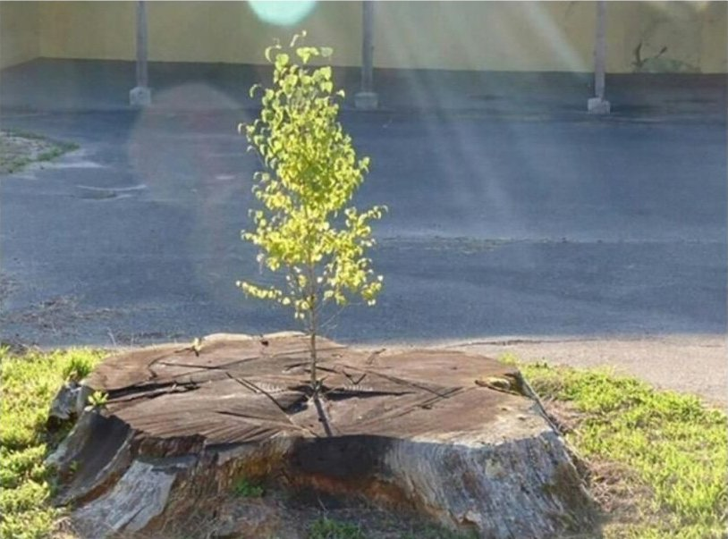
Images in Jeremiah
The Branch
Jeremiah 23:5-6

Slide 19
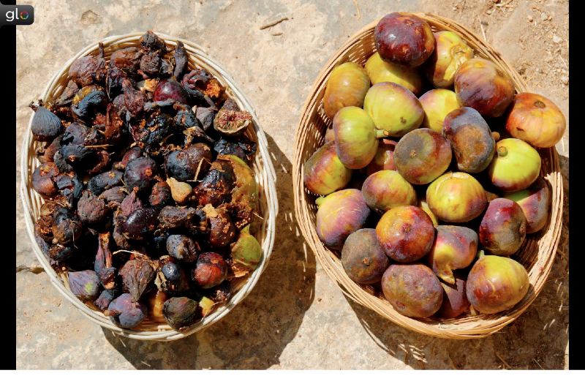
Images in Jeremiah
Two Baskets of Figs
Jeremiah 24; 29:17

Slide 20
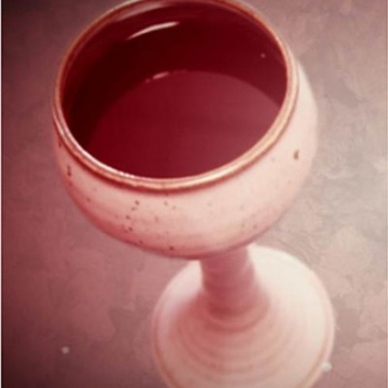
Images in Jeremiah
Cup of Strong Drink
Jeremiah 25:15-29

Slide 21
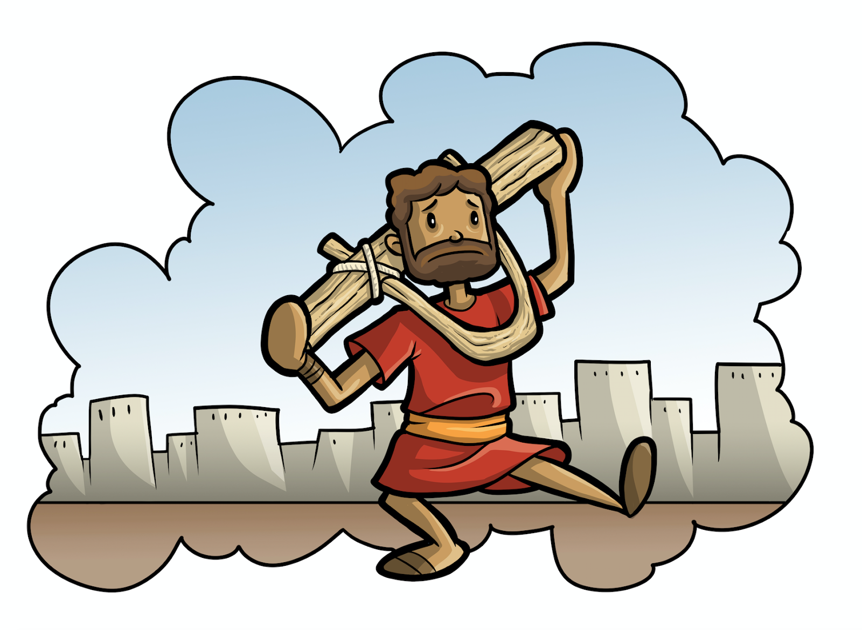
Images in Jeremiah
Yoke and Bonds
Jeremiah 27:1-7; 28:10-11

Slide 22
Historical Context of Jeremiah
Jereboam
Ahab
Assyrian Captivity
Israel (Northern)
Israel (United Kingdom)
Return
Judah (Southern)
Babylonian Captivity
Saul
David
Solomon
Hezekiah
Josiah
= Jeremiah

Slide 23
King Josiah and sons
Josiah
(640 – 609 BC)
Jehoahaz
(609 BC)
Jehoiakim
(609 – 598 BC)
Zedekiah
(597 – 586 BC)
1st wave of captives (605)
Jehoiachin
(597 BC)
3rd wave of captives (586)
2nd wave of captives (597)

Slide 24
King Josiah and sons
Josiah
(640 – 609 BC)
Jehoahaz
(609 BC)
Jehoiakim
(609 – 598 BC)
Zedekiah
(597 – 586 BC)
Jehoiachin
(597 BC)
Lineage of Christ

Slide 25
What is the prophet’s purpose?
Interpret history.
Enforce covenants.
Declare future events.

Slide 26
Structure of Jeremiah
Oracles Against Judah (ch. 1-25)
Historical Interlude (ch. 26-29)
Book of Comfort (ch. 30-33)
Historical Interlude (ch. 34-45)
Oracles Against Nations (ch.46-51)

Slide 27
Structure of Jeremiah
Condemnation & Disaster (1-12)
God’s Plans for Exile, Jer’s Complaints (13-20)
To Kings (& others) (21-29)
Words of Hope (30-33)
To Kings (& others) (34-35)
Jeremiah’s Suffering (36-45)
Oracles Against the Nations (46-51)

