Slide 1
Jeremiah
#26 – I Will Restore You
Jeremiah 30 (continued)

Slide 2
I Will Heal You (30:12-17)
Current situation of the people:
Therefore, God will punish their enemies, restore them, and heal their wounds. (16-17)
Incurable wound. (12)
Serious injury. (12)
None to advocate. (13)
No healing, no recovery. (13)
Lovers have forgotten, no one helps. (14)
Wounded by an enemy. (14)
Great iniquity, numerous sins. (14,15)
Incurable pain. (15)
God has done this. (15)

Slide 3
I Will Be Your God (30:18-24)
Future situation of the people:
God will raise up a ruler (& priest) from the people who will reconcile God & people. (21-22)
But first, God’s wrath must fulfill His intended purpose. (23-24)
Restored fortunes. (18)
Compassion on the city. (18)
Rebuilt from ruins. (18)
Palace in its place. (18)
Voice of celebration and thanks. (19)
People multiplied. (19)
People honored and significant. (19)
Children in the city again. (20)
Congregation assembled again. (20)
Oppressors punished. (20)

Slide 4
Jeremiah
#27 – Ephraim My Dear Son
Jeremiah 31:1-26

Slide 5
An Everlasting Love (31:1-14)
Using Exodus imagery, God emphasizes His everlasting love for His people. (1-3)
“Build and Plant” (see 1:10)
Purity (“O Virgin of Israel”), joy, and unity—Ephraim goes up to Zion. (4-6)
A weak, mourning remnant, but God will save, gather, and lead them. (7-9)
Images of restoration in v.10-14:
Gathered by a shepherd (10)
Ransomed from the enemy (11)
Shout of victory (12)
grain, new wine, and oil (12)
flocks and herds (12)
Virgin dances (13)
Old and young celebrate (13)
Priests have an abundance (14)

Slide 6
Rachel’s Children (31:15-26)
Rachel—mother of Israel—weeps for the plight of her children (15)
God reassures her of hope & a return. (16-17)
Ephraim himself mourns & repents. (18-19)
God looks on him with longing & mercy. (20)
God tells Israel to mark her way home after wandering for so long. (21-22)
There will again be security, righteousness, unity, and abundance in Judah. (23-25)

Slide 7
Matthew 2:16-18
Then when Herod saw that he had been tricked by the magi, he became very enraged, and sent and slew all the male children who were in Bethlehem and all its vicinity, from two years old and under, according to the time which he had determined from the magi. Then what had been spoken through Jeremiah the prophet was fulfilled:
“A voice was heard in Ramah, Weeping and great mourning, Rachel weeping for her children; And she refused to be comforted, Because they were no more.”

Slide 8
Jeremiah
#27 – Ephraim My Dear Son
Next up: Jeremiah 31 (pt.2)

Slide 9
What does the prophet talk about?
Eight things:
Lord of History
Divine Compassion
Election of Israel
Call to Repentance
Rebellion of Israel
Redemption/Restoration
Judgment to Come
Kingdom of God

Slide 10
Themes in the Prophets
Rebellion
Restoration
Repentance
Retribution
= Jeremiah

Slide 11
Fountain
“forsaken me, the _______________ of living waters, and hewed out for themselves broken ___________________.” (2:13)
“They have healed the wound of my people _______________, saying, _____________________, when there is no peace.” (6:14)
“Look for the ancient paths, walk in the good way, and you will find ___________ _____ ______ ________.” (6:16)
“Has this house, which is called by my name, become a ______________________ in your sight?” (7:12)
”But let Him who boasts, boast in this: that he _________________ & _________ Me, that I am the LORD who exercises steadfast love, justice, and righteousness…” (9:24)
“I know, O Lord, that a man’s way is not in ____________, Nor is it in a man who walks to ______________ his steps.” (10:23)
Cisterns…
Lightly
“Peace, Peace!”
rest
for
your
souls
Den of Robbers
Understands
knows
himself
direct

Slide 12
“Blessed is the man who ______________ in the Lord ... He will be like a __________________________________.” (17:7-8)
The heart is more _______________ than all else and is desperately __________.” (17:9)
O Lord, you have ____________ me, and I was ____________; you have _______________ me and prevailed. (20:7)
But if I say, “I will not … speak anymore in His name, then in my heart it becomes like a ____________ ______ .” (20:9)
trusts
Tree planted by the water
deceitful
sick
deceived
deceived
overcome
burning
fire

Slide 13
I will raise up for David a _____________ ; He will reign as king and act wisely and do ___________ & ________________ (23:5)
[of false prophets] “But who has stood in the ____________ of the Lord, the he should see and hear His word?” (23:18)
This whole land will be a desolation and a horror, and these nations will serve the king of Babylon _________ years. (25:11)
Branch
justice
righteousness
council
seventy

Slide 14
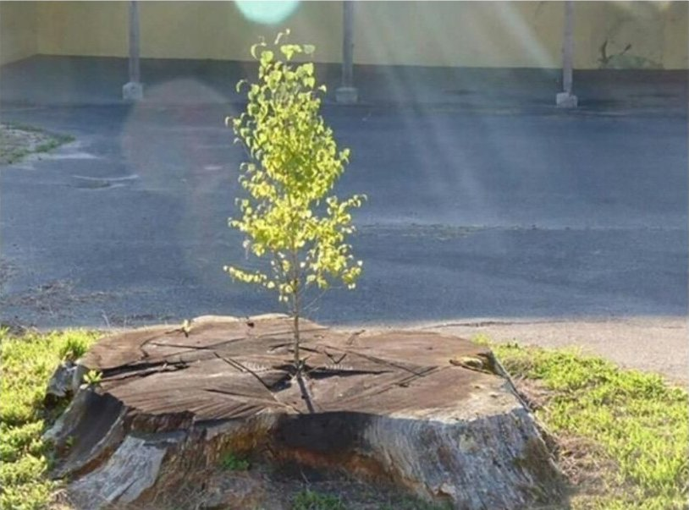
Images in Jeremiah
The Branch
Jeremiah 23:5-6

Slide 15
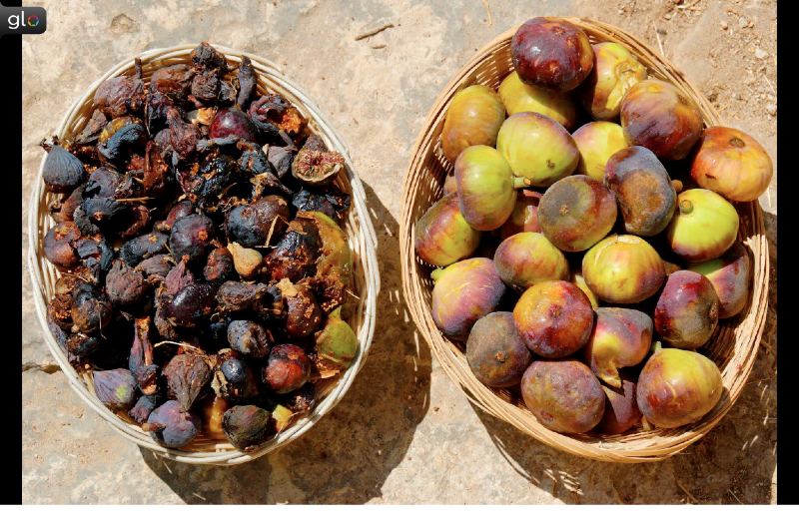
Images in Jeremiah
Two Baskets of Figs
Jeremiah 24; 29:17

Slide 16
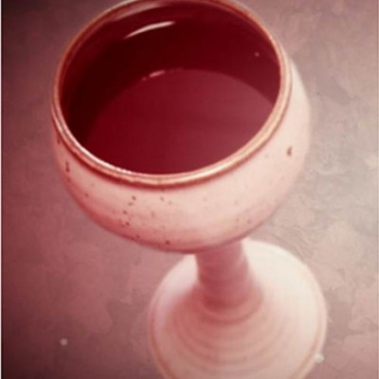
Images in Jeremiah
Cup of Strong Drink
Jeremiah 25:15-29

Slide 17
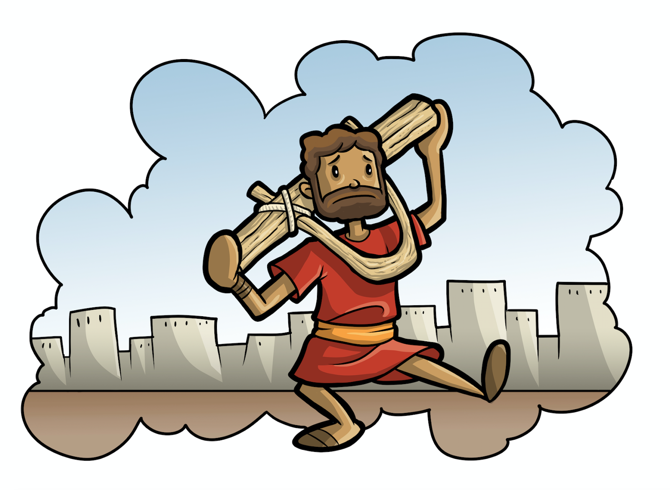
Images in Jeremiah
Yoke and Bonds
Jeremiah 27:1-7; 28:10-11

Slide 18
Historical Context of Jeremiah
Jereboam
Ahab
Assyrian Captivity
Israel (Northern)
Israel (United Kingdom)
Return
Judah (Southern)
Babylonian Captivity
Saul
David
Solomon
Hezekiah
Josiah
= Jeremiah

Slide 19
King Josiah and sons
Josiah
(640 – 609 BC)
Jehoahaz
(609 BC)
Jehoiakim
(609 – 598 BC)
Zedekiah
(597 – 586 BC)
1st wave of captives (605)
Jehoiachin
(597 BC)
3rd wave of captives (586)
2nd wave of captives (597)

Slide 20
King Josiah and sons
Josiah
(640 – 609 BC)
Jehoahaz
(609 BC)
Jehoiakim
(609 – 598 BC)
Zedekiah
(597 – 586 BC)
Jehoiachin
(597 BC)
Lineage of Christ

Slide 21
What is the prophet’s purpose?
Interpret history.
Enforce covenants.
Declare future events.

Slide 22
Structure of Jeremiah
Oracles Against Judah (ch. 1-25)
Historical Interlude (ch. 26-29)
Book of Comfort (ch. 30-33)
Historical Interlude (ch. 34-45)
Oracles Against Nations (ch.46-51)

Slide 23
Structure of Jeremiah
Condemnation & Disaster (1-12)
God’s Plans for Exile, Jer’s Complaints (13-20)
To Kings (& others) (21-29)
Words of Hope (30-33)
To Kings (& others) (34-35)
Jeremiah’s Suffering (36-45)
Oracles Against the Nations (46-51)

