Slide 1
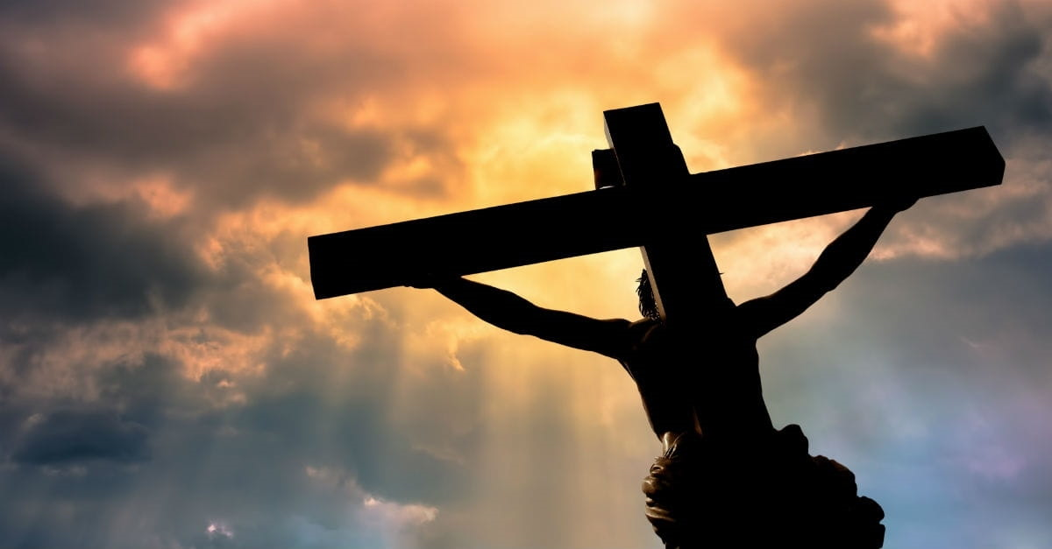
Death – Burial and Resurrection of Christ
One Sacrifice – Two Offerings
Notes:
To prepare our minds for the Lord’s Supper:
Let us reflect upon the One Sacrifice that Jesus Suffered
The one sacrifice in which He made two offerings (His sacrificial Death and His Shed Blood)
The two offerings that accomplished two results – removal of the penalty of death from God’s Children and the giving of eternal life to God’s Children

Slide 2
Promise of Eternal Life
Titus 1:2 … eternal life, which God, who cannot lie, promised long ages ago,
1 John 2:25 This is the promise which He Himself made to us: eternal life.
1 John 5:11-12 … God has given us eternal life, and this life is in His Son. ¹² He who has the Son has the life; he who does not have the Son of God does not have the life.
Notes:
So lets begin with eternal life with Titus 1:2. Here, the Apostle Paul reveals that God promised His children the gift of eternal life “long ages ago.”
That term “long ages ago” means:
before time began,
before eternity existed,
before God made the world, God created man
This promise is foundational to all that God purposed for man.
At 1 John 2:25, the Apostle John confirms Paul’s declaration stating God himself made a promise to give us eternal life
Then at 1 John 5:11-12, the Apostle John makes an amazing declaration.
God gives His promised gift of eternal life to God’s children while alive in the flesh.
They had that life in the present physical life
And therefore, we now likewise have that same eternal life

Slide 3
Law Demands the Death of Sinners
Isaiah 59:2 But your iniquities have made a separation between you and your God….
2 Thessalonians 1:8-9 to those who do not obey the gospel of our Lord Jesus. ⁹ These will pay the penalty of eternal destruction, away from the presence of the Lord ….
Ezekiel 18:20 "The person who sins will die….
Romans 6:23 For the wages of sin is death….
Notes:
But the Law is unlike the Promise. Because God is perfectly holy, God will not allow anything impure, defiled or evil to enter into His presence.
Thus, Isaiah 59:2 declares our sins separate us from God
That principle carries over into the New Covenant – those that do not obey the gospel of Jesus will pay the penalty of eternal destruction. How? Away from the presence of the Lord, i.e., separation
Scripture further defines that separation to be death. Ezekiel 18:20, Romans 6:23

Slide 4
Problem: All Men Have Sinned
Psalm 14:3 … There is none righteous, not even one.
Romans 3:23 for all have sinned and fall short of the glory of God
Romans 5:12 …. and so death spread to all men, because all sinned—
Notes:
Which presents us with problem. The scriptures are clear.
There is none righteous – including the sons of God
All have sinned – including the sons of God
Because all sinned, death spread to all men – including the sons of God

Slide 5
A Dilemma?
God’s Promise of Eternal Life versus God’s Law Requiring Death
Law of Sin and Death: God must satisfy the requirements of His law demanding the eternal death of those who sin and, at the same time,
Law of the Spirit of Life: Provide His children under the sentence of death with salvation through His love, mercy, grace and compassion – according to His eternal promise
Notes:
Thus the Law and the promise appear to be in conflict with each other – each a contradiction to the other – which suggests a dilemma.
The law demands death while God promised His Children eternal life
Therefore, God must some how satisfy the requirements of the law demanding death while, at the same time
Provide His children under the Law’s sentence death with salvation – according to His eternal promise

Slide 6
One Sacrifice – Two Offerings
Jesus Christ’s Sacrificial Death – Two Accomplishments: Abolished Death and Brought Life – broadly referred to as salvation
2 Timothy 1:8-10 …God, ⁹ who has saved us (How? by Christ’s one sacrifice) … not according to our works (why? All have sinned), but according to His own purpose (save His children in order to have children – Ephesians 1:4-5) and grace (God’s favor by which we are saved – Ephesians 2:8-9) which was granted us in Christ Jesus (1 John 5:11-12) from all eternity (before time began – when the Promise was given – Titus 1:2), ¹⁰ but now has been revealed by the appearing of our Savior Christ Jesus, who abolished death and brought life and immortality ….
Notes:
Which brings us to Jesus Christ’s Sacrificial Death – the one sacrifice with two offerings
Sacrificial Death and Shed blood
Each resulting in two accomplishments – removal of death and the giving of eternal life
2 Timothy 1:8-10 gives a good summary of these two principles
The distinction between the Abolishment of death and the giving of life re nuanced but are very important to understand – for in understanding this helps us to understand what we are doing when we partake of the Lord’s Supper

Slide 7
Abolish Death
God sent His Son, Jesus Christ into the world to suffer our penalty of death in our stead. Romans 5:6, 8, 10
The Law Demands the Penalty of Death for the Commission of Sin.
Justice requires sin’s death penalty be paid and Jesus paid it. When Christ died in our stead, He abolished death. 2 Timothy 1:10
But Jesus’s supreme act of love on our behalf, as great as it is, is not enough to save us.
Jesus had to also give God’s children life and immortality as likewise expressed in 2 Timothy 2:10. This is the second offering through Christ’s one sacrifice.
Notes:
So let’s look at Christ’s first offering achieved through His one sacrifice.
In order to satisfy the demands of the law, God sent Jesus into the world to suffer our penalty of death in our stead.

Slide 8
Abolishment of Death Penalty
Salvation – 2 Timothy 1:10: Jesus accomplished two results on the cross
Abolished Death and Gave Eternal Life
Although Closely Aligned – They are not the same
The Point is this:
In order to be fully saved from death,
God must give us eternal life. 2 Timothy 1:10
Eternal life (union with God) requires the forgiveness and cleansing of our sins (never remembered – Hebrews 10:17; Jeremiah 31:34) such that we become perfectly and infinitely holy and blameless.
Notes:
Let me explain further. In reference to our previously discussed verse at 2 Timothy 1:10, Jesus accomplished two things on the cross.
He abolished death and He brough immortality and eternal life
Although closely aligned, Saving a person from the penalty of death is not the granting to them of life.
Example: If a man who is under penalty of death for terrorizing a community with horrific crimes obtains a pardon from the Governor who releases that man unforgiven back into the community he terrorized, that man’s sins will never be forgotten. He will forever remain an outcast and a guilty sinner to be avoided forever.
The point is this. To be fully saved from death, God must also give us eternal life
Why? Because eternal life requires the complete forgiveness and cleansing our sins – never ever to be remembered. Hebrews 10:17 as first prophecied by Jeremiah at Jeremiah 31:34
Eternal life requires perfect and infinite holiness and sinlessness.
And that’s what the second offering in Christ’s sacrificial death provides us - granting of eternal life

Slide 9
Cleansing & Forgiveness – Shed Blood of the Innocent Life Sacrificed for Our Sins
Leviticus 17:11
Life: Life is in the blood.
Atonement: God gives the innocent blood to the guilty sinner to make atonement for sin (cover, propitiate, forgive)
The blood by reason of the life: Makes atonement.
Hebrews 9:22
Sanctification: All things are cleansed with blood
Forgiveness: Without shedding of blood there is no forgiveness.
Notes:
Which brings us to the means by which God cleanses us of all sin and forgives us of all sin – which is achieved through the shed blood of Christ
Only two verses in all of scripture explain the efficacy of shed blood that brings about the cleansing and forgiveness of sins
In reference to the imperfect animal sacrifices offered under the first covenant, Leviticus 17:11 states that life is in the blood.
Therefore, God gives the innocent blood of the sacrificed life and gives it to the guilty sinner.
It is the blood by reason of the life that makes atonement.
In a sense, the innocent life given in sacrifice for sins is not the giving up of life – but the giving of innocent life to the guilty
That Old Law principle is carried over into the New Covenant.
In reference to the perfect blood of Christ, God states all things (referring to all sin) are cleansed with blood and without the shedding of blood there is no forgiveness.
Or to state it in the positive, forgiveness and cleansing of sin are only obtained through the shedding of blood

Slide 10
In Death - Christ Shed His Blood
Scourging: Mt 22:26; Mk 15:15; Luke 18:33; John 19:1
Crown of Thorns: Mt 27:29; Mk 15:17; John 19:2,5
Jesus’s hands and feet were pierced: Acts 2:23
Pierced through with a Roman spear: John 19:34
Notes:
In death, the scriptures are clear. Jesus shed His blood for us.

Slide 11
Christ Shed His Blood
Forgiveness of All Sins for All Time: Ephesians 1:7-8; Hebrews 10:12
Cleansing – Washing Away of All Sin for All Time: 1 John 1:7; Hebrews 10:12
Eternal Life – Through Christ’s Shed Blood
Notes:
Thus the scriptures reveal that through the shed blood of Christ, we obtain both the forgiveness and cleansing of all sin for all time.

Slide 12
One Supper – Two Offerings
1 Corinthians 11:23-24 …. the Lord Jesus in the night in which He was betrayed took bread; ²⁴ and when He had given thanks, He broke it and said, "This is My body, which is for you; do this in remembrance of Me."
1 Corinthians 11:25 In the same way He took the cup also after supper, saying, "This cup is the new covenant in My blood; do this, as often as you drink it, in remembrance of Me."
Notes:
Which now brings us to the Lord’s Supper
The Apostle Paul writing at 1 Corinthians chapter 11 states: …..
“This is My body” which is given to you – This is Christ’s broken body that died and paid the penalty of death on our behalf never to be under the sentence of death again. Why? Because when Christ died, He abolished death.
“This cup is the new covenant in My blood” – the blood that Christ shed for us in order to cleanse us of all sin for all time. The blood that makes us infinitely and perfectly holy and sinless. The blood that gives us eternal life
Thus, as Christ’s one sacrificial death resulted in two offerings – Christ’s sacrificial death and Christ’s shed blood
We now have one Lord’s Supper comprised of two offerings – Remembrance of Christ’s sacrificial death (the bread) and remembrance of Christ’s shed blood (the wine)

Slide 13
One Lord’s Supper – Two Offerings
Over the course of 2,000 years, every true child of God over the entire world partakes of the Lord’s Supper in the exact way that Christ ordained.
This morning, we will partake of:
Bread – Christ’s Body – Died in our Place – the offering that abolished death
Wine – Christ’s Blood – Shed to Wash our Sins Away – the offering that gave Eternal Life

