Slide 1
WHAT SPARKS FORGIVENESS?
MATTHEW 6:14-15

Slide 2
Matthew 6:14-15
“For if you forgive other people when they sin against you, your heavenly Father will also forgive you. But if you do not forgive others their sins, your Father will not forgive your sins.”

Slide 3
Matthew 6:12 (KJV)
Forgive us our trespasses, as we forgive those who have trespassed against us.

Slide 4
1. We choose to forgive because we have been forgiven.

Slide 5
Ephesians 4:32
Be kind and compassionate to one another, forgiving each other, just as in Christ God forgave you.

Slide 6
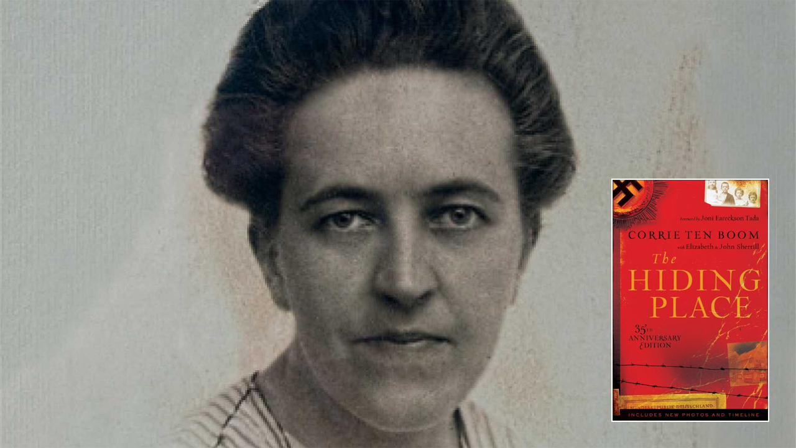

Slide 7
He said, "What a fine message. And how good it is to know that our sins have been cast into the bottom of the sea."

Slide 8
"I was a guard in the camp where you stayed. Since then I have become a Christian. I know that God has forgiven me for the cruel things I did ... but I would like to hear it from you. Will you forgive me?"

Slide 9
She later said, "I, whose sins had to be forgiven everyday, could not forgive him." And then she remembered the forgiveness that God had already lavished upon her, and she remembered the words of Jesus that we read just a moment ago. And she said, "I knew that I had to do it.“
She said, "Jesus, help me. I can lift my hand. I can do that much. Please help me do the rest."

Slide 10
We forgive by choice because we have been forgiven by grace.

Slide 11
2. We forgive as many times as it takes to see it through.

Slide 13
He said, "In the church tower there is a bell which is rung by pulling on a rope. And after you let go of the rope, the bell continues to swing back and forth for a few minutes, and it continues to clang."

Slide 15
He said, "The same thing is true of forgiveness. When you forgive someone, you take your hand off the rope. But if you've been tugging at it a long time, don't be surprised if the thoughts of resentment keep coming back for a while. They’re just the clanging of the bell while it slows down."

Slide 16
Every time you hear the clanging of unforgiving thoughts, stop for a moment, make sure you've let go of the rope, then resolve once again to forgive, and move forward.

Slide 17
Mark 11:25
“And when you stand praying, if you hold anything against anyone, forgive them, so that your Father in heaven may forgive you your sins.”

Slide 18
3. When you forgive, make it your objective to forget.
Frederick Buechner

Slide 19
"But they still don't see it like I see it. They still say there was nothing to forgive. They deny that it ever happened. But I can prove it. I have it in black and white. I still have the letters and documents."
"Corrie, aren't you the one who said your sins are at the bottom of the sea? Why, then, are the sins of your friends still etched in black and white?"
"Lord Jesus, forgive me for preserving all these years the evidence against others."

Slide 20
Isaiah 43:25 (NLT)
“I—yes, I alone—will blot out your sins for my own sake and will never think of them again.”

Slide 21
"When somebody you've wronged forgives you, you're spared the dull and self-diminishing throb of a guilty conscience. When you forgive somebody who has wronged you, you're spared the dismal corrosion of bitterness and wounded pride. For both parties, forgiveness means the freedom again to be at peace inside their own skin and to be glad in each other's presence."
Frederick Buechner

Slide 22
We forgive by choice because we have been forgiven by grace.

Slide 23
1. We choose to forgive because we have been forgiven.
2. We forgive as many times as it takes to see it through.
3. When you forgive, make it your objective to forget.

Slide 24
WHAT SPARKS FORGIVENESS?
MATTHEW 6:14-15

