Slide 1
The Book of Judges
December 2020 – January 2021
Bellaire church of Christ

Slide 2
Goals of this Class
Avoid the destructive cycle of sin—in ourselves, our families, and our churches.
Cultivate trust in God that grows from generation to generation.
Recognize our desperate need (and the world’s need) for the kingship of Jesus Christ.

Slide 3
Class Objectives
List all twelve judges (6 major, 6 minor) plus two extra leaders of note in the book.
Name the enemy defeated by each judge, and the unique events in each story.
Describe the four-part sin cycle.
Explain the overall trajectory of the collection of stories in Judges.
Recall the story of Micah & the Danites.
Recall the story of the concubine, the men of Gibeah, and the tribe of Benjamin.
Recite Judges 21:25.

Slide 4
Judges So Far
Enemy | Judge | Unique
Mesopotamia
(Cushan-rishathaim)
“knight in shining armor”
Othniel*
Moabites
(Eglon)
left-handed secret assassin
Ehud*
Philistines
Shamgar
likely a
non-Israelite
Canaanites
(Jabin/Sisera)
Deborah* (Barak)
chariots in the rain

Slide 5
The Downward Spiral
Prologue (ch.1-3)
Failure to drive out the inhabitants, pattern of judges established.
Deborah & Barak (ch.4-5)
Gideon & Abimelech (ch.6-9)
Jephthah (ch.10-12)
Samson (ch.13-16)
Horrifying stories of people doing “right in their own eyes.”
Epilogue (ch.17-21)

Slide 7
Judges 13
Questions:
How did Manoah’s wife originally refer to the visitor?
What was the purpose of the 2nd visit? What was accomplished?
Were Monoah and his wife God fearing?
Notes:
Zorah originally given to Judah, see it again belonging to Judah post captivity.
Nazirite Vows were typically self imposed for a set amount of time.
Patterns: Sara, Rachel, Hannah, Elizabeth. Jacob.

Slide 10
Judges 14
Questions:
Was Samson wrong to take a Philistine wife?
Was Samson’s riddle able to be deciphered?
Did Samson adequately hold up his end of the bet?
Notes:
To “rent” a kid likely meant splitting from the hind legs.
~23 miles from Timnah to Ashkelon
It would not appear that the marriage was consummated.

Slide 11
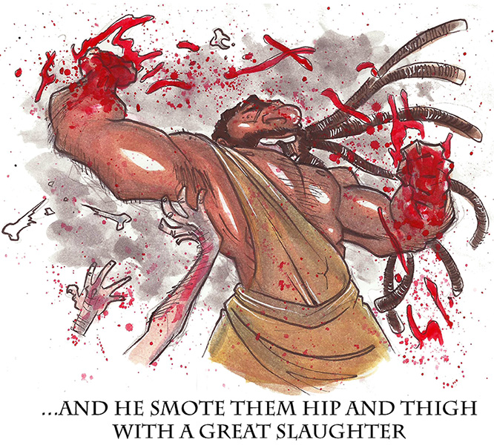
Judges 15: Samson
Courtesy of Nate Creekmore (creekingmore.com)

Slide 13
Judges15
Questions:
What business did Samson have way down in Gaza?
Did Samson fear the men of Judah?
How many men were in Samson’s “army”?
Notes:
7 instances of breaking the NV.
(not to mention his women)
Lehi = Height of a Jawbone
Gaza to Hebron would have been over 40 miles!

Slide 14
The Book of Judges
December 2020 – January 2021
Bellaire church of Christ
Next: Judges16

