Slide 1
The Book of Judges
December 2020 – January 2021
Bellaire church of Christ

Slide 2
Review of Judges 17-18
Sequence of Events
Micah (in Ephraim) makes idols from stolen $$, makes son priest.
A Levite from Bethlehem travels by, Micah hires him to be priest.
Danites send spies north to find territory from them to possess.
When the Danites head north, they stop to steal Micah’s idols & priest.
Danites conquer Laish, which becomes the city of Dan.

Slide 3
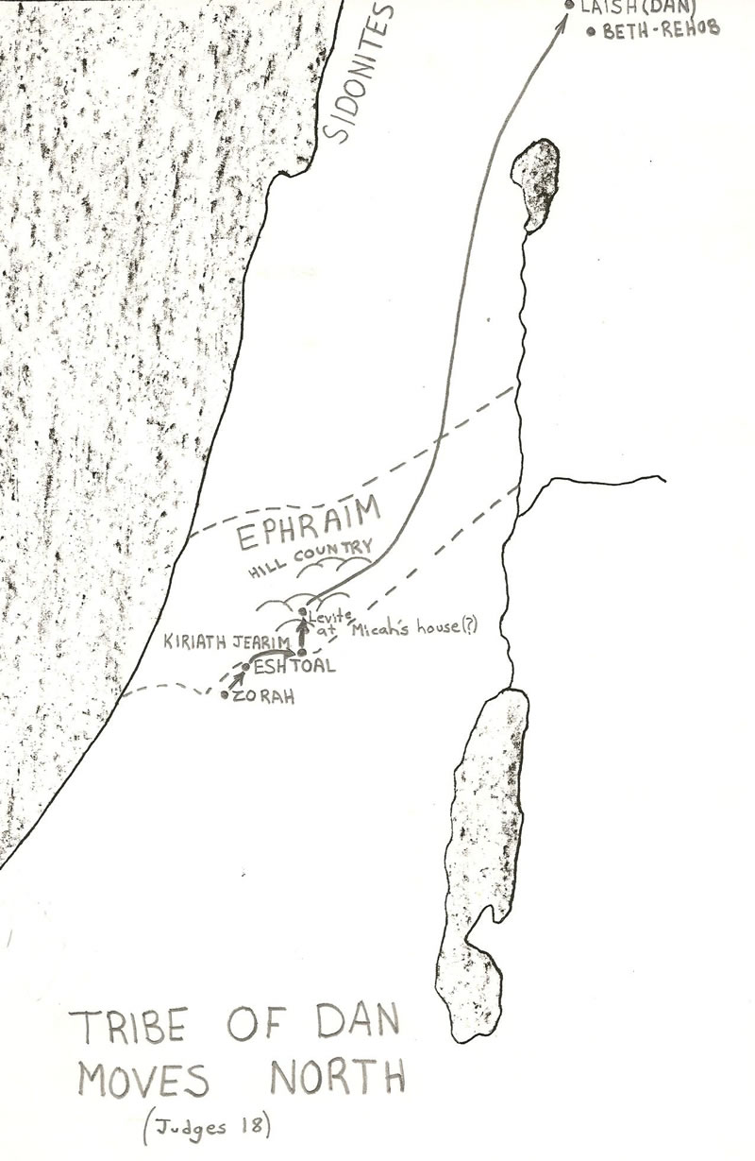
Judges 17-18

Slide 4
Review of Judges 17-18
Significance:
“In those days there was no king in Israel; every man did what was right in his own eyes.” (17:6)
Motivated by greed (Micah, his mother, the Levite, the Danites)
Danites seeking what is most convenient, self-serving.
Inquiry of Yahweh is superficial.
Might makes right.

Slide 5
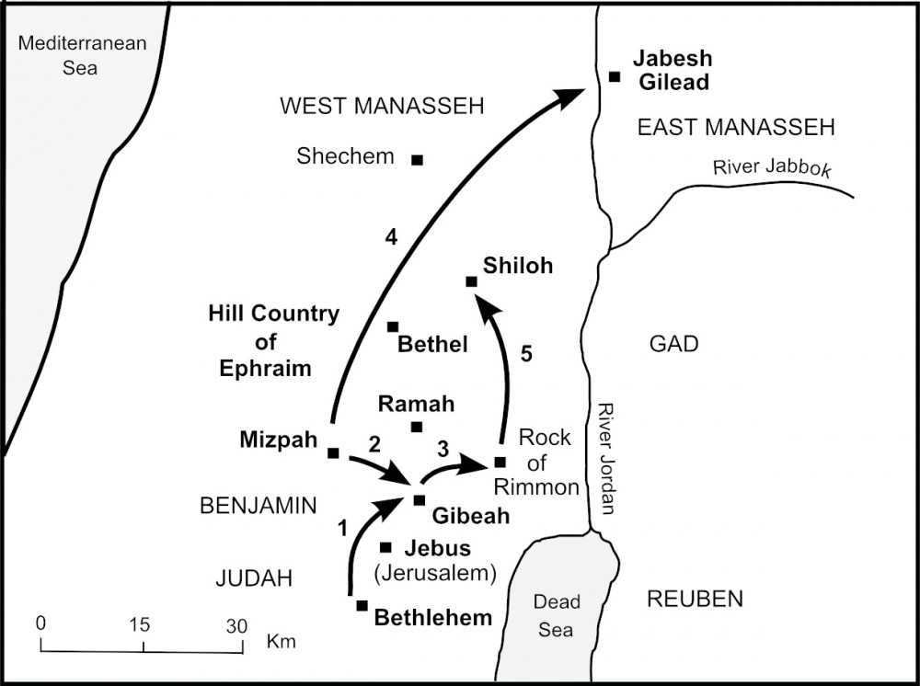
Judges 19-21

Slide 6
Judges 19
Questions:
What is happening?
What is ironic? Confusing? Tragic?
What stories are you reminded of?
Notes:
Hospitality (see Genesis 19, 24, 30)
Worse than pagans (Jebus, Sodom)
Levite cares only for himself.
Saul (from Gibeah) - 1 Samuel 11

Slide 7
Judges 19-21

Slide 8
Judges 20
Questions:
Evaluate each side’s response.
Jehovah’s role in all of this?
What are the big takeaways?
Notes:
Just retribution? (see Deut. 13:12ff)
Judah first (see Judges 1:1-2)
God says go, but two defeats?
Victory at Gibeah like Ai (Joshua 8)

Slide 9
Judges 19-21

Slide 10
Goals of this Class
Avoid the destructive cycle of sin—in ourselves, our families, and our churches.
Cultivate trust in God that grows from generation to generation.
Recognize our desperate need (and the world’s need) for the kingship of Jesus Christ.

Slide 11
Class Objectives
List all twelve judges (6 major, 6 minor) plus two extra leaders of note in the book.
Name the enemy defeated by each judge, and the unique events in each story.
Describe the four-part sin cycle.
Explain the overall trajectory of the collection of stories in Judges.
Recall the story of Micah & the Danites.
Recall the story of the concubine, the men of Gibeah, and the tribe of Benjamin.
Recite Judges 21:25.

Slide 12
Cycle of Sin in Judges
“did evil in the sight of the Lord.” (2:11)
sin
salvation
“the Lord raised up judges for them.” (2:18)
“the hand of the Lord was against them.” (2:15)
servitude
“the Lord was moved…by their groaning.” (2:18)
supplication

Slide 13
The Downward Spiral
Prologue (ch.1-3)
Failure to drive out the inhabitants, pattern of judges established.
Deborah & Barak (ch.4-5)
Gideon & Abimelech (ch.6-9)
Jephthah (ch.10-12)
Samson (ch.13-16)
Horrifying stories of people doing “right in their own eyes.”
Epilogue (ch.17-21)

Slide 14
Enemy | Judge | Unique
Mesopotamia
(Cushan-rishathaim)
Caleb’s nephew
Othniel
Moabites
(Eglon)
left-handed secret assassin
Ehud
Shamgar
Canaanites
(Jabin/Sisera)
Deborah (Barak)
chariots in the rain
Midianites
(Zebah/Zalmunna)
Gideon (Abimelech)
300 men with torches
Tola
Jair
Vows to sacrifice…
Ammonites
Jephthah
Ibzan
Elon
Abdon
“For my two eyes”
Phillistines
Samson

Slide 15
Judges 21
Questions:
What is the dilemma?
How is it ‘solved’? Commendably?
How does 21:25 color the story?

Slide 16
The Book of Judges
December 2020 – January 2021
Bellaire church of Christ
Next: Judges 19-21

