Slide 1
Lesson 4: Gal 2:11-21
Standing Up to Peter

Slide 2
Paul’s Argument’s Reviewed
Chapters 1-2:
Authenticity of the gospel and Paul’s apostleship defended

Slide 3
Paul’s Argument’s Reviewed
Chapter 1:
The gospel that he was teaching did not come from man. v11
He received the gospel was no different than the Twelve v12
He persecuted the church, not taught by other Christians or by his colleagues that were advanced in Judaism. v13-14
God Chose Him v15-17
He never went to Jerusalem and when he did it was only for 15 days to briefly talk with Peter. v18-20
His work in Judea was independent of the apostles and he did not look for their approval of oversight. v22

Slide 4
Paul’s Argument’s Reviewed
Chapter 2:
We see Paul going up to Jerusalem after 14 year to show to them the gospel he was preaching. v1
He brings up a Test case in Titus to show that not even Titus was compelled to be circumcised being a Gentile v3
Right Hand of Fellowship from James, Cephas and John v9
It was here that we see Paul as a accepted as a fellow Apostle preaching the gospel. v9

Slide 5
Chapter 2: 11-21
Paul’s defense is concluded in these final verses of chapter 2.
Review the incident when Paul opposed and rebuked Peter publicly in Antioch.

Slide 6
Peter’s life Reviewed
Peter Meets Cornelius
[Act 10:28 NKJV] 28 Then he said to them, "You know how unlawful it is for a Jewish man to keep company with or go to one of another nation. But God has shown me that I should not call any man common or unclean.
[Act 10:44-48 NKJV] 44 While Peter was still speaking these words, the Holy Spirit fell upon all those who heard the word. 45 And those of the circumcision who believed were astonished, as many as came with Peter, because the gift of the Holy Spirit had been poured out on the Gentiles also. 46 For they heard them speak with tongues and magnify God. Then Peter answered, 47 "Can anyone forbid water, that these should not be baptized who have received the Holy Spirit just as we [have]?" 48 And he commanded them to be baptized in the name of the Lord. Then they asked him to stay a few days.

Slide 7
Peter’s life Reviewed
Peter talking with the Jews
[Act 11:2-5, 17-18 NKJV] 2 And when Peter came up to Jerusalem, those of the circumcision contended with him, 3 saying, "You went in to uncircumcised men and ate with them!" 4 But Peter explained [it] to them in order from the beginning, saying: 5 "I was in the city of Joppa praying; and in a trance I saw a vision, an object descending like a great sheet, let down from heaven by four corners; and it came to me. ... 17 "If therefore God gave them the same gift as [He gave] us when we believed on the Lord Jesus Christ, who was I that I could withstand God?" 18 When they heard these things they became silent; and they glorified God, saying, "Then God has also granted to the Gentiles repentance to life."

Slide 8
[Gal 2:11-21 NKJV] 11 Now when Peter had come to Antioch, I withstood him to his face, because he was to be blamed; 12 for before certain men came from James, he would eat with the Gentiles; but when they came, he withdrew and separated himself, fearing those who were of the circumcision. 13 And the rest of the Jews also played the hypocrite with him, so that even Barnabas was carried away with their hypocrisy. 14 But when I saw that they were not straightforward about the truth of the gospel, I said to Peter before [them] all, "If you, being a Jew, live in the manner of Gentiles and not as the Jews, why do you compel Gentiles to live as Jews? 15 "We [who are] Jews by nature, and not sinners of the Gentiles, 16 "knowing that a man is not justified by the works of the law but by faith in Jesus Christ, even we have believed in Christ Jesus, that we might be justified by faith in Christ and not by the works of the law; for by the works of the law no flesh shall be justified. 17 "But if, while we seek to be justified by Christ, we ourselves also are found sinners, [is] Christ therefore a minister of sin? Certainly not! 18 "For if I build again those things which I destroyed, I make myself a transgressor. 19 "For I through the law died to the law that I might live to God. 20 "I have been crucified with Christ; it is no longer I who live, but Christ lives in me; and the [life] which I now live in the flesh I live by faith in the Son of God, who loved me and gave Himself for me. 21 "I do not set aside the grace of God; for if righteousness [comes] through the law, then Christ died in vain."

Slide 9
[Gal 2:11-21 NKJV] 11 Now when Peter had come to Antioch, I withstood him to his face, because he was to be blamed; 12 for before certain men came from James, he would eat with the Gentiles; but when they came, he withdrew and separated himself, fearing those who were of the circumcision. 13 And the rest of the Jews also played the hypocrite with him, so that even Barnabas was carried away with their hypocrisy. 14 But when I saw that they were not straightforward about the truth of the gospel, I said to Peter before [them] all, "If you, being a Jew, live in the manner of Gentiles and not as the Jews, why do you compel Gentiles to live as Jews? 15 "We [who are] Jews by nature, and not sinners of the Gentiles, 16 "knowing that a man is not justified by the works of the law but by faith in Jesus Christ, even we have believed in Christ Jesus, that we might be justified by faith in Christ and not by the works of the law; for by the works of the law no flesh shall be justified. 17 "But if, while we seek to be justified by Christ, we ourselves also are found sinners, [is] Christ therefore a minister of sin? Certainly not! 18 "For if I build again those things which I destroyed, I make myself a transgressor. 19 "For I through the law died to the law that I might live to God. 20 "I have been crucified with Christ; it is no longer I who live, but Christ lives in me; and the [life] which I now live in the flesh I live by faith in the Son of God, who loved me and gave Himself for me. 21 "I do not set aside the grace of God; for if righteousness [comes] through the law, then Christ died in vain."

Slide 10
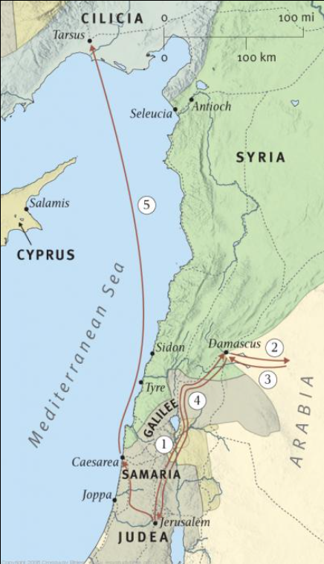
[Act 9:26, 30 NKJV] 26 And when Saul had come to Jerusalem, he tried to join the disciples; but they were all afraid of him, and did not believe that he was a disciple. ... 30 When the brethren found out, they brought him down to Caesarea and sent him out to Tarsus.
[Act 11:25-26, 29-30 NKJV] 25 Then Barnabas departed for Tarsus to seek Saul. 26 And when he had found him, he brought him to Antioch. So it was that for a whole year they assembled with the church and taught a great many people. And the disciples were first called Christians in Antioch. ... 29 Then the disciples, each according to his ability, determined to send relief to the brethren dwelling in Judea. 30 This they also did, and sent it to the elders by the hands of Barnabas and Saul.

Slide 11
[Act 12:25 NKJV] 25 And Barnabas and Saul returned from Jerusalem when they had fulfilled [their] ministry, and they also took with them John whose surname was Mark.
[Act 13:1 NKJV] 1 Now in the church that was at Antioch there were certain prophets and teachers: Barnabas, Simeon who was called Niger, Lucius of Cyrene, Manaen who had been brought up with Herod the tetrarch, and Saul.

Slide 12
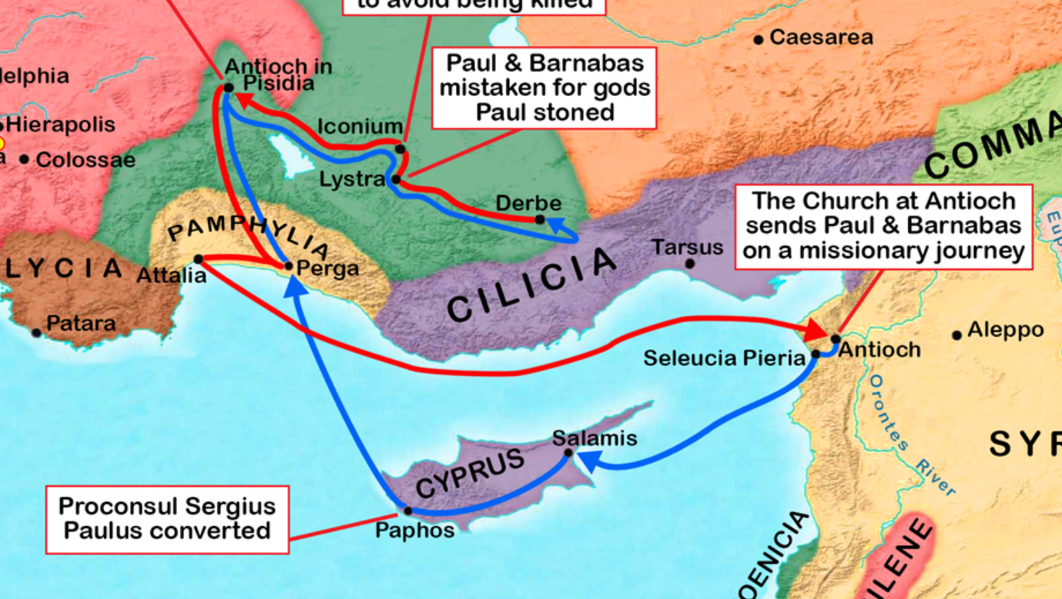
Paul’s 1st Missionary Journey
[Act 13:4-5, 13-14, 51 NKJV] 4 So, being sent out by the Holy Spirit, they went down to Seleucia, and from there they sailed to Cyprus. 5 And when they arrived in Salamis, they preached the word of God in the synagogues of the Jews. They also had John as [their] assistant. ... 13 Now when Paul and his party set sail from Paphos, they came to Perga in Pamphylia; and John, departing from them, returned to Jerusalem. 14 But when they departed from Perga, they came to Antioch in Pisidia, and went into the synagogue on the Sabbath day and sat down. ... 51 But they shook off the dust from their feet against them, and came to Iconium.

Slide 13
Paul’s 1st Missionary Journey
[Act 14:6, 20-21, 24-26 NKJV] 6 they became aware of it and fled to Lystra and Derbe, cities of Lycaonia, and to the surrounding region. ... 20 However, when the disciples gathered around him, he rose up and went into the city. And the next day he departed with Barnabas to Derbe. 21 And when they had preached the gospel to that city and made many disciples, they returned to Lystra, Iconium, and Antioch, ... 24 And after they had passed through Pisidia, they came to Pamphylia. 25 Now when they had preached the word in Perga, they went down to Attalia. 26 From there they sailed to Antioch, where they had been commended to the grace of God for the work which they had completed.

Slide 14
[Act 15:1-2 NKJV] 1 And certain [men] came down from Judea and taught the brethren, "Unless you are circumcised according to the custom of Moses, you cannot be saved." 2 Therefore, when Paul and Barnabas had no small dissension and dispute with them, they determined that Paul and Barnabas and certain others of them should go up to Jerusalem, to the apostles and elders, about this question.
Jerusalem Council
[Act 15:7 NKJV] 7 And when there had been much dispute, Peter rose up [and] said to them: "Men [and] brethren, you know that a good while ago God chose among us, that by my mouth the Gentiles should hear the word of the gospel and believe.

Slide 15
Jerusalem Council
[Act 15:7 NKJV] 7 And when there had been much dispute, Peter rose up [and] said to them: "Men [and] brethren, you know that a good while ago God chose among us, that by my mouth the Gentiles should hear the word of the gospel and believe.
[Act 15:30 NKJV] 30 So when they were sent off, they came to Antioch; and when they had gathered the multitude together, they delivered the letter.

Slide 16
[Gal 2:11-21 NKJV] 11 Now when Peter had come to Antioch, I withstood him to his face, because he was to be blamed; 12 for before certain men came from James, he would eat with the Gentiles; but when they came, he withdrew and separated himself, fearing those who were of the circumcision. 13 And the rest of the Jews also played the hypocrite with him, so that even Barnabas was carried away with their hypocrisy. 14 But when I saw that they were not straightforward about the truth of the gospel, I said to Peter before [them] all, "If you, being a Jew, live in the manner of Gentiles and not as the Jews, why do you compel Gentiles to live as Jews? 15 "We [who are] Jews by nature, and not sinners of the Gentiles, 16 "knowing that a man is not justified by the works of the law but by faith in Jesus Christ, even we have believed in Christ Jesus, that we might be justified by faith in Christ and not by the works of the law; for by the works of the law no flesh shall be justified. 17 "But if, while we seek to be justified by Christ, we ourselves also are found sinners, [is] Christ therefore a minister of sin? Certainly not! 18 "For if I build again those things which I destroyed, I make myself a transgressor. 19 "For I through the law died to the law that I might live to God. 20 "I have been crucified with Christ; it is no longer I who live, but Christ lives in me; and the [life] which I now live in the flesh I live by faith in the Son of God, who loved me and gave Himself for me. 21 "I do not set aside the grace of God; for if righteousness [comes] through the law, then Christ died in vain."

Slide 17
What was wrong with Peter separating himself?
Peter was a hypocrite. He was not acting correctly based of what he knew.
Is it hard to believe that Peter would act this way after the Council after only a few weeks/months?
Is this the first time we’ve seen Peter switch around like this?
[Mat 26:35 NKJV] 35 Peter said to Him, "Even if I have to die with You, I will not deny You!" And so said all the disciples.
[Mat 14:28 NKJV] 28 And Peter answered Him and said, "Lord, if it is You, command me to come to You on the water.“
[Jhn 13:8-9 NKJV] 8 Peter said to Him, "You shall never wash my feet!" Jesus answered him, "If I do not wash you, you have no part with Me." 9 Simon Peter said to Him, "Lord, not my feet only, but also [my] hands and [my] head!"

Slide 18
[Gal 2:11-21 NKJV] 11 Now when Peter had come to Antioch, I withstood him to his face, because he was to be blamed; 12 for before certain men came from James, he would eat with the Gentiles; but when they came, he withdrew and separated himself, fearing those who were of the circumcision. 13 And the rest of the Jews also played the hypocrite with him, so that even Barnabas was carried away with their hypocrisy. 14 But when I saw that they were not straightforward about the truth of the gospel, I said to Peter before [them] all, "If you, being a Jew, live in the manner of Gentiles and not as the Jews, why do you compel Gentiles to live as Jews? 15 "We [who are] Jews by nature, and not sinners of the Gentiles, 16 "knowing that a man is not justified by the works of the law but by faith in Jesus Christ, even we have believed in Christ Jesus, that we might be justified by faith in Christ and not by the works of the law; for by the works of the law no flesh shall be justified. 17 "But if, while we seek to be justified by Christ, we ourselves also are found sinners, [is] Christ therefore a minister of sin? Certainly not! 18 "For if I build again those things which I destroyed, I make myself a transgressor. 19 "For I through the law died to the law that I might live to God. 20 "I have been crucified with Christ; it is no longer I who live, but Christ lives in me; and the [life] which I now live in the flesh I live by faith in the Son of God, who loved me and gave Himself for me. 21 "I do not set aside the grace of God; for if righteousness [comes] through the law, then Christ died in vain."
NOTE: Peter’s problem here is one of CONDUCT not of DOCTRINE

Slide 19
NOTE: Peter’s problem here is one of CONDUCT not of DOCTRINE
What message was his Conduct giving to people?
That Gentiles were unclean and that they were not saved until they kept the Law of Moses
Peter and the Jews actions even persuaded Barnabas to go into hypocrisy.
Barnabas was not young in the faith, he had been with Paul on his missionary journey
Went to the council in Jerusalem.
What example are we setting with our actions for other Christians?

Slide 20
[Gal 2:11-21 NKJV] 11 Now when Peter had come to Antioch, I withstood him to his face, because he was to be blamed; 12 for before certain men came from James, he would eat with the Gentiles; but when they came, he withdrew and separated himself, fearing those who were of the circumcision. 13 And the rest of the Jews also played the hypocrite with him, so that even Barnabas was carried away with their hypocrisy. 14 But when I saw that they were not straightforward about the truth of the gospel, I said to Peter before [them] all, "If you, being a Jew, live in the manner of Gentiles and not as the Jews, why do you compel Gentiles to live as Jews? 15 "We [who are] Jews by nature, and not sinners of the Gentiles, 16 "knowing that a man is not justified by the works of the law but by faith in Jesus Christ, even we have believed in Christ Jesus, that we might be justified by faith in Christ and not by the works of the law; for by the works of the law no flesh shall be justified. 17 "But if, while we seek to be justified by Christ, we ourselves also are found sinners, [is] Christ therefore a minister of sin? Certainly not! 18 "For if I build again those things which I destroyed, I make myself a transgressor. 19 "For I through the law died to the law that I might live to God. 20 "I have been crucified with Christ; it is no longer I who live, but Christ lives in me; and the [life] which I now live in the flesh I live by faith in the Son of God, who loved me and gave Himself for me. 21 "I do not set aside the grace of God; for if righteousness [comes] through the law, then Christ died in vain."
What is Pauls’ reaction to all this hypocrisy?

Slide 21
Public vs. Private
[Mat 18:15-17 NKJV] 15 "Moreover if your brother sins against you, go and tell him his fault between you and him alone. If he hears you, you have gained your brother. 16 "But if he will not hear, take with you one or two more, that 'by the mouth of two or three witnesses every word may be established.' 17 "And if he refuses to hear them, tell [it] to the church. But if he refuses even to hear the church, let him be to you like a heathen and a tax collector.
[1Ti 5:20 NKJV] 20 Those who are sinning rebuke in the presence of all, that the rest also may fear.
[Act 18:25-26 NKJV] 25 This man had been instructed in the way of the Lord; and being fervent in spirit, he spoke and taught accurately the things of the Lord, though he knew only the baptism of John. 26 So he began to speak boldly in the synagogue. When Aquila and Priscilla heard him, they took him aside and explained to him the way of God more accurately.

Slide 22
[Gal 2:11-21 NKJV] 11 Now when Peter had come to Antioch, I withstood him to his face, because he was to be blamed; 12 for before certain men came from James, he would eat with the Gentiles; but when they came, he withdrew and separated himself, fearing those who were of the circumcision. 13 And the rest of the Jews also played the hypocrite with him, so that even Barnabas was carried away with their hypocrisy. 14 But when I saw that they were not straightforward about the truth of the gospel, I said to Peter before [them] all, "If you, being a Jew, live in the manner of Gentiles and not as the Jews, why do you compel Gentiles to live as Jews? 15 "We [who are] Jews by nature, and not sinners of the Gentiles, 16 "knowing that a man is not justified by the works of the law but by faith in Jesus Christ, even we have believed in Christ Jesus, that we might be justified by faith in Christ and not by the works of the law; for by the works of the law no flesh shall be justified. 17 "But if, while we seek to be justified by Christ, we ourselves also are found sinners, [is] Christ therefore a minister of sin? Certainly not! 18 "For if I build again those things which I destroyed, I make myself a transgressor. 19 "For I through the law died to the law that I might live to God. 20 "I have been crucified with Christ; it is no longer I who live, but Christ lives in me; and the [life] which I now live in the flesh I live by faith in the Son of God, who loved me and gave Himself for me. 21 "I do not set aside the grace of God; for if righteousness [comes] through the law, then Christ died in vain."

Slide 23
[Gal:2:15-21] "We [who are] Jews by nature, and not sinners of the Gentiles, 16 "knowing that a man is not justified by the works of the law but by faith in Jesus Christ, even we have believed in Christ Jesus, that we might be justified by faith in Christ and not by the works of the law; for by the works of the law no flesh shall be justified. 17 "But if, while we seek to be justified by Christ, we ourselves also are found sinners, [is] Christ therefore a minister of sin? Certainly not! 18 "For if I build again those things which I destroyed, I make myself a transgressor. 19 "For I through the law died to the law that I might live to God. 20 "I have been crucified with Christ; it is no longer I who live, but Christ lives in me; and the [life] which I now live in the flesh I live by faith in the Son of God, who loved me and gave Himself for me. 21 "I do not set aside the grace of God; for if righteousness [comes] through the law, then Christ died in vain."

Slide 24
Chapters 3-4:
Principle of justification by faith (apart from law) defended.
15 "We [who are] Jews by nature, and not sinners of the Gentiles, 16 "knowing that a man is not justified by the works of the law but by faith in Jesus Christ, even we have believed in Christ Jesus, that we might be justified by faith in Christ and not by the works of the law; for by the works of the law no flesh shall be justified. 17 "But if, while we seek to be justified by Christ, we ourselves also are found sinners, [is] Christ therefore a minister of sin? Certainly not! 18 "For if I build again those things which I destroyed, I make myself a transgressor.

Slide 25
Does the Law Justify?
[Rom 7:7 NKJV] 7 What shall we say then? [Is] the law sin? Certainly not! On the contrary, I would not have known sin except through the law. For I would not have known covetousness unless the law had said, "You shall not covet."
[Rom 3:20 NKJV] 20 Therefore by the deeds of the law no flesh will be justified in His sight, for by the law [is] the knowledge of sin.

Slide 26
Does the Law Justify?
[Heb 9:7 NKJV] 7 But into the second part the high priest [went] alone once a year, not without blood, which he offered for himself and [for] the people's sins [committed] in ignorance;
[Heb 10:3-5, 9-12 NKJV] 3 But in those [sacrifices there is] a reminder of sins every year. 4 For [it is] not possible that the blood of bulls and goats could take away sins. 5 Therefore, when He came into the world, He said: "Sacrifice and offering You did not desire, But a body You have prepared for Me…..9 then He said, "Behold, I have come to do Your will, O God." He takes away the first that He may establish the second. 10 By that will we have been sanctified through the offering of the body of Jesus Christ once [for all]. 11 And every priest stands ministering daily and offering repeatedly the same sacrifices, which can never take away sins. 12 But this Man, after He had offered one sacrifice for sins forever, sat down at the right hand of God,

Slide 27
Chapters 3-4:
Principle of justification by faith (apart from law) defended.
15 "We [who are] Jews by nature, and not sinners of the Gentiles, 16 "knowing that a man is not justified by the works of the law but by faith in Jesus Christ, even we have believed in Christ Jesus, that we might be justified by faith in Christ and not by the works of the law; for by the works of the law no flesh shall be justified. 17 "But if, while we seek to be justified by Christ, we ourselves also are found sinners, [is] Christ therefore a minister of sin? Certainly not! 18 "For if I build again those things which I destroyed, I make myself a transgressor.
Did Peter believe the LAW could not justify?
[Act 15:10-11 NKJV] 10 "Now therefore, why do you test God by putting a yoke on the neck of the disciples which neither our fathers nor we were able to bear? 11 "But we believe that through the grace of the Lord Jesus Christ we shall be saved in the same manner as they."

Slide 28
Chapters 3-4:
Principle of justification by faith (apart from law) defended.
15 "We [who are] Jews by nature, and not sinners of the Gentiles, 16 "knowing that a man is not justified by the works of the law but by faith in Jesus Christ, even we have believed in Christ Jesus, that we might be justified by faith in Christ and not by the works of the law; for by the works of the law no flesh shall be justified. 17 "But if, while we seek to be justified by Christ, we ourselves also are found sinners, [is] Christ therefore a minister of sin? Certainly not! 18 "For if I build again those things which I destroyed, I make myself a transgressor.

Slide 29
Living by Faith – 2:19-21
20 "I have been crucified with Christ; it is no longer I who live, but Christ lives in me; and the [life] which I now live in the flesh I live by faith in the Son of God, who loved me and gave Himself for me. 21 "I do not set aside the grace of God; for if righteousness [comes] through the law, then Christ died in vain."

