Slide 1
The Suffering of
Our Savior

Slide 2
The Sacrifice of Our Savior
Thursday Night
The Last Supper
Mt. of Olives
Garden of Gethsemane
Friday
Betrayal and Arrest
Trial 1 – Annas
Trial 2 - Caiaphas
Trial 3 – Sanhedrin
Trial 4 – Pilate
Trial 5 – Herod
Trial 6 – Pilate
Beaten
Crucifixion
On the Cross / Death
Burial
Sunday – Resurrection!

Slide 3
The Last Supper
Thursday
~6:30-11:30 PM

Slide 4
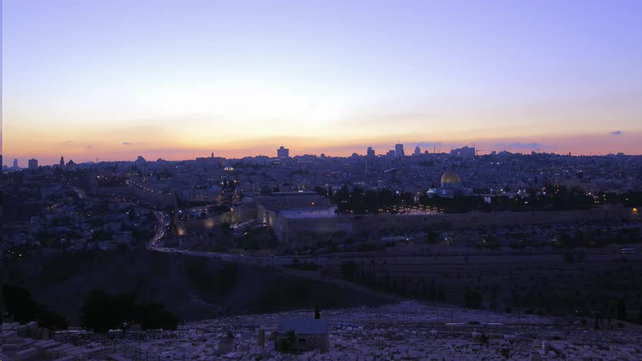
Mount of Olives
Thursday
~11:30 PM – 12:00 AM

Slide 5
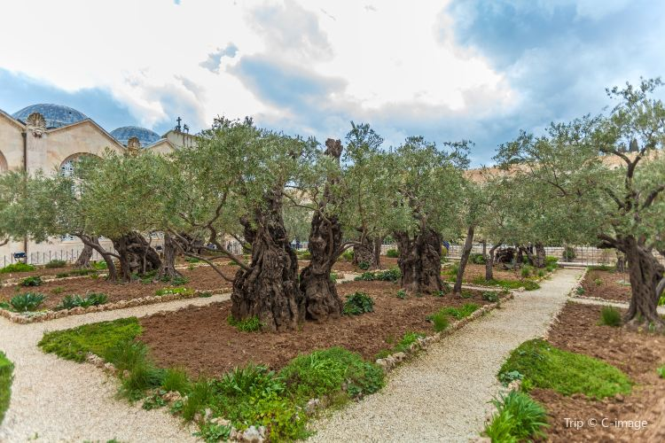
Garden of Gethsemane
Friday
~12-2:00 AM
Prayer
Forsaken by Disciples (Sleeping)
Betrayed by Friend
Arrested

Slide 6
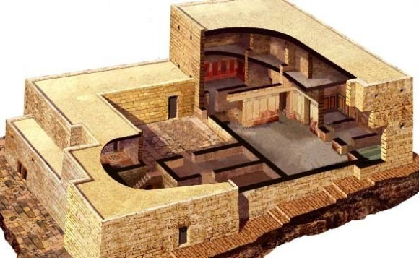
House of Annas (former High Priest)
Friday
~2-3:00 AM
Trial 1
Before Annas

Slide 7
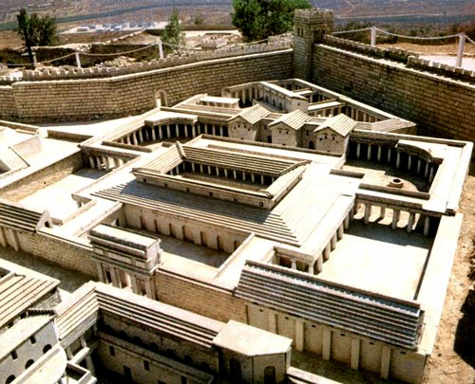
House of Caiaphas (current High Priest)
Friday
~3-5:00 AM
Trial 2
With the Sanhedrin Court
Peter Denies Christ - 3x
Imprison-ment

Slide 8
House of Caiaphas (current High Priest)
Friday
~5-6:00 AM
Trial 3
Whole Sanhedrin,
Elders,
Chief Priests,
Scribes
Judas kills himself

Slide 9
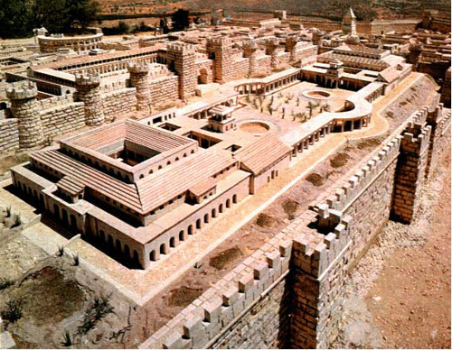
Praetorium - (Home of Pilate – part of Herod’s Palace)
Friday
~6-7:00 AM
Trial 4
Before Pilate the Roman Governor
1st time

Slide 10
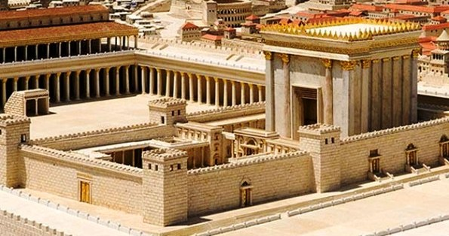
Herod Antipas (Roman Governor of Galilee)
Friday
~7-7:30 AM
Trial 5
Herod

Slide 11
Pilate’s House (Roman Governor of Galilee)
Friday
~7:30-8:30 AM
Trial 6
Final Trial
Chief Priests,
Rulers
Jesus is Tortured

Slide 12
Praetorium
Friday
~8:30-9:30 AM
Jesus is
Beaten
Mocked & Tortured
Crown of Thorns

Slide 13
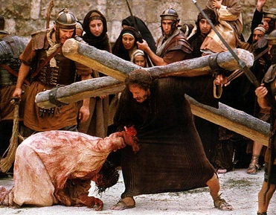
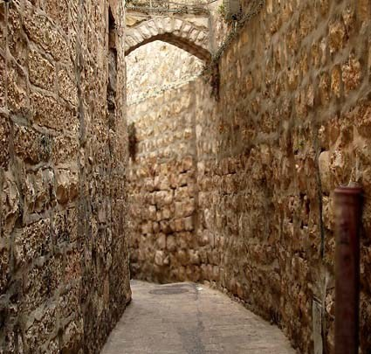
Travel to Golgotha (through Jerusalem)
Friday
~9:30 AM - Noon
Jesus is
forced to carry His cross
Simon of Cyrene also carries the cross
Two robbers were also taken with Him
Pilate accompanies him to Golgotha

Slide 14
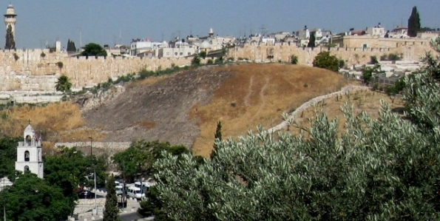
Golgotha (the Place of the Skull)
Friday
~Noon – 3 PM
Jesus is Crucified
Jesus on the Cross
Darkness over the land

Slide 15
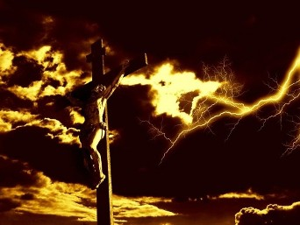
Golgotha (the Place of the Skull)
Friday
~About 3 PM
Jesus Dies
It is finished

Slide 16
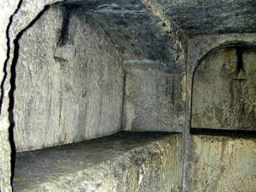
Jesus is Buried
Friday
~3-6 PM
Jesus is Buried
Guards are placed

Slide 17
The Resurrection from the Dead – Salvation

Slide 18
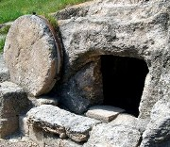
Resurrected!
Matthew 28:1-8
Stone is rolled away
Jesus is gone
Angels greet Mary, Mary Magdalene, Salome
John 20:2-10 – Peter and John see for themselves
John 20:11-18 – Jesus appears to Mary
1 Peter 1:18-21 – Redeemed by Jesus blood

