Slide 1
Our Greatest Command
Deuteronomy 6

Slide 2
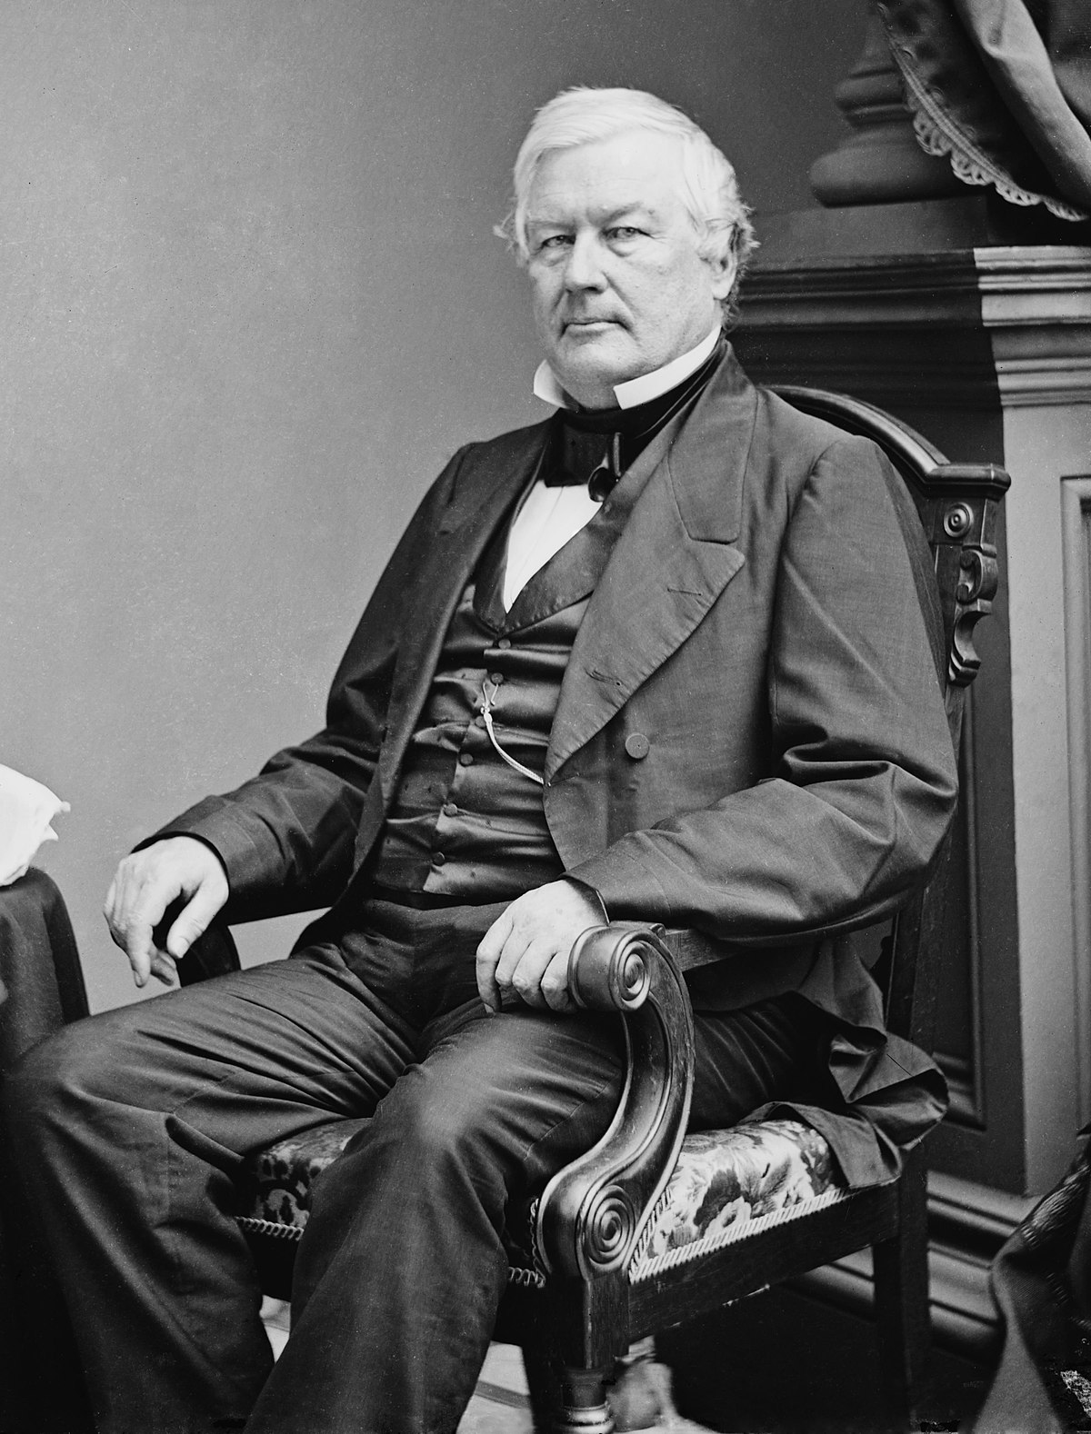

Slide 3
²⁹ Jesus answered, “The most important is, Hear, O Israel: The Lord our God, the Lord is one.
⁶ And these words that I command you today shall be on your heart.
⁴ “Hear, O Israel: The LORD our God, the LORD is one.
⁵ But thus shall you deal with them: you shall break down their altars and dash in pieces their pillars and chop down their Asherim and burn their carved images with fire. (7:5)

Slide 4
⁴ Therefore, as to the eating of food offered to idols, we know that “an idol has no real existence,” and that “there is no God but one.” 1 Cor. 8:4
⁵ For although there may be so-called gods in heaven or on earth—as indeed there are many “gods” and many “lords”— 1 Cor. 8:5
⁶ yet for us there is one God, the Father, from whom are all things and for whom we exist, and one Lord, Jesus Christ, through whom are all things and through whom we exist. 1 Cor. 8:6

Slide 5
Deut. 6:5 You shall love the LORD your God with all your heart and with all your soul and with all your might.
1. You should love the Lord Your God with all your Heart.
2. Love the Lord Your God with All your Soul.
3. Strength “Muchness”
110%

Slide 6
⁶ And these words that I command you today shall be on your heart. Deut 6:6
⁷ You shall teach them diligently to your children, and shall talk of them when you sit in your house, and when you walk by the way, and when you lie down, and when you rise.
⁸ You shall bind them as a sign on your hand, and they shall be as frontlets between your eyes.
⁹ You shall write them on the doorposts of your house and on your gates.

Slide 7
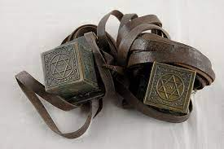
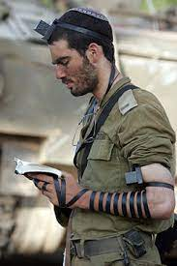
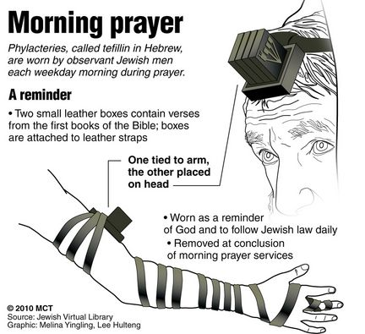

Slide 8
¹⁰ “And when the LORD your God brings you into the land that he swore to your fathers, to Abraham, to Isaac, and to Jacob, to give you—with great and good cities that you did not build, ¹¹ and houses full of all good things that you did not fill, and cisterns that you did not dig, and vineyards and olive trees that you did not plant—and when you eat and are full, ¹² then take care lest you forget the LORD, who brought you out of the land of Egypt, out of the house of slavery.

Slide 9
¹³ It is the LORD your God you shall fear. Him you shall serve and by his name you shall swear. Deut. 6:13
¹⁶ “You shall not put the LORD your God to the test, as you tested him at Massah.from before you, as the LORD has promised.
¹⁷ You shall diligently keep the commandments of the LORD your God, and his testimonies and his statutes, which he has commanded you. ¹⁸ And you shall do what is right and good in the sight of the LORD, that it may go well with you, and that you may go in and take possession of the good land that the LORD swore to give to your fathers ¹⁹ by thrusting out all your enemies

Slide 10
⁶ But godliness with contentment is great gain, ⁷ for we brought nothing into the world, and we cannot take anything out of the world. ⁸ But if we have food and clothing, with these we will be content. ⁹ But those who desire to be rich fall into temptation, into a snare, into many senseless and harmful desires that plunge people into ruin and destruction. ¹⁰ For the love of money is a root of all kinds of evils. It is through this craving that some have wandered away from the faith and pierced themselves with many pangs. Fight the Good Fight of Faith ¹¹ But as for you, O man of God, flee these things. Pursue righteousness, godliness, faith, love, steadfastness, gentleness. ¹² Fight the good fight of the faith. 1 Tim. 6:6-12

Slide 12
¹⁷ You shall diligently keep the commandments of the LORD your God, and his testimonies and his statutes, which he has commanded you.
1. The Word of God Must Saturate every aspect of your life!
2. If you are truly a person with the word of God in your heart that means you are going to keep it in good times and in bad times.
3. If the word of God is truly in your heart you share it with other people.

Slide 13
²⁰ “When your son asks you in time to come, ‘What is the meaning of the testimonies and the statutes and the rules that the LORD our God has commanded you?’
²⁴ And the LORD commanded us to do all these statutes, to fear the LORD our God, for our good always, that he might preserve us alive, as we are this day.

Slide 14
²¹ then you shall say to your son, We were Pharaoh's slaves in Egypt. And the LORD brought us out of Egypt with a mighty hand. ²² And the LORD showed signs and wonders, great and grievous, against Egypt and against Pharaoh and all his household, before our eyes. ²³ And he brought us out from there, that he might bring us in and give us the land that he swore to give to our fathers.

Slide 15
²⁵ And it will be righteousness for us, if we are careful to do all this commandment before the LORD our God, as he has commanded us.’

Slide 16
Our Greatest Command
Deuteronomy 6

