Slide 1
The Gospel of Matthew
Summer 2021
Bellaire Auditorium

Slide 2
Beginnings (1:1 – 4:25)
Jesus is the King
Jesus Fulfills Israel’s Story
S.o.t.M. (5:1– 7:27)
Kingdom Righteousness
The Law Fulfilled
Miracles (8:1 – 9:38)
Demonstrates Authority
Signals Healing Purpose
Sending the 12 (10:1-42)
Apostles Given Authority
Prophesied Receptance
He’s greater (11:1 –12:50 )
Come to Me; Take My Yoke
Rejection/No Repentance
Parables (13:1-52)
Sower
Kingdom Parables

Slide 3
Read Matthew 13:24 – 13:43

Slide 4
Parable of the Weeds/Tares
Man sows good seed in his field
Enemy sowed weeds among the wheat
When the grains sprout, both wheat and weeds are noticed
Servants offer to pull up the weeds
Master says, “No, wait until harvest, and the reapers will separate it out”
Wheat gathered into the master’s barn
Weeds bundled and burned

Slide 5
Parable of Weeds/Tares Explained
Man who sows = Son of Man = Jesus
Enemy = devil
Field = world
Good seed = sons of the kingdom
Weeds = sons of the wicked one
Harvest = end of the age = second coming
Reapers = angels

Slide 6
Parable of Weeds/Tares Explained
The Son of Man will send out his angels,
All that cause sin, and those who practice lawlessness, will be cast into fire
The righteous will shine forth in the kingdom of their Father.
What spiritual truths do we learn from this parable and the parable of the net?

Slide 7
Mustard Seed & Leaven
Characterized as a double parable – repetition used to emphasize
Kingdom of heaven is the least of all seeds but grows bigger than than the herbs into a tree

Slide 8
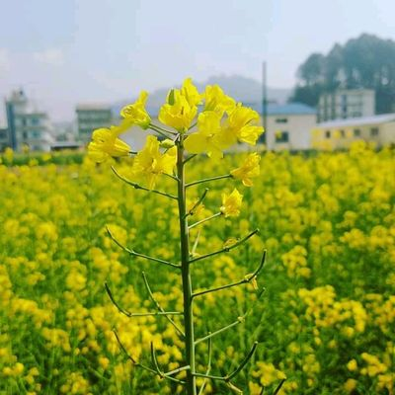
Mustard Plant

Slide 9
Mustard Seed & Leaven
Kingdom of heaven is the least of all seeds but grows bigger than than the herbs into a tree
Spiritual truth: A large heavenly kingdom will grow from something small
Who would think, after looking at a mustard seed, that a tree could come from it?
And who would think that a universal, eternal kingdom could come from a King who was despised, rejected, and put to death by his own

Slide 10
Mustard Seed & Leaven
Kingdom of heaven is like leaven hid in three measures of flour until it was all leavened.
Spiritual truth: A large heavenly kingdom will grow from something small
The leaven was hidden in the flour (the growth would be unexpected by some)
The unleavened flour is converted, and it rises

Slide 12
Hidden Treasure & Pearl of Value
Another double parable
Kingdom is like hidden treasure
A man finds treasure and buries it
He then sells all he has to buy the land where he buried it.
Spiritual truth: The kingdom of heaven is worth more than anything we have here on earth

Slide 13
Hidden Treasure & Pearl of Value
Kingdom is a merchant seeking pearls
He finds one pearl of great price
He then sells all he has to buy that pearl.
Spiritual truth: The kingdom of heaven is worth more than anything we have here on earth
Seizing the opportunity

Slide 14
New and Old Treasures
Scribes - learned people; teachers of the book
The disciples were being taught and instructed
They were to be like a householder who brings out his treasure
New and old - apostles show the continuity of the Old Testament and the gospel
Interpreting OT prophecies
Showing the relationship between the old and new
How the OT scriptures all point to Christ

Slide 15
Overview of Ch. 13 Parables
Sower
How the word will be received
Weeds/Tares & Net
There will be judgment at the end of the age
Leaven and Mustard Seed
Kingdom will grow from something small to large
Hidden Treasure/Pearl
The kingdom is more valuable
New and Old Treasures
Apostles must be skilled in the the new and old

Slide 16
The Gospel of Matthew
Homework: Chapter 14

