Slide 1
The Gospel of Matthew Bellaire Auditorium Summer 2021
Be thinking about the events in Chapter 26 →
Chapter 27 is a continuation

Slide 2
Key Events - Last 21 Hours of Jesus’ Life
The Suffering of Our Savior
Friday
Trial 1 – Annas
Trial 2 - Caiaphas
Trial 3 – Sanhedrin
Trial 4 – Pilate
Trial 5 – Herod
Trial 6 – Pilate
Beaten /Crucifixion
On the Cross
Death (~3 PM)
Burial
Jews
Thursday
The Last Supper (~6 PM)
Mt. of Olives
Garden of Gethsemane
Betrayal and Arrest
Mt 26
Romans
Mt 27
Everyone
Notes:
I want us to make sure we have the context firmly in our minds as we approach these final passages about Jesus’ death.

Slide 3
Reminder - The Question Asked of Jesus Matthew 24:1-3 - Answers (24,25)
“When will these things happen?”
“What will be the sign of your coming, and of the end of the age?”
“Your coming” & “the end” & destruction of the temple were on their minds, along with three years of teaching and living with Jesus.
Here in Chapter 26, did the Disciples have any idea that this was the beginning of the end, or did they believe that Jesus would “escape” again?
(hint – disciples' reaction in the Garden)
Notes:
Notice Ch 24:1 – Where is Jesus leaving from?
What does Ch 23:38 reveal? See – Your house is left to you desolate.
Thus, just as he declares the Pharisees have left the temple, Jesus returns to the temple no more.
A period of lasts.
Last question from the Pharisees – Ch 22:41-46 – No one was able to answer him. No more questions.
Last address to the multitudes – Ch 23:1
Last time in the temple – Ch 24:1
We see here in Chapter 25 that Jesus continues the themes and answers to their questions in Ch 24.
Just 3 days left in his ministry at this time.

Slide 4
Let’s re-read Matthew 26:57-68
How do the Jewish trials tie back to Chapters 21, 23?

Slide 5
The Last Supper
Thursday
~6:00-11:00 PM

Slide 6
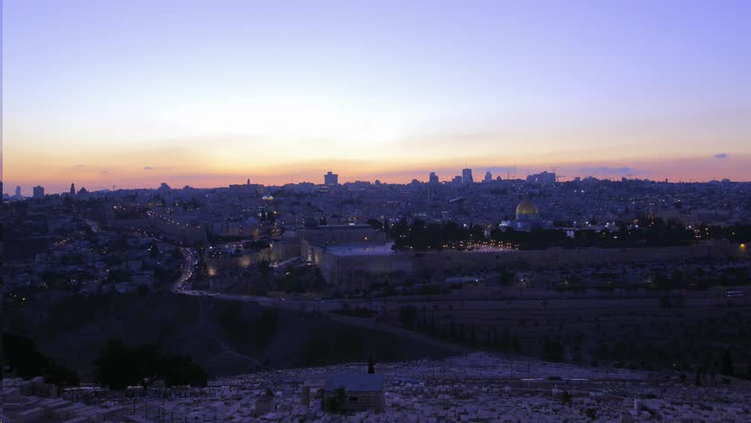
Mount of Olives
Thursday
~11:00 PM – 12:00 AM

Slide 7
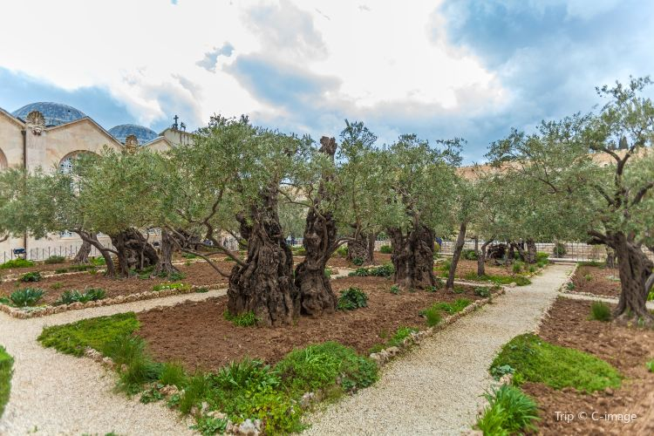
Garden of Gethsemane
Friday
~12-2:00 AM
Prayer
Forsaken by Disciples (Sleeping)
Betrayed by Friend
Arrested

Slide 8
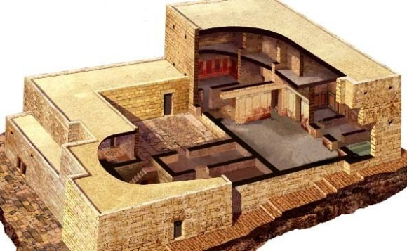
House of Annas (former High Priest)
Friday
~2-3:00 AM
Trial 1
Annas – father-in-law to Caiaphas
John 18 only

Slide 9
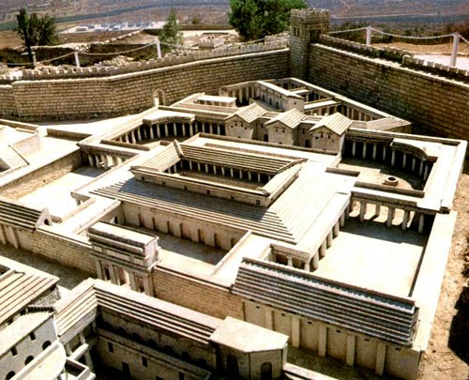
House of Caiaphas (current High Priest)
Friday
~3-5:00 AM
Trial 2
With Caiaphas, the Sanhedrin Court
Peter Denies Christ - 3x
Imprisonment
Caiaphas – expedient for 1 man to die for the people

Slide 10
House of Caiaphas (current High Priest)
Friday
~5-6:00 AM
Trial 3
Whole Sanhedrin,
Elders,
Chief Priests,
Scribes
Judas kills himself

Slide 11
The Trials - Matthew 26:57-68
What was the purpose of the Jewish trials?
Why Annas first?
Seeking justification for their actions?
Why had the Jews been seeking to kill Jesus? (26:3-4,16)
Why come to a head now, at the Passover?
Had they had to “deal” with a false Messiah before?
Themes – First look
Did the Jews love God or power? (Mt 21 – multitudes praise) Was it personal? (Mt 23 – woes)
Did Jesus know these Jewish leaders by name? Didn’t He teach in the synagogues?
How does murder and bearing false witness honor/”protect” God?
Jesus offered a defense only when asked about His spiritual claims...
Notes:
What do they represent?
Bridegroom – Christ’s return
Wise maidens – those disciples who have prepared / are ready
Foolish maidens – those disciples / the lost who are not ready
Messenger – signs, loud cry, great noise – 2 Pet 3:10-11
Doorkeeper – Open until Christ’s return – once Christ comes back, Judgement Day – too late to get ready

Slide 12
Let’s Read Matthew 27:1-65
How does the Jewish / Roman co-governing impact the outcome?

Slide 13
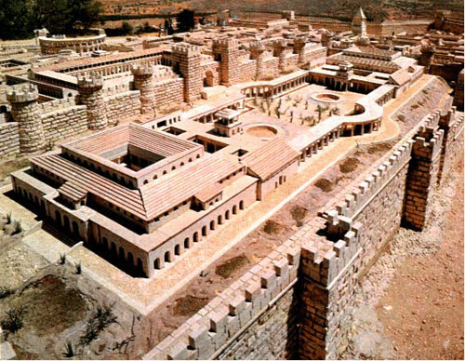
Praetorium - (Home of Pilate – part of Herod’s Palace)
Friday
~6-7:00 AM
Trial 4
Before Pilate the Roman Governor of Judea
1st time

Slide 14
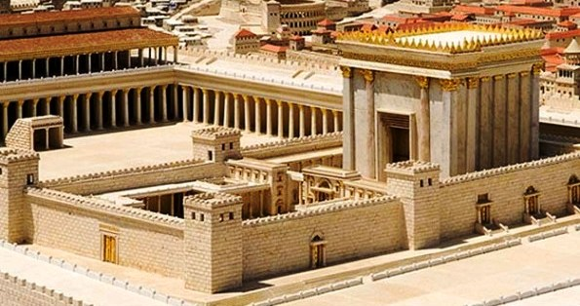
Herod Antipas (Roman Governor of Galilee)
Friday
~7-7:30 AM
Trial 5
Herod

Slide 15
Pilate’s House (Roman Governor of Judea)
Friday
~7:30-8:30 AM
Trial 6
Final Trial
Chief Priests,
Rulers
Jesus is Tortured

Slide 16
The Trials - Matthew 27:1-26
Judas?
Did Judas repent? If not, why? He didn’t keep the money…
What was the purpose of the Roman trials?
Why Pilate?
Why did Pilate send Jesus to Herod?
How were the relations between the Jews and Romans? How about amongst the Romans? (Lk 23:12)
What was Pilate concerned about? Mt. 27:11
Themes – Second look
Jesus vs. Jerusalem – No, Mankind
Authority
Man vs. God (Pilate vs. Jesus)
Governed vs. Governors (release a prisoner)
Justice or Compassion
Romans were very much “by the book” (e.g. Paul) – yet Mt 27:24
Can you “wash your hands” of evil? – Mt. 27:23, 24
Judas showed remorse – Mt 27:3-4
Who did Jesus say bore the guilt of this trial? Jn 19:10-11
Is compassion shown in this account?
Again - Jesus offered a defense only when asked about His spiritual claims...

Slide 17
The Gospel of Matthew
Homework: Re-read
Chapters 26 & 27
- The Conclusion

