Slide 1
Paul’s Second Letter to the Corinthians
Bellaire Auditorium
Wednesday Nights, Fall 2021

Slide 2
History of Paul & Corinth
Founds the church in Corinth (Acts 18)
Writes a letter to Corinth (1 Corinthians 5:9)
Receives a letter/bad report (1 Cor. 1:11; 7:1)
Writes 1 Corinthians from Ephesus
Makes a sorrowful visit (2 Corinthians 2:1)
Writes a sorrowful letter (2 Cor. 7:8)
Leaves Ephesus for Macedonia (Acts 20:1)
Good news from Titus (2 Cor. 2:13; 7:6-7)
Writes 2 Corinthians from Macedonia

Slide 3
Inductive Bible Study
Observation → Interpretation → Application
Encourages exploration & self-discovery
Use the booklet prepared for you:
Mark up the text on the left
Answer open-ended ?s on the right
Class will be about sharing findings and “guiding” us toward proper understanding

Slide 4
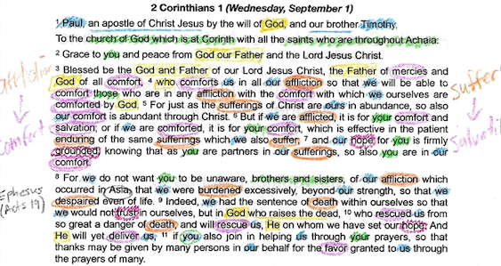
Example: 2 Corinthians 1:1-11
Observations?
Questions?
Summary?
Connections?
About God?
Response?

Slide 5
Practice: 2 Corinthians 1:12-24
Work with someone to explore the text
Talk, point things out, ask questions, etc.
Use your pen/pencil to mark in your booklet
When you think you are done, keep going
Let’s read the passage, then begin.

Slide 6
Practice: 2 Corinthians 1:12-24
Initial Observations?
Confusions? Questions?
Summary?
Connections?
What about God?
Our response?

Slide 7
Paul’s Second Letter to the Corinthians
Homework for Sunday:
2 Corinthians 2-3 (pages 4-5)

