Slide 1
extra charts

Slide 2

something I’ve needed
& would recommend: the improvement game

Slide 3
ROLES
Josh. 24.15
Eph.5.25
1Ptr. 3; 1Tm.5.14
Eph.6

Slide 4
3 messages for
sons & daughters:
a.) learn to love
b.) roads go places
c.) lessons from Luke 15

Slide 5
a.) learn to love
Eph. 5.25 & Titus 2.45

Slide 6
c.) lessons from Luke 15

Slide 7
Roads lead to places
(Prov. 4; Mt.7.12-14)
Roads lead to places
&
Two foolish sons

Slide 8
EXTRA SLIDES & FAQ

Slide 9
What about
ADHD?

Slide 10
What about
ADHD?

Slide 11
Never spank
your child.
Your son is a problem in class
Don’t be controlling. Let him be himself.
Your son has a behavioral disorder.
Straight correlation? No, not that simple…
Build up his
self esteem.
Here’s a drug
to control the problem.

Slide 12
parenting
& meds

Slide 13
two premises:
Biblical premise
we have physical needs
we have moral, spiritual, & social duties
we are
physical
we are
spiritual
We are created by God.
We are to turn from sin.
We will face judgment.

Slide 14
evolutionary premise
biblical premise
some
adapt
easily to social
constructs
some do not adapt easily to
to social
constructs
we are unplanned accumulations of chemicals
ideas of
God, sin, and judgment are irrelevant myths

Slide 15
GOOD PHYSICIANS
a noble profession…
Mark 2.17 “It is not the healthy who need a doctor, but the sick”
Col. 4.14 “Luke, the beloved physician”
LTD. PHYSICIANS
Mark 5.26 “who had suffered much under many physicians, and had spent all that she had, and was no better but rather grew worse.”

Slide 16
ADHD
familial
component
training
component
gender
component

Slide 17
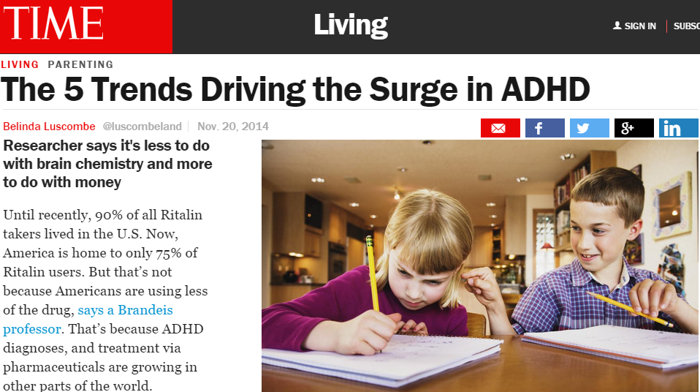
NOV. 2014 http://time.com/3595712/the-5-trends-driving-the-surge-in-adhd/
Until recently, 90% of all Ritalin takers lived in the U.S. Now, America is home to only 75% of Ritalin users.

Slide 18

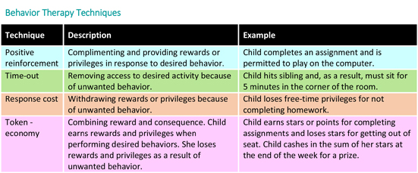
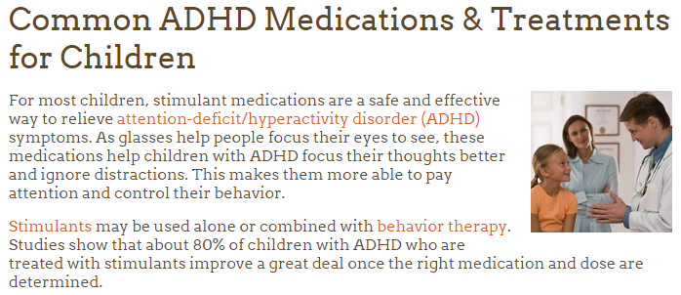
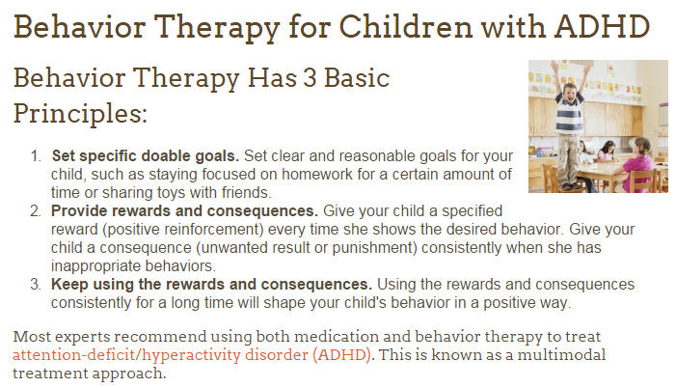
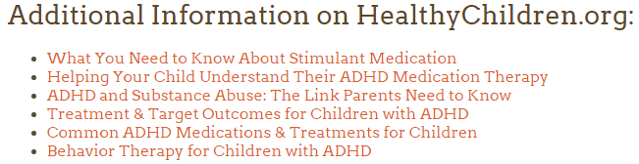
WHY not
use such
therapy for childhood diseases
?
Under this approach, parents, teachers, and other caregivers learn better ways to work with and relate to the child with ADHD. You will learn how to set and enforce rules, help your child understand what he needs to do, use discipline effectively, and encourage good behavior. Your child will learn better ways to control his behavior as a result. You will learn how to be more consistent

Slide 19
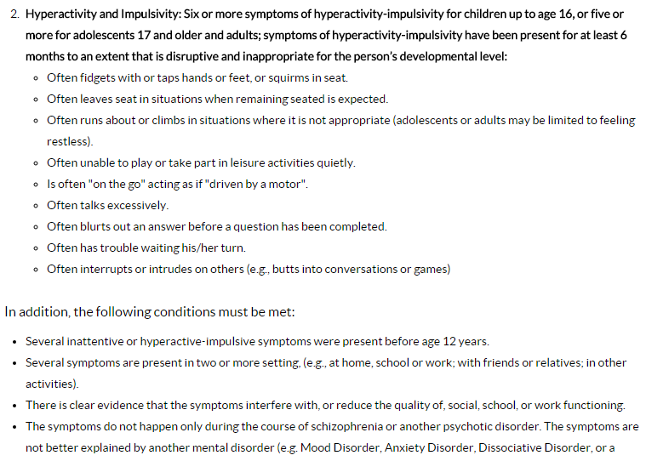
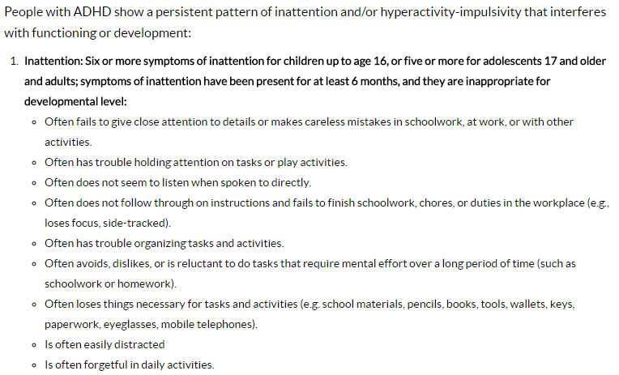
http://www.cdc.gov/ncbddd/adhd/diagnosis.html

Slide 20
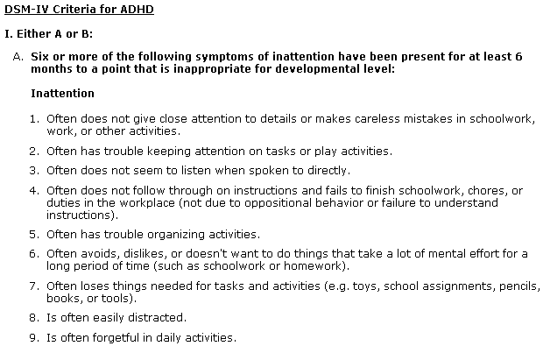
www.cdc.gov
1. Often does not give close attention to details or makes careless mistakes in schoolwork, work, or other activities.
2. Often has trouble keeping attention on tasks or play activities.
3. Often does not seem to listen when spoken to directly.
4. Often does not follow through on instructions and fails to finish schoolwork, chores, or duties in the workplace (not due to oppositional behavior or failure to understand instructions).
5. Often has trouble organizing activities.
6. Often avoids, dislikes, or doesn't want to do things that take a lot of mental effort for a long period of time (such as schoolwork or homework).
7. Often loses things needed for tasks and activities (e.g. toys, school assignments, pencils, books, or tools).
8. Is often easily
distracted
9. Is often forgetful
in daily activities.

Slide 21
Research shows no long term benefit from ADHD medication – abc.net (australian TV) abc.net.au/worldtoday/content/2007/s2089497.htm
Professor William Pelham from the State University of New York at Buffalo has been involved in a national study on ADHD treatment since the 1990s.
WILLIAM PELHAM: We published a report in 1999 that appeared to suggest that medication was the best way to treat children with ADHD. Other treatments were also good, that is a psychosocial approach, training parents and children and teachers how to work together, but medication appeared to be a bit better and we published that.
And then a year later did follow up, and two years later did another follow up, and that was just reported. And each time we did follow up, the effects of medication were less and less. And this last follow up, we can no longer detect any beneficial effects of medication.
The explosion in ADHD diagnosis and treatment with stimulants such as Ritalin (Methylphenidate) represents the greatest medical catastrophe since Thalidomide -B.Turner Lecturer in Legal Studies in Forensic Science in the Department of Biological Sciences, University of Lincoln, UK, counselingonlinesite.com/blog/archives/2009_03_01
PBS.COM > search: BRAIN POLITICS

Slide 22

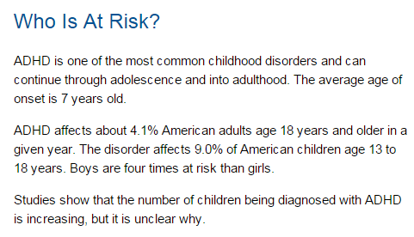

Slide 23
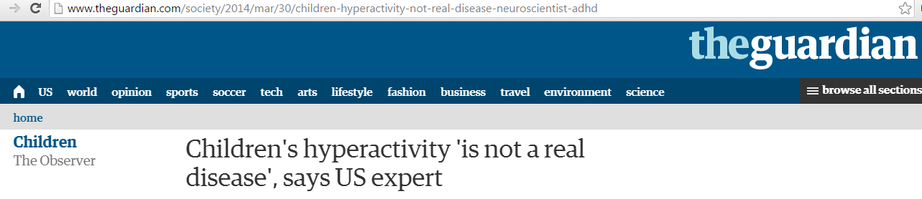
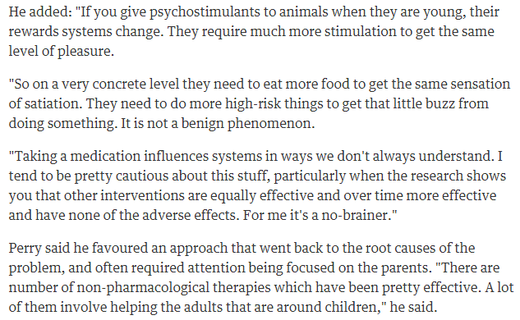
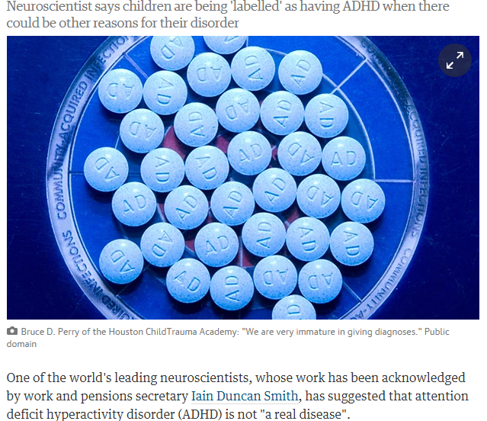
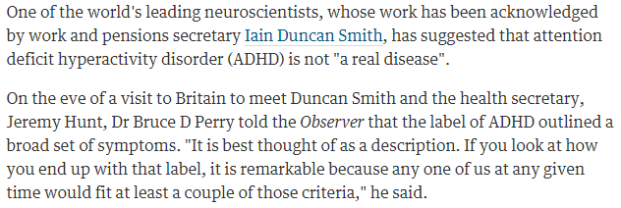

Slide 24
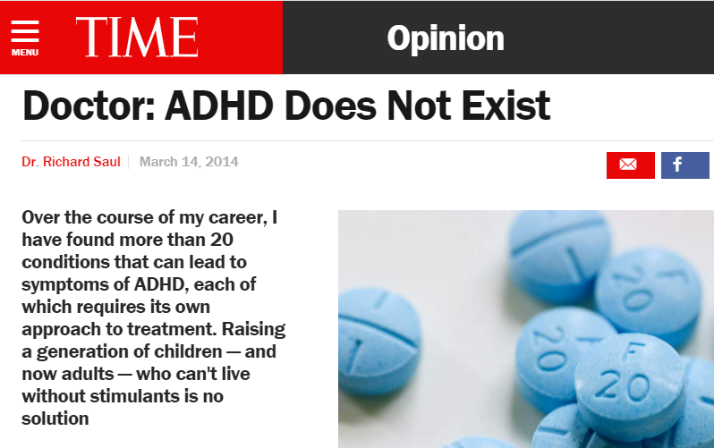
http://time.com/25370/doctor-adhd-does-not-exist/
Over my 50-year career in behavioral neurology and treating patients with ADHD, it has been in the past decade that I have seen these diagnoses truly skyrocket.
First, addiction to stimulant medication is not rare; it is common. The drugs’ addictive qualities are obvious. We only need to observe the many patients who are forced to periodically increase their dosage if they want to concentrate. This is because the body stops producing the appropriate levels of neurotransmitters that ADHD meds replace — a trademark of addictive substances. I worry that a generation of Americans won’t be able to concentrate without this medication; Big Pharma is understandably not as concerned.
Today, the fifth edition of the DSM only requires one to exhibit five of 18 possible symptoms to qualify for an ADHD diagnosis. If you haven’t seen the list, look it up. It will probably bother you. How many of us can claim that we have difficulty with organization or a tendency to lose things; that we are frequently forgetful or distracted or fail to pay close attention to details? Under these subjective criteria, the entire U.S. population could potentially qualify. We’ve all had these moments, and in moderate amounts they’re a normal part of the human condition.
In short, I’ve come to believe based on decades of treating patients that ADHD — as currently defined by the Diagnostic and Statistical Manual of Mental Disorders (DSM) and as understood in the public imagination — does not exist.
Dr. Richard Saul is a behavioral neurologist practicing in the Chicago area. His book, ADHD Does Not Exist, is published by HarperCollins.

Slide 25
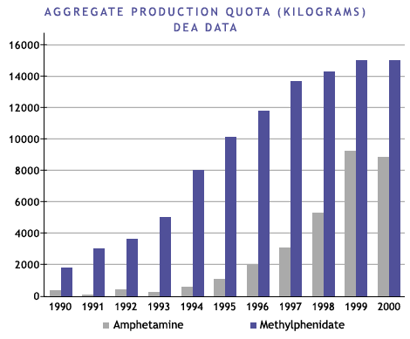
http://www.pbs.org/wgbh/pages/frontline/shows/medicating/drugs/stats.html
The production of methylphenidate (Ritalin) and the legal production of amphetamine in the form of Adderall and Dexedrine in the U.S. has soared since 1990… these drugs are considered to be potential drugs of abuse under the Controlled Substances Act
Source: www.dea.gov/pubs/cngrtest/ct051600.htm

Slide 26
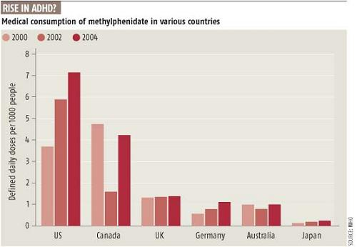
http://scienceblogs.com/retrospectacle/2007/07/27/the-neuroscience-of-adhd-1/

Slide 27

It is tempting to view this pattern as suggesting that the ADHD diagnosis provides teachers with a new technique for regaining control of the classroom in a world where many of the traditional methods of control have been eliminated. Drugs have replaced the reprimand.
… Nor is there any mechanism, of the sort one would find in a school-choice-based system of education, for parents to seek out schools tailored to the temperaments and capabilities of their children… when it is difficult or inconvenient to change the environment, we don't think twice about changing the brain of the person who has to live in it…
None of this should be taken to suggest that there are no cases of genuine brain damage or dysfunction that require medical intervention… But difference does not automatically equal disease. Is changing the child's brain chemistry, by prescribing Ritalin-like drugs, really the most appropriate response to the child who doesn't perform well in the modern school environment?
Imagine yourself sitting in a classroom--say, a fourth-grade social-studies class. There is a teacher at the front of the room, but a groundskeeper mowing grass outside captures your attention instead. When the mower moves away, however, you feel bored and restless. Pretty soon your swinging feet slam into the seat in front of you. The attentive student sitting there yelps and the teacher interrupts the class to ask what the problem is. This sudden activity jolts you back into focus; at least something interesting is happening. You're beyond feeling embarrassed about being the center of this kind of attention. It happens all the time, and you have quite a reputation for this sort of thing. And besides, it isn't really your fault. They all say you probably have ADD or ADHD or something like that and can't help but act this way. It's just the way life is for some kids.
There is something odd, if not downright ironic, about the picture of millions of American school children filing out of "drug-awareness" classes to line up in the school nurse's office for their midday dose of amphetamine.

Slide 28

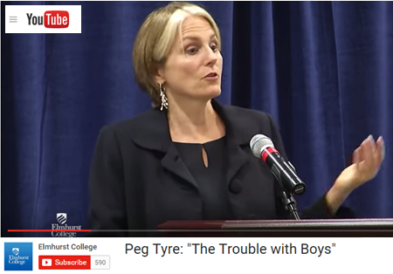
The Trouble with boys, Peg Tyre
2nd graders : hares & tortoises
boys: “reading is kinda girly”
gender & movement
G&B
recess & sitting still
att.: “girls are the gold std. & boys are the defective girls”
teachers: females dominant
maturity rate difference
G
B
< most /\ most >
sedentary avg. active
Developmental Psychology Warren O. Eaton
http://home.cc.umanitoba.ca/~eaton/child-development-motor-activity-level.htm

Slide 29
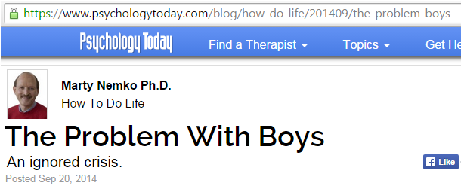
four to eight times as likely to be drugged with Ritalin and other stimulants, which pediatrician Leonard Sax, calls “academic steroids.”
reading much more poorly than are other students.
three times as likely to commit suicide.
2 1/2 times as likely to drop out of high school.
severely underrepresented in college and even more so among college graduates, thereby locking them out of today’s, let alone tomorrow’s professional-level jobs.

Slide 30
And our schools continue to get ever more feminized. Competition, one of boys’ favorite motivators, has largely been excised in favor of “cooperative learning,” (which ends up often meaning hat the bright and dedicated do the dull's and lazy's work.) Stories of heroism and bravery are replaced with tomes about relationships and sheroes. Recess, which active boys desperate seek to release pent up energy is increasingly replaced by yet another round of phonics. Girls are told they can accomplish anything while boys are taught that masculinity is an anti-social trait that must be extinguished.
The percentage of female K-12 teachers has risen to an all-time high: 76.3 percent (link is external). In elementary school, it’s well over 90 percent. The main role model boys see in school is the custodian.
And when boys get home from school, the male role models get worse. Whether watching a sitcom, movie, cartoon, or commercial, the odds are good that the male is a buffoon or sleazebag while the female is savvy and confident.

Slide 31
DOES NOT MEAN:
Let boys get away with bad behavior
Boys can’t sit still
Boys shouldn’t be disciplined
But:
Girls are girls, and boys are boys
Both need parenting, raising, & training
Pr.22.6
Little boys will not stay little boys. Let’s help them grow to be godly young men.
Little girls will not stay little girls. Let’s help them grow to be godly young women.

Slide 32
CHI LD
TRAINING
Therefore a man shall leave his father and his mother and hold fast to his wife, and they shall become one flesh. Gen. 2.24 esv
You shall love the LORD your God with all your heart and with all your soul and with all your might. And these words that I command you today shall be on your heart. You shall teach them diligently to your children, and shall talk of them when you sit in your house, and when you walk by the way, and when you lie down, and when you rise. Deut. 6.5-6 esv
The rod and reproof give wisdom, But a child who gets his own way brings shame to his mother. Prov. 29.15 nasb
Correct your son, and he will give you comfort; he will also delight your soul. Prov. 29.17 nasb
Train up a child in the way he should go, Even when he is old, he will not depart from it. Prov. 22.6 esv
Older women… teach what is good …train the young women to love their husbands and children… working at ome…submissive to their own husbands Titus 2.4-5 esv
Fathers, do not provoke your children to anger, but bring them up in the discipline and instruction of the Lord. Eph.6.4 esv

Slide 33
LOVE
Eph.5.25;
Titus 2.4

Slide 34
PARENTS
Proverbs 22.6
“Train up a child in the way he should go,
Even when he is old, he will not depart from it”

Slide 35
The Homes We Need
Built with the Lord
Ps. 127:1
Built on the word
Mt. 7:24-27
Built in sanctification
Josh. 24:15; Dt. 6:4-9; Jas. 4:4

Slide 36
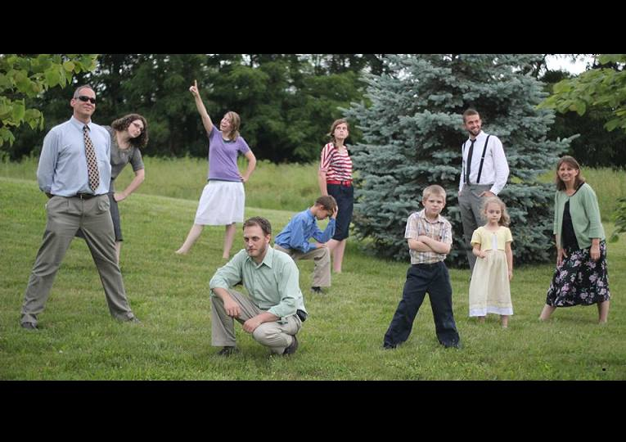

Slide 37

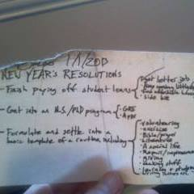

Slide 38
Biblical examples of parenting
(good and bad)
(-) choice of environ. Lot Gen.13:12-13
(-) deceit & favoritism R & I / J. G.25 & 37
(-) not restraining Eli 1S.2:22-23/ 3.13
(-) didn’t “displease” him David 2Sam.13/ 1K.1.6
(+) lasting influence Jonadab Jer. 35:1-19
(+) raised in the Word L > E > T 2Tim.1:5; 3:15

Slide 39
ROLES
Josh. 24.15
Eph.5.25
1Ptr. 3; 1Tm.5.14
Eph.6:1-4

