Slide 1
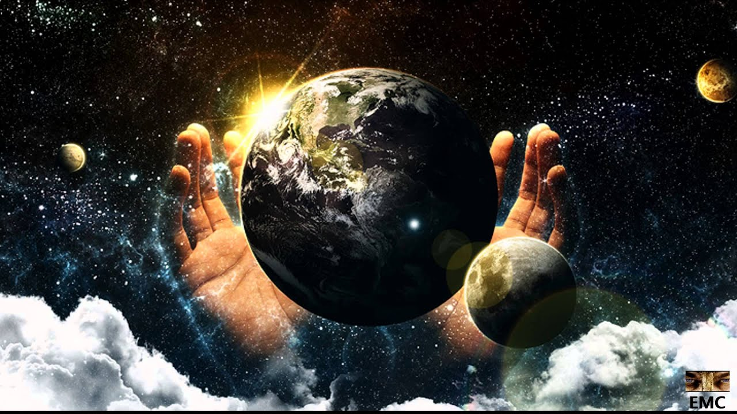
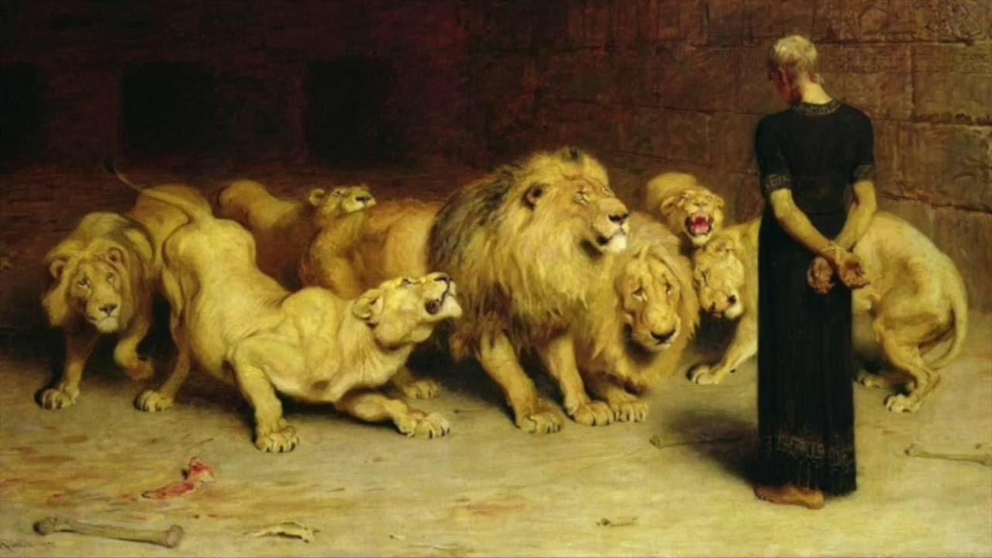
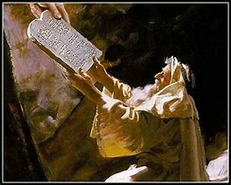
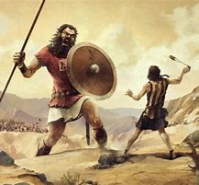
Old Testament Survey
Lesson 5 – The Law
“….our tutor to bring us to Christ” (Gal 3:24)

Slide 2
Structure of the Old Testament
Section | Key Topics
Genesis - Deuteronomy | Creation through the exodus Books of the law
Joshua - Ruth | Conquest of Canaan through the time of the judges
1 Samuel – 2 Chronicles | The time of the kings, the divided kingdom, and the captivity
Ezra - Esther | The return to Judah
Psalms – Song of Solomon | Books of poetry and wisdom
Isaiah - Daniel | Major prophets
Hosea - Malachi | Minor prophets

Slide 3
Summary of OT Bible Chronology (In Round Numbers)
Event | Approximate Date
Creation | ~4,200 BC
Noah / The Flood | ~2,600 BC
Joseph / Israel to Egypt | ~2,000 BC
Moses / Exodus from Egypt
Solomon / 4th year of his reign | 970 BC
The Babylonian captivity | ~606 BC
Return to Judah | ~436 BC
Birth of Christ | ~3 BC
~1,500 BC

Slide 4
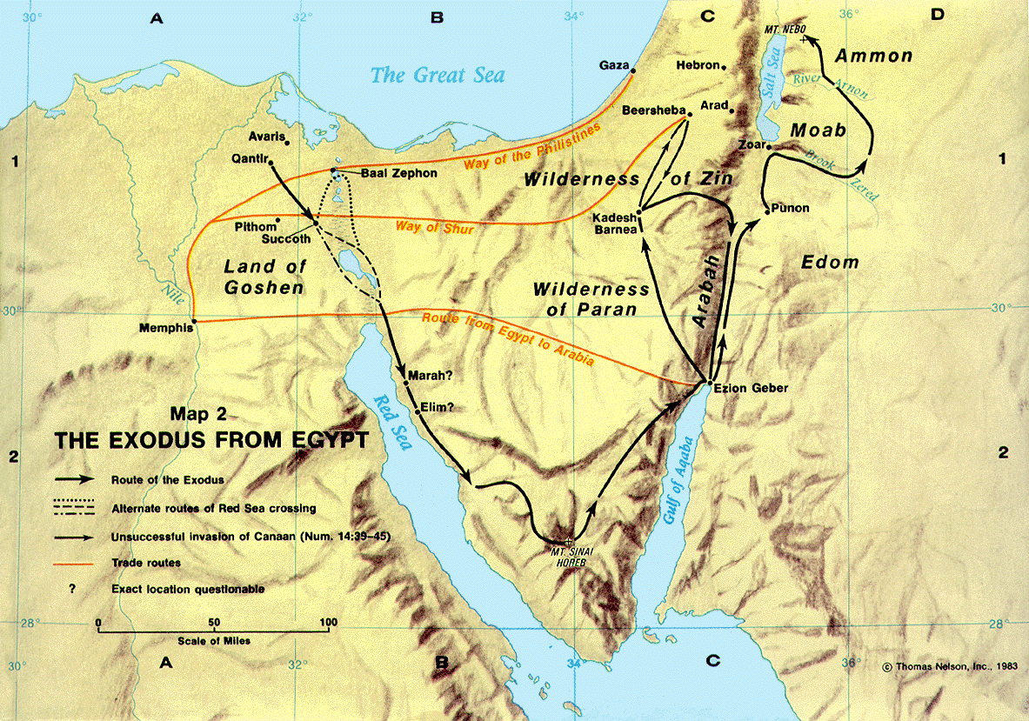
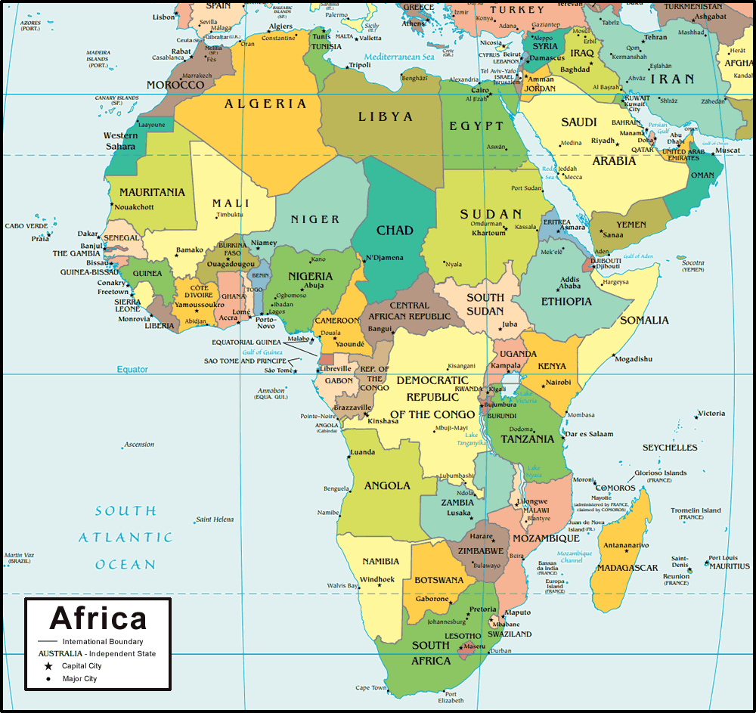
Map of the Exodus
Deuteronomy
Exodus
Numbers
Leviticus

Slide 5
Outline of the Exodus
Exodus (“going out”)
From Egypt to Mt Sinai
Leviticus (“relating to the Levites”)
Occurs at Mt Sinai
Numbers (“numbering”, or “census”)
From Mt Sinai to the edge of Canaan over ~40 years
Deuteronomy (“second law”)
Occurs on the east edge of Canaan

Slide 6
Key Personalities
Moses
The Israelites
The Lord

Slide 7
Focus Events
Rebellion of Korah (Num 16)
“You [Korah] take too much upon yourself”
"By this you shall know that the Lord has sent me to do all these works, for I have not done them of my own will. “
Moses strikes the rock (Num 20)
"Because you did not believe Me, to hallow Me in the eyes of the children of Israel, therefore you shall not bring this assembly into the land which I have given them."
The greatest commandment (Deut 6) / Circumcise your hearts (Deut 10)
"Hear, O Israel: The Lord our God, the Lord is one! You shall love the Lord your God with all your heart, with all your soul, and with all your strength.
“Therefore circumcise the foreskin of your heart, and be stiff-necked no longer.”

Slide 8
Leading us to Christ
Brass serpent
John 3:14-15. And as Moses lifted up the serpent in the wilderness, even so must the Son of Man be lifted up, 15 that whoever believes in Him should not perish but have eternal life.
Moses led God’s people away from slavery in Egypt, Jesus leads God’s people away from slavery to sin

Slide 9
The Law

Slide 10
Summary of The OT Law
Divinely given through Moses from Exodus through Deuteronomy
Across 40 years, from Mt Sinai to the eastern border of Canaan
Called “the torah”
"to teach” or “to instruct"
A total of ~613 statues
Addressed the spiritual, civil, social, health, and family aspects of the Israelite life
Purpose:
Deut 6:24-25. And the Lord commanded us to observe all these statutes, to fear the Lord our God, for our good always, that He might preserve us alive, as it is this day. Then it will be righteousness for us, if we are careful to observe all these commandments before the Lord our God, as He has commanded us.'

Slide 11
Key Teachings (1)
Deut 4:5-6
5 "Surely I have taught you statutes and judgments, just as the Lord my God commanded me, that you should act according to them in the land which you go to possess. 6 Therefore be careful to observe them; for this is your wisdom and your understanding in the sight of the peoples who will hear all these statutes, and say, 'Surely this great nation is a wise and understanding people.’
Deut 6:6-9
"And these words which I command you today shall be in your heart. You shall teach them diligently to your children, and shall talk of them when you sit in your house, when you walk by the way, when you lie down, and when you rise up. You shall bind them as a sign on your hand, and they shall be as frontlets between your eyes. You shall write them on the doorposts of your house and on your gates.

Slide 12
Key Teachings (2)
Deut 12:32
"Whatever I command you, be careful to observe it; you shall not add to it nor take away from it.
Deut 18:15
"The Lord your God will raise up for you a Prophet like me from your midst, from your brethren. Him you shall hear”

Slide 13
34 Categories (1)
Spiritual laws
God
The Law
Signs & Symbols
Prayer & Blessing
Prophecy
High Priests, Priests, Levites
The Temple, the Sanctuary, Sacred Objects
Sacrifices & Offerings
Spiritual laws (cont.)
Ritual Purity & Impurity
Nazarites
Vows, Oaths, Swearing
Idolatry, Idolaters, Idolatrous Practices
Sabbatical & Jubilee Years
The Firstborn
Tithes, Taxes, Offerings
Times & Seasons

Slide 14
34 Categories (2)
Civil laws
Judicial Proceedings
Injuries & Damages
Property & Property Rights
Criminal Laws
Punishment & Restitution
The King
Wars
Social laws
Love & Brotherhood
The Poor
Treatment of Gentiles
Business Practices
Employee, Servants, Slaves
Clothing

Slide 15
34 Categories (3)
Health laws
Agriculture & Animal Husbandry
Lepers & Leprosy
Dietary Laws
Family laws
Marriage, Divorce, Family
Forbidden Sexual Relations

Slide 16
OT Law Jeopardy
Select categories for questions regarding the 34 topics

Slide 17
Categories
1. God | 13. Employees, Servants | 24. Clothing
2. The Law | 14. Vows, Oaths, Swearing | 25. The Firstborn
3. Signs, Symbols | 15. Sabbatical, Jubilee Years | 26. Priests, Levites
4. Prayer, Blessing | 16. Court, Judicial Proceedings | 27. Tithes, Taxes, Offerings
5. Love, Brotherhood | 17. Injuries, Damages | 28. The Temple
6 The Poor | 18. Property, Property Rights | 29. Sacrifices, Offerings
7. Treatment of Gentiles | 19. Criminal Laws | 30. Ritual Purity & Impurity
8. Marriage, Divorce | 20. Punishment & Restitution | 31. Lepers, Leprosy
9. Sexual Relations | 21. Prophecy | 32. The King
10. Times, Seasons | 22. Idolatry, Idolaters | 33. Nazarites
11. Dietary Laws | 23. Agriculture, Husbandry | 34. Wars
12. Business Practices

Slide 18
NT Teachings (1)
Matt 22:35-40.
35 Then one of them, a lawyer, asked Him a question, testing Him, and saying, 36 "Teacher, which is the great commandment in the law?" 37 Jesus said to him, "'You shall love the Lord your God with all your heart, with all your soul, and with all your mind.' 38 This is the first and great commandment. 39 And the second is like it: 'You shall love your neighbor as yourself.' 40 On these two commandments hang all the Law and the Prophets."
Luke 24:44
44 Then He said to them, "These are the words which I spoke to you while I was still with you, that all things must be fulfilled which were written in the Law of Moses and the Prophets and the Psalms concerning Me."
Rom 8:3-4
3 For what the law could not do in that it was weak through the flesh, God did by sending His own Son in the likeness of sinful flesh, on account of sin: He condemned sin in the flesh, 4 that the righteous requirement of the law might be fulfilled in us who do not walk according to the flesh but according to the Spirit

Slide 19
NT Teachings (2)
Gal 3:23-25
23 But before faith came, we were kept under guard by the law, kept for the faith which would afterward be revealed. 24 Therefore the law was our tutor to bring us to Christ, that we might be justified by faith. 25 But after faith has come, we are no longer under a tutor.
Heb 10:1
For the law, having a shadow of the good things to come, and not the very image of the things, can never with these same sacrifices, which they offer continually year by year, make those who approach perfect.
Col 2:13-14
13 And you, being dead in your trespasses and the uncircumcision of your flesh, He has made alive together with Him, having forgiven you all trespasses, 14 having wiped out the handwriting of requirements that was against us, which was contrary to us. And He has taken it out of the way, having nailed it to the cross.

Slide 20
Leading Us to Christ
The Passover
1 Cor 5:7. For indeed Christ, our Passover, was sacrificed for us.
The scapegoat
Lev 16:21-22. 21 Aaron shall lay both his hands on the head of the live goat, confess over it all the iniquities of the children of Israel, and all their transgressions, concerning all their sins, putting them on the head of the goat, and shall send it away into the wilderness by the hand of a suitable man. 22 The goat shall bear on itself all their iniquities to an uninhabited land; and he shall release the goat in the wilderness.
The coming Prophet
Deut 18:15. "The Lord your God will raise up for you a Prophet like me from your midst, from your brethren. Him you shall hear”

Slide 21
Date | Lesson Topic | Class Leader
Dec 1 | Why study the OT? Theme of the OT. OT Summary. | Rick
Dec 5 | Genesis (part 1) | Jordan
Dec 8 | Genesis (part 2) | Jordan
Dec 12 | The Exodus (Egypt to Canaan) | Rick
Dec 15 | The Law | Rick
Dec 19 | Joshua and Judges | Jordan
Dec 22 | Joshua and Judges (part 2) | Jordan
Dec 26 | The United Kingdom: Saul, David, and Solomon | Rick
Jan 2 | The Divided Kingdom: Israel | Jordan
Jan 5 | The Divided Kingdom: Judah | Rick
Jan 9 | Books of Poetry and Wisdom | Jordan
Jan 12 | Major Prophets: Isaiah, Jeremiah, Lamentations, Ezekiel, Daniel | Rick
Jan 16 | Brief OT summary, between the testaments | Jordan

Slide 22
Thanks

Slide 23
Backup Material

Slide 24
Key Personalities and Events
Personalities
Moses
The Israelites
The Lord
Events
Rebellion of Korah
Moses strikes the rock instead of speaking to it
The greatest commandment

Slide 25
Leading us to Christ
Brass serpent
“A prophet like unto me”
Moses led from Egypt, Jesus leads from sin

Slide 26
Leading us to Christ
Brass serpent
John 3:14-15. And as Moses lifted up the serpent in the wilderness, even so must the Son of Man be lifted up, 15 that whoever believes in Him should not perish but have eternal life.
A prophet like unto me
Deut 18:15-20. "The Lord your God will raise up for you a Prophet like me from your midst, from your brethren. Him you shall hear….I will raise up for them a Prophet like you from among their brethren, and will put My words in His mouth, and He shall speak to them all that I command Him. And it shall be that whoever will not hear My words, which He speaks in My name, I will require it of him.
Moses led from Egypt, Jesus leads from sin

