Slide 1
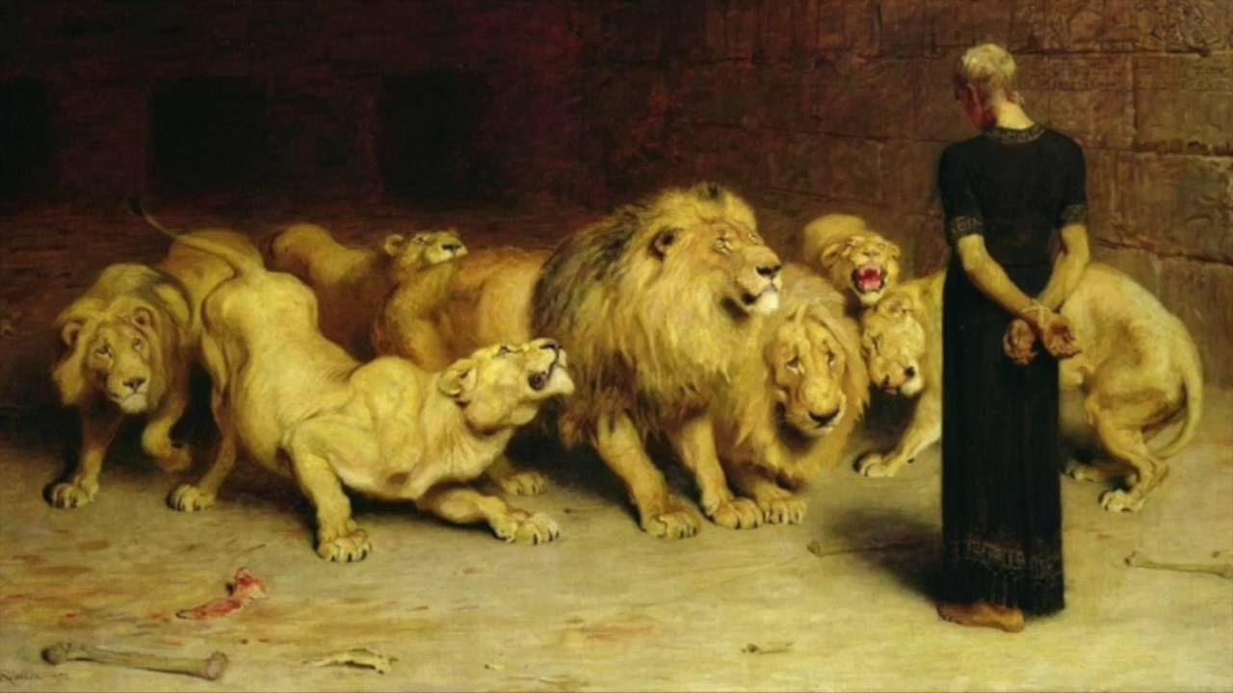
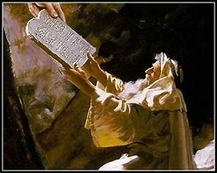
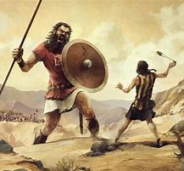
Old Testament Survey
Lesson 9: The Divided Kingdom – Judah
“….our tutor to bring us to Christ” (Gal 3:24)

Slide 2
Structure of the Old Testament
Section | Key Topics
Genesis - Deuteronomy | Creation through the exodus Books of the law
Joshua - Ruth | Conquest of Canaan through the time of the judges
1 Samuel – 2 Chronicles | The time of the kings, the divided kingdom, and the captivity
Ezra - Esther | The return to Judah
Psalms – Song of Solomon | Books of poetry and wisdom
Isaiah - Daniel | Major prophets
Hosea - Malachi | Minor prophets

Slide 3
Summary of OT Bible Chronology (In Round Numbers)
Event | Approximate Date
Creation | ~4,200 BC
Noah / The Flood | ~2,600 BC
Joseph / Israel to Egypt | ~2,000 BC
Moses / Exodus from Egypt | ~1,500 BC
Reign of Solomon | ~970 BC
The Divided Kingdom (Rehoboam / Jeroboam) | ~930 BC
The Assyrian captivity of Israel | ~740 BC
The Babylonian captivity of Judah | ~606 BC / ~587 BC
Return to Judah | ~536 BC
Birth of Christ | ~3 BC

Slide 4
The Coming King – Per Moses
The people will ask for a king
“like all the nations around me”
“the Lord your God chooses” the king
He shall be a brother, not a foreigner
He shall not:
Multiply horses, wives, or silver and gold
Return to Egypt
He shall have a copy of the law
Read it, fear the Lord, and observe all the law, so that:
His heart is not lifted above his brethren
He does not turn aside from the commandments
He prolongs the days of his kingdom

Slide 5
The Coming King – Per Samuel
The people demand:
“make use a king to judge us like all the nations”
God said:
“they have rejected Me, that I should reign over them”
Samuel says the king will:
Take your sons
As servants, for an army, as farmers, for making weapons
Take your daughters
For perfumers, cooks, bakers
Take the best of your fields
Take a tenth of your produce and your sheep
Take your servants, young men, and donkeys for his work
Make you his servants, and you will cry out
The Lord will not hear you
The people reply:
“We will have a king, that we may be like all the nations”

Slide 6
Results After the First 3 Kings United Kingdom
Saul, David, and Solomon
Only 1 of 3 fully served the Lord
1 Sam 17:25
“[If someone will kill Goliath, the king will] give his father's house exemption from taxes in Israel
1 Kings 12:3-4
Jeroboam and the whole assembly of Israel: "Your father made our yoke heavy"
1 Kings 7
Solomon built his house, the House of the Forest of Lebanon, the Hall of Pillars, a hall for the throne, the Hall of Judgement, a house for Pharaoh’s daughter…..
Told you so…..

Slide 7
Review of the Northern Kingdom
List of faithful kings during the Northern Kingdom of Israel
Crickets…..

Slide 8
Outline of the Divided Kingdom - Judah
1 Kings 12-22
Rehoboam through Jehoshaphat
And….
2 Kings 1-25
Jehoshaphat through the Babylonian captivity
Covers the kings of Judah and Israel
2 Chronicles 10-36
Rehoboam through the Babylonian captivity
Focuses on the kings of Judah
The Divided Kingdom covers the period from ~931 BC to 587 BC (~344 years)

Slide 9
DON’T PANIC!

Slide 10
Kings of Judah (Divided Kingdom) (1)
Name | ~Start (BC) | Age | Reigns | Faithful? | Key Comments
Rehoboam | 931 | 49 | 17 | No | Forsook the law
Abijam | 915 | -- | 3 | No | Heart not loyal to the Lord his God
Asa | 913 | -- | 41 | Yes | Did what was good and right
Jehoshaphat | 873 | 35 | 25 | Yes | Sought the God of his father
Jehoram | 849 | 32 | 8 | No | Killed all his brothers, did evil
Ahaziah | 842 | 42 | 1 | No | Did evil, followed Ahab’s counsellors
Athaliah | 841 | -- | 6 | No | Queen mother, killed heirs, wicked
Joash | 835 | 7 | 42 | Yes / No | Did what was right with Jehoiada Forsook the Lord after Jehoiada
Amaziah | 796 | 25 | 29 | Yes(ish) | Did what was right, not a loyal heart
Uzziah | 791 | 16 | 52 | Yes | Did what was right

Slide 11
Kings of Judah (Divided Kingdom) (2)
Name | ~Start (BC) | Age | Reigns | Faithful? | Key Comments
Jotham | 750 | 25 | 16 | Yes | Did what was right
Ahaz | 735 | 20 | 16 | No | Did not do what was right
Hezekiah | 716 | 25 | 29 | Yes | Did what was right
Manasseh | 696 | 12 | 55 | No / Yes | Did evil in the sight of the Lord Humbled himself greatly before God
Amon | 642 | 22 | 2 | No | Did evil, trespassed more and more
Josiah | 640 | 8 | 31 | Yes | Walked in the ways of David Tipping point announced Captivity will take place

Slide 12
Kings of Judah (Divided Kingdom) (3)
Name | ~Start (BC) | Age | Reigns | Faithful? | Key Comments
Jehoahaz | 609 | 23 | 3 mos | No | Did evil in the sight of the Lord Deposed to Egypt by Pharoah Necho
Jehoiakim | 609 | 25 | 11 | No | Did evil in the sight of the Lord Babylonian conquest in 605 BC
Jehoiachin | 598 | 8 | 3 mos | No | Did evil in the sight of the Lord
Zedekiah | 597 | 21 | 11 | No | Did evil in the sight of God Did not humble himself before Jeremiah Jerusalem destroyed 587 BC

Slide 13
Summary
Total of 20 rulers over Judah in the divided kingdom
Includes the 6-year reign of Athaliah, queen mother
Obeyed God - 7
Did not obey God - 11
Obeyed, then disobeyed - 1 (Joash)
Disobeyed, then obeyed - 1 (Manasseh)
First king of Judah – Rehoboam (931 BC)
Fell away after 3 years
Captivity tipping point – Amon (642 BC)
Served idols, sacrificed to all carved images, forsook God
Announced to his son Josiah
Amon’s son Josiah was the last faithful and obedient king of Judah (640 BC)
Spared because he humbled himself and served God
Final king of Judah – Zedekiah (597 – 587 BC)
Jerusalem destroyed by the Babylonians
God continually tried to warn His people. 2 Chron 36:15-17

Slide 14
Pop Quiz Match the statement to the ruler
Could have used some Imodium AD
Followed Gen X counsel
Life extended 15 years
We’re not following the directions!
Jeremiah wasn’t on his playlist
Humbled himself greatly before God
Digressed after Jehoiada left
Incense got him into trouble
Necho curtailed his rule
Women’s rights leader
Athaliah
Joash
Jehoram
Hezekiah
Manasseh
Zedekiah
Rehoboam
Uzziah
Josiah
Jehoahaz

Slide 15
Pop Quiz Answers
Could have used some Imodium AD
Followed Gen X counsel
Life extended 15 years
We’re not following the directions!
Jeremiah wasn’t on his playlist
Humbled himself greatly before God
Digressed after Jehoiada left
Incense got him into trouble
Necho curtailed his rule
Women’s rights leader
Jehoram
Rehoboam
Hezekiah
Josiah
Zedekiah
Manasseh
Joash
Uzziah
Jehoahaz
Athaliah

Slide 16
Observations
Children don’t always follow in the steps of godly parents
Children can be faithful to God despite having ungodly parents
The call of the world and peer pressure are VERY strong
God rules in the kingdoms of men
The necessity of humility before God
2 Chron 34:21
“for great is the wrath of the Lord that is poured out on us, because our fathers have not kept the word of the Lord, to do according to all that is written in this book”

Slide 17
Leading Us to Christ
The lineage and kingship of David leads to Jesus
1 Chron 17:14
And I will establish him in My house and in My kingdom forever; and his throne shall be established forever.
God’s oversight: Only one child saved of the king’s lineage
2 Chron 22:11
But Jehoshabeath, the daughter of the king, took Joash the son of Ahaziah, and stole him away from among the king's sons who were being murdered, and put him and his nurse in a bedroom.

Slide 18
Date | Lesson Topic | Class Leader
Dec 1 (W) | Why study the OT? Theme of the OT. OT Summary. | Rick
Dec 5 (S) | Genesis (part 1) | Jordan
Dec 8 (W) | Genesis (part 2) | Jordan
Dec 12 (S) | The Exodus (Egypt to Canaan) | Rick
Dec 15 (W) | The Law | Rick
Dec 19 (S) | Joshua and Judges | Jordan
Dec 22 (W) | The United Kingdom: Saul, David, and Solomon | Rick
Dec 26 (S) | The Divided Kingdom: Israel | Jordan
Jan 2 (S) | The Divided Kingdom: Judah | Rick
Jan 5 (W) | Major Prophets: Isaiah, Jeremiah, Ezekiel, Daniel | Rick
Jan 9 (S) | Books of Poetry and Wisdom | Jordan
Jan 12 (W) | Old Testament Review | Jordan & Rick
Jan 16 (S) | Between the Testaments | Jordan

Slide 19
Thanks

Slide 20
Backup Material

Slide 21
Date | Lesson Topic | Class Leader
Dec 1 (W) | Why study the OT? Theme of the OT. OT Summary. | Rick
Dec 5 (S) | Genesis (part 1) | Jordan
Dec 8 (W) | Genesis (part 2) | Jordan
Dec 12 (S) | The Exodus (Egypt to Canaan) | Rick
Dec 15 (W) | The Law | Rick
Dec 19 (S) | Joshua and Judges | Jordan
Dec 22 (W) | The United Kingdom: Saul, David, and Solomon | Rick
Dec 26 (S) | The Divided Kingdom: Israel | Jordan
Jan 2 (S) | The Divided Kingdom: Judah | Rick
Jan 5 (W) | Books of Poetry and Wisdom | Jordan
Jan 9 (S) | Major Prophets: Isaiah, Jeremiah, Ezekiel, Daniel | Rick
Jan 12 (W) | Old Testament Review | Jordan & Rick
Jan 16 (S) | Between the Testaments | Jordan

