Slide 1
The Book of Ezekiel
Class #27
Judgment on Tyre – Conclusion
Chapter 28

Slide 2
Class Objectives
Identify the sin(s) for which Tyre is judged by God.
Explain why God spends so much more time with Tyre than the other nations.
Explain what lessons we can learn and apply for us today.

Slide 3
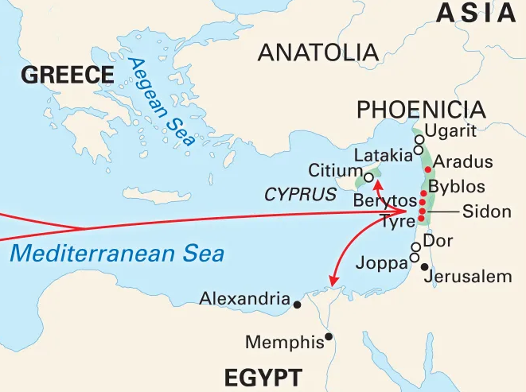
Ezekiel 25-28
underwater
Tyre
Ammon
Jerusalem
Moab
Philistia
Edom
https://www.britannica.com/place/Tyre

Slide 4
Judgment against Tyre – Ez 26-28
God lays out the case against Tyre in three sections:
Prophecy & judgment on Tyre – Ez. 26:2-21
Lament for Tyre – Ez. 27:1-36
Prophecy & Lament for Ruler of Tyre – Ez. 28:1-19

Slide 5
Review - Judgment on Tyre – Ez. 26-27
When did Ezekiel write the judgment? (Ez 26:1)
What was happening in Jerusalem at the time?
How is it different from the other nations?
Other Nations – set themselves up to oppose Jerusalem / Judah – constant thorn in their side
Tyre’s Goal: substitute themselves for Jerusalem
Ez 26:3 – would move right in – no competition;
Ez. 27:2 – become the complete center of the
Jerusalem was God’s city (Ps 48:1-2), but now broken (Ez 1-24)
For what sin was God condemning Tyre?
Pride – she thought she was…
Ez. 27:3 – beautiful, perfect
Ez. 27:5-7 – envied, all commerce came through her
Ez. 27:8-11 – invincible - best crews, soldiers; protected by the sea

Slide 6
Ezekiel 28 – Tyre and Sidon
Tyre (Ez 28) – 4 sections
Ez. 28:1-10 - Proclamation against the King of Tyre
Ez. 28:11-19 – Lamentation for the King (and Tyre)
Ez. 28:20-24 – Judgment on Sidon
Ez. 28: 25-26 – Future Hope for Israel
Let’s read… Ezekiel 28:1-19; 20-24; 25-26

Slide 7
Ezekiel 28 – Tyre and the King
Tyre (Ez 28) – Observations
Ez. 28:1-10 - Proclamation against the King of Tyre
v.2 – King said, “I am a god”
v.3 – Wiser than Daniel???
v.4-5 – wisdom produced wealth from trading
v.6-7 – Judgement from the most terrible
v.10 – at the hand of the true LORD GOD
Ez. 28:11-19 – Lamentation for the King (and Tyre)
v.11-15 – the king had perfection
v.16 – abundance of your trading – caused violence
v.17-18 – Pride – corrupted your wisdom – sin of your trading
v.19 – all are astonished, you are a horror – No More - Forever

Slide 8
Ezekiel 28 – Sidon and Hope
Tyre (Ez 28) – Observations
Ez. 28:20-24 – Judgment on Sidon
v.22 – God is against you, He will be glorified in her midst
v.23 – pestilence, sword, judged
v.23 – They shall know that “I am the LORD”
Ez. 28: 25-26 – Future for Israel
v.24 – no longer a thorn in the house of Israel
v.24 – They shall know that “I am the LORD”
v.25 – the house of Israel will be gathered out of the peoples they were scattered
v.25 – God is hallowed before the Gentiles
v.26 – Dwell safely, houses, vineyards
v.26 – They shall know that “I am the LORD”

Slide 9
Tyre – Lessons for Us
Beware of Pride and Seduction – don’t trust in the sea (or your own power)
Look to God for true Beauty – Trust in Him, not the things of the temple, or the “holy” city
Faithfulness – increase your faith, Look up, not around, trust God → He will deliver…In His Time (e.g. Abraham and Isaac, departure from Egypt, crossing of Red Sea, Mt. Sinai, promised land, etc.)
Proclaim - All shall know that “God is the LORD”

Slide 10
Class Objectives
Identify the sin(s) for which Tyre is judged by God.
Explain why God spends so much more time with Tyre than the other nations.
Explain what lessons we can learn and apply for us today.

Slide 11
The Book of Ezekiel
For Sunday: Ezekiel 29 - Egypt

Slide 12
Ezekiel 25-32
Summary: Fill out the table below in groups
Locate it on the map.
Recall origin and/or history.
Identify sins and consequence.
Nation | Location | Origin | Sins | Consequence
Ammon | Northeast | Lot | Fighting Israel (God) | They will know I am Yahweh
Moab | East | Lot | Fighting Israel (God)
Edom | Southeast | Esau | Fighting Israel (God)
Philistia | West | Crete | Fighting Israel (God)
Tyre | Northwest | Unknown | Pride | Gone – forever
Egypt | Southwest | Egypt | Fighting Israel (God)

