Slide 1
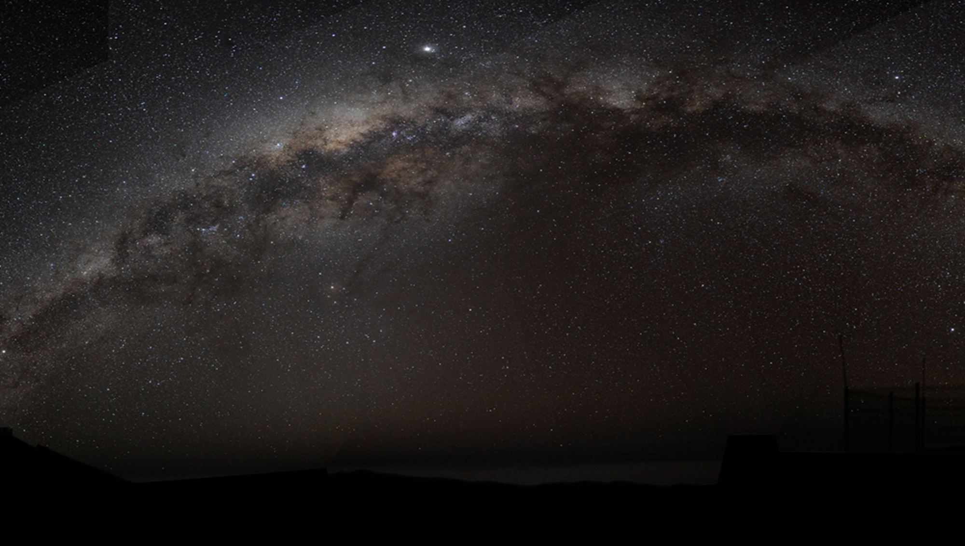
What is man that God Cares for HIM
How Important are you to God?

Slide 2
Psalm 8:4 What is man that You take thought of him, And the son of man that You care for him?

Slide 3
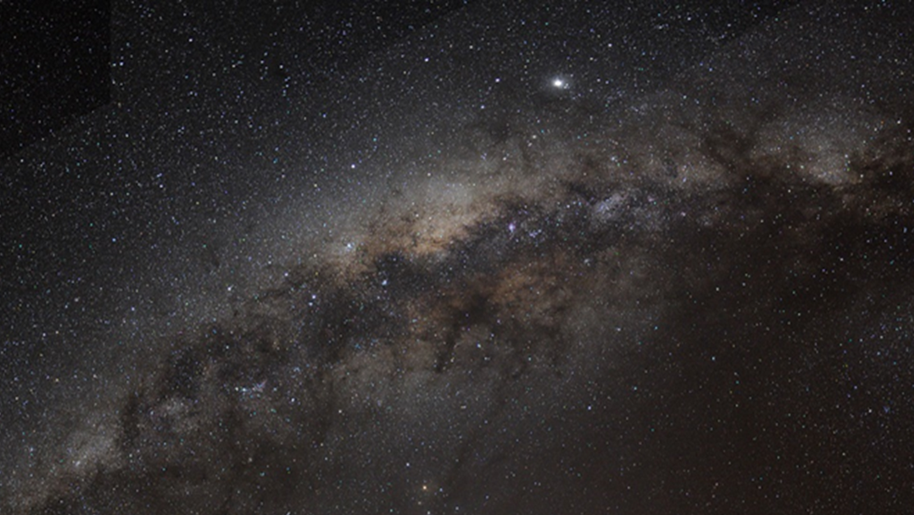
The Inherent Answer is simply this:
We are worth far far more than all of creation
God made creation for us – to serve us

Slide 4
Declarations of God’s Care for Man
Psalm 8:5-6 …You have made him a little lower than God, And You crown him with glory and majesty! ⁶ You make him to rule over the works of Your hands; You have put all things under his feet,
Psalm 16:3 As for the saints who are in the earth, They are the majestic ones in whom is all my delight.

Slide 5
God Created Man in His Image Gen 1:6; 1 John 3:2
God Created Man to be His Sons Ephesians 1:4-5
Therefore, God cherishes, honors and loves us
Isaiah 43:4…you are precious in My sight, … you are honored and I love you.
Declarations of God’s Care for Man

Slide 6
Jesus Made All Things
Colossians 1:16 For by Him all things were created, both in the heavens and on earth, visible and invisible, … all things have been created through Him and for Him.
See also John 1:3-4; 1 Corinthians 8:6; Hebrews 1:2

Slide 7
Jesus Made All Things
Jesus made this physical kingdom - extraordinary splendor, massiveness, and infinite complexity:
God gave it to us.
God gave us reigning authority over it.
A prophetic figure of the heaven

Slide 8
Man’s Loss of Dominion
Do not have complete control over our lives
Do not have complete control over this world
Contrary to Psalms 8:6 – Do not have reigning authority
We Suffer Tribulations, Afflictions, Sorrows, Losses, Physical Death

Slide 9
What Happened? Sin Happened!
Sin Entered the World
Man Lost His Full Dominion
Sin Became the Master
Man Became the Slave
A Slave to Sin Romans 6:16-17
With sin came suffering and death in this world
Eternally Separated from God – Eternal Death

Slide 10
Man Needed Salvation
Man Needed a Savior
God Gave Us Both in His Son – Jesus Christ
Jesus is the Promised Blessing
Jesus Fulfilled God’s Promised Gift of Eternal Life
Man Needed Help!!

Slide 11
God had to Redeem Man out Slavery
Our Redemption Price was Horrific:
Suffer
Shed His Precous Blood
Die a Cruel Death by Crucifixion
Perfect Sacrifice that Takes the Sins of the World Away John 1:29
For All Men - Romans 5:18; Hebrews 7:27
For All Time – Hebrews 10:12
But the Gift Came at a Terrible Price
… ans Jesus had to pay it

Slide 12
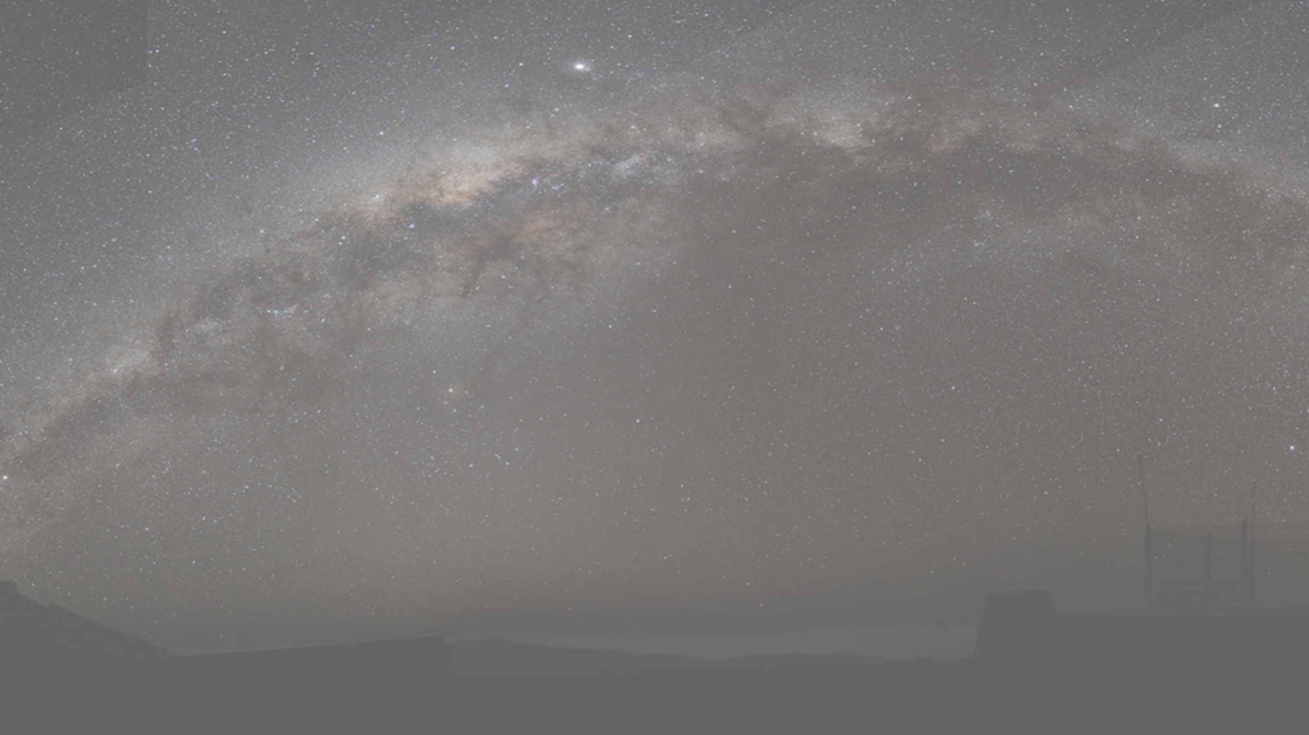
Christ’s Death Did Even More for Us
God Makes the Saved in Christ His Sons
The children of God are literally created by God when we enter into Christ at baptism
Ephesians 2:10 For we (the children of God) are God's workmanship, created in Christ Jesus ….

Slide 13
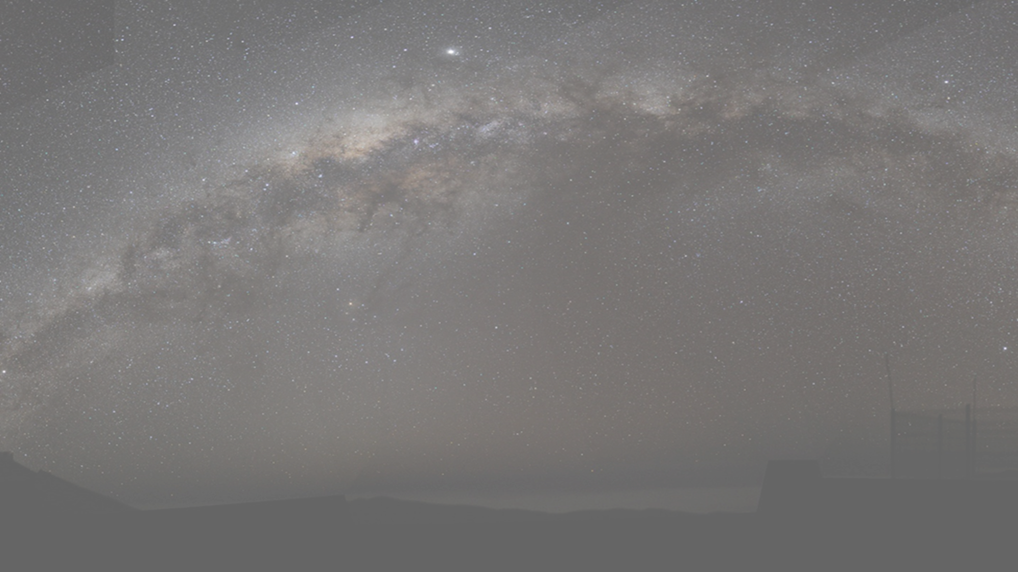
Restored Dominion
Having been Saved in Christ
Having Become the Sons of God in Christ
God Restored Man’s Dominion that we lost to Sin
Not in this Present Temporal World Still Lost to Sin
But in the World to Come – Eternal Heaven
Which now brings us to Hebrews chapter 2 and Psalms 8 where we began

Slide 14
Restored Dominion
Hebrew writer reveals Psalm 8 to be a Messianic prophecy of Man’s Restoration and the Greatness of our Salvation
In Chapter 2, the writer begins by pleading with us to not neglect God’s word – warning that if we do:
Hebrews 2:3 how will we escape (penalty of death) if we neglect so great a salvation….?

Slide 15
Restored Dominion
How Great is Our Salvation?
After all - We Still Suffer in this Life.
Hebrew writer begins His answer:
Hebrews 2:5 For He did not subject to angels the world to come, concerning which we are speaking.

Slide 16
Subjection to Angels?
“World to Come” is not the Present Physical World – it is Heaven
If Heaven is not subjected to Angels – then who is it Subjected to?
Scripture only Identifies Two who were Subjected to Angels
Man – Psalms 8:5
Jesus – Hebrews 2:9

Slide 17
If Heaven is not Subjected to Angels
Then Those Subjected to Angels in this Present World
Will occupy a higher Position than Angels in the World to Come, i.e., Jesus and the Sons of God
Thus, the Hebrew writer confirms:
Angels worship Jesus in Heaven – Hebrews 1:6
Angels will serve the Sons of God in Heaven – Hebrews 1:14
The Message

Slide 18
But There is More ….
At Hebrews 2:6-8 – The writer further elaborates upon the greatness of our salvation by quoting Psalms 8:4-6
Cites the glory, honor, possession, and reigning authority that God gave man in this physical world
To Reveal the glory, honor, possession, and reigning authority God will give to man in the World to Come - Heaven

Slide 19
But There is a Catch
The Hebrew Writer makes the Obvious Observation as previously discussed.
Hebrews 2:8 … But now we do not yet see all things subjected to him.
Because of sin, man lost much of his reigning authority in this physical world.
Question: How then is it possible for fallen man to take possession and reigning authority in God’s eternal heavenly kingdom?

Slide 20
The Hebrew Writer’s Answer
Hebrews 2:9 But we do see Him who was made for a little while lower than the angels, namely, Jesus, because of the suffering of death crowned with glory and honor, so that by the grace of God He might taste death for everyone.

Slide 21
The Hebrew Writer’s Answer
Jesus Christ Died for the Sins of the World – Made us Sons of God
Because Jesus died for our sins, God rewarded Him with Glory and Honor
But Jesus did not go into His glory alone
He brings us - God’s other sons with Him
Hebrews 2:10 For it was fitting for Him (God), for whom are all things, and through whom are all things, in bringing many sons to glory, ….

Slide 22
The “Other Sons” Share in Christ’s Reward
Deity
Jesus is God - Col 1:19; Phil 2:6
Sons are partakers of the divine nature – 2 Peter 1:4
Image of God
Jesus bears the exact image of God – Hebrews 1:2
Sons are transformed into image of God – 1 John 3:2
Son of God
Jesus bears title Son of God – Mark 1:1
Sons bear the title sons of God – Romans 8:16

Slide 23
The “Other Sons” Share in Christ’s Reward
Exaltation
God exalted Jesus – Philippians 2:9
God exalts His Children – James 4:10
Glorification
God glorified Jesus – Hebrews 2:9
God glorifies His Children – 2 Thessalonians 2:14
Priesthood
Jesus is the royal High Priest – Hebrews 2:17; 7:17
The sons are Royal Priests – 1 Peter 2:9

Slide 24
The “Other Sons” Share in Christ’s Reward
Possession of the Kingdom
Jesus posseses His kingdom – John 18:36; Colossians 1:13
The sons inherit God’s Kingdom – Matthew 25:34; Luke 12:32
Reigning Power
Jesus sits on God’s Throne to Reign Forever – Eph 1:20-21, Rev 11:13
Sons sit on Christ’s Throne to Reign with Jesus Forever – 2 Tim 2:12; Revelation 3:21; 22:5

Slide 25
Conclusion – The Question
Hebrews 2:6 … "WHAT IS MAN, THAT YOU REMEMBER HIM? OR THE SON OF MAN, THAT YOU ARE CONCERNED ABOUT HIM?

Slide 26
Conclusion – The Answer
God Cherishes, Honors, and Loves Us – Isaiah 43:4
God expresses the fullness of His Love through Jesus – John 3:16
God gave us the physical kingdom that Jesus made - Ps 8:4-6; Col 1:16
God gave us the gift of eternal life that Jesus purchased - 1 Pt 1:18; Rev 5:9
God makes the saved in Christ His children – Eph 1:4-5; 2:10; Gal 3:26-27
God gives the saved in Christ every spiritual blessing in the heavenly places. – Ephesians 1:3

Slide 27
And on the last day, God will give us His kingdom as an inheritance where we will reign with Christ. As it is written, on that day….
Matthew 25:34 "… the King (Jesus) will say to those on His right, 'Come, you who are blessed of My Father, inherit the kingdom prepared for you from the foundation of the world.
…. The kingdom prepared by Jesus Christ for us

