Slide 1
The Book of Ezekiel
Class #43 – Ezekiel’s Temple
(Ezekiel 41-42)

Slide 2
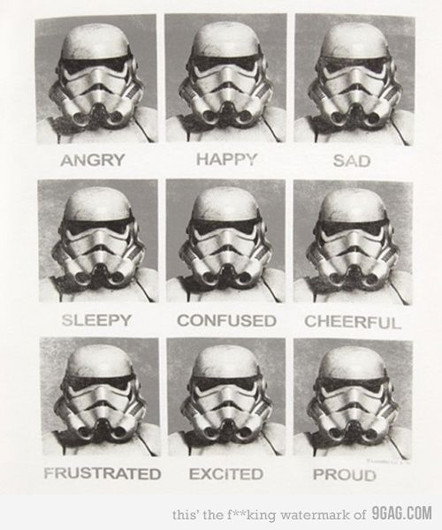

Slide 4
Today’s Topics
Timeline
Review last two classes
Contemporary prophesies
Temple comparison
Overview of Ezekiel 41-42
Attribute comparison
Applications for today

Slide 5
Timeline
Years BC
586
606
598
593
588
573
536
First captivity
Daniel
Ezekiel
called
Jerusalem
destroyed
Return to Jerusalem
Second captivity
King Jehoiachin
Ezekiel
Jerusalem
besieged
Ezekiels’s vision of the temple
Ezekiel (Babylon, River Chebar)
Daniel (Babylon, palace)
Jeramiah (Jerusalem)

Slide 6
Review – Overview of Ezekiel 40-48
A direct answer to the vision of God’s presence leaving Jerusalem back in Ezekiel 8-11
The glory of the Lord fills the [new] temple (Ezek 43:5)
“The Lord is there” (Ezek 48:35)
This temple was not built by Zerubbabel when the Israelites returned
Symbolic description of God dwelling with His people
Starts with the exiles, fulfilled in Christ and the age to come
Visions are intended to be imagined, not necessarily dissected
Symbols have meaning, often connecting to other Bible passages.
Jesus is the interpretative key of the Old Testament
“our tutor to bring us to Christ” (Gal 3:24)
This includes Ezekiel 40-48

Slide 7
Review – Ezekiel 40
Temple vision in the 25th year of exile, 10th day of the first month
14 years after Jerusalem destroyed. Halfway to the year of Jubilee.
This is a time of anticipation / anxiety for the future of the city, the land, and God’s people.
Ezekiel taken to a very high mountain in Israel.
No more dry bones. Spiritual geography, not literal.
An angelic figure guides Ezekiel and measures the facilities.
Ezek told to observe, then declare to the house of Israel.
Why use a temple complex to show how God will intimately dwell with His people?
Israelites were very familiar with the temple and its purpose.
The temple consisted of separation and order.
Separates the holy from the profane (common).
Provides very serious protection (walls, stairs, gateways, courts).
Palm trees for ornamentation.
Priests from the sons of Zadok.
Zadok was faithful, the Levites had not been faithful (see prior chapters in Ezek).
All the rooms indicate the dwelling of God and His people together.
“In my Father’s house (temple) there are may rooms (abodes, mansions).” John 14:2.

Slide 8
Contemporary Prophecy - Daniel
Prophesies of 4 earthly kingdoms. Dan 2
Babylon, Persia, Greece, and Rome
Very detailed prophecies concerning Persia and Greece. Dan 10-11
God will establish an everlasting kingdom during the Roman kingdom
God rules in the kingdoms of men, and gives it to whomever He chooses. Dan 4
“Jerusalem and Your people are a reproach to all those around us.” Dan 9
The coming of Messiah the Prince. Dan 9
The ascension of the Son of Man to the Ancient of Days during the 4th kingdom.
Given a kingdom that will never be destroyed. Dan 7
It was almost time for Israel to return home. Dan 9
Fulfilling the prophecy of Jeremiah.

Slide 9
Contemporary Prophecy - Jeremiah
Instructions to the exiles on how to live in Babylon. Jer 29
After 70 years of Babylonian captivity:
Punish the kingdom of Babylon. Jer 25
Cause the Israelites to return to Jerusalem. Jer 29
God will establish a new covenant with Israel. Jer 31
“I will bring them back to this place, and they shall dwell safely.” Jer 32
"Behold, the days are coming," says the Lord, "That I will raise to David a Branch of righteousness; A King shall reign and prosper, And execute judgment and righteousness in the earth. In His days Judah will be saved, And Israel will dwell safely; Now this is His name by which He will be called: THE LORD OUR RIGHTEOUSNESS.” Jer 23

Slide 10
Temple Comparison

Slide 11
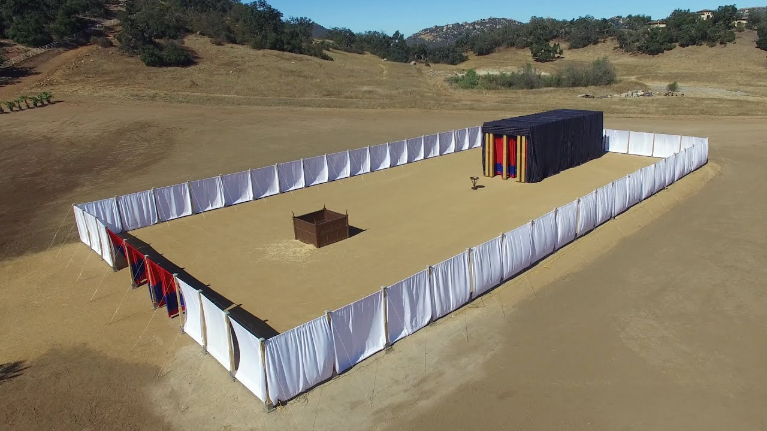
The Tabernacle
Tabernacle:
Length: 45 ft
Width: 15 ft
Height: 15 ft
Ex 25-30
75 ft
150 ft

Slide 12
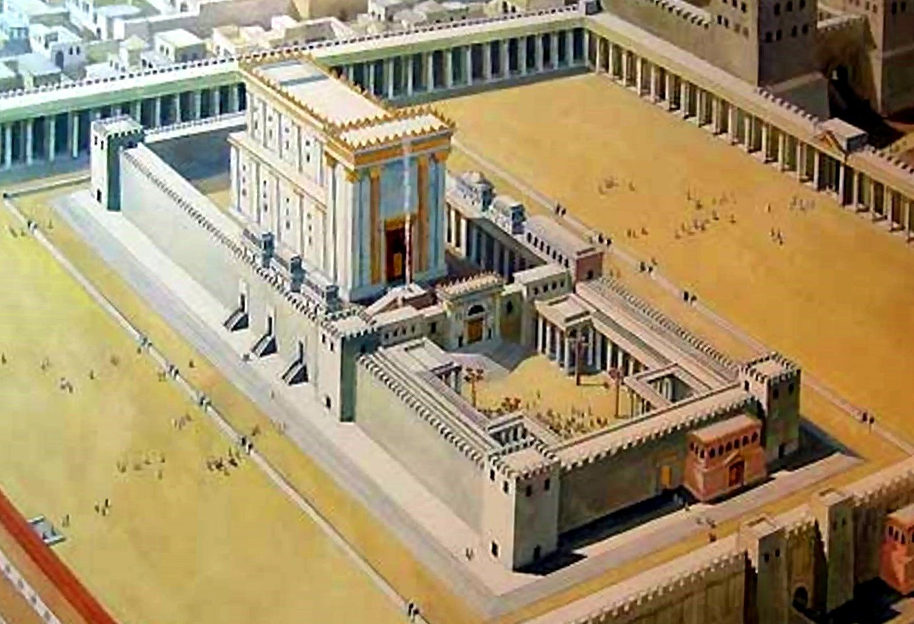
Solomon’s Temple
300 ft
Temple:
Length: 90 ft
Width: 30 ft
Height: 45 ft
1 Kings 6:2
150 ft

Slide 13
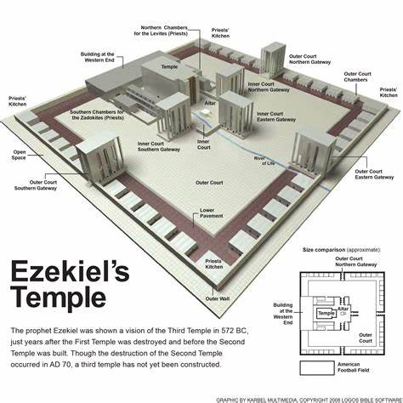
175 ft
875 ft
875 ft
Temple:
Length: 175 ft
Width: 60 ft
Height: 80 ft
Ezekiel 40-42

Slide 14
Ez 40:47-49
Court
150’x150’
Altar
Vestibule
Doorposts
North
Ez 42:13-14
Holy chambers
North and South walls
For the priests to eat the holy offerings
Leave holy garments before leaving
Ez 41:1-4
Sanctuary
Doorposts
Entryway
Most Holy Place
Ez 41:5-11
Side Chambers
3 stories
30 chambers per story
Ez 42:15-20
The four walls
875’ on each side
Ez 41:12
West End Building
Ez 42:1-9
Galleries and chambers
Along North, South and East walls
3 stories
Walkway (18’)
Ez 41:13-26
Temple
175’ x 90’
Wood paneling
3 stories of galleries
Cherubim and palm tree carvings

Slide 15
Attribute Comparison
The garden
A dwelling without walls
No sacrifices, there was no sin.
The only “fence” was God’s commands
“tend the garden”
“you must not eat of it or you will surely die”.
Solomon’s Temple
Solid walls, permanent residence
Ornate
It was not kept holy
The uncircumcised foreigners penetrated the heart of the temple (Ezek 44:7).
Idolatry was allowed in and defiled it (Ezek 8-11).
The tabernacle
Allowed God to dwell in the midst of His people.
Flimsy walls so that it could travel with the people.
Sacrifices in place
Only the priests had access to the Holy Place
Only the High Priest accessed the Most Holy Place once per year
Ezekiel’s Temple
God’s planning and preparation
Larger dimensions, more people
Separate the common from the holy.
Raised walls for protection
Keep the holy in, the profane out
Focus on sacrifice
Increased standards of holiness
Sons of Zadok served before the Lord
Fulfilled in Christ.

Slide 16
Applications
What does God’s temple consist of today?
How do we protect ourselves from the common and profane?
How does God’s eternal abode for His people differ from these temples?

Slide 17
The Book of Ezekiel
For Wednesday: Ezekiel 43-44

Slide 18
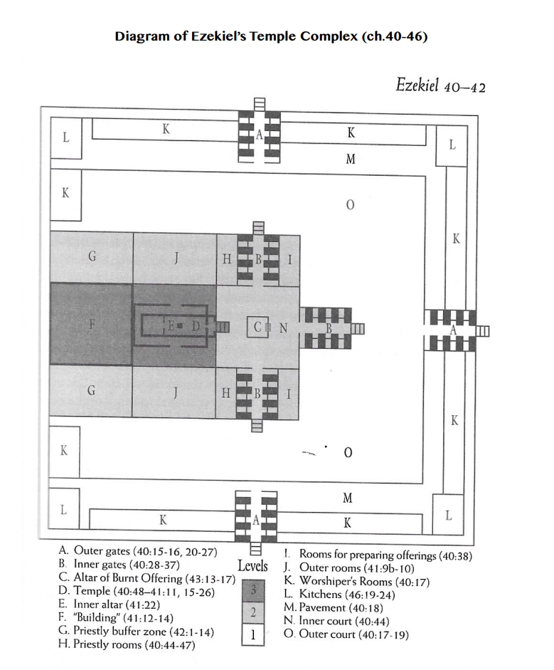
North
West
East
South

Slide 19
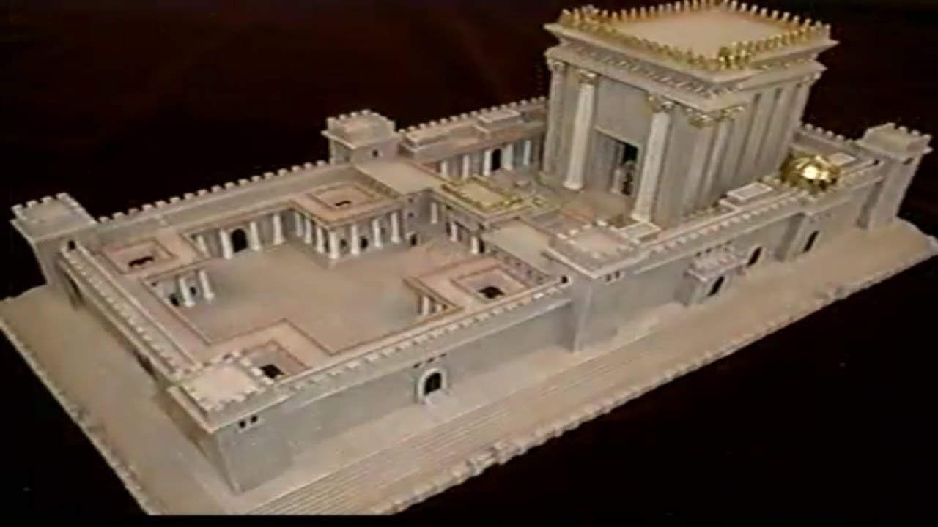
Temple in Revalation

Slide 20
