Slide 1
The Book of Ezekiel
Class #44
God Fills His Temple

Slide 2
Class Objectives
Explain similarities/differences between Eden and the temple.
Recall why God wanted Ezekiel to relay this vision to the people.
Connect one element of the temple in Ezekiel 43 to Jesus.

Slide 3
Creation & Temple (Genesis 1-2)
In the beginning, the earth is without form and void. (Genesis 1:1-2)
Over 7 days, God forms and fills:
Days 1-3: Orders the habitations
Days 4-6: Fills with the inhabitants
On Day 7, God rested, meaning that He sanctified the creation with His presence. (2:1-3)

Slide 4
Creation & Temple (Genesis 1-2)
On the earth was Eden; (2:8-9)
within Eden God put a garden;
in its midst was the tree of life.
Out of the garden, waters flowed to the rest of the earth. (2:10-14)
God put man in the garden to tend it and to keep it. (2:15)

Slide 5
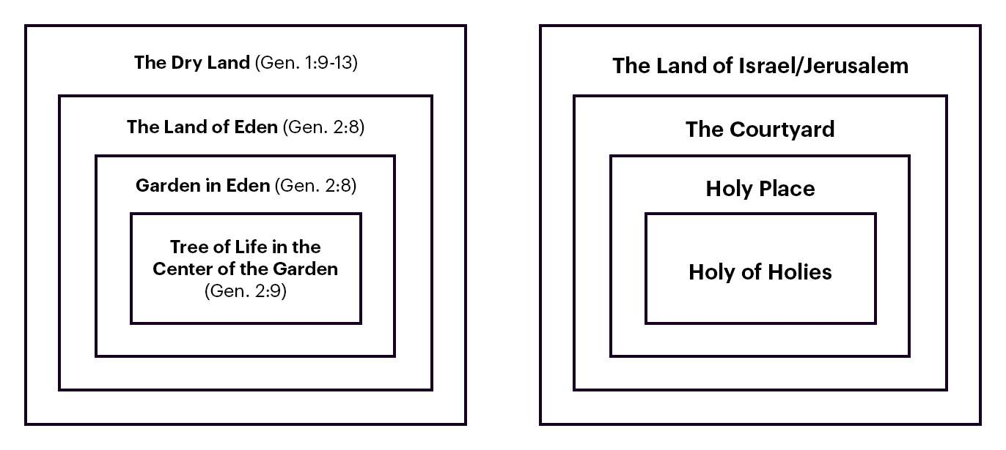
Creation & Temple (Genesis 1-2)

Slide 6
Creation & Temple (Genesis 1-2)
Tabernacle was constructed in detailed order, mirroring the “layout” of Eden. (Exodus 25-27; 1 Kings 6-8)
Tabernacle/temple were consecrated with 7-day ceremonies (Lev8; 1Kgs8)
Were sanctified with God’s presence (Ex 40:34; 1Kgs 8:10-11)
Priests chosen to serve in the temple and keep it (Num 3:7-8; Gen 2:15)

Slide 7
Creation & Temple (Genesis 1-2)
God created humans
to dwell with them
to partner with them in ruling creation
to enjoy with them its fruitfulness
to fill the earth with His glory
Tabernacle & temple represent the place where God dwells with His people and rules over creation.
Question: What element of tabernacle / temple worship was not in Eden?

Slide 8
Glory & Holiness (Ezekiel 43:1-12)
Ezekiel sees the glory of the Lord come into the temple. (43:1-5)
Same vision from his call (ch.1) and destruction of Jerusalem (ch.8-11)
His response is to fall on his face (1:28; see Isaiah 6:5)
Glory fills the temple; God proclaims that this is His throne, where He will dwell with His people forever. (43:5-7)

Slide 9
Glory & Holiness (Ezekiel 43:1-12)
No longer defile His name – by worshipping other gods / at the monuments of dead kings. (43:7-9)
Relay this vision so that they will be ashamed of their iniquities. (43:10)
Question: How would this description of a temple make them ashamed?
They are to keep the “law of the temple,” which is: Be Holy. (43:11-12)

Slide 10
Temple Complex (Ezekiel 40-43)

Slide 11
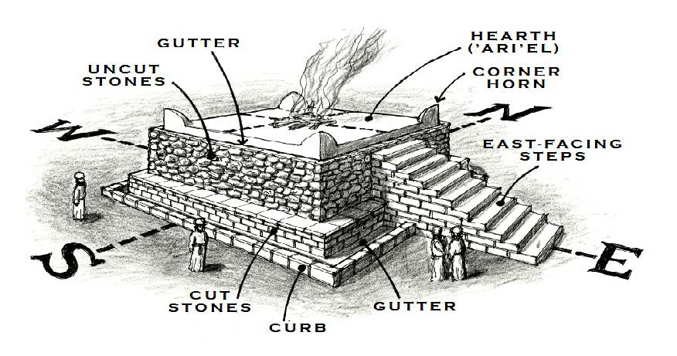
The Altar (Ezekiel 43:13-27)

Slide 12
The Altar (Ezekiel 43:13-27)
At the center of the temple complex is a huge, square altar. (43:13-17)
Question: Why is such prominent attention given to the altar?
Priests purify (atonement for) the altar before it can be used. (43:18-27)
This is a 7-day ceremony. (43:26)
At the end of 7 days, God will accept the sacrifices made on it. (43:27)

Slide 13
Ezekiel 43
Discussion Question:
What are all the various ways we see Jesus in this chapter?

Slide 14
Class Objectives
Explain similarities/differences between Eden and the temple.
Recall why God wanted Ezekiel to relay this vision to the people.
Connect one element of the temple in Ezekiel 43 to Jesus.

Slide 15
The Book of Ezekiel
For Sunday: Ezekiel 44

