Slide 1
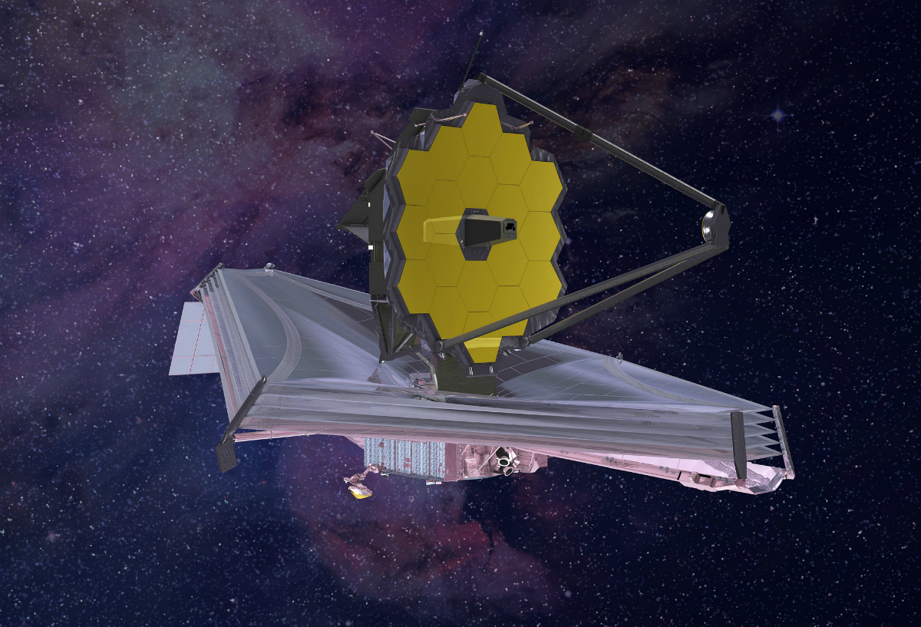
This Photo by Unknown Author is licensed under CC BY-NC-ND

Slide 2
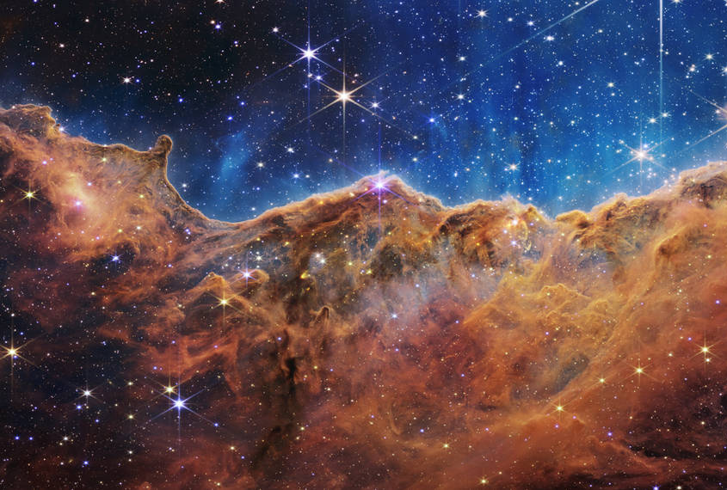
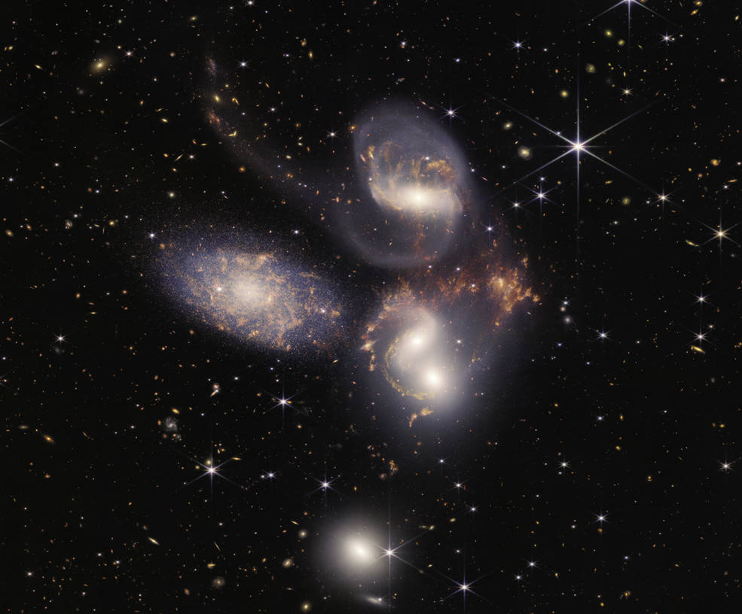
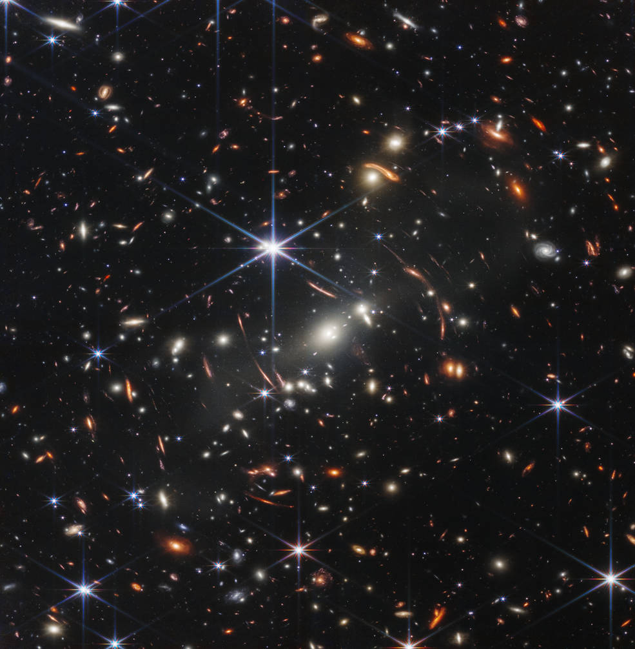

Slide 3
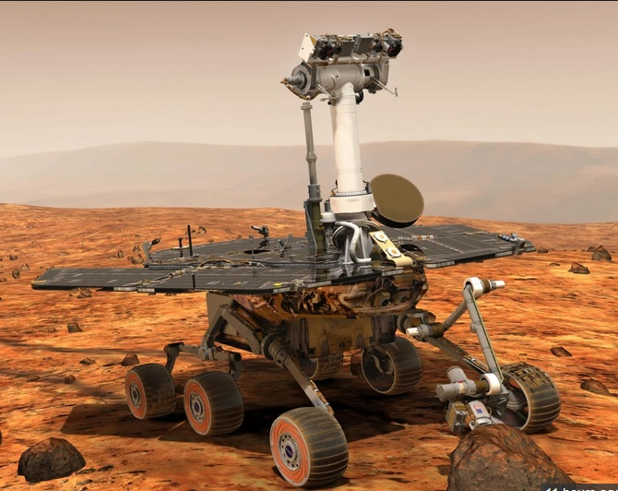

Slide 4
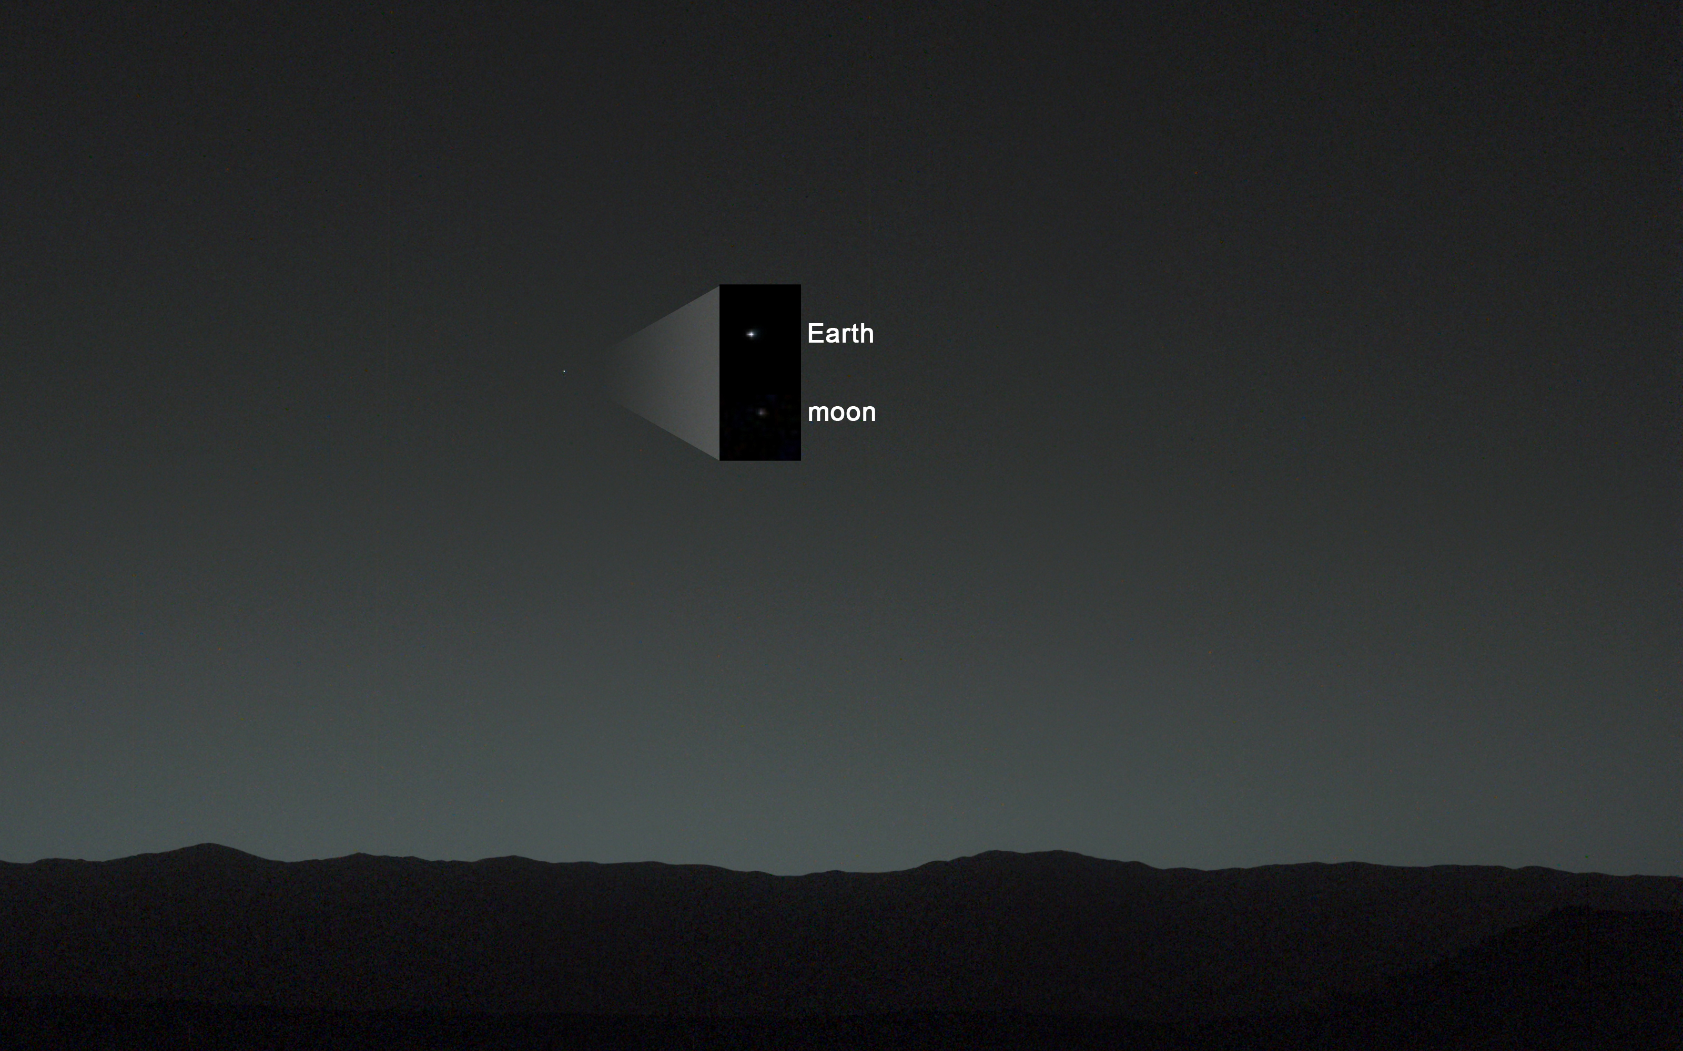

Slide 5
Romans 5:8
But God demonstrates His own love toward ME, in that while I was still a sinner, Christ died for ME.

Slide 6
Romans 5:8
But God demonstrates His own LOVE toward ME, in that while I was still a sinner, Christ died for ME.

