Slide 1
Think/Discuss Before Class Starts
What is the style of chapters 1-6? What is the style of 7-12?
Which section is written in a different language? What language?
How are chapters 2-7 arranged?

Slide 3
Daniel: Class Schedule
Class Date | # | Text
August 31 | 1 | Intro to Book
September 7 | 2 | Daniel 1/Intro 2-7
September 14 | 3 | Daniel 2
September 21 | 4 | Daniel 3
September 28 | 5 | Daniel 4
October 5 | 6 | Daniel 5
October 12 | 7 | Daniel 6
October 19 | 8 | Daniel 7
October 26 | 9 | Daniel 8
November 2 | 10 | Daniel 9-10
November 9 | 11 | Daniel 9-10
November 16 | 12 | Daniel 11-12
November 23 |  | No Class
November 30 | 13 | Daniel 11-12

Slide 4
The Book of Daniel (Structure)
Ch. 1-6: Story
ch.7
Style:
Ch. 7-12: Vision
Ch. 1 Hebrew
Ch. 2-7
Aramaic
Ch. 8-12
Hebrew
Language:
Prologue
God rules in the kingdoms of man.
God preserves His sacred people.
Theme:

Slide 5
Daniel 2-7: A Chiastic Structure
A
A’
B
B’
C
C’
X
^{Example: Amos 5:4-6}
^{Seek me and live;}
^{do not seek Bethel,}
^{do not go to Gilgal,}
^{do not journey to Beersheba.}
For Gilgal will surely go into exile,
and Bethel will be reduced to nothing.
^{Seek the Lord and live…}

Slide 6
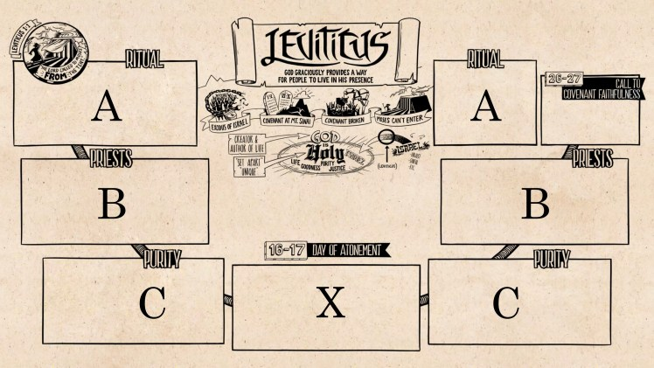
Daniel 2-7: A Chiastic Structure

Slide 7
Daniel 2-7: God Rules in the Kingdoms of Men
Ch. 2: Nebuchadnezzr’s Dream of a Statue
Ch. 7: Daniel’s Vision of Beasts
Ch. 3: 3 Hebrews in Fiery Furnace
Ch. 6: Daniel in the Lions’ Den
Group 1*
*Discuss:
Similarities? Message?
Ch. 4: Neb’s Humiliation
Ch. 5: Belshaz. Loses Kingdom
Group 2*

Slide 8
When are we in Daniel 7?

Slide 9
Daniel 7:1-14 – Daniel’s Vision
How would we interpret this vision in light of the connection to chapter 2?

Slide 10
Daniel 7:1-14 – Daniel’s Vision
How is this vision different from the dream of ch.2, and why is that significant?

Slide 11
Daniel 7:15-17 – Interpretation
Daniel’s reaction is anxiety & alarm
Four kings = Four kingdoms (see v.23)
Point: Saints possess eternal kingdom

Slide 12
Daniel 7:19-28 – Question/Answer
Concern about the 4th beast (and its horns) which made war on the saints.
4th would be Rome, after Babylon (2:38), Medo-Persia (8:20), & Greece (8:21)
10 kings (literal?) before one who will boast, persecute the saints temporarily.
Ultimately, God will judge in favor of the saints who will be given dominion.

Slide 13
Daniel 7: Saints Receive Kingdom
Discuss!
From our point of view, should Daniel 7 alarm us? Comfort us? Sober us?

Slide 14
Chapter 8 for Next Week (10/26)

