Slide 2
Christians in the Workplace
Matthew 10:16

Slide 3
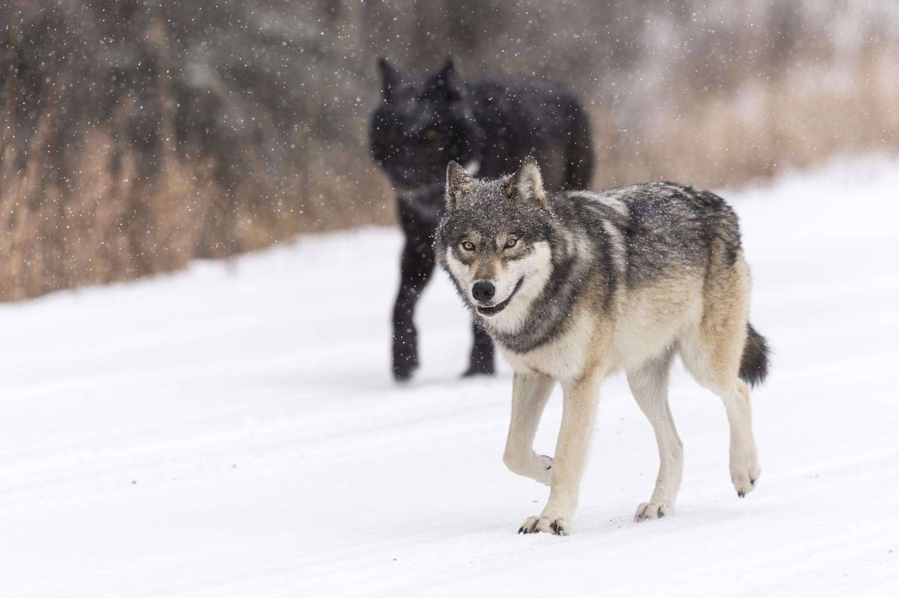

Slide 4
Matt 10:16
[Mat 10:16 NKJV] 16 "Behold, I send you out as sheep in the midst of wolves. Therefore, be wise as serpents and harmless as doves.

Slide 6
Pillars of our lives

Slide 7
Pillars of our lives

Slide 8
Pillars of our lives
You

Slide 9
Pillars of our lives
You
Christians in the Workplace

Slide 10
Join at slido.com #1017404
ⓘ Start presenting to display the joining instructions on this slide.

Slide 11
Tell us where you are in your Career.
ⓘ Start presenting to display the poll results on this slide.

Slide 12
Why do you think it's important to study how we as Christian's act in the Workplace?
ⓘ Start presenting to display the poll results on this slide.

Slide 13
We are interacting with work how much?? (8760 hours)
Work | Assuming 40hrs per week for 52 weeks
Church | Assuming 10 hours a week for 52 weeks
Sleep | Assuming 8 hours a day for 365 days
Leisure | All other remaining time
Driving | Assuming 2 hours to and from work for 52 weeks

Slide 14
Class Schedule
Lesson | Theme | Title | Date | Teacher
1 | Introduction | Introduction – A Biblical Subject | Sunday, December 4, 2022 | Alex Morolez
2 | Biblical Foundation | Our Viewpoint – Work Unto God Not Unto Men | Wednesday, December 7, 2022 | Doug
3 |  | God’s Viewpoint of Our Work | Sunday, December 11, 2022 | Alex Morolez
4 |  | Viewpoint of Others – Working as Godly Examples | Wednesday, December 14, 2022 | Alex Morolez
5 | Issues with the Pursuit and Achievement of Success | Pride and Competition | Sunday, December 18, 2022 | Alex Morolez
6 |  | Materialism | Wednesday, December 21, 2022 | Doug
7 |  | Misplaced Priorities | Wednesday, December 28, 2022 | Doug
8 | Issues with Workplace Adversity and Failure | Bitterness and Resentment | Sunday, January 1, 2023 | Doug
9 |  | Discouragement | Wednesday, January 4, 2023 | Doug
10 | Workplace Temptations and Challenges | Lying and Integrity | Sunday, January 8, 2023 | Alex Morolez
11 |  | Corporate and Peer Pressure | Wednesday, January 11, 2023 | Doug
12 |  | Women in the Workplace | Sunday, January 15, 2023 | Alex Morolez
13 |  | Stress and Anxiety | Wednesday, January 18, 2023 | Doug

Slide 15
What Bible Verses come to mind when thinking about our jobs and what God tells us about work?
ⓘ Start presenting to display the poll results on this slide.

Slide 16
Verses related to our study
Prov 16:3
Commit your works to the LORD, And your thoughts will be established.
Col 3:23
And whatever you do, do it heartily, as to the Lord and not to men,
Phil 2:14-15
Do all things without complaining and disputing, 15 that you may become blameless and harmless, children of God without fault in the midst of a crooked and perverse generation, among whom you shine as lights in the world,
1 The 4:11-12
and to make it your ambition to lead a quiet life: You should mind your own business and work with your hands, just as we told you, 12 so that your daily life may win the respect of outsiders and so that you will not be dependent on anybody.
Titus 2:7-8
In everything set them an example by doing what is good. In your teaching show integrity, seriousness 8 and soundness of speech that cannot be condemned, so that those who oppose you may be ashamed because they have nothing bad to say about us.
Verses in the Bible

Slide 17
OUR GOALS
God’s Glory
Have a continuous mentality that we are working for God’s glory rather than our own. Meaning every phase or pillar of our life, the will of Christ should be in it.
Identify & Overcome
Learn to identify the spiritual challenges in our own workplace and make a plan to overcome it.
Decisions
Make more goldy decisions while in the workplace by bringing God to work with us.
Christ like examples to those around us
Be more aware of our actions and how we are the examples of Christ to our co-workers.
Guidance from Godly men and women
We have a church family and it is one of the great gifts of being a Christian to have so many brother and sisters. Asking for help is not a sign of weakness. It is a sign of wisdom.
Seek guidance in Scripture
There is no situation you will ever face at work or any other setting that is not spoken to in the Bible. We need to learn to use it before taking action and not use it to validate a decision we have already made.

Slide 18
Application for All
Study will emphasize principles that apply to any situation in our lives.
as a student, in raising children, in caring for loved ones.
It is beneficial to understand the challenges that other Christian's face in the workplace.
Maybe those of us with experience can be more effective with warning or encouragement of our fellow brothers and sisters.
[Ecc 9:10 NKJV] 10 Whatever your hand finds to do, do [it] with your might; for [there is] no work or device or knowledge or wisdom in the grave where you are going.

Slide 19
Exercise Questions
List or think about every job that you ever had, including those for which you may have not been paid.
Subway Artist, Lifeguard, painted schools, mowed lawns, waiter, Physical Therapy Tech, admin assist for UT Volleyball, Lab testing volunteer, city worker painting the streets, computer tech, desktop support, manager.
Decide which workplace was the easiest for you to live and practice what the Bible teaches. Then ask yourself, which was the hardest.
Anyone want to share?
What were the key difference in the work environment?
What were the difference in your age?

Slide 20
Class Schedule
Lesson | Theme | Title | Date | Teacher
1 | Introduction | Introduction – A Biblical Subject | Sunday, December 4, 2022 | Alex Morolez
2 | Biblical Foundation | Our Viewpoint – Work Unto God Not Unto Men | Wednesday, December 7, 2022 | Doug
3 |  | God’s Viewpoint of Our Work | Sunday, December 11, 2022 | Alex Morolez
4 |  | Viewpoint of Others – Working as Godly Examples | Wednesday, December 14, 2022 | Alex Morolez
5 | Issues with the Pursuit and Achievement of Success | Pride and Competition | Sunday, December 18, 2022 | Alex Morolez
6 |  | Materialism | Wednesday, December 21, 2022 | Doug
7 |  | Misplaced Priorities | Wednesday, December 28, 2022 | Doug
8 | Issues with Workplace Adversity and Failure | Bitterness and Resentment | Sunday, January 1, 2023 | Doug
9 |  | Discouragement | Wednesday, January 4, 2023 | Doug
10 | Workplace Temptations and Challenges | Lying and Integrity | Sunday, January 8, 2023 | Alex Morolez
11 |  | Corporate and Peer Pressure | Wednesday, January 11, 2023 | Doug
12 |  | Women in the Workplace | Sunday, January 15, 2023 | Alex Morolez
13 |  | Stress and Anxiety | Wednesday, January 18, 2023 | Doug

