Slide 1
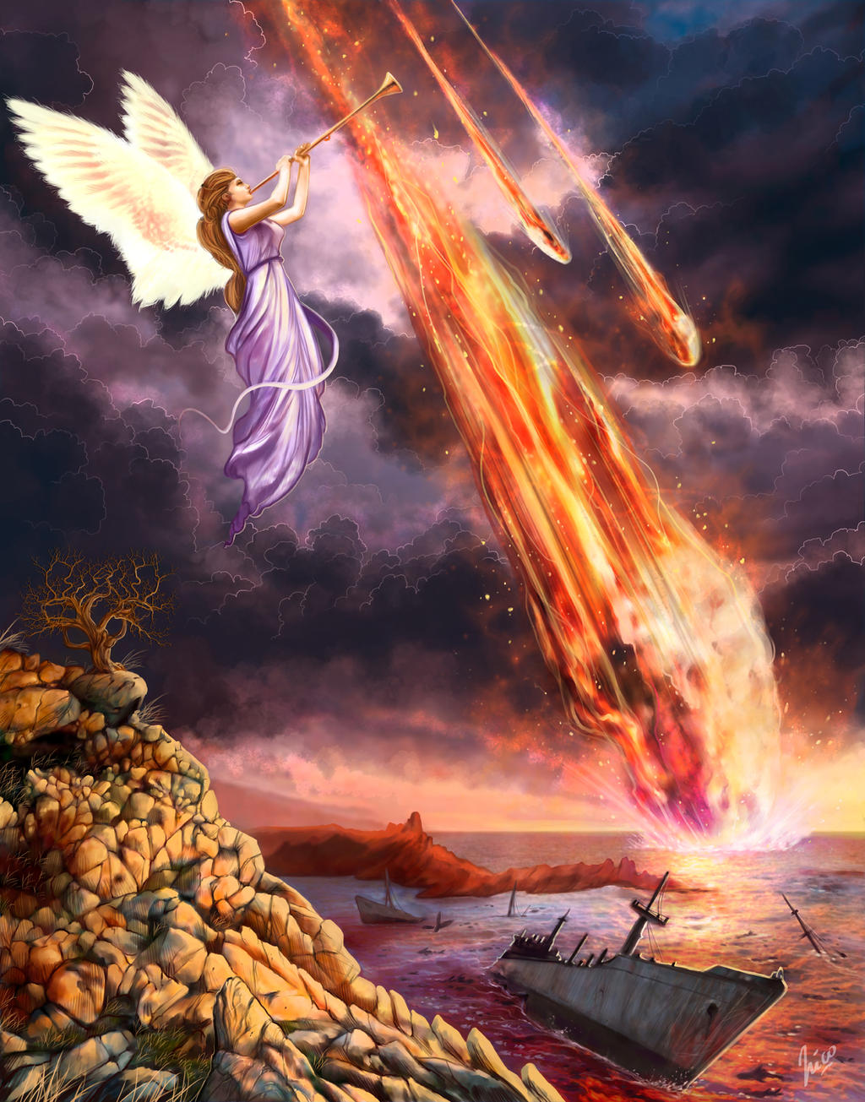
The Revelation
11. Seven trumpets were given
chapter 8-9

Slide 2
Review Quiz
Place these sections in order:
Letters to the churches
Seven seal judgments
Seven trumpet judgments
Christ appears to John
Vision of God & the Lamb
Christ appears (1)
Letters (2-3)
Throne & Lamb (4-5)
7 Seals (6-7)
7 Trumpets (8-9)

Slide 3
Revelation 8-9
Read (listen) to these chapters.
How would you (briefly, simply) explain what is going on in these chapters?
Discuss in groups
Share to the class

Slide 4
Making sense of Revelation 8-9
Put it in context – “when the Lamb opened the 7th seal…” (8:1)
the unfolding of God’s plan
serial judgments + rescue of God’s people
Identify key points – from this text
God responding to prayers (8:3-4)
heaven’s power unleashed on earth (8:5)
partial judgments (8:6-12; 9:5,18)
nightmares become reality (9:1-10)
purpose: mankind’s repentance (9:20-21)

Slide 5
Making sense of Revelation 8-9
See Biblical patterns – from OT and NT
fire, thunder, lightning of Sinai (8:5)
trumpets for warning, gathering, battle
plagues against Egypt (Exodus 7-12)
judgment as cosmic unraveling (Isaiah 13)
locusts / armies for judgment (Joel 1-2)
Consider the audience – 1st century Asia
persecuted, looking for God to act
tempted to compromise with sin
this comforts & rebukes in shocking images

Slide 6
More on the trumpets…
“silence in heaven” – gravity, anticipation
not a linear, chronological description
another angle on the judgments of 6-7
images & numbers are symbolic
the point: the horrors of God’s judgment
had a target for readers (Rome?)
same God Who works in the same way

Slide 7
Revelation 8-9
What do we learn about…
prayer?
catastrophes?
sin / wickedness?

Slide 8
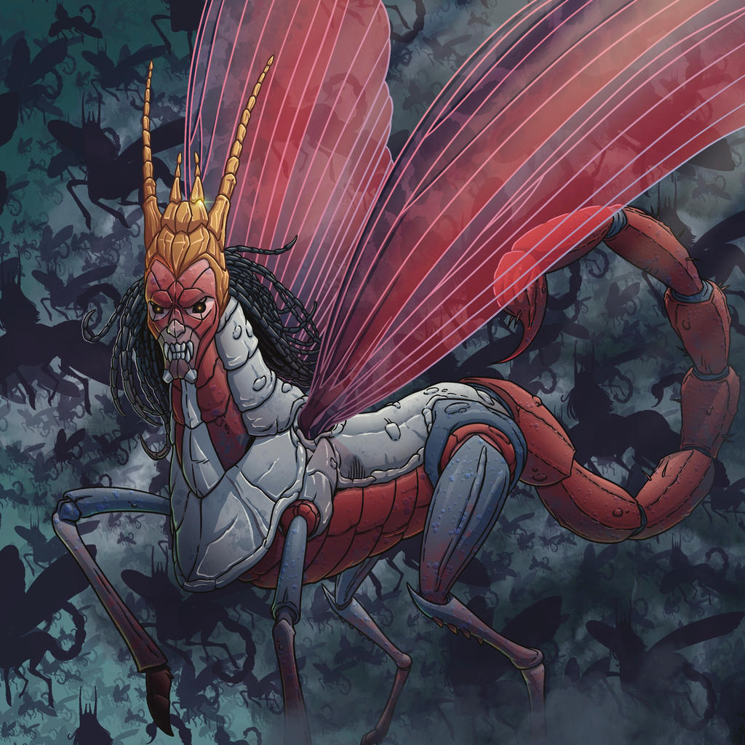
The Revelation
For Sunday (4/16)
12. Woe to those on the earth

