Slide 1
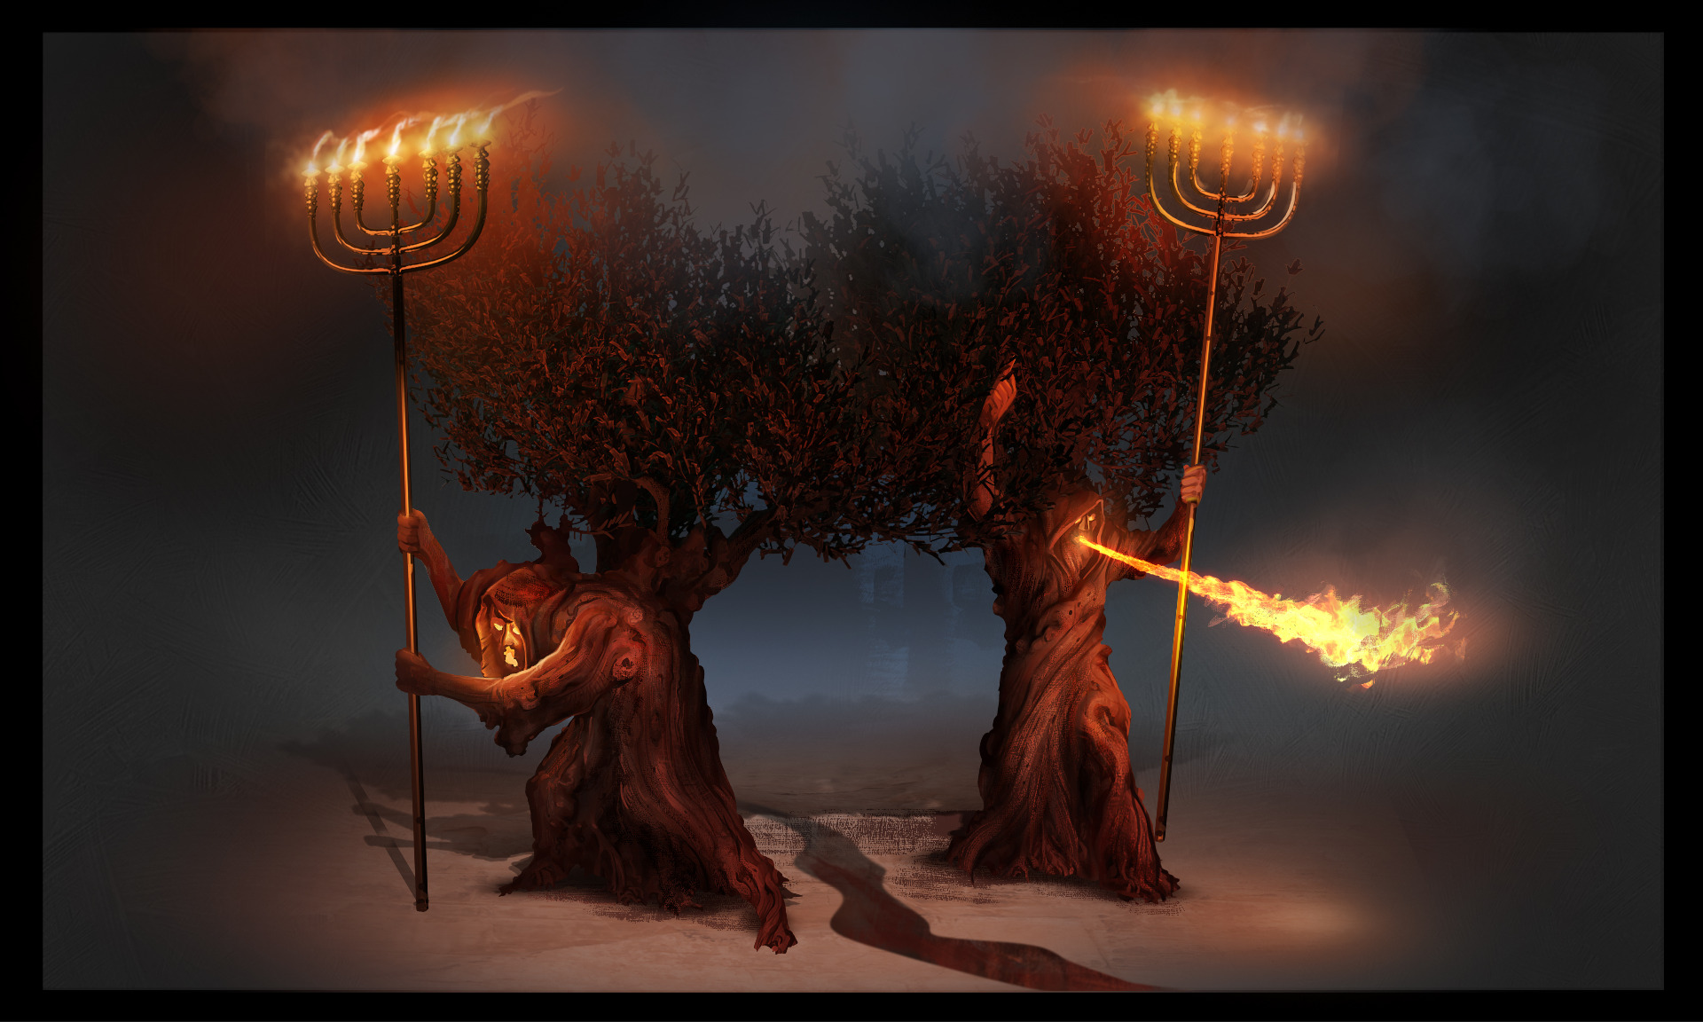
The Revelation
14. Authority to my two witnesses
chapter 11

Slide 2
Review: Revelation 1-11
Glorified Christ among the ______________ (1)
7 churches charged “he who ____________” (2-3)
God on throne, ______ taken by slain ______ (4-5)
lampstands
conquers
scroll
Lamb
Six ______ opened (6)
Interlude: God’s people _________ (7)
7th _____ opened (8)
Six _________ (8-9)
Interlude: John’s _____, _____________ (10-11)
7th _______ sounds (11)
seals
trumpets
call
sealed
????????
seal
trumpet
Interludes “happen” alongside the judgments
Interludes show role of God’s people in His plan

Slide 3
Revelation 10-11
Read (listen) to these chapters.
Get the big picture sense of what is going on

Slide 4
Making sense of Revelation 11
Do your best to offer a simple “explanation” of what is going on in Revelation 11
Use the tools we’ve discussed:
Put it in context of the Revelation story
Identify key points from this text
See Biblical patterns from OT and NT
Consider the audience (1st century Asia)

Slide 5
Two Witnesses (Rev. 11:1-14)
Measure the temple (1-2) – like sealing in ch.7, this marks off the people of God
God’s people as the temple (Ezekiel 40-48)
Protected, but not spared (trampling)
Two Witnesses (3-14) – granted authority
Called witnesses, prophets, olive trees, and lampstands → people of God (3-4)
They have the spirit of Moses & Elijah (5-6)
They are killed by the beast (see ch.13), their death is celebrated by the world (7-10)
They are raised & taken to heaven (11-12)
The result? The people glorify God (13)

Slide 6
Seventh Trumpet (Rev 11:15-19)
Eternal kingdom (15) – of God & His Christ
Everything fulfilled, completed (see 10:7)
Heaven and Earth reunited under the authority of God and the Son of Man
Worship around throne (16-18) – see ch.4
God is and was; “is to come” is no more (?)
He’s dealt with raging nations, destroyed the destroyers, and rewarded His servants
Temple opens (19) – separation removed
cycle concludes with God’s power (4:5; 8:5)

Slide 7
Reflections on Revelation 11
How can we as the church live as the witnesses described in Revelation 11?

Slide 8
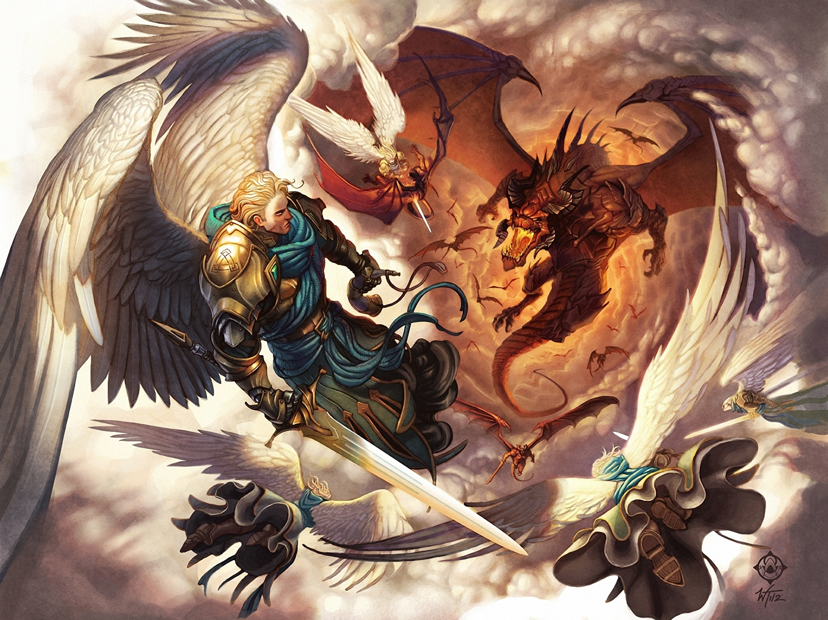
The Revelation
For Wednesday (4/26)
15. Now war arose in heaven

