Slide 1
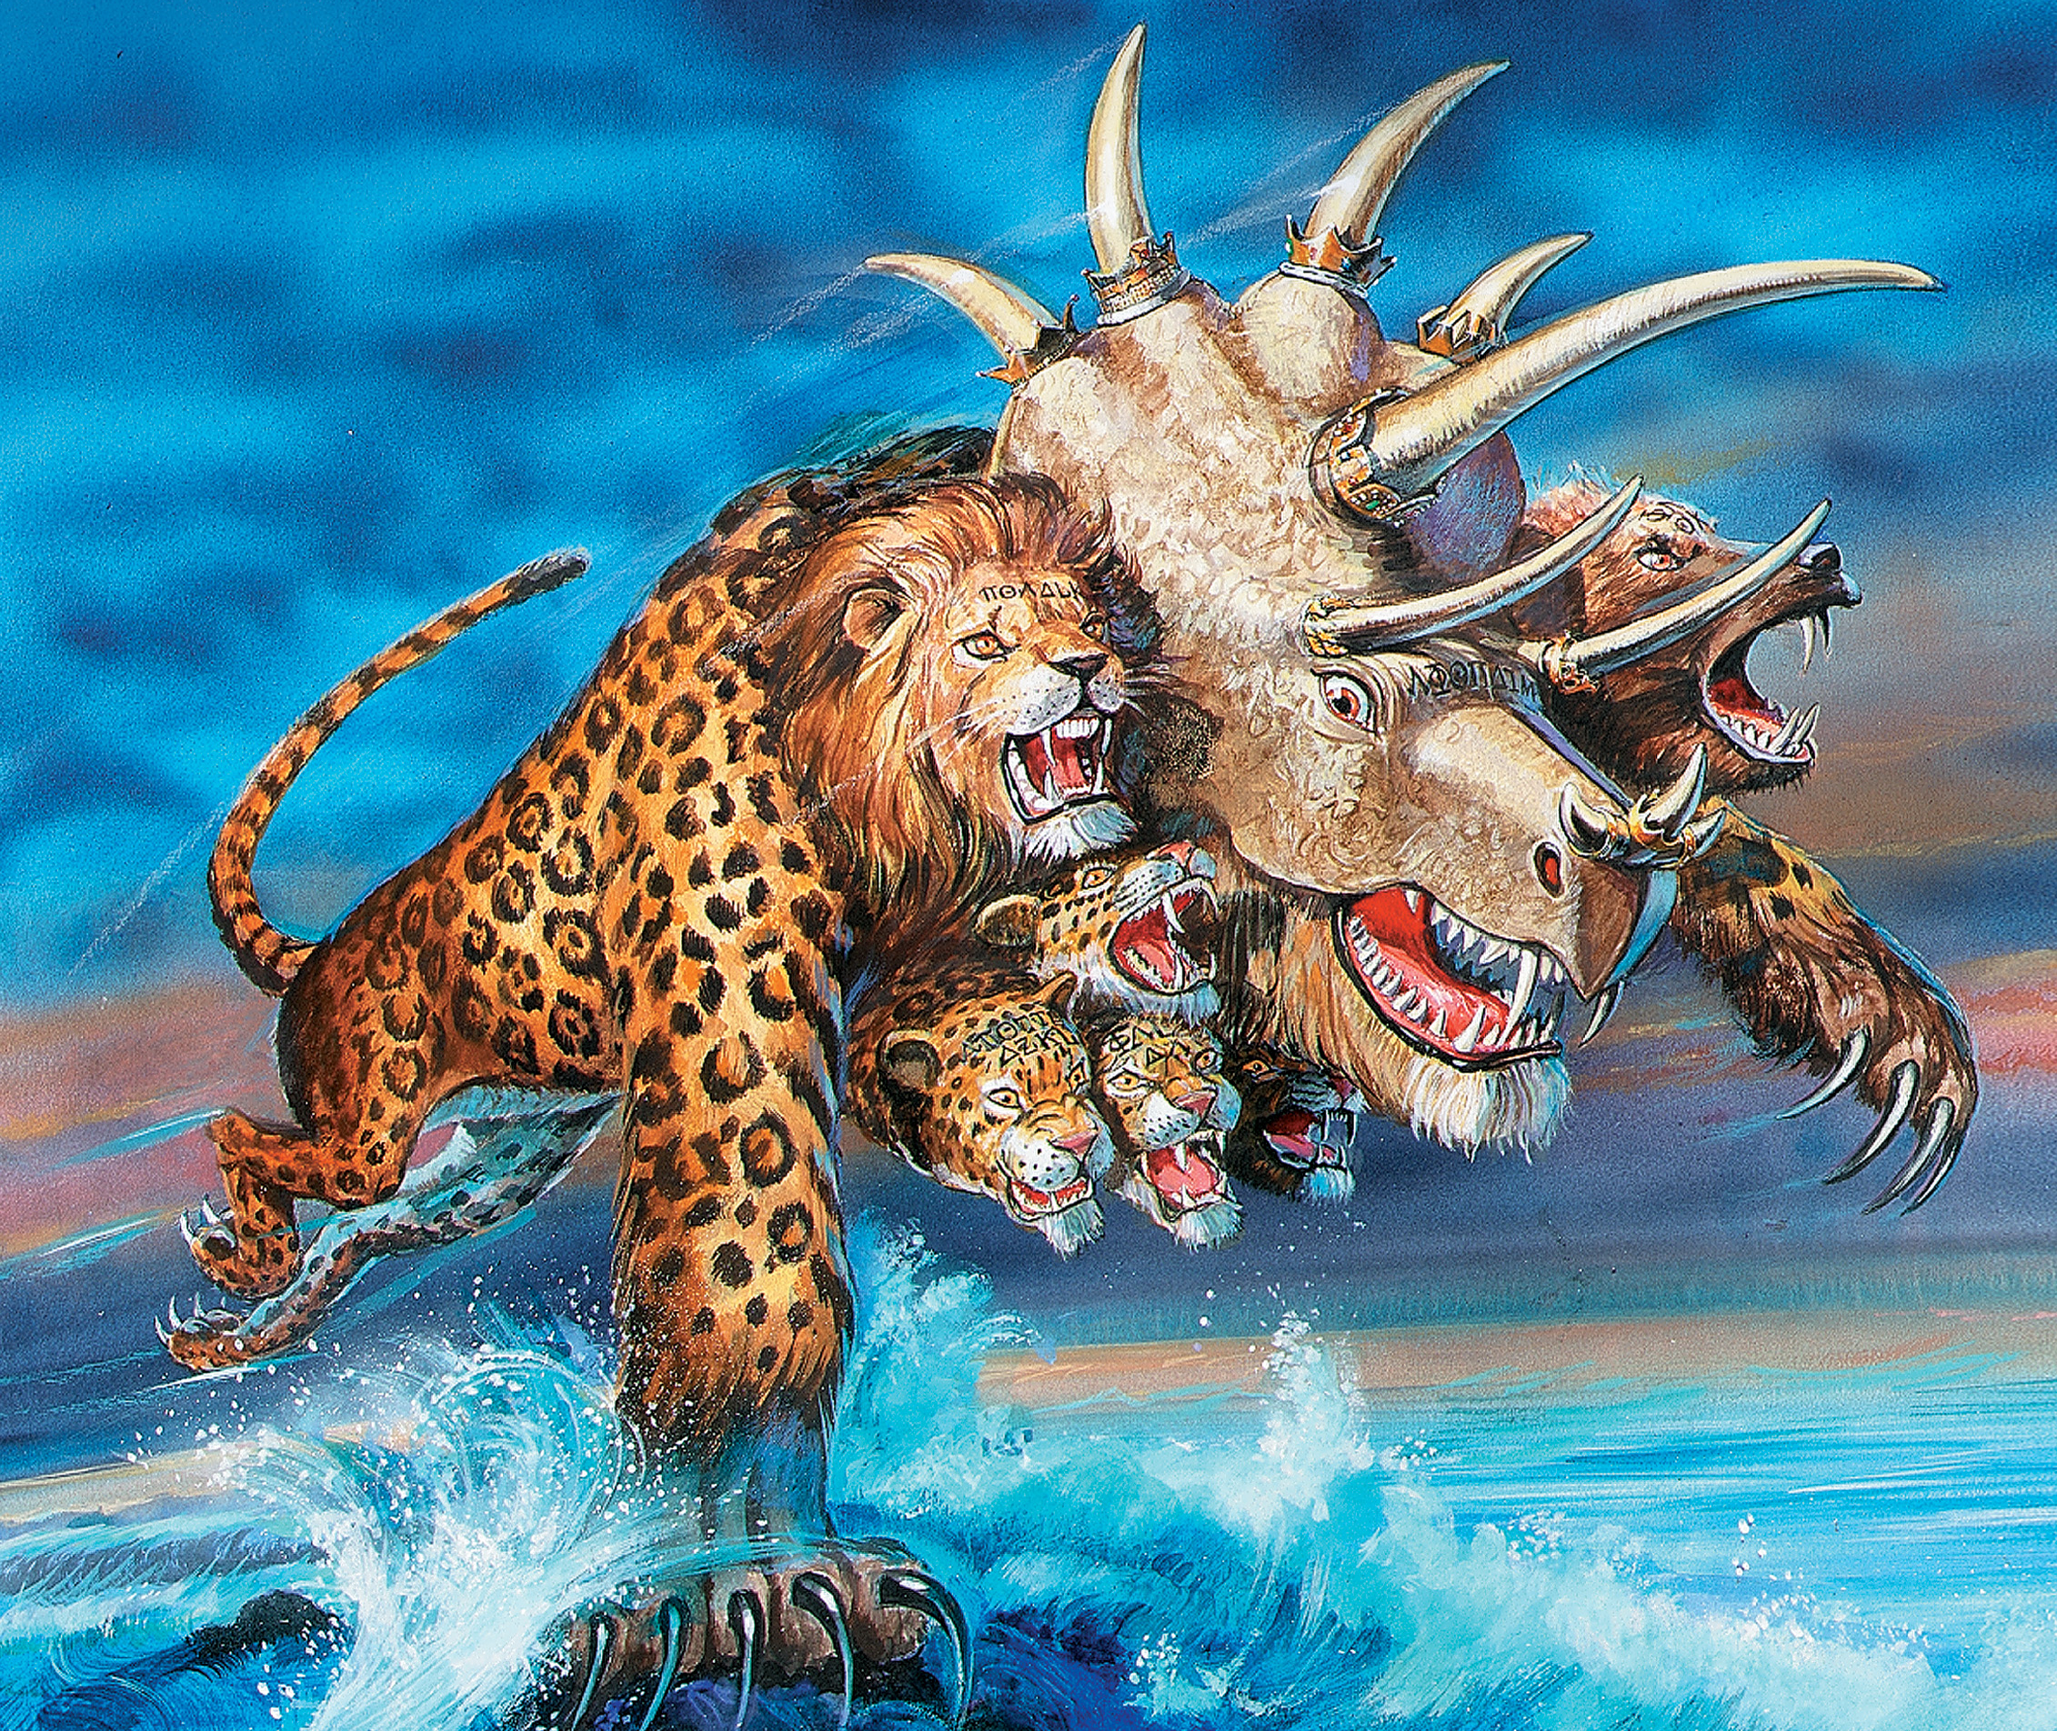
The Revelation
16. A beast rising out of the sea
chapter 13

Slide 2
Review (Revelation 12)
Who is the dragon?
What is his first attempt?
How is he cast out of heaven?
What does he do next?

Slide 3
Revelation 13:1-10
Read (listen to) the scene.
How is the dragon using the beast for his purposes?

Slide 4
Making sense of Revelation 13
See biblical patterns – from Daniel 7
What did the beasts represent in Dan 7?
Which beast does Rev 13 resemble?
10 horns, haughty words – 4th beast (7:7-8)
Makes war on saints – 4th beast (7:21)
Leopard, Bear, & Lion - all the beasts in one
What is the end/point of the Daniel 7?
The beast is the empire (Rome, then any other) which exalts itself in pride, and persecutes God’s people.

Slide 5
Making sense of Revelation 13
See in context – continuing the story
How does the dragon use the beast?
How is the beast a counterfeit Lamb?
Mortal wound healed → world marvels
Worshipped, “Who is like the beast?”
Conquers every tribe, people, language…
Dragon gives authority to beast, who causes all people to worship the dragon
The beast (empire) set itself up as god, to the diabolical end that honor, trust, and adoration are given to men and not to God.

Slide 6
Revelation 13:11-18
Read (listen to) the scene.
See this as another aspect of the same empire, not a different empire.

Slide 7
Making sense of Revelation 13
See in context – continuing the story
What tactics does the earth beast use to make people worship the sea beast?
Deceives them with signs
Gives breath to the lifeless image
Slays those who will not worship
Excludes those not belonging to the beast from the marketplace
Beasts (nations) use deception, force, economic pressure to achieve conformity.

Slide 8
Reflections on Revelation 13
How does the beast conquer us? How do we conquer the beast and the dragon?

Slide 9
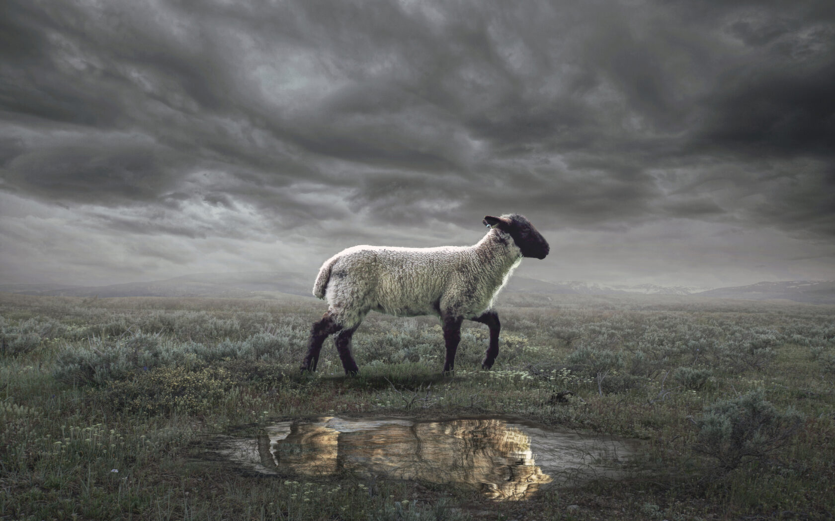
The Revelation
For Wednesday (5/3)
17. They follow the Lamb…

