Slide 1
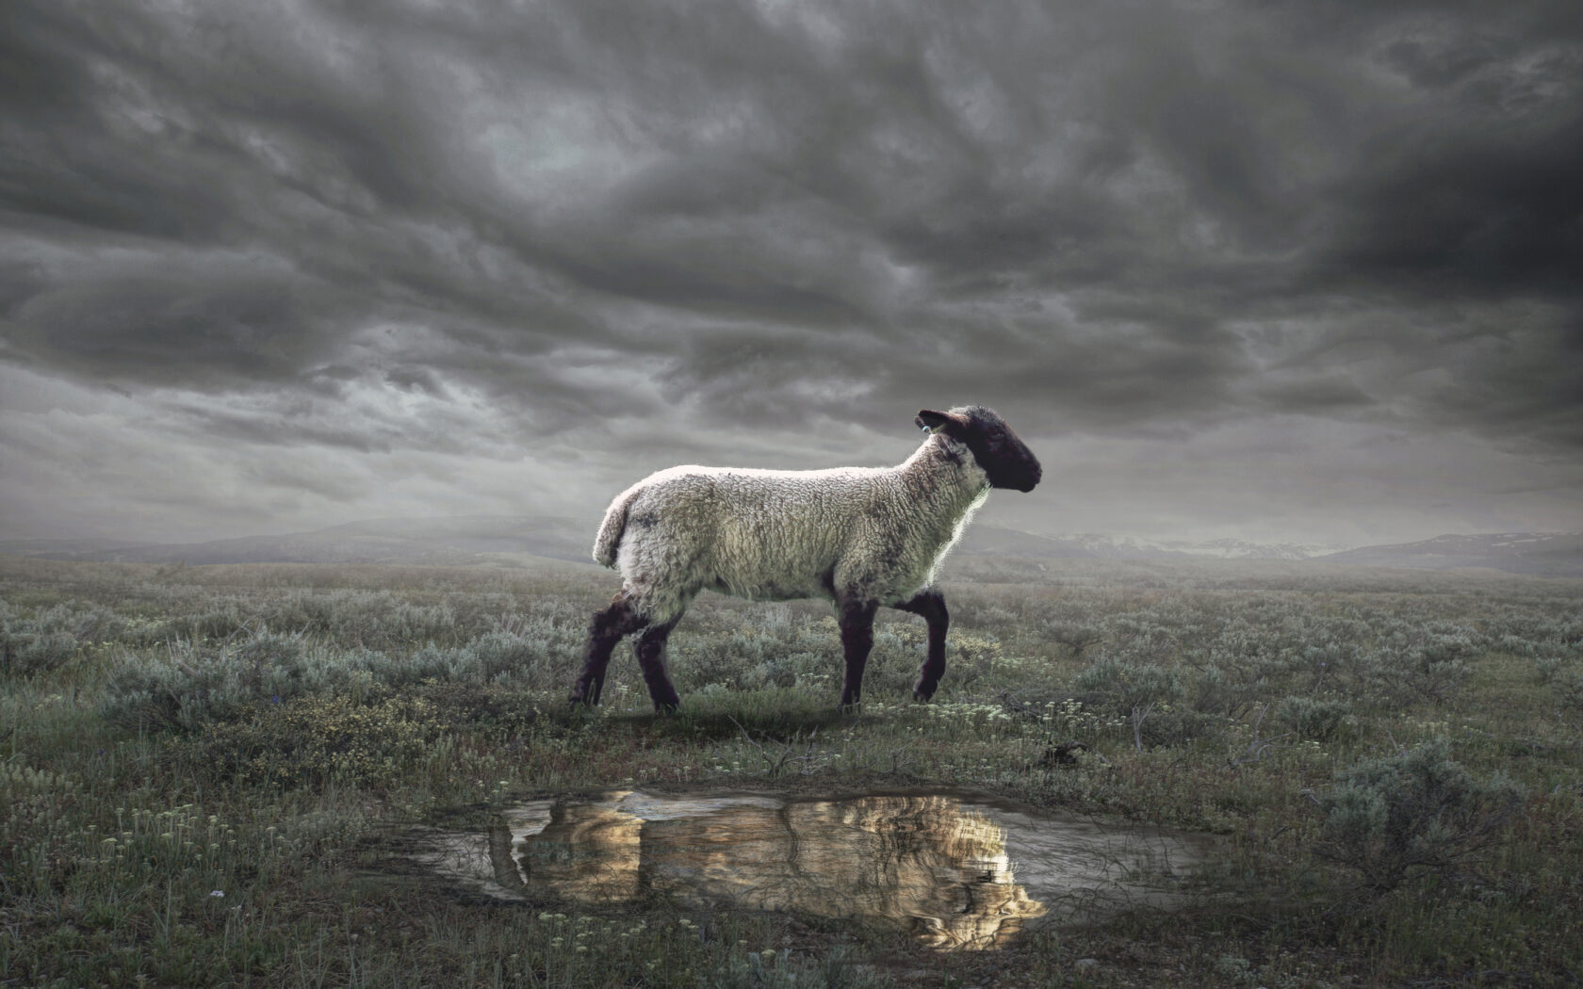
The Revelation
9. The Lamb opened the seals
chapter 6

Slide 2
Review Quiz
Summarize Revelation ch. 1, 2-3, 4, 5 with one sentence each.
Share out your answers
Discuss together in small groups

Slide 3
Revelation by the Chapter
Glorified Christ among the lampstands (1)
The state of the churches revealed (2-3)
God, sitting on the throne in heaven (4)
The Lamb is worthy to open the scroll (5)
First six seals opened → Judgments (6)
Interlude: Washed Israel is sealed (7)
Seventh seal opened → … (8)
Six Trumpets → Judgments (8-9)
Interlude: John’s prophetic call (10)
Interlude: Witness of the church (11)
Seventh trumpet → Visions in heaven (11)

Slide 4
Revelation 6-7
Imagine and feel what John is describing.
In the most basic terms, what is God planning to do?

Slide 5
Revelation 6:1-17
Four horsemen (1-8) – from Zechariah, where God was not blind or inactive
the judgments are painful but partial
Souls under the altar (9-11) – cry out for justice, told to rest until more are killed
slain for their witness like the Lamb
Sixth seal (12-17) – the final judgment?
prophets talk this way about nations
all days of the Lord point to The Day

Slide 6
How should we interpret Revelation?
Past Focus
As a Code
Present Focus
As a Lens
Future Focus

Slide 7
Revelation 6
What does this vision mean for the Christians in Roman Asia?
What does it mean for us?

Slide 8
The Revelation
For Sunday (4/9)
10. Who are these in white robes?

