Slide 1
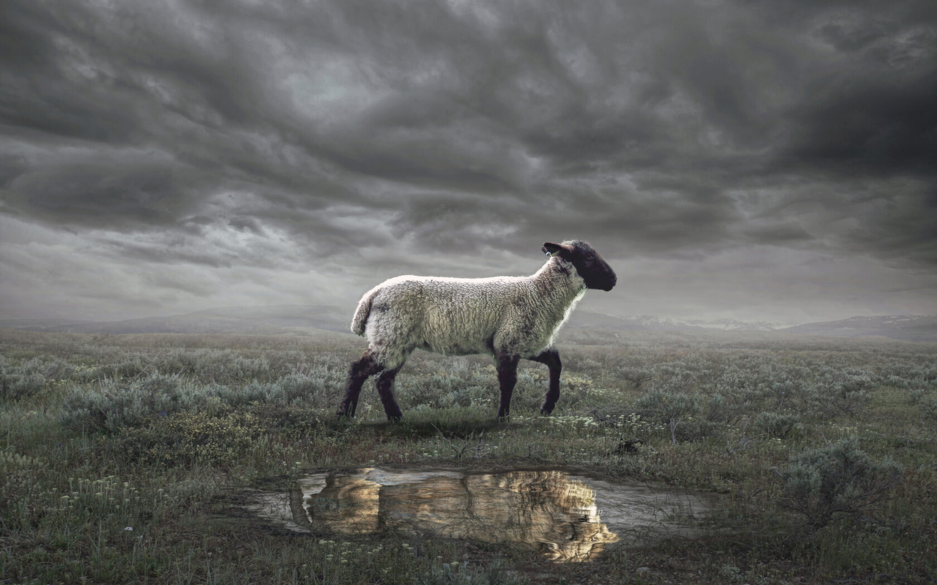
The Revelation
17. They follow the Lamb
chapter 14

Slide 2
Review (Revelation 12-13)
What is the dragon’s goal?
Who does he employ?
How does the beast operate?
What does all of this mean for saints?

Slide 3
Revelation 14
Read (listen to) the signs.
How does this chapter give confidence & comfort to the people of God?

Slide 4
Revelation 14:1-5
The Lamb on Mount Zion (1) – God’s king over the raging nations (Psalm 2)
The 144,000 (1-5) – The Lamb’s Army
Marked with Lamb’s name (see 13:16-18)
Sing a new song (5:9) that no one knows
They have resisted the world’s immortality
They imitate the Lamb’s conquering death
Redeemed as a promise of more to come
They choose truth over lies (see 13:14)

Slide 5
Revelation 14:6-13
1st proclamation (6-7) – gospel for all: Sovereign God’s judgment has come
2nd proclamation (8) – Babylon is fallen
3rd proclamation (9-11) – all who belong to the beast will be tormented forever
Call for endurance (12-13) – trust King Jesus, obey Him, rest is promised

Slide 6
Revelation 14:14-20
Two pictures of judgment? sharp sickle cuts down the wicked, tramples them in the winepress of God’s wrath (Isaiah 63:3)
One picture of salvation and one picture of judgment? the righteous are gathered in (Mark 4:29), wicked trampled
Two pictures of salvation? God’s people saved by shedding of their blood, like their Lamb (4:6) and King (19:15)

Slide 7
Reflections on Revelation 14
Why do we not see judgment as “good news” and why do we often fail to include it in our “testimony”?

Slide 8
Overview: Revelation 1-14
Introduction (1-3) – Glorified Christ revealed to John in exile; seven churches in crisis addressed
Heavenly Council (4-5) – God on throne, the scroll (plan to judge & to save), and the worthy Lamb
Seven seals (6-8) – God’s judgments on earth (6), God’s people sealed (7), 7th seal → trumpets (8)
Seven Trumpets (8-11) – God’s wrath on earth (8-9), God’s people bear witness (10-11), 7th trumpet brings the eternal kingdom of Christ (11)
Seven signs (12-15) – War in heaven (12) spills onto earth (13), Lamb conquers, wicked judged (14)

Slide 9
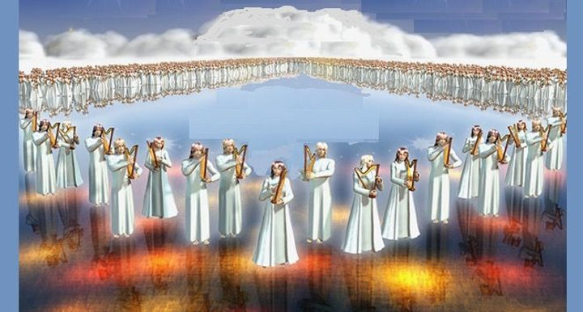
The Revelation
For Sunday (5/7)
18. Seven angels & seven plagues

