Slide 1
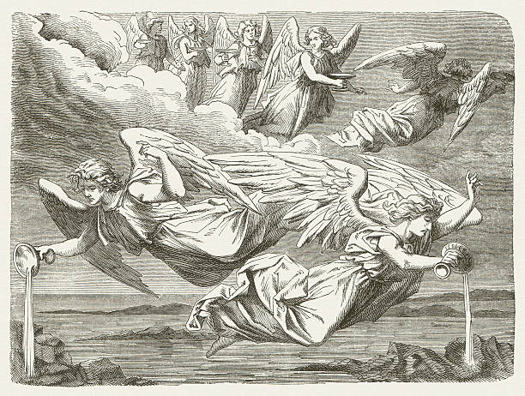
The Revelation
19. Seven bowls of God’s wrath
chapter 16

Slide 2
How we are reading The Revelation
Not so much…
Literal
Predictions of specific events
Timeline
Code to decipher
But more so…
Symbolic
Descriptions of God’s work
Drama
Lens for insight
This book reveals God’s sovereignty, His judgment on a wicked world; the nature of the enemy, his attacks; what’s at stake for God’s people in crisis.

Slide 3
Overview: Revelation 1-16
Introduction (1-3) – Glorified Christ revealed to John in exile; seven churches in crisis addressed
Heavenly Council (4-5) – God on throne, the scroll (plan to judge & to save), and the worthy Lamb
Seven seals (6-8) – God’s judgments on earth (6), God’s people sealed (7), 7th seal → trumpets (8)
Seven Trumpets (8-11) – God’s wrath on earth (8-9), God’s people bear witness (10-11), 7th trumpet brings the eternal kingdom of Christ (11)
Seven Signs (12-15) – War in heaven (12) spills onto earth (13), Lamb’s army conquers, wicked judged (14), 7th sign → angels with plagues/bowls (15)
Seven Bowls (15-16) – Total pouring out of wrath on the unrepentant, beast-worshipping Babylon

Slide 4
Revelation 15-16
Read (listen to) the drama.
What is revealed about God’s justice, holiness, & truth?

Slide 5
Making sense of Revelation 16
Patterns in Scripture – What reminds you of Exodus? Why is that significant?
In Context – What had the souls under the altar cried (6:10)? What is said here?
Key Points – What happens (in simple terms) at the “Battle of Armageddon”?
Original Readers – Why do the churches (ch.2-3) need the warning of 16:15?

Slide 6
Reflections on Revelation 16
How do we need to “wake up” (16:15) in response to Revelation 16?

Slide 7
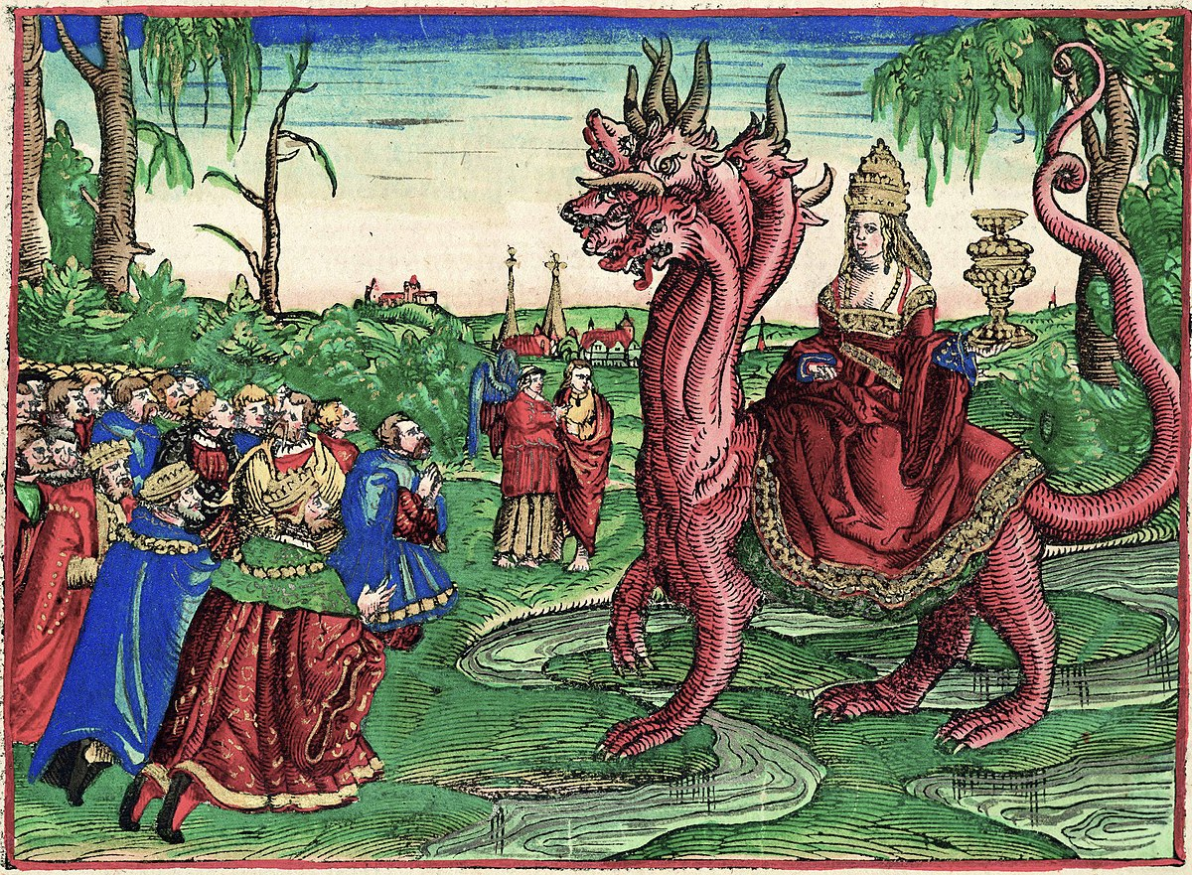
The Revelation
For Sunday (5/14)
20. The Great Prostitute (ch.17)

