Slide 1
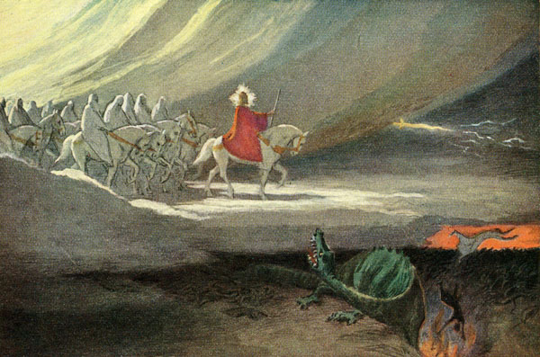
The Revelation
22. He will tread the winepress
chapter 19

Slide 2
Revelation Review
Look over, discuss in groups, we will share out soon
What are the three dangers facing the churches (ch.2-3)
What does the scroll (ch.5) represent?
What happens when seals are broken, trumpets are blown, and bowls are poured out?
Who is the Dragon? Who is the Beast? What is their relationship?
How does Lamb/His army conquer?

Slide 3
Overview of Revelation
Earthly Setting (1-3) – Jesus speaks, saints in crisis
Heavenly Setting (4-5) – God reigns; His plan (accomplished by the Lamb) will be carried out
Dramatic Cycles Picturing God’s Action:
Seven Seals (6-8) – Judgment (Saints protected)
Seven Trumpets (8-11) – Judgment (Saints testify)
Seven Signs (12-15) – Dragon & Beast vs. Saints
Seven Bowls (15-16) – Total wrath poured out
Final Showdowns:
Fall of Babylon (17-19) – and Bride readies herself
Defeat of Satan (19-20) – Christ conquers & reigns
New Jerusalem (21-22) – naught unclean will enter

Slide 4
Revelation 19
Read (listen to) the chapter.
What storylines, themes, symbols, ideas, etc. are starting to culminate in ch.19?

Slide 5
Revelation 19: Closer Look
Hallelujah, Worship God (1-10)
“Hallelujah!” (1,3,4,6) – Praise Yahweh!
“for he has judged” (2) – see 14:6-7, the “eternal gospel” of God’s just rule
elders & living creatures (4) – ch.4-5
“Marriage of the Lamb has come” (7-8) – faithful Bride, clothed in righteous deeds
“testimony of Jesus” (9-10) – it’s about Him, and no one else

Slide 6
Revelation 19: Closer Look
Tread the Winepress (11-21)
The Rider on the White Horse (11-16)
What is His name? (11,13,16, also v.12)
He conquers, but how? (13,15; 12:11)
He rules nations and kings (15-16)
Another feast! (17-18) – for the birds, see Ezekiel 39:17-20
The Beast (13:1), False Prophet (13:11, 16:13) and all with them are slain (19-21)

Slide 7
Reflections on Revelation 19
How does this vision of Jesus victory inspire you as His follower?

Slide 8
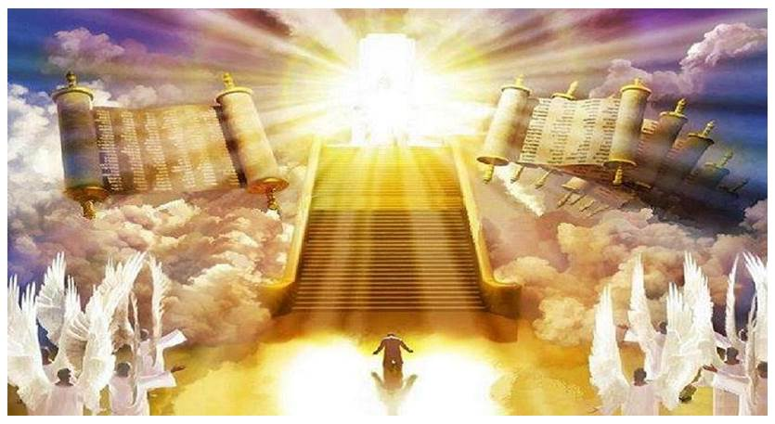
The Revelation
For Wednesday (5/24)
22. He seized Satan… (ch.20)

