Slide 1
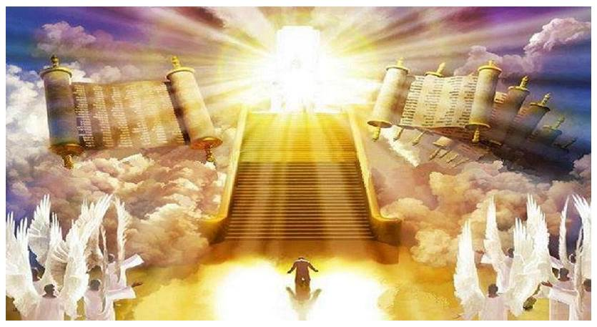
The Revelation
23. He seized Satan and bound
chapter 20

Slide 2
Revelation Review
What does it mean that Revelation is “apocalyptic literature”?
Written in a time of crisis
Pulls back the curtain, revealing transcendent reality (time & space)
Highly symbolic drama (story)
About God’s ultimate victory
Intended to grab attention, to comfort, and to challenge

Slide 3
Revelation Review
Earthly Setting (1-3) – Jesus speaks, saints in crisis
Heavenly Setting (4-5) – God reigns; His plan (accomplished by the Lamb) will be carried out
Dramatic Cycles Picturing God’s Action:
Seven Seals (6-8) – Judgment (Saints protected)
Seven Trumpets (8-11) – Judgment (Saints testify)
Seven Signs (12-15) – Dragon & Beast vs. Saints
Seven Bowls (15-16) – Total wrath poured out
Final Showdowns:
Fall of Babylon (17-19) – and Bride readies herself
Defeat of Satan (19-20) – Christ conquers & reigns
New Jerusalem (21-22) – naught unclean will enter

Slide 4
Revelation Review
What have we learned about the dragon so far in Revelation?
(ch.12; maybe also 9:1-11)
Violently opposes God’s plan
Thrown down/conquered by God, the Lamb, and the saints
Enraged against God’s people
Used by God to carry out His judgments on the earth

Slide 5
Revelation 20
Read (listen to) the chapter.
See the drama unfold, the basic plot points of the story.

Slide 6
Revelation 20: Closer Look
The Dragon’s Fall (1-6)
Satan Bound (1-3) – Defeated, limited, doomed (Lk 10:18; Jn 12:31; Rev 12:9)
for 1,000 years (2,3,4,6) – a long (complete?) time (Ps 50:10; 2 Pet 3:8)
Reign of the Beheaded (4) – the faithful witnesses conquer (11:11-12; 12:10-11)
“First resurrection” (5-6) - Rev 11:11 + Jn 11:35; or Jn 5:26 + Rom 6:4)

Slide 7
Revelation 20: Closer Look
One Final Rebellion (7-10)
To deceive the nations (8) – 2 Thess 2:11-12; Rom 1:18, 24, 26, 28
Gog & Magog (8-9) – from Ezekiel 38-39
After return & restoration (Ez 34-37)
Biggest, baddest army imaginable
God brings it to Judah to slay them
“Once I’ve restored you, even if the nations do their worst, I will protect/deliver you.”
Lake of Fire (10) – After final attempt, Satan joins beast in eternal destruction

Slide 8
Revelation 20: Closer Look
Great White Throne (11-15)
Him who was seated on it (11-12)
Back to ch. 5 (heavenly council)
Holy, transcendent (earth/sky flee)
Sits for judgment (books opened)
Holds each one accountable
Knows who are His (3:5; 13:8; 17:8)
Death & Hades (13-5) – ”the last enemy to be conquered is death” (1 Cor 15:26)

Slide 9
Reflections on Revelation 20
What perspective does this chapter give us and how does it shape our lives?

Slide 10
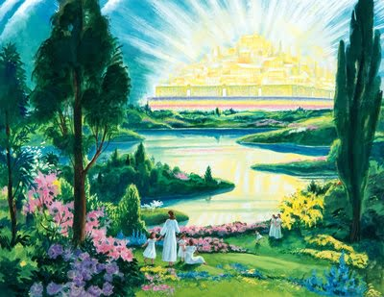
The Revelation
For Sunday (5/28)
23. New heaven, new earth (ch.21)

