Slide 1
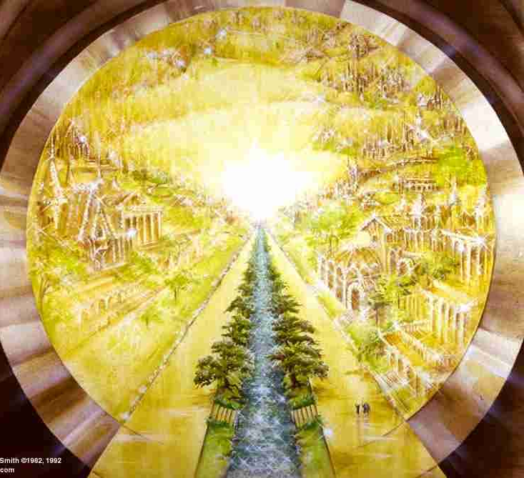
The Revelation
25. They will reign forever and ever
chapter 22

Slide 2
Revelation Review
What is the genre (type of writing) of the Book of Revelation?
_____________________
_________
______
Apocalyptic Literature
Prophecy
Letter

Slide 3
How should we interpret Revelation?
Our attempt at a “sweet spot”
Past Focus
As a Code
As a Lens
Future Focus

Slide 4
Revelation Review
What were the dangers facing the Christians in 1st century Asia?
___________
____________
_______
Persecution
The Revelation pulls back the curtain to comfort (God reigns, evil will fall) and challenge (get on the right side or else).
Compromise
Apathy

Slide 5
Revelation Overview
Earthly Setting (1-3) – Jesus speaks, saints in crisis
Heavenly Setting (4-5) – God reigns; His plan (accomplished by the Lamb) will be carried out
Dramatic Cycles Picturing God’s Action:
Seven Seals (6-8) – Judgment (Saints protected)
Seven Trumpets (8-11) – Judgment (Saints testify)
Seven Signs (12-15) – Dragon & Beast vs. Saints
Seven Bowls (15-16) – Total wrath poured out
Final Showdowns:
Fall of Babylon (17-19) – and Bride readies herself
Defeat of Satan (19-20) – Christ conquers & reigns
New Jerusalem (21-22) – naught unclean will enter

Slide 6
Making sense of Rev. 21-22
Original Readers
What promises were made to the seven churches in ch.2-3?
Eat of the tree of life (2:7)
Crown of life, not hurt by 2nd death (10-11)
Hidden manna, white stone, new name (17)
Authority over the nations; morning star (27)
Clothed in white; name not blotted (3:5)
Pillar in the temple of God; new name (12)
Grant him to sit on my throne (21)

Slide 7
Revelation 22:6-21
Read (listen to) the conclusion.
What is the final note(s) sounded in this symphony? What does that say about the book?

Slide 8
Rev. 22:6-21 - Closer Look
These words are faithful & true (6)
Faithful Witness (13,16,20; see 1:5,8)
chain of revelation (6,8,16; see 1:1-3)
I am coming soon (7,10-11,12,17,20)
immediacy (10-11; “thief in the night”)
invitation (17; see Isaiah 55:1-3)
Keep the words (7,9,12,14-15,18-19)
Coming with recompense (12-13)
Grace (21), cleansing (14), and living water for the thirsty (17)

Slide 9
Reflections on Revelation 22
How do we “keep the words” of the Book of Revelation?

Slide 10
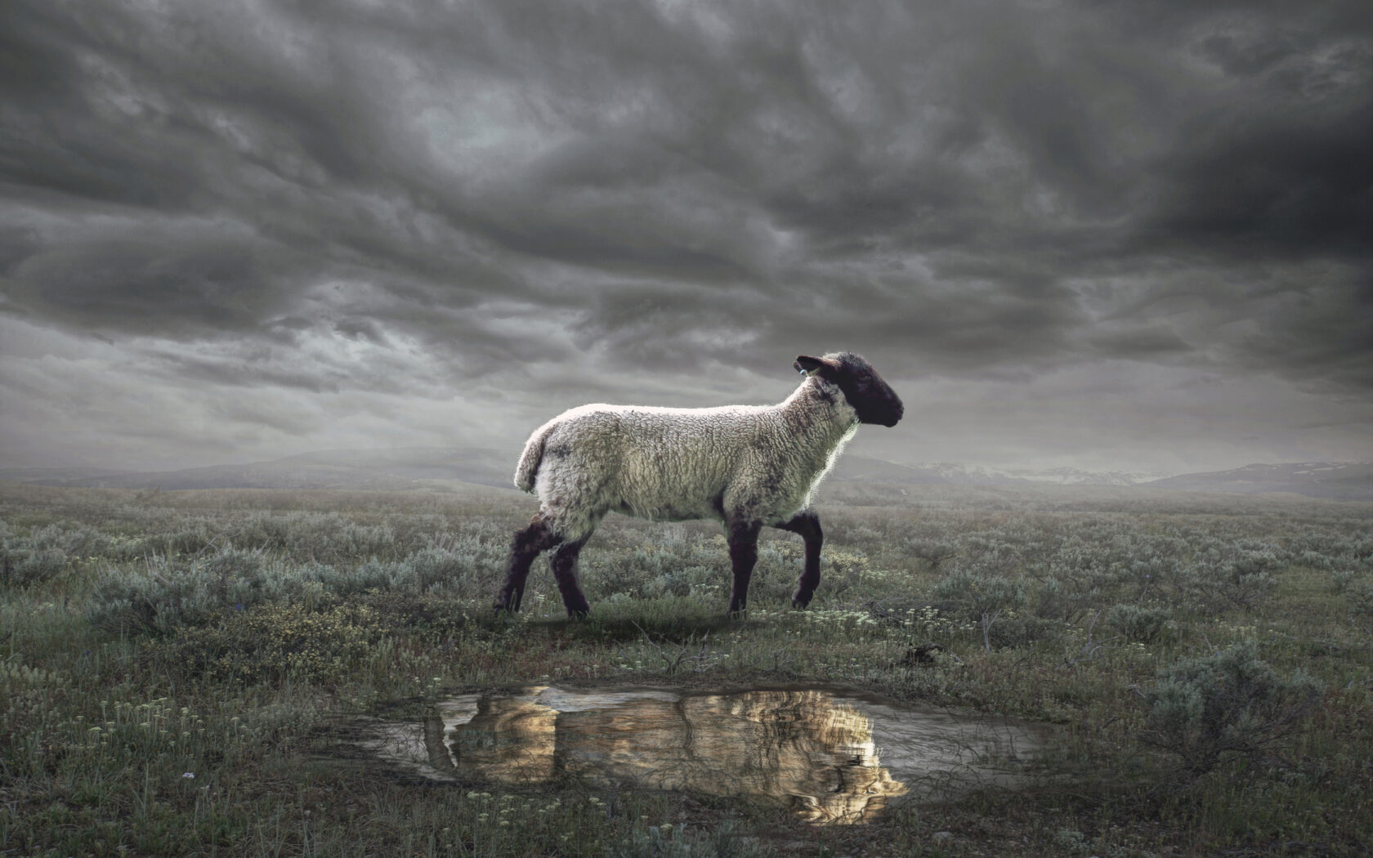
The Revelation
Sunday, June 4 – New Class!
The Church (Brian Haley)

