Slide 1
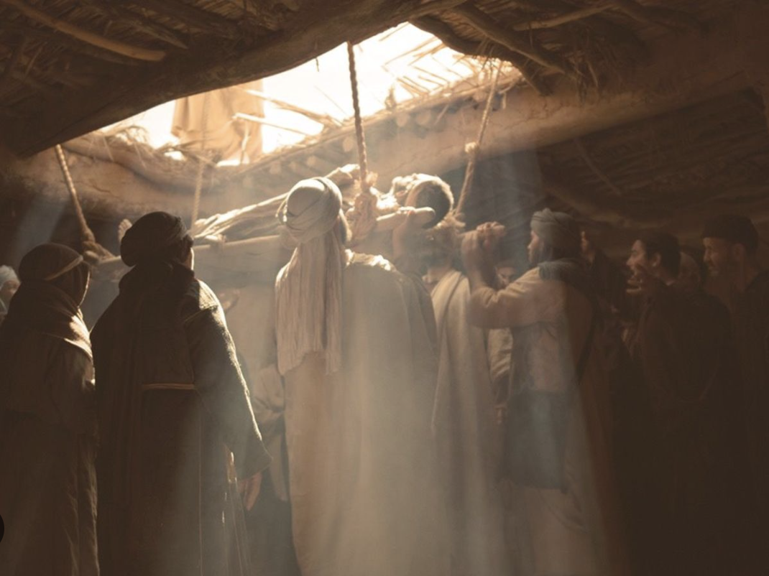
Forgiven & Healed
Matthew 9:1-8

Slide 2
And getting into a boat he crossed over and came to his own city. And behold, some people brought to him a paralytic, lying on a bed. And when Jesus saw their faith, he said to the paralytic, “Take heart, my son; your sins are forgiven.” And behold, some of the scribes said to themselves, “This man is blaspheming.” But Jesus, knowing their thoughts, said, “Why do you think evil in your hearts? For which is easier, to say, ‘Your sins are forgiven,’ or to say, ‘Rise and walk’? But that you may know that the Son of Man has authority on earth to forgive sins”—he then said to the paralytic—“Rise, pick up your bed and go home.” And he rose and went home. When the crowds saw it, they were afraid, and they glorified God, who had given such authority to men. (Matt. 9:1-8)

Slide 3
Authority to Forgive
“And getting into a boat he crossed over and came to his own city. And behold, some people brought to him a paralytic, lying on a bed.” Matthew 9:1-2

Slide 5
Authority to Forgive
“And getting into a boat he crossed over and came to his own city. And behold, some people brought to him a paralytic, lying on a bed.” Matthew 9:1-2
“And when Jesus saw their faith, he said to the paralytic, ‘Take heart, my son; your sins are forgiven.’” Matthew 9:2
Why forgiveness and not healing?

Slide 6
“Thank you, Jesus, but this man is paralyzed! He needs healing, not forgiveness!”
Would the coming of such a one be good news for sinners?
Only if that same Lord came with grace & forgiveness for sinners.
What are we seeing in this act of forgiveness?
The gift of reconciliation with God through the forgiveness of sin.

Slide 7
Without the forgiveness Christ can offer, healing is a fresh battery in a flashlight on the edge of an eternal night.
Guilt paralyzes. Grace heals.
Have mercy on me, O God,
according to your steadfast love;
according to your abundant mercy
blot out my transgressions.
Wash me thoroughly from my iniquity,
and cleanse me from my sin! (Psa. 51:1-2)

Slide 8
Purge me with hyssop, and I shall be clean;
wash me, and I shall be whiter than snow.
Let me hear joy and gladness;
let the bones that you have broken rejoice.
Hide your face from my sins,
and blot out all my iniquities.
Create in me a clean heart, O God,
and renew a right spirit within me.
Cast me not away from your presence,
and take not your Holy Spirit from me.
Restore to me the joy of your salvation,
and uphold me with a willing spirit. (Psa. 51:7-12)

Slide 9
Blessed is the one whose transgression is forgiven,
whose sin is covered.
Blessed is the man against whom the LORD counts no iniquity,
and in whose spirit, there is no deceit.
For when I kept silent, my bones wasted away
through my groaning all day long.
For day and night your hand was heavy upon me;
my strength was dried up as by the heat of summer. Selah
I acknowledged my sin to you,
and I did not cover my iniquity;

Slide 10
I said, “I will confess my transgressions to the LORD,”
and you forgave the iniquity of my sin. Selah
Therefore, let everyone who is godly
offer prayer to you at a time when you may be found;
surely in the rush of great waters,
they shall not reach him.
You are a hiding place for me;
you preserve me from trouble;
you surround me with shouts of deliverance. Selah
(Psa. 32:1-7)

Slide 11
Because he intends to pay the debt that this man owed in blood, in his own blood, by the end of his ministry.
He knew that he would take this man’s record of wrongdoing to his cross, to be nailed there, and left there, and finished there.
He knew that he would go into the grave of death,
He knew He would rise from that grave,
He knew He would destroy death right there so that this man could have resurrection and life.
He knows that “He is the resurrection and the life”. (John 11:25-26)

Slide 12
“because, if you confess with your mouth that Jesus is Lord and believe in your heart that God raised him from the dead, you will be saved. For with the heart one believes and is justified, and with the mouth one confesses and is saved.” (Romans 10:9-10)
“In him you also, when you heard the word of truth, the gospel of your salvation, and believed in him, were sealed with the promised Holy Spirit,” (Ephesians 1:13)
“Now when they heard this they were cut to the heart, and said to Peter and the rest of the apostles, “Brothers, what shall we do?” And Peter said to them, “Repent and be baptized every one of you in the name of Jesus Christ for the forgiveness of your sins, and you will receive the gift of the Holy Spirit.” (Acts 2:37-38)

Slide 13
“If we confess our sins, he is faithful and just to forgive us our sins and to cleanse us from all unrighteousness. If we say we have not sinned, we make him a liar, and his word is not in us.” (1John 1:9-10)
“Do you not know that all of us who have been baptized into Christ Jesus were baptized into his death? We were buried therefore with him by baptism into death, in order that, just as Christ was raised from the dead by the glory of the Father, we too might walk in newness of life. For if we have been united with him in a death like his, we shall certainly be united with him in a resurrection like his. We know that our old self was crucified with him in order that the body of sin might be brought to nothing, so that we would no longer be enslaved to sin.” (Romans 6:3-6, ESV)

Slide 14
“And He said to them, “Go into all the world and preach the gospel to all creation. The one who has believed and has been baptized will be saved; but the one who has not believed will be condemned.” (Mark 16:15-16)
“in whose case the god of this world has blinded the minds of the unbelieving so that they will not see the light of the gospel of the glory of Christ, who is the image of God.” (2 Corinthians 4:4)
“For whoever has been born of God overcomes the world; and this is the victory that has overcome the world: our faith. Who is the one who overcomes the world, but the one who believes that Jesus is the Son of God?” (1John 5:4-5)

Slide 15
Forgiven & Healed
Matthew 9:1-8

