Slide 1
Church of Christ
God’s Unfolding Plan of Salvation

Slide 2
Baptism – Choosing of God’s Sons
Become Children of God at Baptism

Slide 3
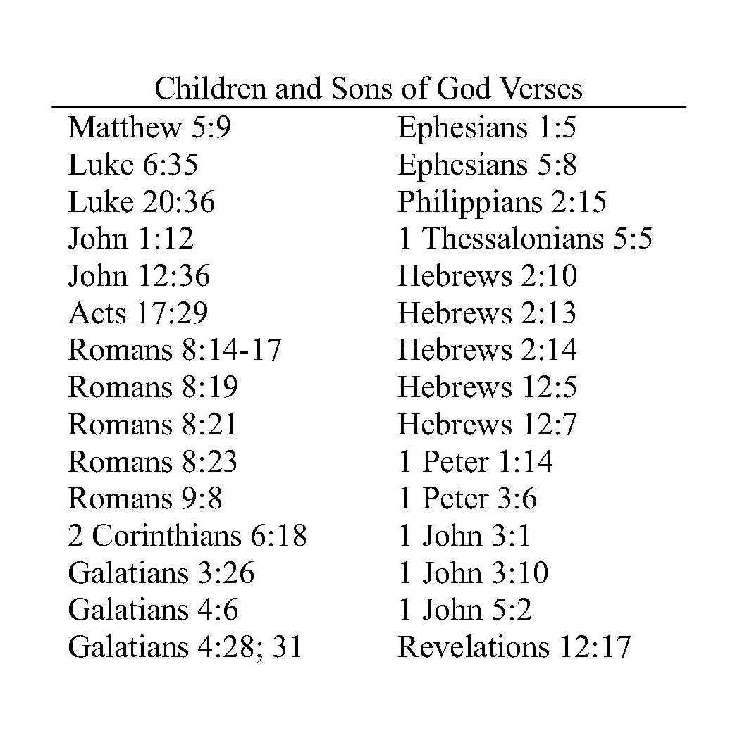
Baptism – Choosing of God’s Sons
There are a number of verses revealing the sons and children of God
However, there are only two verses that reveal when and how we become the children of God

Slide 4
Baptism – Choosing of God’s Sons
Galatians 3:26-29 For you are all sons of God through faith in Christ Jesus. ²⁷ For all of you who were baptized into Christ have clothed yourselves with Christ. ²⁸ … for you are all one in Christ Jesus. ²⁹ And if you belong to Christ, then you are Abraham's descendants, heirs according to promise.
Ephesians 1:4-5 just as He chose us in Him before the foundation of the world, that we would be holy and blameless before Him. In love ⁵ He predestined us to adoption as sons through Jesus Christ to Himself, according to the kind intention of His will,

Slide 5
Baptism – Choosing of God’s Sons
In the English language, the word “for” has many different meanings. For purposes of understanding scripture, there are two principal applications of the word “for” when used as a preposition in the English language
For – a “function word” indicating the object of the verb to show purpose or cause of something
Example: Exercise for strength. Strength is the object of the verb exercise – shows the purpose or goal of the verb exercise, i.e., for the purpose of strength or in order to be strong
For – a “causal word” that introduces a clause which is used as an explanation, i.e., because.
Example: Put on your coat for it is cold, i.e, “for” introduces the clause explaining why you put your coat on - because it is cold

Slide 6
Baptism – Choosing of God’s Sons
In the Greek language, the English word “for” is translated from two Greek words
Eis – a “function word” indicating the object of the verb to show purpose or cause of something. It is directional – it is always forward looking. In its most literal sense, it means “to” or “into”
Acts 2:38 Peter said to them, "Repent, and each of you be baptized in the name of Jesus Christ for (eis – for the purpose of, in order for, to, into) the forgiveness of your sins; ….
Gar - a “causal word” that introduces a clause which is used as an explanation, i.e., because. In Matthew 26:28, why drink from the cup? Because ….
Matthew 26:28 (drink from the cup) for (gar – because) this is My blood of the covenant, which is poured out for (peri – concerning) many for (eis – for the purpose of, in order for, to, into) forgiveness of sins.

Slide 7
Baptism – Choosing of God’s Sons
Galatians 3:24-25 (Concerning the preparatory nature of the Law of Moses) Therefore the Law has become our tutor to lead us to Christ, so that we may be justified by faith. ²⁵ But now that faith has come, we are no longer under a tutor.
Question: Why? How do we know faith has come? Because….
Galatians 3:26 For (Geek gar - because) you are all sons of God through faith in Christ Jesus.
Question: Why? How do we know we are sons of God? Because….
Galatians 3:27 For (Geek gar - because) all of you who were baptized into Christ have put on Christ.
Question: Why? How do we know we are in Christ? Because….
²⁸ … for (Geek gar - because) you are all one in Christ Jesus.(the body of Christ which is the church) ²⁹ And if you belong to Christ (church belongs to Christ), then you are Abraham's descendants, heirs according to promise. (Promise is eternal life – Titus 1:2; Christ is the promised blessing – Galatians 3:16)
Galatians 4:28 And you brethren, like Isaac, are children of promise.

Slide 8
Baptism – Choosing of God’s Sons
God promised Abraham a son – Isaac – the promised child
God chose Isaac over Ishmael – Abraham’s son and heir
God chooses us in Christ (the promised blessing) to be His children
Therefore, we are children of promise and heirs of promise
Galatians 3:26-29 For you are all sons of God through faith in Christ Jesus. (Why?) ²⁷ For all of you who were baptized into Christ have clothed yourselves with Christ. (Why?)
²⁸ … for you are all one in Christ Jesus. ²⁹ And if you belong to Christ (church belongs to Christ), then you are Abraham's descendants, heirs according to promise.
Galatians 4:28 And you brethren, like Isaac, are children of promise. (Christ is the promise)
Romans 9:6-8 … For they are not all Israel who are descended from Israel; ⁷ nor are they all children because they are Abraham's descendants, but: "THROUGH ISAAC YOUR DESCENDANTS WILL BE CALLED." ⁸ That is, it is not the children of the flesh who are children of God, but the children of the promise are regarded as descendants.

Slide 9
Baptism – Choosing of God’s Sons
Confirming Galatians 3:26-27 is Ephesians 1:4-5
Ephesians 1:4-5 just as He chose us in Him before the foundation of the world , that we would be holy and blameless before Him. In love ⁵ He predestined us to adoption as sons through Jesus Christ …
2 Peter 3:15-16 just as also our beloved brother Paul, …wrote to you, ¹⁶ as also in all his letters, speaking in them of these things, in which are some things hard to understand, which the untaught and unstable distort, as they do also the rest of the Scriptures, to their own destruction.

Slide 10
Baptism – Choosing of God’s Sons
Ephesians 1:4 just as He chose us in Him before the foundation of the world , ….
2 Thessalonians 2:13 …. God has chosen you from the beginning for salvation ….
Question: What did God choose us for?
Answer: God chose us for salvation – 2 Thessalonians 2:13.
Therefore, the Ephesians 1:4 should be understood as
Ephesians 1:4-5 just as He chose us (for salvation) in Him before the foundation of the world

Slide 11
Baptism – Choosing of God’s Sons
Ephesians 1:4 just as He chose us (for salvation) in Him…
Question: Who are the “in Him”?
Answer: Those who have been baptized into Christ
Galatians 3:27 For all of you who were baptized into Christ have put on Christ.
Question: Who did God choose for salvation?
Answer: Those who have been baptized into Christ – the “in Christ” - Mark 16:16
Therefore, Ephesians 1:4 can now be understood to say
Ephesians 1:4 just as He chose us (for salvation) in Him (the baptized in Christ - the church) …

Slide 12
Baptism – Choosing of God’s Sons
Ephesians 1:4-5 just as He chose us (for salvation) in Him (the baptized in Christ – the church) before the foundation of the world , …
2 Thessalonians 2:13 …. God has chosen you from the beginning for salvation ….
Question: Who did God predestine for salvation “from the beginning” and “before the foundation of the world”?
Answer: Those who are “in Him.”
Question: Who are the “in Him”?
Answer: Those who have been baptized into Christ – the church
Conclusion: God predestined for salvation the “baptized in Christ – the church” “from the beginning” and “before the foundation of the world.”
God did not predestine who would be saved. He gave us “free will” to choose or not choose salvation through belief and baptism into Christ

Slide 13
Baptism – Choosing of God’s Sons
Ephesians 1:4-5 just as He chose us (for salvation) in Him (the baptized into Christ - the church) before the foundation of the world, that we would be holy and blameless before Him. …
Question: How did the “in Him”, the “in Christ” become holy and blameless?
Answer: Made holy and blameless when baptized into Christ for cleansing of sins – when we became “the predestined” “in Christ”; the predestined “in Him.”
Acts 22:16 … be baptized, and wash away your sins, ....’
Ephesians 5:25-27 … Christ also loved the church and gave Himself up for her, ²⁶ so that He might sanctify her, having cleansed her by the washing of water with the word, ²⁷ that He might present to Himself the church in all her glory, having no spot or wrinkle or any such thing; but that she would be holy and blameless.

Slide 14
Baptism – Choosing of God’s Sons
Therefore, to this point Ephesians 1:4 can be understood to say
Ephesians 1:4-5 just as He chose us (for salvation) in Him (we who have been baptized into Christ – the church) before the foundation of the world , that we would be holy and blameless before Him ( because the in Christ have obtained cleansing of sins). …

Slide 15
Baptism – Choosing of God’s Sons
Ephesians 1:4-5 just as He chose us (for salvation) in Him (we who have been baptized into Christ) before the foundation of the world , that we would be holy and blameless before Him ( because we were baptized into Christ for cleansing of sins). In love ⁵ He predestined us to adoption as sons through Jesus Christ …
Question: How did God predestine us to adoption as sons
Answer: “just as” He chose us (from the beginning for salvation – 2 Thessalonians 2:13) in Him (we who have been baptized for remission of sins – Acts 22:16) before the foundation of the world
Ephesians 1:4-5 just as He chose us (for salvation) in Him (we who have been baptized into Christ) before the foundation of the world , …⁵ He predestined us to adoption as sons through Jesus Christ …. (i.e., God predestined the saved in Christ to be His son) Or:
Galatians 3:26-27 For you are all sons of God through faith in Christ Jesus. ²⁷ For all of you who were baptized into Christ have put on Christ.

Slide 16
Baptism – Choosing of God’s Sons
To Summarize:
When baptized
Our sins are washed away – Acts 22:16
Our sins are forgiven; made holy and blameless– Acts 2:38, Ephesian 1:4; 5:26
We are saved - Mark 16:16
We are in Christ – Galatians 3:26-27
2 Thessalonians 2:13 - From the beginning, God chose us for salvation
Ephesians 1:4 - Before the foundation of the world, God chose us in Him (for salvation)
How and when did God predestine our adoption as sons?
Just as God chose the in Christ for salvation “From the beginning” – 2 Thessalonians 2:13
Just as God chose the in Christ for salvation “Before the foundation of the world” – Ephesians 1:4
Just as God “predestined” us - the in Christ - for adoption as sons Ephesians 1:5

Slide 17
Church of Christ is the Kingdom of Christ
The Church of Christ
is the
Kingdom of Christ

Slide 18
Church of Christ is the Kingdom of Christ
Most know the kingdom of Christ is the Church of Christ
Not many know why
It’s important to understand why the Church is the Kingdom of Christ because
It reveals the grandeur, majesty, and divine purpose of the church.
It answers a number of theological questions such as
How we enter into the church
Who adds us to the church, i.e., God at baptism. closing the loop on who adds us to the church as discussed at Acts 2:41 and 2:47
Moreover, it helps us to make a defense when others deny the church is the kingdom for other doctrinal biases.

Slide 19
Church of Christ is the Kingdom of Christ
False Doctrines Concerning the
Kingdom of Christ

Slide 20
Church of Christ is the Kingdom of Christ
In general among the denominational world, the denial was based upon premillennial theology
Christ came into this world to establish His kingdom
1 Timothy 1:15 It is a trustworthy statement, deserving full acceptance, that Christ Jesus came into the world to save sinners, among whom I am foremost of all.
However, Christ was crucified and the kingdom was not established
Isaiah 14:27 "For the LORD of hosts has planned, and who can frustrate it? And as for His stretched-out hand, who can turn it back?"
Job 42:2 I know that You can do all things, And that no purpose of Yours can be thwarted.
Isaiah 46:9-11 … For I am God, and there is no other; I am God, and there is no one like Me, ¹⁰ … 'My purpose will be established, And I will accomplish all My good pleasure'; ¹¹ … Truly I have spoken; truly I will bring it to pass. I have planned it, surely I will do it.

Slide 21
Church of Christ is the Kingdom of Christ
In general among the denominational world, the denial was based upon premillennial theology
Christ came into this world to establish His kingdom
1 Timothy 1:15 It is a trustworthy statement, deserving full acceptance, that Christ Jesus came into the world to save sinners, among whom I am foremost of all.
However, Christ was crucified and the kingdom was not established
Isaiah 14:27 "For the LORD of hosts has planned, and who can frustrate it? …
Job 42:2 I know that You can do all things, And that no purpose of Yours can be thwarted.
Isaiah 46:9-11 … For I am God, and there is no other; I am God, and there is no one like Me, ¹⁰ … 'My purpose will be established, And I will accomplish all My good pleasure'; ¹¹ … Truly I have spoken; truly I will bring it to pass. I have planned it, surely I will do it.
Colossians 1:13 For He rescued us from the domain of darkness, and transferred us to the kingdom of His beloved Son,

Slide 22
Church of Christ is the Kingdom of Christ
Premillennial Doctrine Continued
Therefore, God established the church as an interim body for the saved pending Christ’s second return.
At the second return, God will rapture His saints (the church) into heaven
After the rapture, a worldwide tribulation ensues
The tribulation ends with the battle of Armageddon in which Christ defeats all evil
It is then that Christ establishes His kingdom on earth for a thousand years
Then the end of the age comes when all will be judged.

Slide 23
Church of Christ is the Kingdom of Christ
70 A.D. Doctrine
Asserts the 40 year period between the crucifixion of Christ and the destruction of Jerusalem in 70 AD is a transitional period (Eschaton Period)
During the 40-year Eschaton period, the Mosaic Dispensation or age under the Law of Moses transitioned into the eternal Christian age.
As such, the coming kingdom was not completely established until the destruction of Jerusalem in 70 AD.

Slide 24
Church of Christ is the Kingdom of Christ
A third school of thought is that:
Jesus established His church during his earthly ministry
However, the kingdom of Christ is something different and something greater than the church
To the effect that the church is in the kingdom, but the kingdom is not the church.
By accepting this doctrine, it is easier to defeat the scriptural truth that we entered the kingdom when baptized into Christ’s body which is the church

Slide 25
Church of Christ is the Kingdom of Christ
A third school of thought is that:
Jesus established His church during his earthly ministry
However, the kingdom of Christ is something different and something greater than the church
To the effect that the church is in the kingdom, but the kingdom is not the church.
By accepting this doctrine, it is easier to defeat the scriptural truth that we entered the kingdom when baptized into Christ’s body which is the church

Slide 26
Church of Christ is the Kingdom of Christ
When sin and death entered into the world, God immediately rolled out His plan of salvation as stated in Gen 3:15.
God stated there would be enmity between the seed or descendant of the woman and the seed of the serpent
The descendant of the woman (the Christ child who had no physical father) would defeat the seed of Satan.
From that point forward, scriptures describe the world in starkly different terms. Satan wages war with the Saints of God
Ephesians 6:12 For our struggle is not against flesh and blood, but against the rulers, against the powers, against the world forces of this darkness, against the spiritual forces of wickedness
Revelation 12:13 And when the dragon (Satan) saw that he was thrown down to the earth, he persecuted the woman who gave birth to the male child.
Revelation 12:17 So the dragon was enraged with the woman, and went off to make war with the rest of her children, who keep the commandments of God and hold to the testimony of Jesus (word of God).

Slide 27
Church of Christ is the Kingdom of Christ
The world is referred to as the dominion of Satan and a place of darkness.
Acts 26:16-18 (Instructions of Ananias to Paul) ¹⁶ 'But get up and stand on your feet; for this purpose I have appeared to you, to appoint you a minister and a witness (to Jews and Gentiles) ….¹⁸ to open their eyes so that they may turn from darkness to light and from the dominion of Satan to God, that they may receive forgiveness of sins and an inheritance (eternal life – kingdom) among those who have been sanctified by faith in Me.'
1 Peter 2:9 But you are A CHOSEN RACE, A royal PRIESTHOOD, A HOLY NATION, A PEOPLE FOR God's OWN POSSESSION, so that you may proclaim the excellencies of Him (God) who has called you out of darkness into His marvelous light;
Colossians 1:13-14 For He rescued us from the domain of darkness, and transferred us to the kingdom of His beloved Son, ¹⁴ in whom we have redemption, the forgiveness of sins.

Slide 28
Church – Kingdom of Christ
Summary of the Major Kingdoms identified in Scripture

Slide 29
Church of Christ is the Kingdom of Christ
The scriptures description of this fallen physical realm is remarkably similar to the description of hell
Jude 1:6 And angels who did not keep their own domain, but abandoned their proper abode, He has kept in eternal bonds under darkness for the judgment of the great day,
Matthew 8:12 but the sons of the kingdom will be cast out into the outer darkness; in that place there will be weeping and gnashing of teeth."

Slide 30
Church of Christ is the Kingdom of Christ
Over the course of human history, we witness through scripture major milestones in God’s Plan of Salvation
The promised blessings given to Abraham prophesying that through His seed or descendant all nations would be blessed – that promised blessing being Christ. Galatians 3:16
Abraham – Isaac – Jacob (Israel) – Law of Moses - Kingdom of Israel – Christ – Kingdom of Christ
Associated with the Old Testament or Old Law which served as a tutor to lead us to Christ were all the prophecies.
Most prophecieds revealed the coming Messiah but many revealed the coming eternal kingdom of God or heaven.
Two significant promises are in Daniel and 2 Samuel 7

Slide 31
Church of Christ is the Kingdom of Christ
2 Samuel 7:12-17 "When your days are complete and you lie down with your fathers, I will raise up your descendant after you, who will come forth from you, and I will establish his kingdom. ¹³ "He shall build a house for My name, and I will establish the throne of his kingdom forever. ¹⁴ "I will be a father to him and he will be a son to Me; …¹⁶ "Your house and your kingdom shall endure before Me forever; your throne shall be established forever."'" ¹⁷ In accordance with all these words and all this vision, so Nathan spoke to David.
This is the prophecy and covenant with David that spoke of the coming Messiah. Thus, Jesus bore three titles:
Son of God – Matthew 27:54 – because He was conceived by the Holy Spirit with out a physical father
Son of Man – Matthew 9:6 – Because He was born of a woman
Son of David – Matthew 1:1; 9:27 - the prophesied King as spoken of in 2 Samuel 7

Slide 32
Church of Christ is the Kingdom of Christ
Daniel 2:44 "In the days of those kings the God of heaven will set up a kingdom which will never be destroyed, and that kingdom will not be left for another people; it will crush and put an end to all these kingdoms, but it will itself endure forever.
Daniel 7:13-14 "I kept looking in the night visions, And behold, with the clouds of heaven One like a Son of Man was coming, And He came up to the Ancient of Days And was presented before Him. ¹⁴ "And to Him was given dominion, Glory and a kingdom, That all the peoples, nations and men of every language Might serve Him. His dominion is an everlasting dominion Which will not pass away; And His kingdom is one Which will not be destroyed.

Slide 33
Church of Christ is the Kingdom of Christ
When Jesus came into the world to save men, the repeated refrain was the prophesied kingdom of heaven
The term church is only mentioned twice in the four gospel accounts – really only once.
The post-Pentecost use of the term church and body or body of Christ explodes
Conversely, with one exception, Gospel accounts refer exclusively to the kingdom of God or the Kingdom of Heaven.
The remaining 23 books continue to mention the kingdom but not nearly as often as it references the church

Slide 34
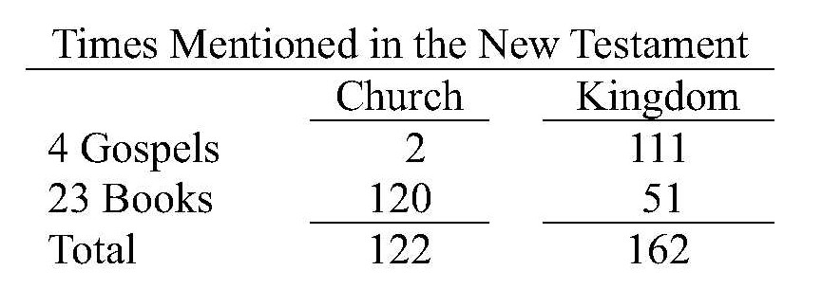
Church – Kingdom of Christ

Slide 35
Church of Christ is the Kingdom of Christ
The most profound reference of the church in the gospels is in Matthew 16. Here Jesus responds to Peter’s good confession that Jesus is the Christ and the Son of God. And in that response, Jesus mentions the church and the kingdom together
Matthew 16:17-19 And Jesus said to him, "Blessed are you, Simon Barjona, because flesh and blood did not reveal this to you, but My Father who is in heaven. ¹⁸ "I also say to you that you are Peter, and upon this rock I will build My church; and the gates of Hades will not overpower it. ¹⁹ "I will give you the keys of the kingdom of heaven; and whatever you bind on earth shall have been bound in heaven, and whatever you loose on earth shall have been loosed in heaven."
Here, the juxtaposition of the church and the kingdom in the same statement indicates they are synonymous with each other, i.e., they are one and the same.

Slide 36
Church of Christ is the Kingdom of Christ
The most profound reference of the church in the gospels is in Matthew 16. Here Jesus responds to Peter’s good confession that Jesus is the Christ and the Son of God. And in that response, Jesus mentions the church and the kingdom together
Matthew 16:17-19 And Jesus said to him, "Blessed are you, Simon Barjona, because flesh and blood did not reveal this to you, but My Father who is in heaven. ¹⁸ "I also say to you that you are Peter, and upon this rock I will build My church; and the gates of Hades will not overpower it. ¹⁹ "I will give you the keys of the kingdom of heaven; and whatever you bind on earth shall have been bound in heaven, and whatever you loose on earth shall have been loosed in heaven."
Here, the juxtaposition of the church and the kingdom in the same statement indicates they are synonymous with each other, i.e., they are one and the same.

Slide 37
Church of Christ is the Kingdom of Christ
The key to understanding the relationship between the church and the kingdom is the reference to the “keys of the kingdom”.
Keys are of course the means of gaining and denying entrance
In this instance, the keys here refer to gaining or denying access the kingdom of heaven.
It is almost universally understood that the keys mentioned by Jesus is a metaphorical reference to salvation and entrance into the kingdom.
There are many scriptural examples confirming this conclusion of which we covered them all

Slide 38
Church of Christ is the Kingdom of Christ
2 Peter 1:5-11 Now for this very reason also, applying all diligence, in your faith supply moral excellence, and in your moral excellence, knowledge, ⁶ and in your knowledge, self-control, and in your self-control, perseverance, and in your perseverance, godliness, ⁷ and in your godliness, brotherly kindness, and in your brotherly kindness, love …⁹ For he who lacks these qualities is blind or short-sighted, having forgotten his purification from his former sins (at baptism). ¹⁰ Therefore, brethren, be all the more diligent to make certain about His calling (gospel) and choosing you (for salvation in Christ); for as long as you practice these things, you will never stumble; ¹¹ for in this way the entrance into the eternal kingdom of our Lord and Savior Jesus Christ will be abundantly supplied to you.
Note: Peter is writing to the saints in Christ – those already sanctified through baptism
Eternal Kingdom belongs to our Lord and Savior Jesus Christ
Practice of obedience (holiness and love) assures us entrance into the Kingdom
Matthew 7:21 "Not everyone who says to Me, 'Lord, Lord,' will enter the kingdom of heaven, but he who does the will of My Father who is in heaven will enter.

Slide 39
Church of Christ is the Kingdom of Christ
The second time the term “church” is used in the New Testament gospel accounts is at Matthew 18:17 in reference to discipline of an erring brother
Matthew 18:15-16 "If your brother sins, go and show him his fault in private; if he listens to you, you have won your brother. ¹⁶ "But if he does not listen to you, take one or two more with you, so that BY THE MOUTH OF TWO OR THREE WITNESSES EVERY FACT MAY BE CONFIRMED.
Matthew 18:17 "If he refuses to listen to them, tell it to the church; and if he refuses to listen even to the church, let him be to you as a Gentile and a tax collector.
In the Greek, the ecclesia means literally a community assembly of citizens that had governing authority.
Church of Christ was not established until the Day of Pentecost and
Cited discipline for the unrepentant sinner is to treat him as a gentile or tax collector (i.e., separate him from the church)
Appears the term church or assembly refers more specifically to a synagogue.

Slide 40
Church of Christ is the Kingdom of Christ
The second time the term “church” is used in the New Testament gospel accounts is at Matthew 18:17 in reference to discipline of an erring brother
Matthew 18:15-16 "If your brother sins, go and show him his fault in private; if he listens to you, you have won your brother. ¹⁶ "But if he does not listen to you, take one or two more with you, so that BY THE MOUTH OF TWO OR THREE WITNESSES EVERY FACT MAY BE CONFIRMED.
Matthew 18:17 "If he refuses to listen to them, tell it to the church; and if he refuses to listen even to the church, let him be to you as a Gentile and a tax collector.
In the Greek, the ecclesia means literally a community assembly of citizens that had governing authority.
Church of Christ was not established until the Day of Pentecost and
Cited discipline for the unrepentant sinner is to treat him as a gentile or tax collector (i.e., separate him from the church)
Appears the term church or assembly refers more specifically to a synagogue.

Slide 41
Church of Christ is the Kingdom of Christ
The gospel accounts exclusively refer to both the church and the kingdom in the future tense.
Church will be Built
Matthew 16:18 "I also say to you that you are Peter, and upon this rock I will build My church; and the gates of Hades will not overpower it.
Kingdom preached before hand
Matthew 3:2 "Repent, for the kingdom of heaven is at hand."
Mark 1:14-15 Now after John had been taken into custody, Jesus came into Galilee, preaching the gospel of God, ¹⁵ and saying, "The time is fulfilled, and the kingdom of God is at hand; repent and believe in the gospel."

Slide 42
Church of Christ is the Kingdom of Christ
People alive in time of Christ were to witness the coming of the Kingdom
Mark 9:1 And Jesus was saying to them, "Truly I say to you, there are some of those who are standing here who will not taste death until they see the kingdom of God after it has come with power."
Luke 9:27 "But I say to you truthfully, there are some of those standing here who will not taste death until they see the kingdom of God."

Slide 43
Church of Christ is the Kingdom of Christ
After Pentecost & indwelling of the Holy Spirit, the Kingdom is spoken of as in Existence
Acts 8:12 But when they believed Philip preaching the good news about the kingdom of God and the name of Jesus Christ, they were being baptized, men and women alike.
Acts 20:25 "And now, behold, I know that all of you, among whom I went about preaching the kingdom, will no longer see my face.
Colossians 1:13-14 For He rescued us from the domain of darkness, and transferred us to the kingdom of His beloved Son, ¹⁴ in whom we have redemption, the forgiveness of sins.
1 Thessalonians 2:12 so that you would walk in a manner worthy of the God who calls you into His own kingdom and glory.
1 Peter 2:9 But you are A CHOSEN RACE, A royal PRIESTHOOD, A HOLY NATION,
Question: How can we enter into God’s Kingdom without the washing away of our sins?

Slide 44
Church of Christ is the Kingdom of Christ
Question: How can we enter into God’s Kingdom without the washing away of our sins?
Revelation 21:2 And I saw the holy city, new Jerusalem, coming down out of heaven from God, made ready as a bride adorned for her husband. … ²⁷ and nothing unclean, and no one who practices abomination and lying, shall ever come into it, but only those whose names are written in the Lamb's book of life.
Revelation 22:14-15 Blessed are those who wash their robes, so that they may have the right to the tree of life, and may enter by the gates into the city. ¹⁵ Outside are the dogs and the sorcerers and the immoral persons and the murderers and the idolaters, and everyone who loves and practices lying.

Slide 45
Church of Christ is the Kingdom of Christ
Question: How can we enter into God’s Kingdom without the washing away of our sins?
Revelation 21:2 And I saw the holy city, new Jerusalem, coming down out of heaven from God, made ready as a bride adorned for her husband. … ²⁷ and nothing unclean, and no one who practices abomination and lying, shall ever come into it, but only those whose names are written in the Lamb's book of life.
Revelation 22:14-15 Blessed are those who wash their robes, so that they may have the right to the tree of life, and may enter by the gates into the city. ¹⁵ Outside are the dogs and the sorcerers and the immoral persons and the murderers and the idolaters, and everyone who loves and practices lying.

Slide 46
Church of Christ is the Kingdom of Christ
Kingdom of Israel is the prophetic figure of the Kingdom of Christ in virtually every detail.
The revelations concerning these different aspects of the two kingdoms are spoken respectively to
The children of Israel under the Old Law of Moses and
The saints in the church (children of God) under the New Covenant law of Christ, i.e., to the the saints in the church
The fact these revelations are spoken to the children of God who are in the church is a fairly decisive confirmation the church is the Kingdom of Christ also called the Kingdom of God and the Kingdom of Heaven

Slide 47
Physical Realm - The Rise and Fall of Kingdoms
Kingdom of Israel and Kingdom of Christ
Kingdom of Israel and the Kingdom of Christ
Law of Moses – 1 Samuel 15:28; 24:20
Law of Christ – Ephesians 5:5; Colossians 1:13-14
Kingdom of Priests
Law Moses – Exodus 19:6
Law of Christ – Revelation 1:6
Holy Nation
Law of Moses – Exodus 19:6
Law of Christ – 1 Peter 2:9
God’s Chosen People – out of all the people on the earth. Key Word: Chosen
Law of Moses – Deut 7:6;
Law of Christ – 2 Thess 2:13; Eph 1:4-51 Peter 2:9

Slide 48
Physical Realm - The Rise and Fall of Kingdoms
Kingdom of Israel and Kingdom of Christ
God’s Possession - I will be their God and they will be My people. Key Word: My People
Law of Moses – Ex 19:5-6; Ex 29:45; Lev 26:11-12; Deut
Law of Christ – Hebrews 8:10; 2 Cor 6:16; 1 Peter 2:9
God’s Holy People - God’s children shall be Holy Key Word Holy (Sanctified, Saints)
Law of Moses – Lev 11:45; Deut 7:6
Law of Christ – 1 Peter 1:15-16, Eph 1:5
God’s Dwelling Place – Temple, Saints, Church, and Kingdom Key word: Dwelling Place – think union.
Law of Moses – Ex 25:8-9; Ex 29:45; Lev 26:11-12;
Law of Christ – 2 Cor 6:16

