Slide 1
Imitating Onesiphorus
2 Timothy 1:15-18

Slide 2
Imitating Onesiphorus 2 Timothy 1:15-18
What did he do?
Why did he do it?
What was the result?
What do we learn?
Visited Paul (17)

Slide 3
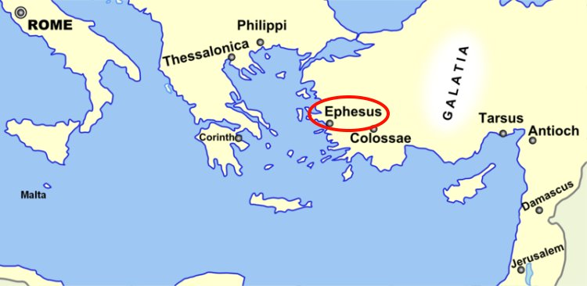
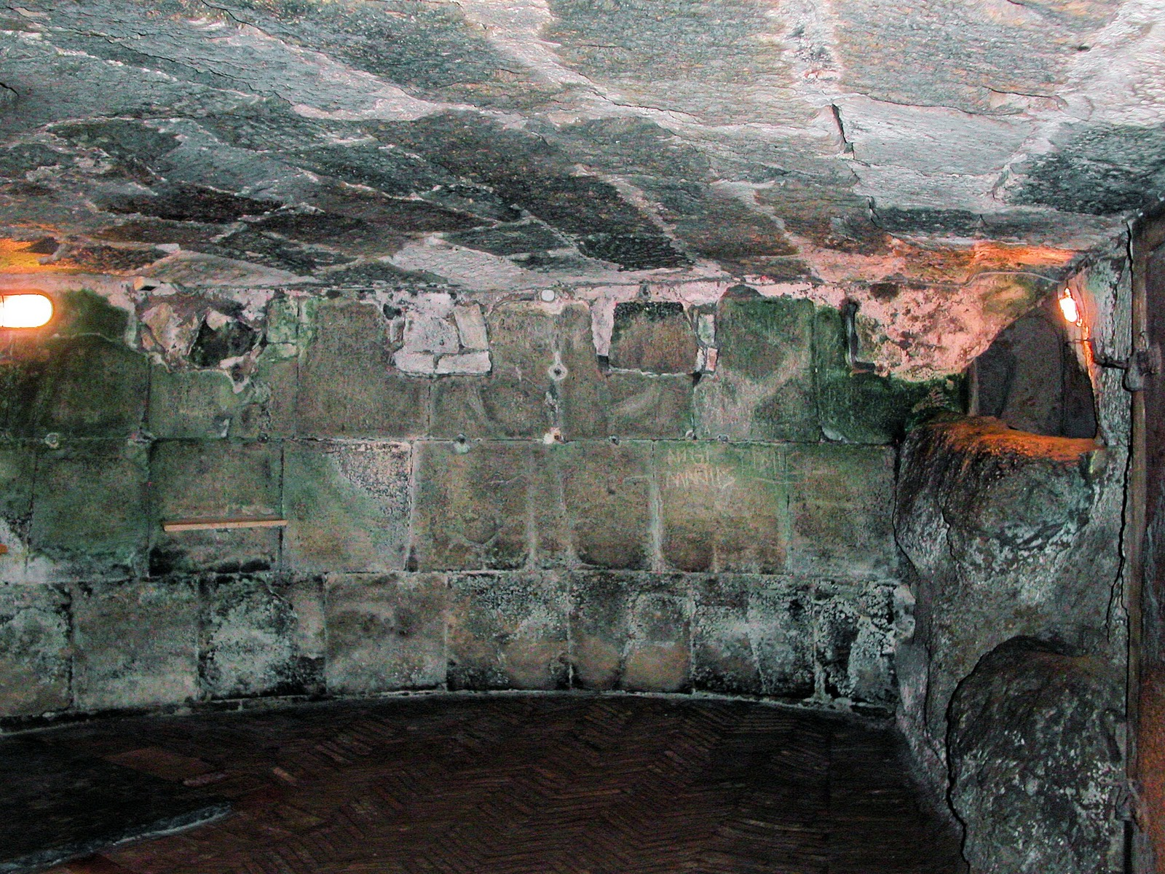

Slide 4
Imitating Onesiphorus 2 Timothy 1:15-18
What did he do?
Why did he do it?
What was the result?
What do we learn?
Visited Paul (17)
Life of service (18)

Slide 5
Imitating Onesiphorus 2 Timothy 1:15-18
What did he do?
Why did he do it?
What was the result?
What do we learn?
“not ashamed of my chains” (1:16)

Slide 6
Imitating Onesiphorus 2 Timothy 1:15-18
What did he do?
Why did he do it?
What was the result?
What do we learn?
Refreshed Paul (16)
Mercy from God (16,18)

Slide 7
Service → Reward
Matthew 10:40-42 - And whoever gives one of these little ones even a cup of cold water because he is a disciple, truly, I say to you, he will by no means lose his reward.
Matthew 25:34-40 - Come, you who are blessed by my Father, inherit the kingdom prepared for you from the foundation of the world. For … I was in prison and you came to me. … Truly, I say to you, as you did it to one of the least of these my brothers, you did it to me.

Slide 8
Imitating Onesiphorus 2 Timothy 1:15-18
What did he do?
Why did he do it?
What was the result?
What do we learn?
Refreshed Paul (16)
Mercy from God (16,18)

Slide 9
Imitating Onesiphorus 2 Timothy 1:15-18
What did he do?
Why did he do it?
What was the result?
What do we learn?
Embrace shame of the cross
Search for ones to refresh

Slide 10
Imitating Onesiphorus
May the Lord grant us to find mercy on that Day!

