Slide 1
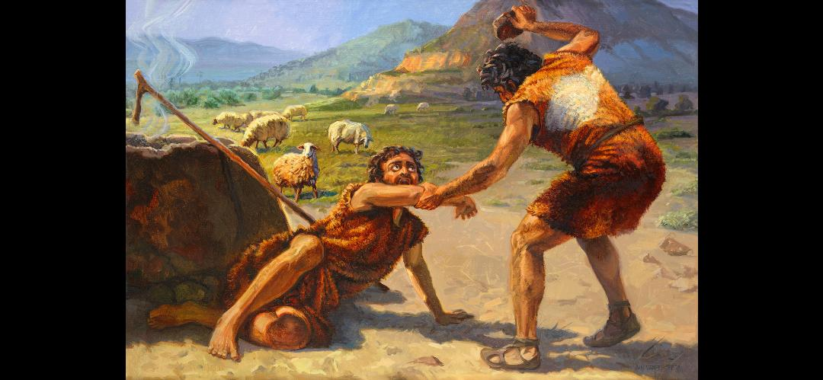
Cain and Abel
Gospel Images / Art Revisited
1

Slide 2
Cain and Abel Genesis 4:1-15
Cain and Abel were brothers and were the first two children of Adam and Eve. They made offerings to God. God respected Abel’s offering, but He did not respect Cain’s offering. Cain killed Abel. Cain was cursed from the earth, the ground would no longer yield its strength to him, and became a fugitive and a vagabond.
2

Slide 3
Cain and Abel
Abel:
Cain:
3

Slide 4
Cain and Abel
Abel:
Name means: Vapor/Vanity
Shepherd
Murdered
Faithful - Heb 11:4
Prophet? – Luke 11:50-51
Cain:
Name means: Gotten
Farmer
Murderer
Was of the wicked one 1 John 3:11 – 12
4

Slide 5
Cain and Abel
Was Cain religious?
5

Slide 6
Cain and Abel
Was Cain religious?
Why did God reject Cain’s sacrifice?
6

Slide 7
Cain and Abel
Was Cain religious?
Why did God reject Cain’s sacrifice?
Did God communicate a standard for sacrifices?
7

Slide 8
Cain and Abel
Was Cain religious?
Why did God reject Cain’s sacrifice?
Did God communicate a standard for sacrifices?
Why did Cain offer what he offered?
8

Slide 9
Sacrifices Today
Living Sacrifices: Romans 12:1
Spiritual Sacrifices: 1 Peter 2:5
Sacrifices of Praise: Hebrews 13:15-16
9

Slide 10
Cain and Abel
Was Cain religious?
Why did God reject Cain’s sacrifice?
Did God communicate a standard for sacrifices?
Why did Cain offer what he offered?
Was Cain disobedient to God?
10

Slide 11
Cain and Abel
Was Cain religious?
Why did God reject Cain’s sacrifice?
Did God communicate a standard for sacrifices?
Why did Cain offer what he offered?
Was Cain disobedient to God?
What did Cain and Abel talk about? (Gen. 4:8)
11

Slide 12
Cain and Abel
Was Cain religious?
Why did God reject Cain’s sacrifice?
Did God communicate a standard for sacrifices?
Why did Cain offer what he offered?
Was Cain disobedient to God?
What did Cain and Abel talk about? (Gen. 4:8)
Was God patient with Cain?
12

Slide 13
Cain and Abel
Was Cain religious?
Why did God reject Cain’s sacrifice?
Did God communicate a standard for sacrifices?
Why did Cain offer what he offered?
Was Cain disobedient to God?
What did Cain and Abel talk about? (Gen. 4:8)
Was God patient with Cain?
Did Cain ever try to repent? Would it have mattered?
13

Slide 14
What do we learn about God in the account of Cain and Abel?
God:
14

Slide 15
What do we learn about God in the account of Cain and Abel?
God:
Patient/Kind/Caring/Loving
Merciful/Fair
He is watching
Wishes all to repent
Does what he says he will do
He judges/He restores
He remembers those in whom he finds favor
15

Slide 16
Questions from God Adam and Eve
Genesis 3:9 – Where are you?
Genesis 3:11 – Who told you that you were naked?
Genesis 3:11 – Have you eaten of the tree of which I commanded you that you should not eat?
Genesis 3:13 – What have you done?
16

Slide 17
Questions from God Cain and Abel
Why are you angry?
17

Slide 18
Questions from God Cain and Abel
Why are you angry?
Why has your countenance fallen?
18

Slide 19
Questions from God Cain and Abel
Why are you angry?
Why has your countenance fallen?
If thou doest well, shall thou not be accepted?
If you do not do well, sin crouches/lies/lurks at the door. And its desire is for you, but you should rule over it.
19

Slide 20
Cain and Abel Sin crouching at the door
20

Slide 21
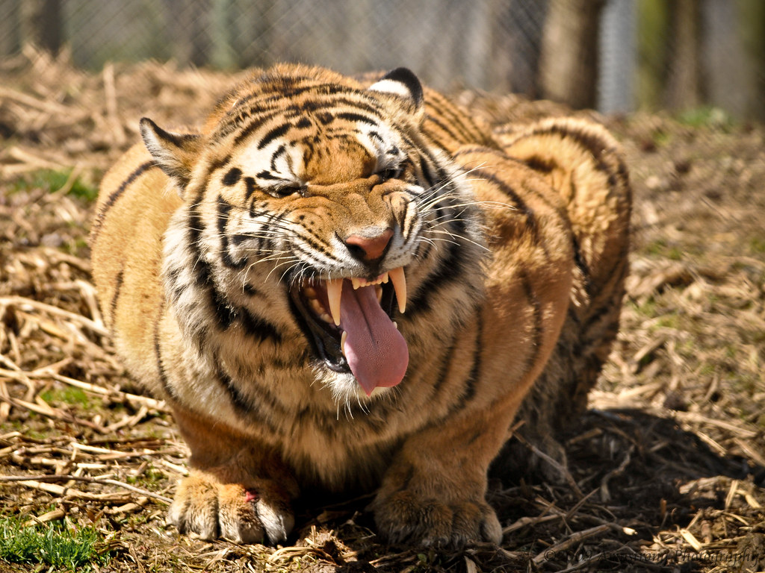
Cain and Abel Sin crouching at the door
21

Slide 22
Progression of Sin
Adam and Eve:
Talked about the tree with the serpent
Doubted God’s authority
Thought about the tree – good for food
Looked at the tree – pleasant to the sight
Got close to the tree
Touched the fruit
Pick the fruit
Ate the fruit
22

Slide 23
Progression of Sin
Cain:
Offered what he wanted
Disobeyed God
Became resentful
Resentfulness turned to envy
Envy turned to anger
Anger turned to hatred
Hatred turned to murder
Lied to cover the murder
23

Slide 24
Progression of Sin
Peter:
Followed Christ from afar
Sat with the enemies of Christ and warmed himself by their fire
Denied Christ
Denied Christ with an oath
Cursed and swore
King Saul
King David
Etc
24

Slide 25
Questions from God Cain and Abel
Why are you angry?
Why has your countenance fallen?
If thou doest well, shall thou not be accepted?
If you do not, sin crouches/lies/lurks at the door. And its desire is for you, but you should rule over it
Where is Abel thy brother?
25

Slide 26
Questions from God Cain and Abel
Why are you angry?
Why has your countenance fallen?
If thou doest well, shall thou not be accepted?
If you do not, sin crouches/lies/lurks at the door. And its desire is for you, but you should rule over it
Where is Abel thy brother?
What has thou done?
26

Slide 27
Cain’s Punishment
Elicited sorrow, but not repentance
Punishment in Hebrew means iniquity
Cain recognized the enormity of his iniquity by his punishment
Cain never suggested his punishment was undeserved
Mercy from God – placed a mark/sign on Cain protecting him from execution.
27

Slide 28
Adam/Eve versus Cain/Abel
Compare and contrast Adam/Eve’s sin with Cain’s sin?
Adam/Eve followed someone else’s guidance and Cain followed his own guidance
Adam/Eve blamed others and Cain claimed ignorance
Both reflect an attitude of refusing to accept responsibility for one’s own behavior
True repentance is about accepting responsibility for our behavior.
28

Slide 29
Lessons Learned from Cain/Abel
No perfect families
Faithful people aren’t exempt from terrible circumstances
Do well – live to find favor in God’s eyes
Our acceptance by God is wholly dependent on doing well
Being religious is not enough – faith/obedience required
Our lives should be offered as living sacrifices today
We may share similar emotions, but God is not like man
Be honest with our brothers and sisters in Christ
29

Slide 30
Lessons Learned from Cain/Abel
God is patient and merciful, but requires repentance
Sin lies at the door of everyone – we should rule over it
We have the choice to open the door to sin
Sin follows a progression – identify it early
We are our brother’s keeper
We can’t hide from God or lie our way out
God’s words warn us of the danger of sin – Authority
Repentance is accepting responsibility for our behavior
30

