Slide 1
Date | Topic | Teacher
12/3/23 | Introduction / Creation | David Haley
12/10/23 | Creation / Fall of Man | David Haley
12/17/23 | Cain & Abel | Doug Greer
12/24/23 | Noah & The Flood | Doug Greer
12/31/23 | Babel and Abrahams Call | David Haley
1/7/24 | Abraham & Sarah | Doug Greer
1/14/24 | Abraham’s Test | David Haley
1/21/24 | Jacob & Esau | Doug Greer
1/28/24 | Jacob’s Dream & Wrestling w/ God | David Haley
2/4/24 | Joseph: Slave to Governor | Doug Greer
2/11/24 | Joseph: Reconciliation w/ Brothers | David Haley
2/18/24 | Jacob: Blessing & Genesis’ End | Doug Greer
2/25/24 | Conclusion / Review | David Haley
Genesis Class
Outline
1

Slide 2
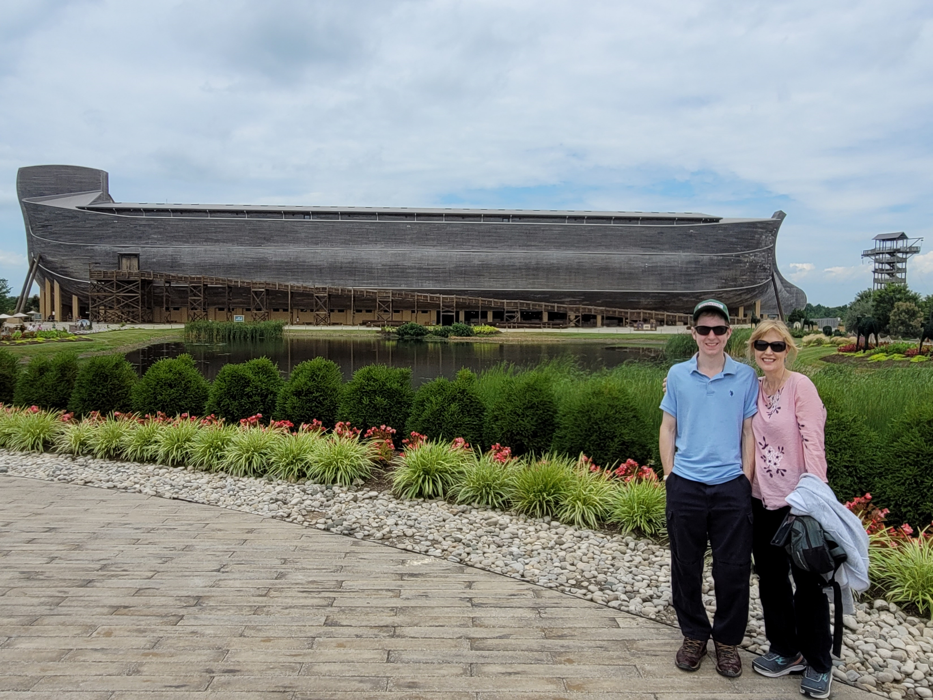
Noah and the Flood
2

Slide 3
Noah and the Flood
God regretted that he had made man because of mankind’s corruption. He commanded Noah to build an ark to be loaded with animals before he destroyed both man and beast by a great flood. Noah, his family and the animals in the ark were saved.
3

Slide 4
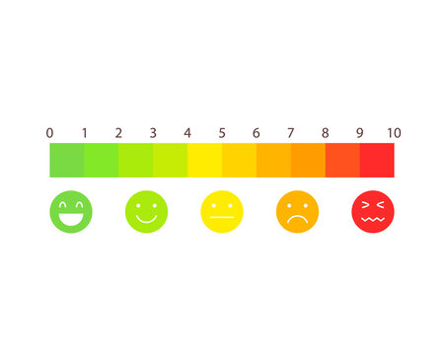
Noah and the Flood
On a scale of 1 – 10, where was God relative to mankind’s behavior?
4

Slide 5
Noah and the Flood
Hebrews 11:7 – By faith Noah, being divinely warned of things not yet seen, moved with godly fear, prepared an ark for the saving of his household, by which he condemned the world and became heir of righteousness according to faith.
5

Slide 6
Noah and the Flood
What would have prevented the flood?
6

Slide 7
Noah and the Flood
Noah:
7

Slide 8
Noah and the Flood
Noah:
Name means rest
Built an ark (50-75 years)
950 years old
Preacher of righteousness: 2 Pet 2:5
Found grace in God’s eyes: Gen 6:8
Walked with God: Gen 6:8-9
Just/Obedient/Perfect: Gen 7:5/9/16
He and his family saved
Strong: physically/spiritually
Committed/Faithful: Heb 11:7
In the ark a little over a year
Remembered by God: Gen 8:1
Did all that God commanded: Gen 6:22/7:5/7:9/7:16
New Adam
He had faults: Intoxicated
8

Slide 9
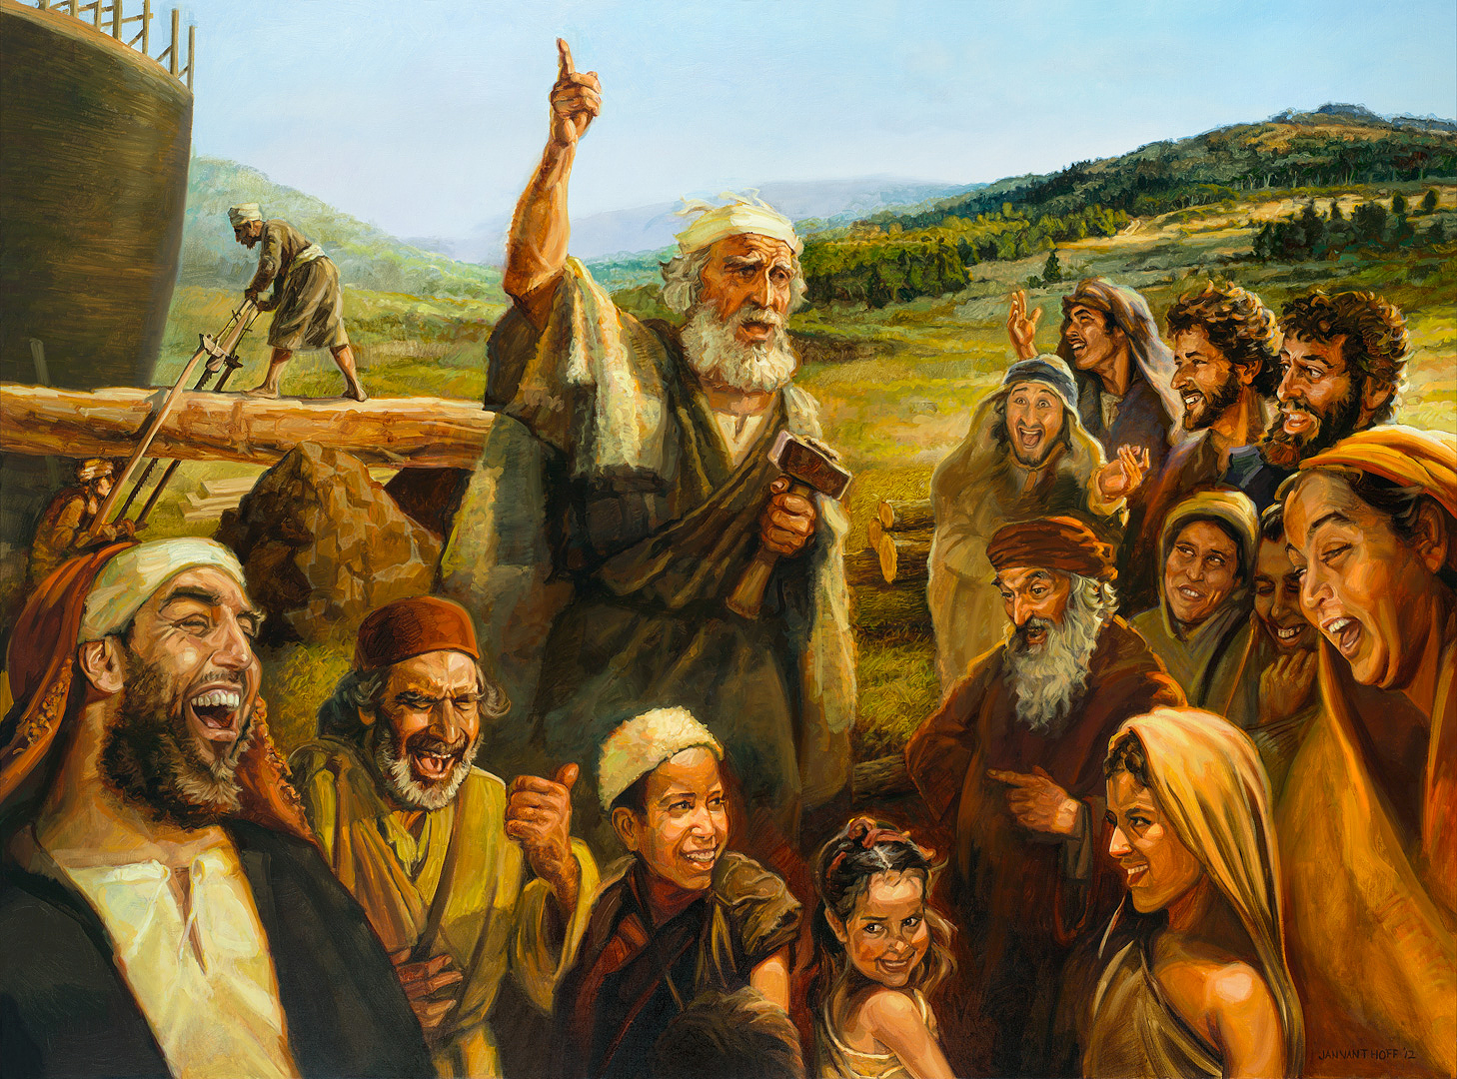
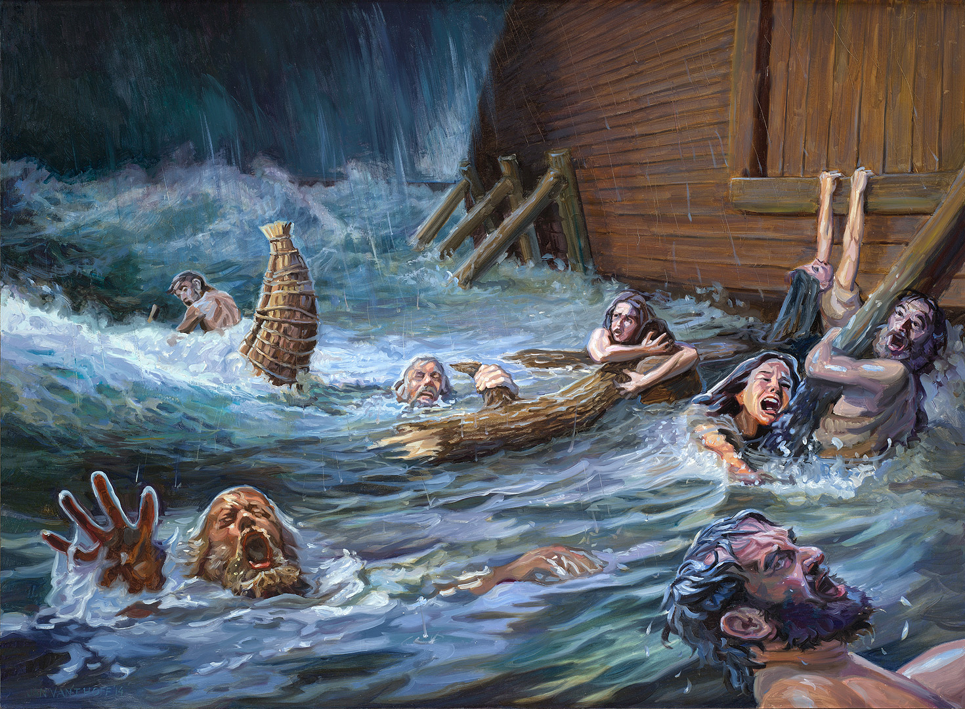
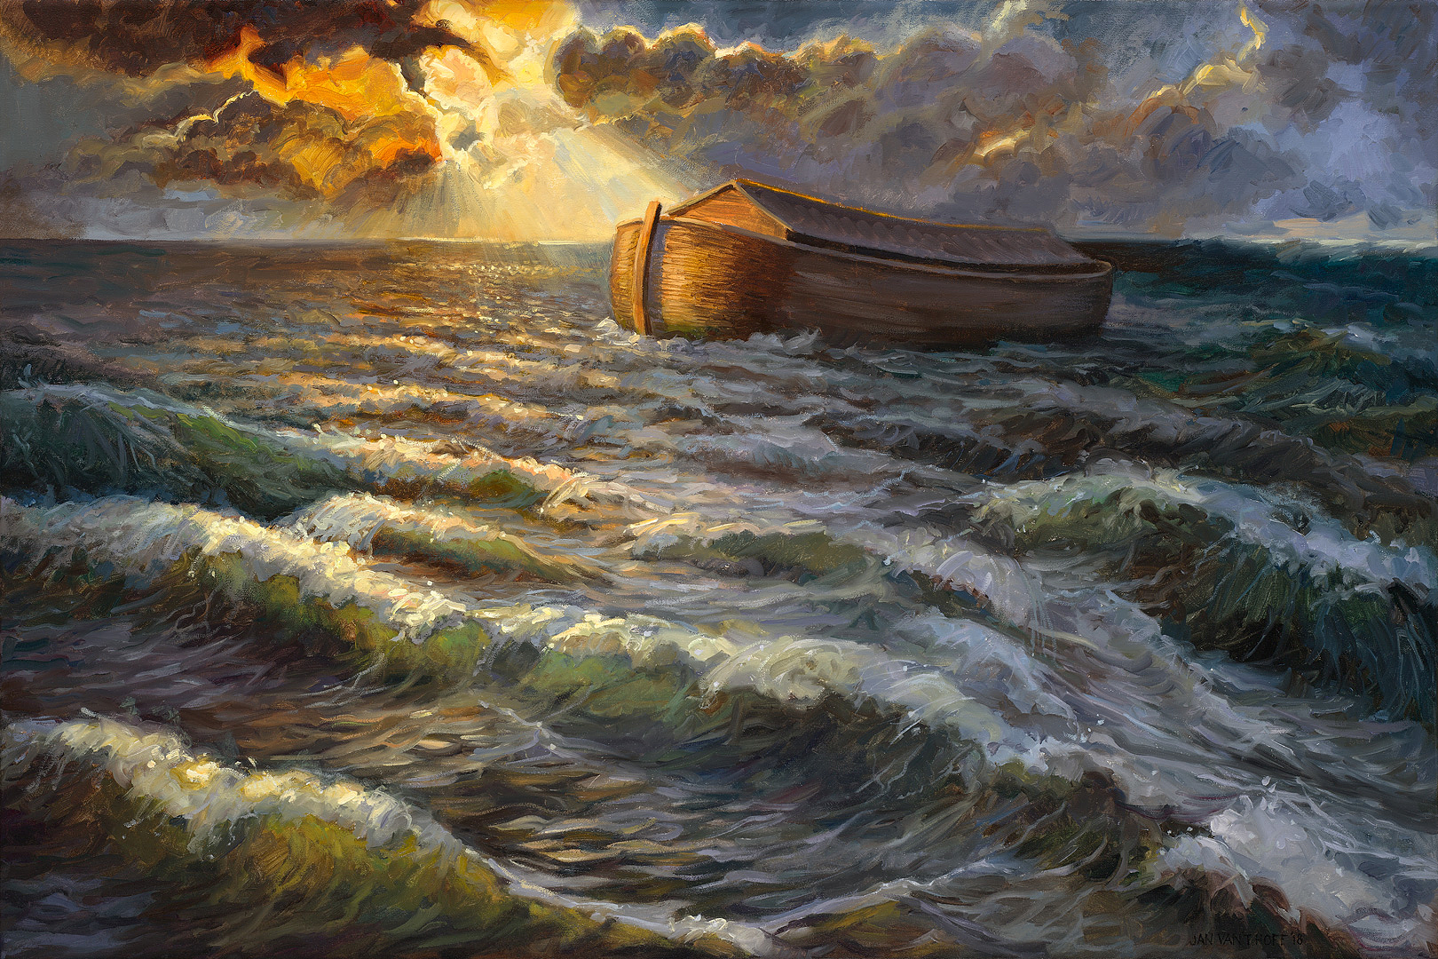
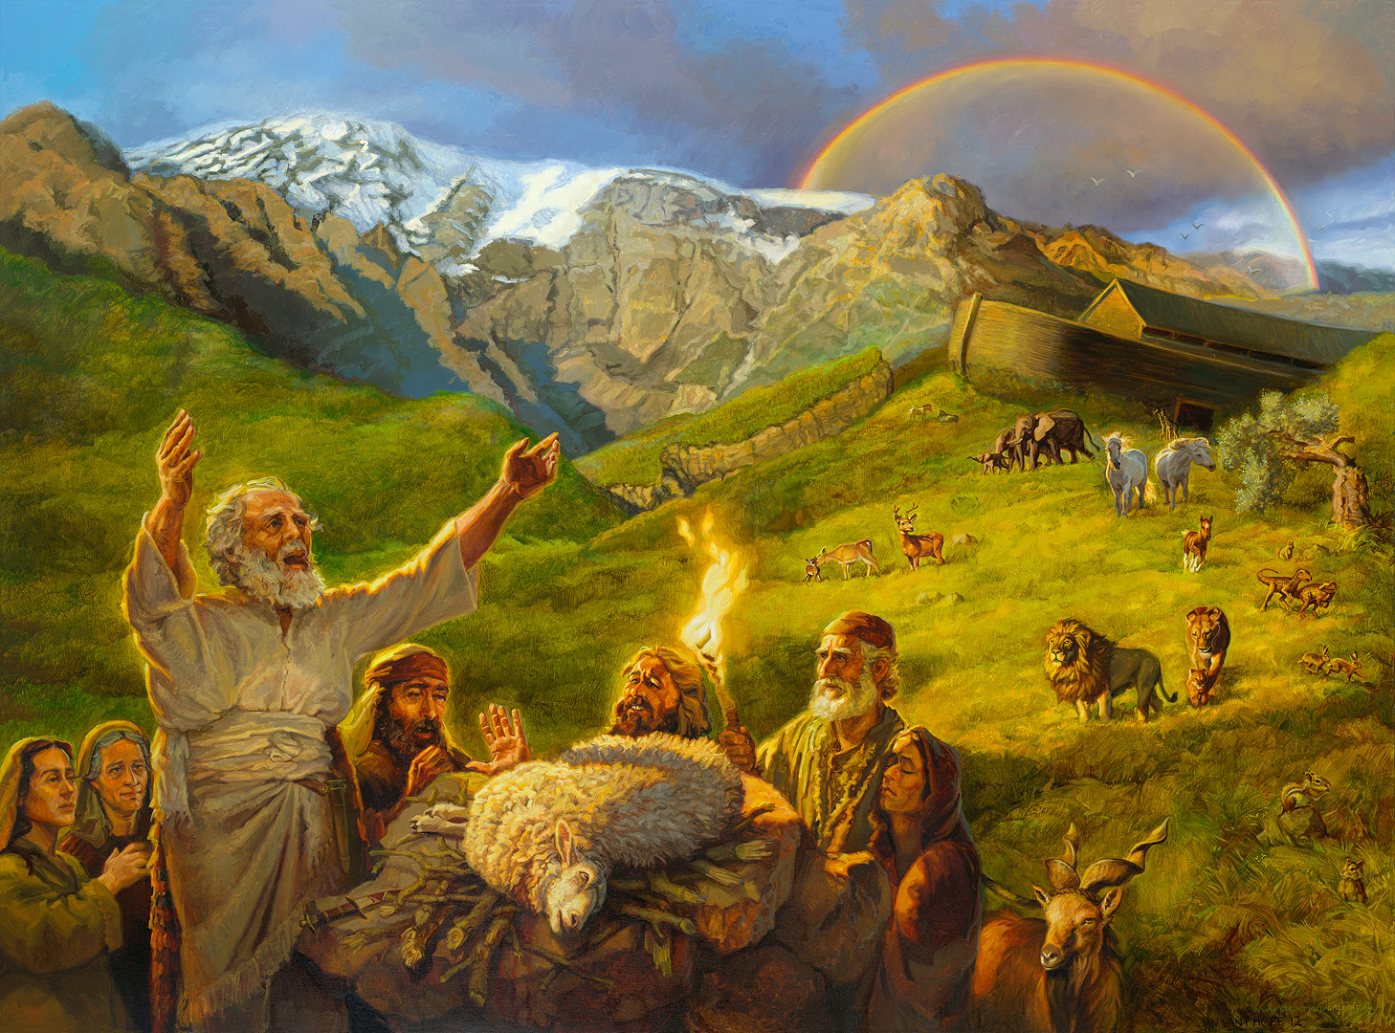
Noah and the Flood
Gospel Images /
Art Revisited
9

Slide 10
Noah and the Flood
The world had become corrupt: Genesis 6:11-12
10

Slide 11
Noah and the Flood
The world had become corrupt: Genesis 6:11-12
Corrupt is from the Hebrew word “shachath” which means to destroy or ruin.
How did Noah and his family escape corruption?
11

Slide 12
Noah and the Flood
Was the flood a miraculous event?
12

Slide 13
Noah and the Flood
Was the flood a miraculous event?
…the Great Promise, the lodestar of their lives,
must be fulfilled divinely and miraculously
or not at all.
13

Slide 14
Noah and the Flood
How many miraculous events can be identified in the account of Noah and the flood?
14

Slide 15
Noah and the Flood
How many miraculous events can be identified in the account of Noah and the flood?
Animals sought out Noah
Orderly entered the ark two by two
Opened the windows of the heavens
Broke the fountains of the great deep
The Lord shut door of the ark
The Lord controlled the duration of the rain (40 days/40nights)
15

Slide 16
Significance of the Number 40
16

Slide 17
Significance of the Number 40
Rained for 40 days / 40 nights (Genesis 7:12)
Israel wondered in the wilderness for 40 years (Joshua 5:6)
Goliath presented himself for 40 days (1 Samuel 17:16)
40 years I was grieved with that generation (Psalms 95:10)
Ezekiel lays on his side for 40 days (Ezekiel 4:6)
Egypt’s cities desolate for 40 years (Ezekiel 29:12)
Jonah cries out in Nineveh for 40 days that it shall be overthrown (Jonah 3:4)
Jesus fasted 40 days before being tempted by Satan (Matt 4:2)
17

Slide 18
What do we know about the flood waters?
Flood waters:
18

Slide 19
What do we know about the flood waters?
Flood waters:
Fountains from the ground were broken up
Windows from Heaven were opened
15 cubits over any land
40 days / 40 nights
Fountains had to be stopped and the windows had to closed
Over all the earth/World wide flood
19

Slide 20
Worldwide Flood versus Local Flood
Mabbul – term used solely in connection with the Noah flood
All the high hills under the whole heaven were covered by fifteen cubits and the mountains were covered (Gen 7:19-20)
Waters were overwhelmingly mighty and prevailed exceedingly over the earth
After the waters began to abate, the ark was grounded on the highest mountains of Ararat. Highest peak is 17,000 feet (Gen 8:4-5)
No local flood has continued to rise for 150 days
Took over a year for waters to abate before enough land had been exposed to permit Noah and family to exit the ark (371 days)
God’s promise to never send such a flood has been broken repeatedly if it were only a local flood
20

Slide 21
Differences Before/After the Flood
21

Slide 22
Differences Before/After the Flood
New cosmological conditions/Rainbow/defined seasons/sharp and varied temperature differentials – Gen 8:22
There would never again be a worldwide flood which would destroy all life – Gen 9:11
There would be a regular order of nature, with a fixed sequence of seasons and a fixed cycle of day and night would prevail from that time on – Gen 8:22
Enmity between man and beasts – Gen 9:2/Gen 9:10/Gen 7:14
Animals authorized for use as food – Gen 9:3-4
Gen 1:29-30
Man’s longevity declines
22

Slide 23
Longevity before and after the Flood
Adam 930
Seth 912
Methuselah 969
Noah 950
FLOOD
Terah 205
Abraham 175
Isaac 180
Jacob 147
23

Slide 24
Old and New Testament References to Noah and/or the Flood
Job 22:15-18 – Wicked men cut down before their time by a flood
Ezekiel 14:13 – Noah considered a very righteous man
Isaiah 54:7-10 – God’s promises compared to the Flood promise
Hebrews 11:7 – By faith Noah, moved with fear, prepared an ark
I Peter 3:20 -21 – God was patience while ark was being built
2 Peter 3:5-7 - Deliberate ignorance/willful blindness
2 Peter 2:5: - Doom to false teachers as the people in Noah’s day were doomed.
24

Slide 25
Old and New Testament References to Noah and/or the Flood
Jesus used the account of Noah and the flood in his teachings:
Matthew 24:36-39 – Jesus taught that as the days of Noah, so also will be the coming of the Son of Man
25

Slide 26
Similarities between Noah’s ark and the church
26

Slide 27
Similarities between Noah’s ark and the church
One ark – One church (1 Cor. 12:12)
One door – One way (John 14:6)
One window – One source of light (John 8:12)
Ark contained the saved – church contains saved (Acts 2:47)
Both are a place of refuge, safety and salvation
Both involved water – Flood/Baptism
27

Slide 28
Similarities to Noah’s ark and Christ
Ark was graciously provided as Christ was graciously provided
Ark was planned by God as salvation was planned by God
Ark was a place of safety as Christ is a place of safety
As Noah must come into the ark, we must come to Christ
The call to come was a limited time offer, so is God’s call to come to his Son
Just as the coming of the flood was unexpected, so is the second coming of Christ.
28

Slide 29
Dove versus the Ravin
What’s the deal with these birds?
29

Slide 30
What do we learn about God from the account of Noah and the Flood?
God:
30

Slide 31
What do we learn about God from the account of Noah and the Flood?
God:
Patient/Kind/Caring/Loving
Merciful/Fair
He is watching
Wishes all to repent
Does what he says
He judges/He restores
He remembers those in whom he finds favor
He expects you to remember: 50-75 years between the command for Noah to build the ark and when God told Noah to enter the ark
31

Slide 32
Similarities between Noah and Adam
Animals came to both of them
Both commanded to multiply and fill the earth Gen 9:7
Both commanded to exercise control over the earth
Everyone on earth today came through them
Both sinned by partaking of fruit
Both found themselves naked and ashamed
Both had to be clothed by someone else
Both sins resulted in a curse – Gen 9:25-27
32

Slide 33
Noah after the Flood
What was Noah’s first act after exiting the ark?
How did Noah sin after the flood?
33

Slide 34
Noah and the Curse Genesis 9:20-29
Who was cursed as a result of Noah’s drunkenness?
Curse was upon a Canaan, a descendent of Ham – the youngest of Ham’s four sons.
34

Slide 35
Words in Chinese Characters:
Ark = Rectangle + Boat
Ship/Vessel = Ship + Eight + People
35

