Slide 1
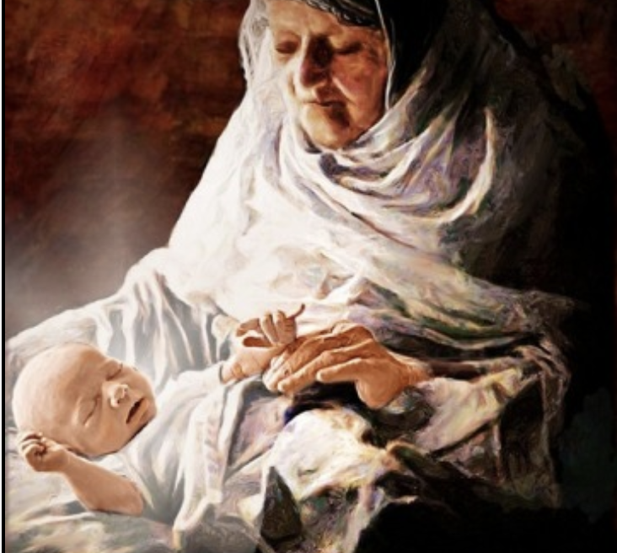
Jesus & Anna Luke 2:36-38

Slide 2
Galatians 4:4, “…when the fullness of the time came, God sent forth His Son, born of a woman, born under the Law.”
36 And there was one Anna, a prophetess, the daughter of Phanuel, of the tribe of Asher (she was of a great age, having lived with a husband seven years from her virginity, 37 and she had been a widow even unto fourscore and four years), who departed not from the temple, worshipping with fastings and supplications night and day. 38 And coming up at that very hour she gave thanks unto God, and spake of him to all them that were looking for the redemption of Jerusalem. (Luke 2:36-38)

Slide 3
1. JESUS’ MISSION - ANNA’S SERMON: OUR REDEMPTION
38 And coming up at that very hour she began to give thanks to God and to speak of him to all who were waiting for the redemption of Jerusalem. (Luke 2:38)
8 knowing that you were ransomed from the futile ways inherited from your forefathers, not with perishable things such as silver or gold, 19 but with the precious blood of Christ, like that of a lamb without blemish or spot. (1 Peter 1:18-19)

Slide 4
He made us – HE IS OUR CREATOR
He lost us – WE REBELLED, SINNED, DID OUR OWN THING
He bought us back – HE PAID THE PRICE FOR OUR SIN
2. JESUS PROVIDES HOPE WITH OUR OBEDIENCE: Expectation
38 And coming up at that very hour she began to give thanks to God and to speak of him to all who were waiting for the redemption of Jerusalem.

Slide 5
He is only your hope if you desire to obey Him above any other.
He is your hope only if your affections for Him are greater than any other thing.
He is your hope only if He is your greatest love.
3. THE RESULT OF CHRIST’S LIFE: OUR WITNESS

Slide 6
Redemption that began with a birth,
Redemption that was finished on the cross with His broken body and shed blood,
Redemption that is guaranteed by His resurrection.
She’s a focused, selfless Grandma.

Slide 7
Anna was soft in heart and faithful in service, night and day.
Anna was ready to respond to the Lord, even as an older grandma.
Anna was committed to the most important–the salvation of souls.

Slide 8
Anna & Jesus Luke 2:36-38

