Slide 1
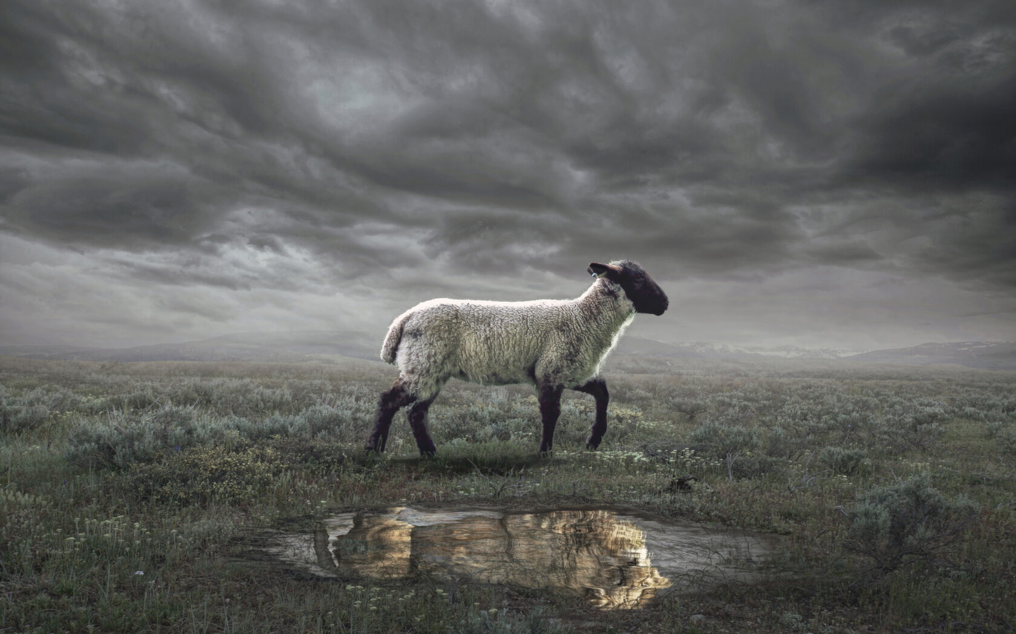
The Revelation
Wednesday Nights
Winter 2023-24

Slide 2
Review Quiz
What is the genre of the Book of Revelation?
______
_________
____________
Addresses specific circumstance
Letter
Call to faithfulness, looks to future
Prophecy
Apocalyptic
Reality unveiled in symbolic visions

Slide 3
Review Quiz
What were the external pressures facing the Christians in Asia?
___________
___________
What were the spiritual dangers?
___________
___________
Persecution
The Revelation pulls back the curtain to comfort (God reigns, evil will fall) and challenge (get on the right side or else).
Prosperity
Compromise
Apathy

Slide 4
Review Quiz
What is the clear message of the heavenly vision in Revelation 4?
God the Creator sits—sovereign and holy—on the throne.

Slide 5
Review Quiz
What is the scroll in God’s hand which only the Lamb is worthy to open in Revelation 5?
God’s plan–to deal with evil and rescue His people.

Slide 7
Revelation by the Chapter
Glorified Christ among the lampstands (1)
The state of the churches revealed (2-3)
God, sitting on the throne in heaven (4)
The Lamb is worthy to open the scroll (5)
First six seals opened → Judgments (6)
Interlude: Washed Israel is sealed (7)
Seventh seal opened → … (8)
Six Trumpets → Judgments (8-9)
Interlude: John’s prophetic call (10)
Interlude: Witness of the church (11)
Seventh trumpet → Visions in heaven (11)

Slide 8
Revelation 6-7
Imagine and feel what John is describing.
In the most basic terms, what is God planning to do?

Slide 9
Revelation 6:1-17
Four horsemen (1-8) – from Zechariah, where God was not blind or inactive
the judgments are painful but partial
Souls under the altar (9-11) – cry out for justice, told to rest until more are killed
slain for their witness like the Lamb
Sixth seal (12-17) – the final judgment?
prophets talk this way about nations
all days of the Lord point to The Day

Slide 10
What are the seal judgments (ch.6) referring to?
Prediction of specific events that will bring about the end of the world?
Prediction of events leading to the downfall of Rome? Or Jerusalem?
Picture of how God deals with human evil (in Rome; throughout history; at the end)
What does this say about conquest, war, famine, and destruction on the earth?

Slide 11
Revelation 7:1-17
God’s Servants Sealed (1-8) – pause in judgment to mark out God’s faithful
John hears a military roll call of Israel
144,000 (12 x 12,000) a complete number
The Great Multitude (9-17) – John sees an innumerable host, from every nation
Who can stand? (6:17) They can (7:9)
Rescued by God, washed in the blood
Brought through the tribulation to life
Follow the Lamb, join the heavenly song

Slide 12
Revelation 6-7
What does this vision mean for the Christians in Roman Asia?
What does it mean for us?

Slide 13
The Revelation
Next Week (1/17)
6. chs. 8-10: Seven Trumpets

