Slide 2
Bellaire Church of Christ
“We Read the Bible and do what it says”
Hasn’t the Bible been changed?
Weren’t some books “left out” of the Bible?
How do we know the Bible is “inspired”?
How do I make sense of this strange book?
Aren’t there many ways to interpret the Bible?
How do you “do what the Bible says”?
Is the Bible authoritative to all people in all times?
Is there a pattern for churches today to follow?

Slide 3
How Firm a Foundation
Rooted. Assured. Equipped.

Slide 4
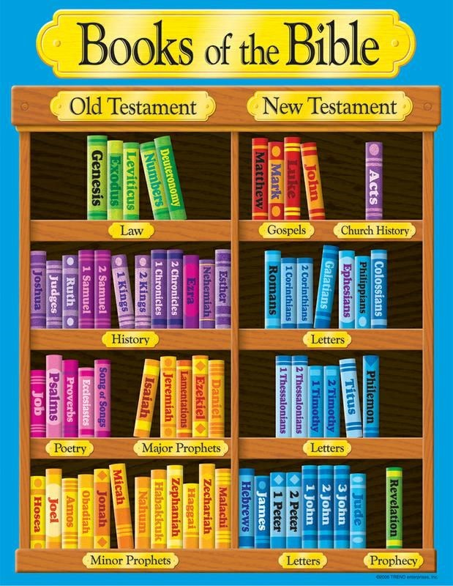

Slide 5
Hebrew Bible (“TaNaK”)
Torah (Law)
Genesis, Exodus, Leviticus, Numbers, Deuteronomy
Nevi’im (Prophets)
Joshua, Judges, Samuel, Kings, Isaiah, Jeremiah, Ezekiel, “The Twelve”
Ketuvim (Writings)
Psalms, Proverbs, Job, Song of Songs, Ruth, Lamentations, Esther, Ecclesiastes, Daniel, Ezra-Nehemiah, Chronicles
“These are my words that I spoke to you while I was still with you, that everything written about me in the Law of Moses and the Prophets and the Psalms must be fulfilled.” (Luke 24:44)

Slide 6
Torah (Law)
Genesis, etc.
Nevi’im (Prophets)
Joshua, etc.
Ketuvim (Writings)
Psalms, etc.
Genesis 1
¹ In the beginning, God created the heavens and the earth. ² The earth was without form and void, and darkness was over the face of the deep. And the Spirit of God was hovering over the face of the waters. ³ And God said, “Let there be light,” and there was light. ⁴ And God saw that the light was good. And God separated the light from the darkness. ⁵ God called the light Day, and the darkness he called Night. And there was evening and there was morning, the first day.

Slide 7
Torah (Law)
Genesis, etc.
Nevi’im (Prophets)
Joshua, etc.
Ketuvim (Writings)
Psalms, etc.
Joshua 1
⁶ Be strong and courageous, for you shall cause this people to inherit the land that I swore to their fathers to give them. ⁷ Only be strong and very courageous, being careful to do according to all the law that Moses my servant commanded you. Do not turn from it to the right hand or to the left, that you may have good success wherever you go. ⁸ This Book of the Law shall not depart from your mouth, but you shall meditate on it day and night, so that you may be careful to do according to all that is written in it. For then you will make your way prosperous, and then you will have good success. ⁹ Have I not commanded you? Be strong and courageous.

Slide 8
Torah (Law)
Genesis, etc.
Nevi’im (Prophets)
Joshua, etc.
Ketuvim (Writings)
Psalms, etc.
Psalm 1
¹ Blessed is the man who walks not in the counsel of the wicked, nor stands in the way of sinners, nor sits in the seat of scoffers;
² but his delight is in the law of the Lord, and on his law he meditates day and night.
³ He is like a tree planted by streams of water that yields its fruit in its season, and its leaf does not wither. In all that he does, he prospers.

Slide 9
Genesis 1
God’s Word creates & orders reality
Joshua 1
God’s Word promises success & victory
Psalm 1
God’s Word makes us strong & fruitful
‘Adopt’ a book of the Bible for 2024
Commit passages to memory
Get active in group Bible classes

Slide 10
How Firm a Foundation
Rooted. Assured. Equipped.

