Slide 1
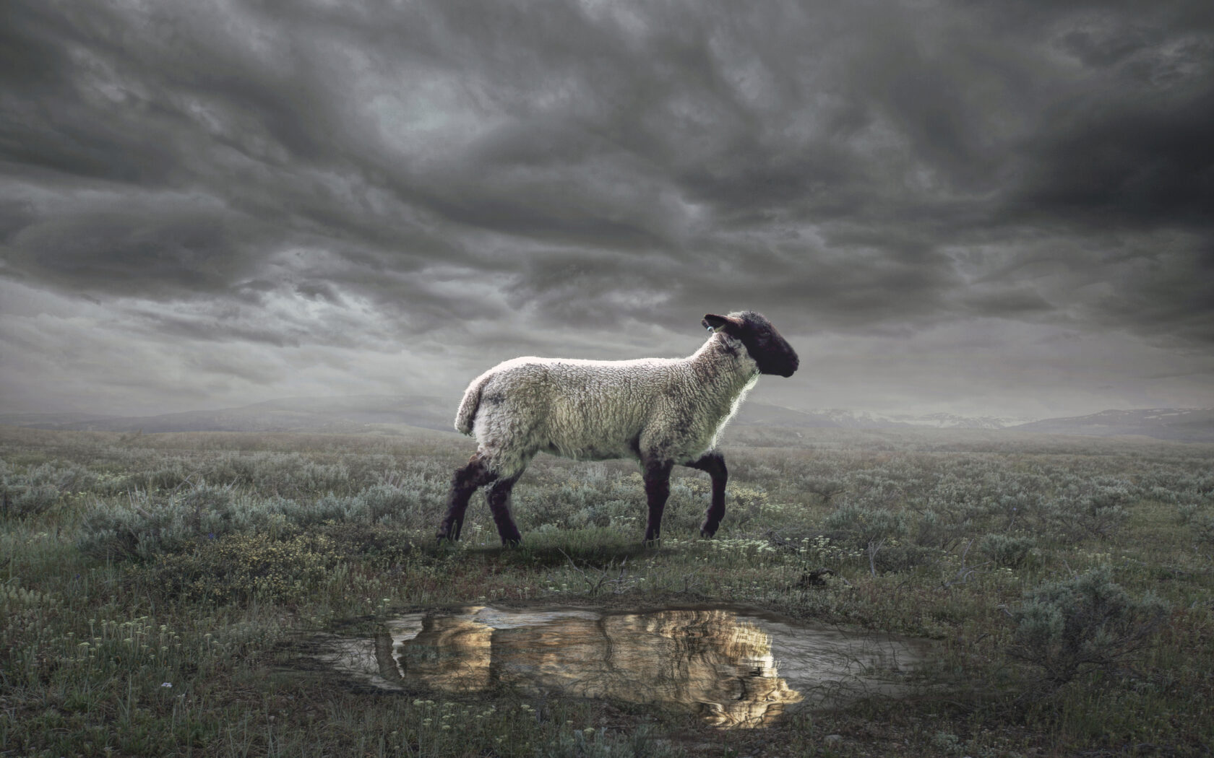
The Revelation
Wednesday Nights
Winter 2023-24

Slide 2
Overview: Revelation 1-16
Intro (1-3) – Glorified Christ revealed; the church in crisis
Heavenly Council (4-5) – God, the scroll, the worthy Lamb
Seven seals (6-8) – God’s judgments on earth (6), God’s people sealed (7), 7th seal → trumpets (8)
Seven Trumpets (8-11) – God’s wrath on earth (8-9), God’s people bear witness (10-11), 7th trumpet brings the eternal kingdom of Christ (11)
Seven signs (12-15) – War in heaven (12) spills to earth (13), Lamb conquers, wicked judged (14)
Seven Bowls (15-16) – Total pouring out of wrath on the unrepentant, beast-worshipping Babylon
Judgment of Babylon & the Beast (17-20)
New Jerusalem, New Heavens, New Earth (21-22)

Slide 3
”Unholy Trinity” of Rev. 12-13
Dragon
(12:1-17)
_________
Sea Beast
(13:1-10)
______
Earth Beast (13:11-18)
__________
devil/satan
empire
imperial cult
The dragon has been defeated, is raging against God’s people
Dragon uses empire(s) to draw people’s worship, war against saints
Empire(s) has appeal of wealth/ belonging to give it life (& teeth)

Slide 4
Revelation 17
Read (listen to) the judgment.
What is the significance of describing ”Babylon” as a “the great prostitute”?

Slide 5
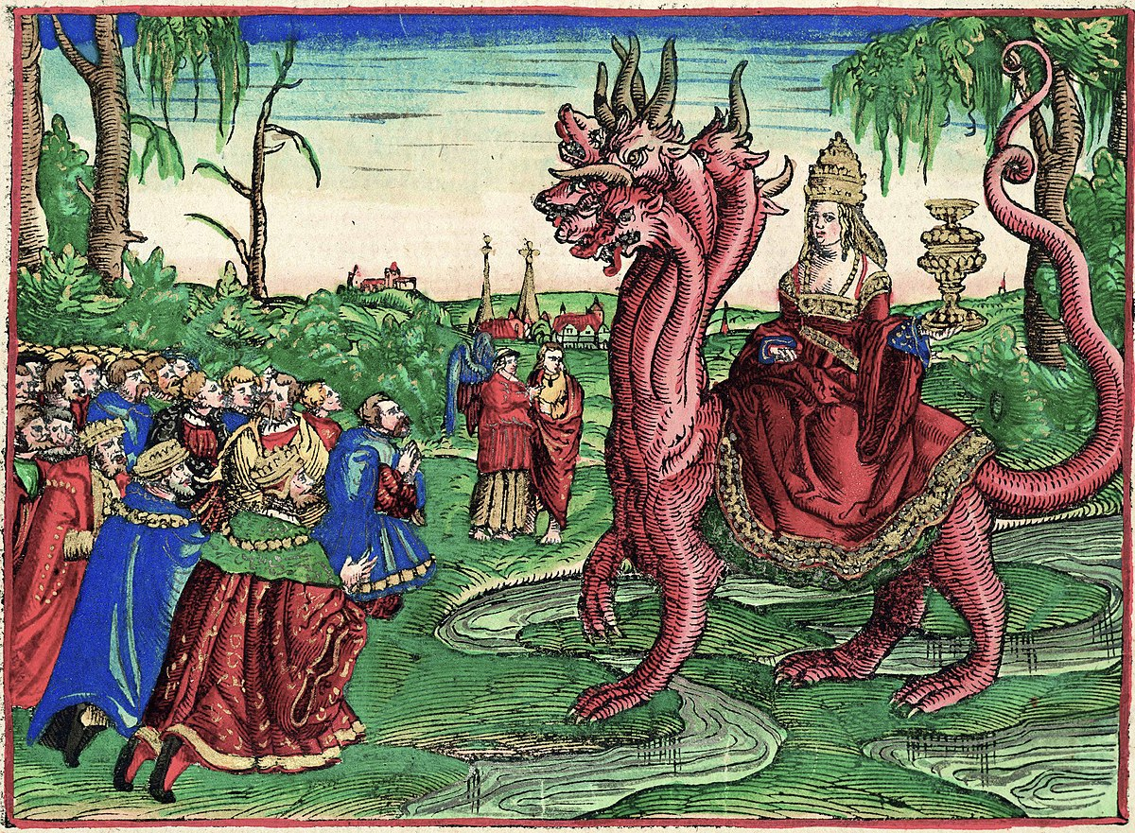
Scarlet Woman (Revelation 17)

Slide 6
Revelation 17: Closer Look
“Mother of Prostitutes” (1-6)
Babylon (5) – archetypal city of pride, opulence, rebellion, cruelty (Gen. 11, Is. 13-14, Dan. 4:30)
I marveled (6) – she seduces and charms with impressive beauty and rich adornment
Golden cup (2,4) – the seduced kings and earth-dwellers must drink the filth of her cup
On the beast (3) – she uses the might of empire to spread her immorality to the nations
Blood of the martyrs (6) – she (and the beast) demand loyalty, so the saints are targeted

Slide 7
Revelation 17: Closer Look
“the Lamb will conquer them” (7-18)
Was, is not, is to come (8) – the beast suffered apparent defeat, but “will rise again” (see 13:3)
Seven mountains (9) – Rome, ‘city of seven hills’
Seven kings (10-11) – Seven Roman emperors?
… or 1) counterfeit perfection, + 2) storied history, hope of revival, but ultimate futility
One mind (12-14) – Ten more kings, all working for the beast to rebel against the Lamb
Beast v. prostitute (16-17) – city & empire self- destruct, devour themselves, as God planned

Slide 8
Revelation 18
Read (listen to) the chapter.
What are the sins for which Babylon is being judged?

Slide 9
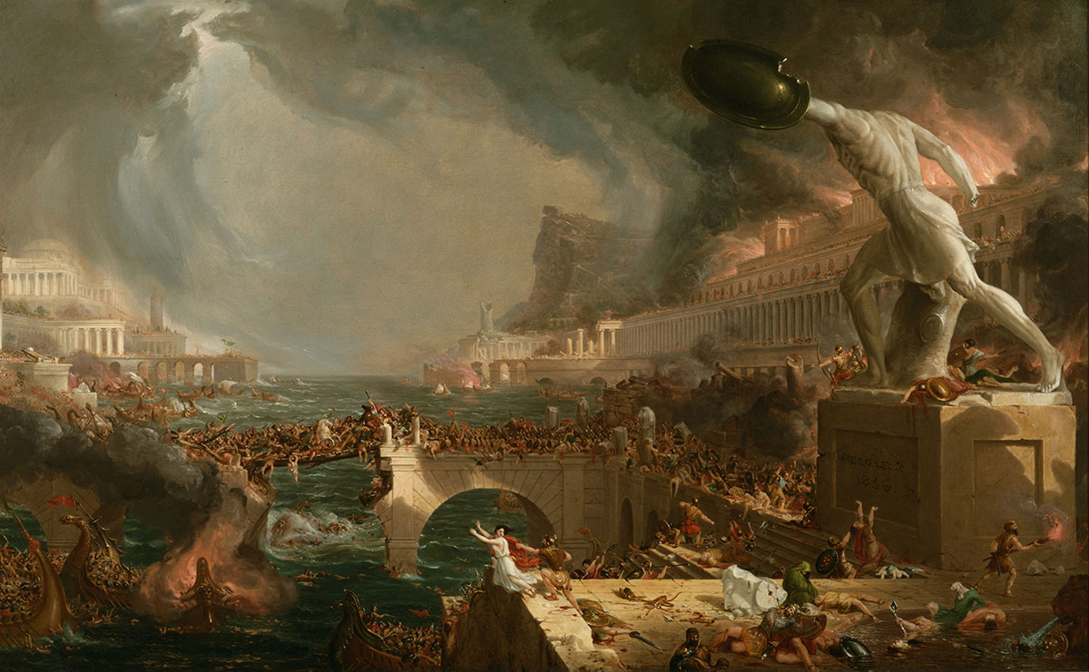
Fallen Babylon (Revelation 18)
Destruction (in The Course of Empire)
Thomas Cole

Slide 10
Revelation 18: Closer Look
Call from Heaven (1-8)
“dwelling place for demons” (2) – see Is. 34:8-15; civilization reverts back to chaos
“immorality with her” (3) – she has seduced the world into join her sins
God’s people called to “come out” (4)
She has brought judgment on herself through her arrogance / tormenting (5-8)
“in a single hour” (8) - cf. Daniel 5:30

Slide 11
Revelation 18: Closer Look
Cries from Earth (9-20)
Kings who benefitted from her luxury stunned with fear-–they could be next (9-10)
Merchants enriched by her now mourn (11-17)
luxuries, gained by oppression? (12-13)
pinnacle of exploitation: slavery (13)
“for which your soul longed” (14)
merchants also fear her torment (15)
Sea-farers marvel at sudden reversal (17-19)
“God has judged your judgment on her” (20)

Slide 12
Revelation 18: Closer Look
Pronouncement from Angel (21-24)
“great millstone” (21) – like Jeremiah’s symbol of Babylon’s fall (51:63-64) and like Jesus’ condemnation on those who cause little ones to stumble (Mark 9:24)
The great city left in total silence (“a haunt,” v.2) after its devastation (21-23)
Deception, oppression, violence (23-24)

Slide 13
Reflections on Revelation 18
What does it mean / look like for us to obey the command of 18:4, “Come out of Babylon”?

Slide 14
The Revelation
Next Week (2/21)
11. ch.19-20: Almighty Reigns

